Slide 1
HSE Moscow 25 September 2013

Slide 2
Climbing the Global Ladder Development of China’s Higher Education
Kai-ming Cheng
University of Hong Kong
“University Traditions: a Resource or a Burden”
Higher School of Economics
Moscow, 25 September 2013

Slide 3
Climbing the Global Ladder
Starting from the Ruins

Slide 4
A brief choronology
Ancient times: institutes of higher learning
1898 First University of western model
1949 Expansion & reclassification (Soviet)
Rigorous manpower planning
1966 Universities replaced by workers’ colleges
1977 Higher education resumes
1985 Project 211
1997 Introduction of Fees
1998 Project 985
2002 Legitimization of private institutions

Slide 5
The Dynasties …
(605-1905)

Slide 7
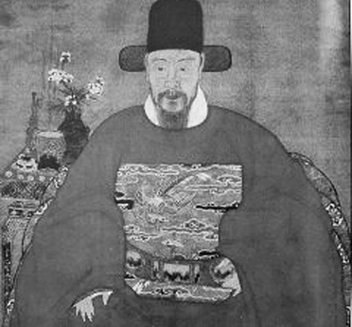

Slide 8
The Imperial Civil Examination
Sole aim for selection of civil servants
The sole means of upward mobility
High affordability
Only hard work counts
No economic calculations

Slide 9
The Imperial Perspective
Imperial Rule 天下
Governing the Nation 治国
Selecting the Officials 科举
Credentials 功名
Study 勤学

Slide 10
The Individual Perspective
Imperial Rule 天下
Serving the Nation 报国
Credentials 功名
Civil Examinations 科举
Study 勤学

Slide 11
The Package Deal
Vision:
The State
Incentive:
Personal Prosperity
修身
齐家
治国
平天下
荣华
富贵
功名
利禄

Slide 12
The pattern sustains …
(1895-1949)

Slide 13
The Early Universities
Established by the Imperial Government
For Self-strengthening
Aiming at Technical Expertise
Western science and technology + Traditional Chinese studies
Free
Exceptions
Christian universities (St John’s, Lingnan)
Free

Slide 14
The Socialist Planned Economy
(1949-early1980s)

Slide 15
Assumption: People are Specialized, Classified & Ranked

Slide 16
Manpower
Education
Young People

Slide 17
Planning …
Economic productions are centrally planned
Manpower is centrally planned
Manpower needs are met by graduates
Graduate production is planned
Admissions are planned
…

Slide 18
Manpower Planning (Schematic)
Production Units
Education
National 5-year Plan
Sector/Unit
Manpower Plans
Schools
Sector Plans
Manpower Needs
Graduates Forecast (T)
Admissions Plans (T-4)

Slide 19
Not only that …
Individuals are “owned” by the work units
Manpower mobility only when needed
Graduates abide by state assignment of work
School leavers abide by state admission plans
No tuition
Subsistence support
People’s Scholarship

Slide 20
The Package Deal
The Socialist Variation
The State
修身
齐家
治国
平天下
荣华
富贵
功名
利禄

Slide 21
The Socialist Market Economy
(1980 to date)

Slide 22
Critical changes
1980
Introduction of Degrees
(Personal Portability)
1986/87
Student Loans
(Personal Investment)
1997
Introducing Tuitions
Ending Work Assignment
(Personal Liability)

Slide 23
The Package Deal
Under Socialist Market Economy
Personal Prosperity
修身
齐家
治国
平天下
荣华
富贵
功名
利禄

Slide 24
The Planning Legacy
Party Secretary-President dual leadership
National appointment of Presidents
Academics linked to official ranks
Strict control of degrees
Slow decentralization of curricula
Uneasiness towards private institutions
Uneasiness towards non-formal education

Slide 25
Re-organization:
Until 1990
Ministry of Education institutions
Other ministerial institutions
Provincial institutions
Transition
State-local joint ventures
Mergers
Now
Central (MoE) institutions
Provincial institutions

Slide 26
Towards excellence
Project 911
Project 985
Yangtse Scholars
Various meritocracy measures

Slide 27
Challenges
A few strong institutions, a week system
Fine academics, lack academic initiatives
Strong performance, weak scholarship
Structural disparity among institutions
Growing disparity among students
Culture against fairness in admissions

Slide 28
Thank you!
kmcheng@hku.hk

