Slide 1
Learning Processes over the Life Course in Russia:
Educational Careers, Labor Market Outcomes and Social Inequalities
Yuliya Kosyakova
Supervisor:
Hans-Peter Blossfeld
Regular seminar of Institute of Education at NRU HSE 2013, 19th of October
Research project, work in progress

Slide 2

Education as a Lifelong Process – Comparing Educational Trajectories in Modern Societies
P.I.: Hans-Peter Blossfeld
A longitudinal view of educational careers over the life course
Four phases
  (1) early childhood education; (2) secondary and tertiary education; (3) the transition from school to work; and (4) adult learning.
Country studies within each of these phases
Aim to establish the generality of findings as well as the impact of institutional contexts.
i

Slide 3
Main idea
The main idea of my research and dissertation project is to map and to analyze the patterns and processes of education and training through the entire youth to adult phases of the life course and their impact on social inequalities in Russia.
However, research usually focuses on the analysis of different stages of educational career separately
  Discussion of educational inequalities within shorter time horizon

Slide 4
Outline
Research project
  Motivation and research questions
  Analytical strategy
Current progress
  Job-related adult learning in Russia: More educational opportunities without an equalization effect?
Agenda
  Further steps

Slide 5
RESEARCH project
Motivation and research questions

Slide 6
Why studying educational trajectories?
MOTIVATION & RESEARCH QUESTIONS
Education as a lifelong process
  Acquiring and development of skills and knowledge through out entire life span
  Formal, non-formal and informal learning
Life course perspective
  Experiences and decisions in educational career trajectories are determined by previous decisions and experiences (Elder et al., 2003).
  “Matthew effect”: (Socio-economic) advantages earlier in life are reproduced and amplified in the later (educational) opportunities and outcomes (Merton, 1968; Elman & O’Rand, 2004)
Important to understand the long-term effect of initial education and its effect over the whole individual’s life course

Slide 7
What should we take in account?
MOTIVATION & RESEARCH QUESTIONS
Structural context
  Institutions as “a mechanism by which lives are channeled in specific ways” (Mayer, 2004: 163)
  Individuals are allocated by the educational system and the economy to various social positions (Kerckhoff, 1976)
  “Contextual” effects might have different impact on different kinds of individuals (Pallas, 2003)

Slide 8

Why studying Russia?
MOTIVATION & RESEARCH QUESTIONS
Post-Soviet Russia
Credential inflation (Müller & Shavit, 1998)
  Almost every second holds a tertiary degree (Barro & Lee, 2001; OECD, 2011)
  Trend to obtain a second or even third tertiary degree (Aistov, 2009; Dubin et al., 2004)
Low educational expenditures (OECD, 2011)
Inefficient institutional structure (Gimpelson et al., 2009; Tan et al., 2007)
  Supply of qualifications does not correspond demand
  ➔ Link between educational system and labor market is lose and
  ➔ Almost no communication between state, educational system and employers (Bühler & Konietzka, 2011; Gerber, 2003)
Value of credentials is low and certificates have low signaling power
  Certificates (particularly of tertiary degree) as a “social norm” (Dubin et al., 2004; Kljachko, 2006; Larionova & Meshkova, 2007; Lukiyanova, 2010)
  “Having a diploma” became as a prerequisite to enter employment
  but is not considered as a signal of the applicants’ skills and knowledge
  and do no guarantee a working place (Larionova & Meshkova, 2007; Krasil’nikova & Bondarenko, 2007a; 2007b)

Slide 9
Stock of the human capital (OECD, 2011)
MOTIVATION & RESEARCH QUESTIONS

Slide 10
Why studying Russia?
MOTIVATION & RESEARCH QUESTIONS
Post-Soviet Russia
Credential inflation (Collins, 1979)
  Almost every second holds a tertiary degree (Barro & Lee, 2001; OECD, 2011)
  Trend to obtain a second or even third tertiary degree (Aistov, 2009; Dubin et al., 2004)
Low educational expenditures (OECD, 2011)
Inefficient institutional structure (Gimpelson et al., 2009; Tan et al., 2007)
  Supply of qualifications does not correspond demand
  ➔ Link between educational system and labor market is lose and
  ➔ Almost no communication between state, educational system and employers (Bühler & Konietzka, 2011; Gerber, 2003)
Value of credentials is low and certificates have low signaling power
  Certificates (particularly of tertiary degree) as a “social norm” (Dubin et al., 2004; Kljachko, 2006; Larionova & Meshkova, 2007; Lukiyanova, 2010)
  “Having a diploma” became as a prerequisite to enter employment
  but is not considered as a signal of the applicants’ skills and knowledge
  and do no guarantee a working place (Larionova & Meshkova, 2007; Krasil’nikova & Bondarenko, 2007a; 2007b)

Slide 11
Public spending on education (OECD, 2011)
MOTIVATION & RESEARCH QUESTIONS

Slide 12
Why studying Russia?
MOTIVATION & RESEARCH QUESTIONS
Post-Soviet Russia
Credential inflation (Müller & Shavit, 1998)
  Almost every second holds a tertiary degree (Barro & Lee, 2001; OECD, 2011)
  Trend to obtain a second or even third tertiary degree (Aistov, 2009; Dubin et al., 2004)
Low educational expenditures (OECD, 2011)
Inefficient institutional structure (Gimpelson et al., 2009; Tan et al., 2007)
  Supply of qualifications does not correspond demand
  ➔ Link between educational system and labor market is weak and
  ➔ Almost no communication between state, educational system and employers (Bühler & Konietzka, 2011; Gerber, 2003)
Value of credentials is low and certificates have low signaling power
  Certificates (particularly of tertiary degree) as a “social norm” (Dubin et al., 2004; Kljachko, 2006; Larionova & Meshkova, 2007; Lukiyanova, 2010)
  “Having a diploma” became as a prerequisite to enter employment
  but is not considered as a signal of the applicants’ skills and knowledge
  and do not guarantee a working place (Larionova & Meshkova, 2007; Krasil’nikova & Bondarenko, 2007a; 2007b)

Slide 13





Education became necessary but not sufficient!
MOTIVATION & RESEARCH QUESTIONS
What are the mechanisms behind these developments?
Is there is a differentiation between “good” and “bad” educational careers?
Which events in and stages of the earlier educational careers have an impact on later educational opportunities and outcomes?
How does the social origin and family background influence educational achievements and is further reproduced in the life course?
Whether and to which extent do specific institutional settings in Russia shape educational paths and subsequent attained (labor market) positions in the individual life course?
Notes:
The result of these developments allows me to conclude that education in Russia became necessary but not sufficient. However the mechanisms behind those trends are not clear yet and if this is true for the whole russian education or there are good and bad educational careers. In other words do certificates obtained in prestiugious schools provide different signals than certificates obtained in less prestigious schools?
And more precicely, which events and stages
Furthermore, how does socials origin and family backround
Finally, whether and to which extent

Slide 14
Structure of research project
ANALYTICAL STRATEGY
(Post-) Secondary educational trajectories
ORIGIN
School-to-work transition
DESTINATION
Adult learning
Linking educational inequalities in these three stages together has not been studied extensively before, particularly in Russia, and this is an important contribution to the sociological literature.
EDUCATIONAL SYSTEM
LABOR MARKET
WELFARE STATE
Notes:
Upond this background, my disseration project ist structured along three main topics…
In line with previous mentioned importance of the instituional context, I will defined my hypotheses and interpret my results taking in account ….

Slide 15
Structure of research project
ANALYTICAL STRATEGY
(Post-) Secondary educational trajectories
ORIGIN
DESTINATION
Research interest: *
  Continuation of education after secondary school & highest educational attainment
  Role of the social origin
  Gender specific educational aspirations
EDUCATIONAL SYSTEM
LABOR MARKET
WELFARE STATE
* Partly in collaboration with Dmitry Kurakin and Cultural Research and Education Group (NRU-HSE)
Notes:
Secondary school choice and its short- and longer-term consequences on competence development and highest educational attainment level
The role of the social origin on the (post-) secondary educational trajectories
The role of institutions and particular if institutional chance reduced or amplified the effect of the social origin

Slide 16
Structure of research project
ANALYTICAL STRATEGY
(Post-) Secondary educational trajectories
ORIGIN
School-to-work transition
DESTINATION
Research interest: *
  Previous educational career and it’s impact on labor market entry
  Timing, characteristics of the first significant job
  Focus on gender determined occupational segregation
EDUCATIONAL SYSTEM
LABOR MARKET
WELFARE STATE
* Partly in collaboration with Dmitry Kurakin and Cultural Research and Education Group (NRU-HSE)
Notes:
Different (post-) secondary educational trajectories and their consequences for entry into the labor market
Previous educational career
Gender determined allocation of labor market entrants
The role of institutions and particular if institutional chance reduced or amplified the effect of gender

Slide 17
Structure of research project
ANALYTICAL STRATEGY
(Post-) Secondary educational trajectories
ORIGIN
School-to-work transition
DESTINATION
Adult learning
Research interest: *
  Role of adult learning to reduce social inequalities in Russia
  Previous educational and labor market career
    Interplay between initial education and labor market status
EDUCATIONAL SYSTEM
LABOR MARKET
WELFARE STATE
* Partly in collaboration with Johanna Dämmrich and Hans-Peter Blossfeld (EUI)
Notes:
Patterns and consequences of adult learning for adults’ employment and job career and its role in compensating for previous educational inequalities.

Slide 18
Time planning
(Post-) Secondary educational trajectories
School-to-work transition
2014-2015
Adult learning
2013-2014
2012-2013

Slide 19
Current progress
Effects of job-related adult learning on social inequalities in Russia

Slide 20
Research questions
Impact of adult learning on economic and social equity over the life course in contemporary Russia
Patterns of participation in adult learning
    Formal adult learning
      Differentiation between tertiary and non-tertiary degrees
    Non-formal adult learning
      Training related to current occupation or profession
The potential of adult learning to reduce social inequalities over life course
    Closer look on participation patterns and returns
    Decline in social inequalities, when disadvantaged groups not only have access to adult education, but also benefit from it

Slide 21
Why adult learning is important in post-Soviet Russia?
MOTIVATION
Transformation (planned economy ➔ labor market system)
  Massive change in occupational structure (Sabirianova, 2002)
  Quick elimination of obsolete occupations & creation of many new ones (Brainerd 1998)
Globalization pressure
  Steadily changing occupational demands (Uggla, 2008)
  Initial high education might be no longer sufficient (Elman & O’Rand, 2002)
  Constant need to update skills and knowledge
Due to this developments many individuals are left behind!
Social inequality perspective (Elman & O’Rand, 2004; Hällsten, 2011)
  Formal adult education as a “second chance education” (Heffler, 2012)
  Possibility to “catch-up” for those with lower initial educational level

Slide 22
Who are adult learners? Theoretical reflections
THEORETICAL PART (1)
Education determines one’s position at the labor market entry and limits the extent to progress (Müller & Shavit, 1998)
Returning to education gives possibility to improve the labor market position:
    Measure of skills and competences (human capital, Becker, 1962)
    Signals for potential productivity (signaling, Arrow, 1997; Spence, 1973)
    Education as a mean of social exclusion (credentialism, Collins, 1979; Dore, 1976)
Therefore, disadvantaged should be motivated the most
  Lower educated
  Non-working

Slide 23
Who are adult learners? Empirical evidence
THEORETICAL PART (2)
Who participates in adult learning?
  “Learning begets learning” (Cai, 2011; Elman & O’Rand, 2002; Hällsten, 2010; Jenkins et al., 2003; Kilpi-Jakonen et al., 2012 for Spain and Sweden; Zhang & Palameta, 2006)
  Adult learners tends to be higher (lower) educated but in disadvantaged (advantaged) labor market positions (Egerton, 2001; Hällsten, 2010; Kilpi-Jakonen et al. 2012; Konietzka & Bühler, 2010; Kosyakova, forthcoming)
Does adult learning pay off?
  Higher earnings (Blanden et al., 2010; Felmlee, 1988; Stenberg et al., 2011; Zhang & Palameta, 2006)
    Other studies found no (Egerton, 2000; Jenkins et al., 2003; Silles, 2007) or negative effects (Egerton, 2000; Elman & O’Rand,2004)
  Improved employment probabilities (Kilpi-Jakonen et al., 2012; Jenkins et al., 2003; Jenkins, 2006; Woodfield, 2011)
    Returns are contingent on the employment status while upgrading! (Kilpi-Jakonen et al., 2012)

Slide 24
Adult learning: data and operationalization
METHODOLOGICAL PART (1)
Datasets:
  Russia Longitudinal Monitoring Survey, 2000–2011
Sample:
  Adults after completion of initial educational attainment
Method:
  Event-history and multilevel random-effect analysis technics
Definition of job-related adult learning:
  Formal qualifications of tertiary level
    graduate, tertiary university and non-university level degree
  Formal qualification of non-tertiary level
    upper and lower secondary with/without some vocational degree
  Non-formal training
    training related to current occupation or profession

Slide 25
Adult learning: analytical strategy
METHODOLOGICAL PART (2)
Who obtains adult learning?
  DV: (formal) tertiary, non-tertiary and non-formal AL
  IV: main focus on initial educational level and labor market status (M1), interaction between both variables (M2)
Who benefits from adult learning?
  DV: occupational class mobility and employment chances
  IV: main focus on type of AL (M3), working status while participating in AL (M4), initial educational level while participating in AL (M5)
➔ Conclusion for inequality patterns:
mapping adult learner groups and their outcomes

Slide 26
Formal adult learners: incentives to participate
EXPECTATIONS (1)
Weak link between educational system and the labor market
Certificates (particularly of tertiary degree) as a “social norm” and a “prerequisite” for employer
Having lower educational level is penalized in Russian labor market
Pressure for non-tertiary educated to “catch-up”

Slide 27
Possibilities and barriers for formal adult learners
EXPECTATIONS (2)
The majority of tertiary AL is available by paying tuition fees (Kozlovskiy et al., 2010)
  Lack of state support → financial barriers → more accessible for the employed
Tertiary adult learners tend to be (H1) individuals without tertiary degree and (H2) working individuals
Public secondary education is free of charge and open for all age groups (ibid.)
  Also accessible for the non-working
  Accessible for non-tertiary educated who can not access tertiary AL
  No motivation for tertiary educated
Non-tertiary adult learners tend to be (H3) individuals without tertiary degree and (H4) non-working individuals

Slide 28
Possibilities and barriers for non-formal adult learners
EXPECTATIONS (3)
Russia: state encourages firms to provide training by interventions through the Labor Codex and the Tax Codex
However, employers are more likely to invest in individuals with more skills, since their training might consume less time and expenditures and lead to higher post-training productivity (Becker, 1962; Elman and O’Rand, 2004)
Moreover, higher educated tend to work in more demanding and knowledge intensive occupations that require more training (Becker, 1993)
Non-formal adult learners tend to be (H5) individuals with tertiary degree and (H6) working individuals

Slide 29
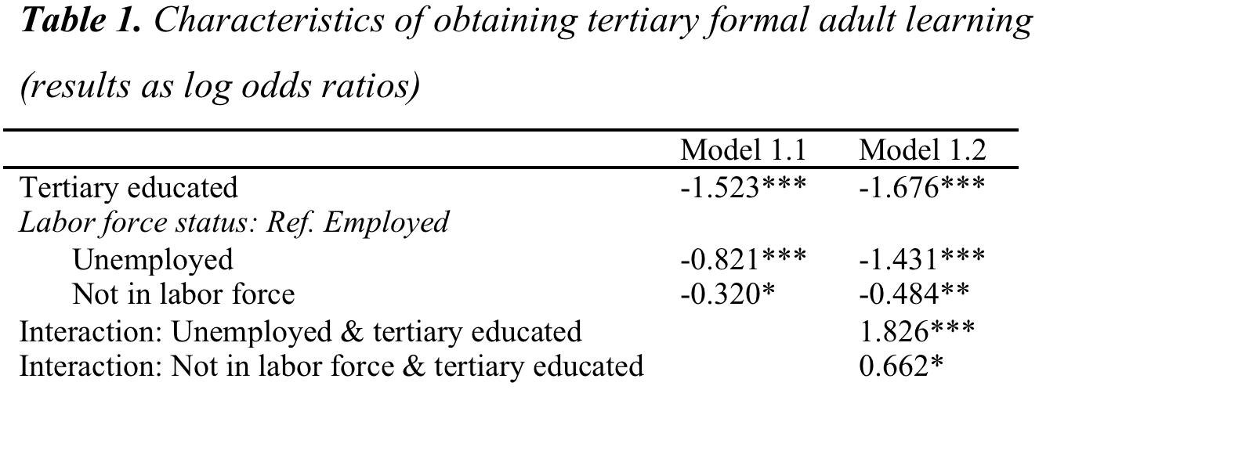
Results: (formal) tertiary adult learners
FINDINGS (1)
(H1) non-tertiary educated confirmed
(H2) working confirmed
*Models control for gender age, marital status, children in the household, residential area, household income, desire to find a (new) job and period.

Slide 30
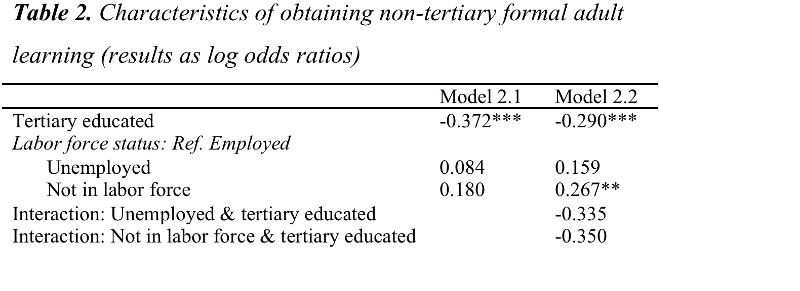
Results: (formal) non-tertiary adult learners
FINDINGS (2)
(H3) non-tertiary educated confirmed
(H4) non-working not confirmed
*Models control for gender age, marital status, children in the household, residential area, household income, desire to find a (new) job and period.

Slide 31
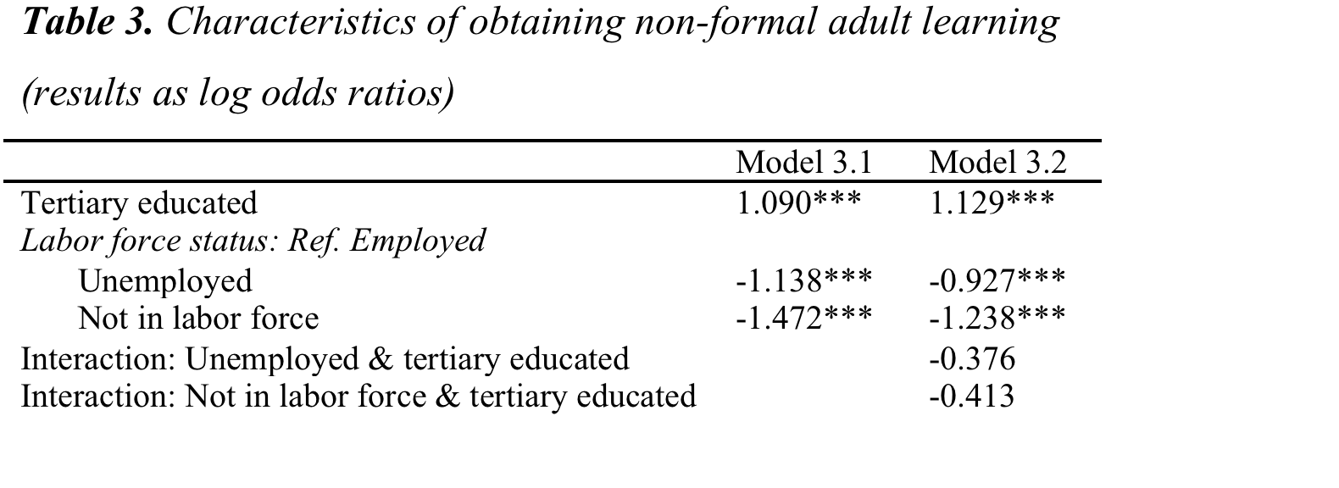
Results: Non-formal adult learners
FINDINGS (3)
(H5) tertiary educated confirmed
(H6) working confirmed
*Models control for gender age, marital status, children in the household, residential area, household income, desire to find a (new) job and period.

Slide 32
Labor market outcomes for adult learners
EXPECTATIONS (4)
Generally positive outcomes from adult learning, as
  Job-related educational activities are crucial for labor market success (DiPrete et al., 1997)
  Formal education is linked to higher productivity & motivation (Arrow, 1997; Becker, 1962; Spence, 1973)
  Yet! Overwhelming role of tertiary education → employers value non-tertiary AL to lower extent
  Negative reputation of evening schools after dissolution of the Soviet Union
  Selectivity issue in non-formal training: Employers invest in employees with higher expected post-productivity (Hansson, 2008)
Compared with non-participants:
(Formal) tertiary adult learners improve their labor market outcomes (H5)
(Formal) non-tertiary adult learners do not improve their labor market outcomes (H6)
Non-formal adult learners improve their labor market outcomes (H7)

Slide 33
Results: occupational mobility
FINDINGS (4.1)
“Direct effect” of adult learning
Impact of adult learning (Ref. No adult learning) | Occupational mobility
 | Upward | Downward
Tertiary AL | More chances | Reduced risks
Non-tertiary AL | n.s. | n.s.
Non-formal AL | More chances | Reduced risks
(H7) confirmed
(H8) confirmed
(H9) confirmed
*Models control for educational status, gender age, marital status, children in the household, residential area, household income, desire to find a (new) job, years since last transition, part-time job, public sector, occupational status, firm size and period.
Notes:
Generally we observe that only those who do tertiary adult learning or non-formal training benefit in term of up- and downward occupational mobility compared to non-participants

Slide 34
Results: occupational mobility
FINDINGS (4.2)
Interaction: adult learning & working status while studying
Impact of adult learning (Ref. No adult learning) | Occupational mobility
 | Upward | Downward
Tertiary AL * employed | More chances | Reduced risks
* unemployed | More chances | Reduced risks
* not in labor force | More chances | Reduced risks
Non-tertiary AL * employed | n.s. | n.s.
* unemployed | n.s. | n.s.
* not in labor force | n.s. | n.s.
Non-formal AL * employed | n.s. | Reduced risks
* unemployed | n.s. | Reduced risks
* not in labor force | n.s. | Reduced risks
Notes:
So see one more time that only tertiary and non-formal adult education benefit participants compared to non-participants.
With regard to working status while studying, we can see, working status while studying does not make any differences for adult learners.

Slide 35
Results: occupational mobility
FINDINGS (4.3)
Interaction: adult learning & initial educational level
Impact of adult learning (Ref. No adult learning) | Occupational mobility
 | Upward | Downward
Tertiary AL * tertiary educated | More chances | n.s.
* non-tertiary educated | Fewer chances | n.s.
Non-tertiary AL * tertiary educated | n.s. | Reduced risks
* non-tertiary educated | n.s. | Increased risks
Non-formal AL * tertiary educated | More chances | Reduced risks
* non-tertiary educated | Fewer chances | Increased risks
Notes:
Tertiary AL improves upward mobility but only if initial educational level was also tertiary! Those doing tertiary but having previously non-tertiary are worse off compared to non-participants!
Non-tertiary AL reduces downward risks for tertiary educated but increases downward risks for non-tertiary educated individuals.
Non-formal training benefits tertiary educated but is harmful for those non-tertiary educated
If initial education is tertiary Adult leaner either benefit from AE or at least not worse off compared to non-participanst!

Slide 36
Results: employment probabilities
FINDINGS (5.1)
“Direct effect” of adult learning
Impact of adult learning (Ref. No adult learning) | Employment probabilities
Tertiary AL | Higher probabilities
Non-tertiary AL | n.s.
Non-formal AL | Higher probabilities
(H7) confirmed
(H8) confirmed
(H9) confirmed
*Models control for educational status, labor market status, gender age, marital status, children in the household, residential area, household income, desire to find a (new) job, and period.
Notes:
Not fully in line with our hypotheses, but all types of AL seems to contribute to employment probabilities compared with non-participants

Slide 37
Results: employment probabilities
FINDINGS (5.2)
Interaction: adult learning & working status while studying
Impact of adult learning (Ref. No adult learning) | Employment probabilities
Tertiary AL * employed | More chances
* unemployed | Fewer chances
* not in labor force | Fewer chances
Non-tertiary AL * employed | Higher probabilities
* unemployed | Fewer chances
* not in labor force | Fewer chances
Non-formal AL * employed | Higher probabilities
* unemployed | Fewer chances
* not in labor force | Fewer chances
Notes:
However, if we look on working status while studying this implies that only those working while studying benefit form adult learning compared with non-participants; whereas adult learners who were non-working while studying are worse off. This implies that previous labor market career is an important factor for employers and might be more valued than education later in life!

Slide 38
Results: employment probabilities
FINDINGS (5.3)
Interaction: adult learning & initial educational level
Impact of adult learning (Ref. No adult learning) | Employment probabilities
Tertiary AL * tertiary educated | More chances
* non-tertiary educated | More chances
Non-tertiary AL * tertiary educated | More chances
* non-tertiary educated | Fewer chances
Non-formal AL * tertiary educated | More chances
* non-tertiary educated | Fewer chances

Slide 39

(Formal) Tertiary adult learners & outcomes for them
MAPPING TOGETHER (1)
Tertiary adult learners
  Employed & non-tertiary educated
Do they benefit from tertiary AL?

Slide 40
(Formal) Tertiary adult learners & outcomes for them
MAPPING TOGETHER (1)
Tertiary adult learners
  Employed & non-tertiary educated
Do they benefit from tertiary AL?
  YES!
    Positive effects on occupational mobility (independent on working status while studying)
  YES!
    Positive effects on employment chances for those employed while studying

Slide 41

(Formal) Tertiary adult learners & outcomes for them
MAPPING TOGETHER (1)
Tertiary adult learners
  Employed & non-tertiary educated
Do they benefit from tertiary AL?
  YES!
    Positive effects on occupational mobility (independent on working status while studying)
  YES!
    Positive effects on employment chances for those employed while studying
  NO & YES!
    Detrimental effects on occupational mobility for those initially non-tertiary educated; But may increase employment chances (independent on initial educational level)

Slide 42
(Formal) non-tertiary adult learners & outcomes for them
MAPPING TOGETHER (2)
Non-tertiary adult learners
  Not in labor force & non-tertiary educated
Do they benefit from non-tertiary AL?

Slide 43
(Formal) non-tertiary adult learners & outcomes for them
MAPPING TOGETHER (2)
Non-tertiary adult learners
  Not in labor force & non-tertiary educated
Do they benefit from non-tertiary AL?
  NO!
    Does not contribute to occupational mobility and does not prevent against downward moves
  NO!
    Detrimental effects on employment chances for those not in labor force while studying

Slide 44
(Formal) non-tertiary adult learners & outcomes for them
MAPPING TOGETHER (2)
Non-tertiary adult learners
  Not in labor force & non-tertiary educated
Do they benefit from non-tertiary AL?
  NO!
    Does not contribute to occupational mobility and does not prevent against downward moves
  NO!
    Detrimental effects on employment chances for those not in labor force while studying
  NO!
    Increases risks of downward occupational mobility and has a detrimental effects on employment chances for those initially non-tertiary educated

Slide 45
Non-formal adult learners & outcomes for them
MAPPING TOGETHER (3)
Non-formal adult learner
  Employed & tertiary educated
Do they benefit from non-formal AL?

Slide 46
Non-formal adult learners & outcomes for them
MAPPING TOGETHER (3)
Non-formal adult learner
  Employed & tertiary educated
Do they benefit from non-formal AL?
  YES!
    Preventive against downward occupational mobility (independent on working status while studying)
  YES!
    Positive effects on employment chances for those employed while studying

Slide 47
Non-formal adult learners & outcomes for them
MAPPING TOGETHER (3)
Non-formal adult learner
  Employed & tertiary educated
Do they benefit from non-formal AL?
  YES!
    Preventive against downward occupational mobility (independent on working status while studying)
  YES!
    Positive effects on employment chances for those employed while studying
  YES!
    Positive effects on upward moves, preventive against downward moves and increases employment chances for those initially tertiary educated

Slide 48
Different types of adult learning
CONCLUDING REMARKS (1)
Crucial to differentiate between different types of adult learning!
    Participation in adult learning differs dependent on one’s needs and financial opportunities
Interplay between initial educational level and working force status!
    Creates different incentives and impediments to return to education as an adult
    May influence adult learning returns

Slide 49
Adult learning & social inequality
CONCLUDING REMARKS (2)
Even if marginalized groups have chances to participate, they face difficulties to improve their labor market position!
In some cases adult learning may have a detrimental effect for participants
It seems that initial educational level is “determinant” for the following career path
  Where tertiary educational level is a “stepping stone” i.e. a basis for successful career development
  Whereas non-tertiary educational level is in most cases an “entrapment” i.e. a disadvantage for subsequent career advancement
And even upgrading from non-tertiary to tertiary educational level (as an adult) may “help” only to limited extent!

Slide 50
agenda
My further steps in the (nearest) future

Slide 51
Structure of dissertation project
AGENDA (1)
(Post-) Secondary educational trajectories
ORIGIN
School-to-work transition
DESTINATION
Adult learning
Accounting for institutional change in cross-temporal analysis
EDUCATIONAL SYSTEM
LABOR MARKET
WELFARE STATE
INSTITUTIONAL CHANGE

Slide 52
Structure of dissertation project
AGENDA (2)
(Post-) Secondary educational trajectories
ORIGIN
School-to-work transition
DESTINATION
Adult learning
Use biographical data – possibility to account for institutional change
    Education and Employment Survey (2005), birth cohorts 1948-1988
Enrich analyses for modern Russia using data from “Research on the educational and occupational trajectories” (NRU-HSE)
Include gender dimension
EDUCATIONAL SYSTEM
LABOR MARKET
WELFARE STATE
INSTITUTIONAL CHANGE
* Partly in collaboration with Dmitry Kurakin and Cultural Research and Education Group (NRU-HSE)

Slide 53
Structure of dissertation project
AGENDA (3)
(Post-) Secondary educational trajectories
ORIGIN
School-to-work transition
DESTINATION
Gender differences in the first significant occupation
    before and after the Fall of the Soviet Union
Education and Employment Survey (2005), birth cohorts 1948-1988
Data from “Research on the educational and occupational trajectories” (NRU-HSE)
EDUCATIONAL SYSTEM
LABOR MARKET
WELFARE STATE
INSTITUTIONAL CHANGE
In collaboration with Dmitry Kurakin and Cultural Research and Education Group (NRU-HSE)

Slide 54
Thank you very much for your attention!
Yuliya Kosyakova
E-Mail: yuliya.kosyakova@eui.eu

