Slide 1
The Promotion of Culture in Citizenship Education and its Influences on Students’ Multiple Identities in China
Du Jianyi
PhD Candidate
Faculty of Education
The University of Hong Kong

Slide 2
Background
Research Questions
Methodology
Findings
Conclusion

Slide 3
Background
New cultural policy in China (Communist Party of China Central Committee, 2011)
Chinese government has implemented a new and important cultural policy in 2011, which emphasis to promote the development of culture and to integrate cultural elements in citizenship education.
Culture & Citizenship Education

Slide 4
Citizenship and Citizenship Education
General understanding
membership (Delanty,2000),
rights and obligations (Heater,1999),
a sense of (national) identity (Cogan, 1998)
Classical theories:
The civic republican tradition: obligations
The liberal tradition: rights
China’s case
the concepts of citizenship and citizenship education in China

Slide 5
Identity
Clarifying this concept
Deng (1995, p1): “the way individual and group define themselves and are defined by others on the basis of race, ethnicity, religion, language and culture”
Guibernau (2007, p10): “a definition, an interpretation of the self that establishes what and where the person is in both social and psychological terms”.
In this study, identity is defined as one’s definition of one’s self, which includes cognitive, attitudinal and behavioral dimensions.
Identity & Citizenship
National Identity
Identity & Citizenship Education

Slide 6
Culture
Collective programming of people’s mind, the core element of which is value (Hofstede, 1984)
The pattern of basic assumptions held among group members to cope with problems arising from external adaption and internal integration , and transferable to new members so as to shape their perceptions, thinking and feeling in relation to these problems (Schein, 1984)
A collection of values, beliefs, behaviors, customs, and attitudes that distinguish members of a group from other groups (Fan, 2000).
A force that shapes people’s beliefs and attitudes and guides their behaviors.

Slide 7
Culture
In this study, culture is regarded as a set of elements, including values, beliefs and customs, which may influence the people’s perceptions, attitudes and behaviors as citizens.
Culture & Identity

Slide 8
Culture and Citizenship
Globalization caused cultural allegiances (Ommundsen et al., 2010), people can now “belong” to different culture simultaneously.
Citizenship is about belong and identity (Cogan, 1998).
Culture becomes a part of theoretical discussion on citizenship.
Cultural citizenship: three trends
Trend 1 (Kymlicka, 1995; Rosaldo, 1997)
Trend 2 (Miller, 1998; Van Zoonen, 2005)
Trend 3 (Delanty, 2002; Stevenson, 2007)
Citizenship: a dynamic process of cultural construction

Slide 9
Culture and Citizenship Education
Multicultural citizenship education
students, especially cultural minorities students, function effectively within their cultural communities (Bank, 1990,2001,2007).
Cosmopolitan citizenship education
qualified citizens should feel, think and act in the interests of all mankind, and treat different culture respectfully and equally (Falk, 1993; Osler & Vincent, 2002).

Slide 10
Research Gap
The general literature is useful in understanding the existing relationship among citizenship, citizenship education and identity; and how culture, citizenship and citizenship education are connected to each other in the global context. However, it does not specify the role of culture in citizenship education, especially in helping students to explore their local, national and global identity.
The general literature is not specific enough to understand the case of China.
China may provide a useful case to understand the role of culture in promoting people’s multiple identities.

Slide 11
Research Questions
What are the major (a) local, (b) national, and (c) global cultural elements promoted in citizenship education in schools? How do schools foster among students these cultural elements?
What are students’ knowledge and attitudes towards these cultural elements ?
How does the students’ possession of these knowledge and attitudes affect (a) their perceptions of multiple (local, national and global) identities, and (b) their sense of affiliation and identification with local, national and global communities?
In addition to school factors, what are other factors influencing the use of culture on students’ multiple identities?

Slide 12
Methodology
A mixed method research
Quantitative methods:
questionnaires
Qualitative methods:
collection and review of documents
observations
interviews
The research site: Beijing
Junior secondary schools

Slide 13
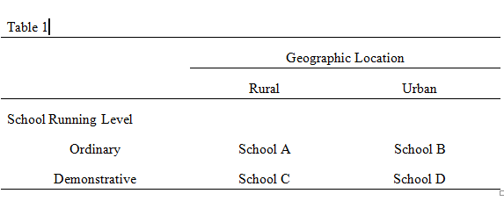
Fieldwork
Time: 2013,03 – 2013, 06
Subject schools

Slide 14
Data
School documents
Collected questionnaires
Interviews recordings
Lessons recordings

Slide 15
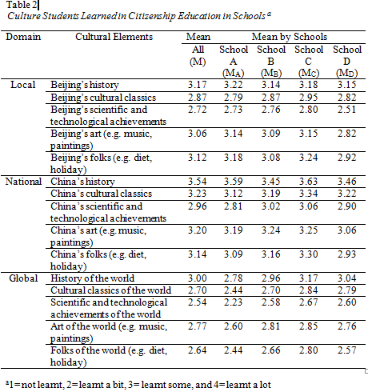
Findings: Pattern I
Coexistence of Local, National and Global Cultural Elements in Citizenship Education
The respondent students from the four subject schools agreed that they were able to get access to the local, national and global cultural elements in citizenship education in school.

Slide 16
The four interviewed school principals and most of the interviewed teachers, such as A/T02, B/T02, C/T03 and D/T01, indicated that they had consciously added different cultural elements into school environments, curriculums and activities, so that to help the students to get aware of them.
“a variety of different cultural elements were involved in our school: (there are) Chinese culture of course, and culture of other countries in the world… Chinese culture is closely related to Beijing culture…” (Student C/S12)

Slide 17
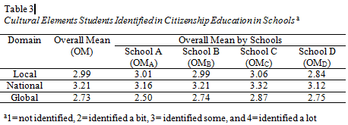
Findings: Pattern II
Strong Identification with National Culture
Students showed a high degree of recognition towards the national cultural elements promoted in schools.

Slide 18
The quantitative data was supported by the qualitative data.
In interviews, when students were asked to recall the cultural elements they accessed in schools, more than 60% of the interviewed students (15 of 24 students) referred to national cultural elements in their first answers. Some students even directly used the words “national culture”; while the others just listed some national cultural elements, such as Chinese history, national arts and handcrafts, Chinese traditional folks, Confucian Analects, Traditional Chinese Medicine, and so on.

Slide 19
Findings: Pattern III
Selective Acceptance of Local and Global Culture
As shown in Table 4, students’ identification with local culture with local culture did not necessarily lead to identification with local identity. Similarly, though students’ identification with global culture was relatively weak, their identification with global identity could be relatively strong.

Slide 20
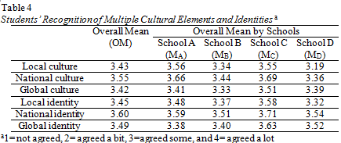
Some students explained that “though I do not like Beijing local culture very much, I live here; my families and my friends are here, there is no way I do not like this city and do not care about its development.” (B/S22, L151)
Some also mentioned that culture was only one of the many factors affecting their multiple identities, such as their birthplace, travel experience, and family background and etc.

Slide 21
Findings: Acting Factors
Parents’ opinions
Students B/S11, B/S21, C/S11, D/S31
Personal interests
Students A/S31, B/S22, C/S21, D/S11
Living experiences
Student C/S11, D/S32

Slide 22
Conclusion
With reference to Beijing, this study has explored the promotion of culture and its influences on students’ multiple identities.
It has three major theoretical implications: first, enriching our understanding of school’s role in implementing national education policy, while pursuing the educational goals of its own; second, explaining the cultural task in citizenship education in China and the role of culture in citizenship education in the global context; third, extending knowledge of how culture may influence students’ their affiliation and identification with local, national and global communities, namely, their multiple identities.

Slide 23
Thank You
Questions & Answers

