Slide 1
School Effectiveness: Origins, History and Future Directions
Professor Alma Harris
University of London

Slide 2
Structure
School Effectiveness
Teacher Effectiveness
Discussion

Slide 3
School Effectiveness :Origins
In July 1966, "The Equal Educational Opportunity Survey" by J.S. Coleman, et al, was published.
The Coleman report concluded that family background, not the school, was the major determinant of student achievement.

Slide 4
Implications
The creation of "compensatory education" programs "taught low-income children to learn in ways that conformed to most schools’ preferred ways of teaching."
These programs focused on changing students’ behavior in order to compensate for their disadvantaged backgrounds and made no effort to change school behavior.

Slide 5
Other Implications
By lending official credence to the notion that "schools didn’t make a difference" in predicting student achievement, the report stimulated a vigorous reaction, instigating many of the studies that would later come to define the research base for the Effective Schools Movement.

Slide 6
Edmonds (1982)
While schools may be primarily responsible for whether or not students function adequately in school, the family is probably critical in determining whether or not students flourish in school."

Slide 7
Initial Tasks
To identify existing effective schools – schools that were successful in educating all students regardless of their socioeconomic status or family background.
The common characteristics among these effective schools. In other words, what philosophy, policies, and practices did these schools have in common?

Slide 8
Identifying Effective Schools
Schools in which students were mastering the curriculum at a higher rate and to a higher level than would he predicted based on students’ family background, gender, and racial and ethnic identification. (Excellence)
Schools that narrowed the achievement gap between students from low socioeconomic and high socioeconomic backgrounds narrowed. (Equity)

Slide 9
Effectiveness Tradition
Strong, positivist, quantitative orientation
Critics focused on identification of ‘effective schools’ and ‘applied’ nature of research v blue skies or pure research

Slide 10
Features
High levels of methodological sophistication –multi-level statistical modelling
Multiple measures of student outcomes
Multiple measures of student intake
Advanced conceptualisation

Slide 11
Effective Schools
These unusually effective schools were found to possess a set of common characteristics, called “correlates.”
The correlates have been shown to be as essential for equitable effectiveness today as they were thirty years ago and thus are building blocks used in the Effective Schools model.

Slide 12
Limitations
Back-mapping from outcomes to characteristics of effective schools
Focus on disadvantaged contexts
School as the focus not the classroom

Slide 13
Important Studies
Rutter (1979) Fifteen Thousand Hours
Mortimore et al (1988) School Matters (Reading, Maths, Writing, Behaviour and Attitudes to School)
Smith and Tomlinson (1989) (differences within and between schools)

Slide 14
In 1979, Fifteen Thousand Hours documented effective schools research in high schools in the United Kingdom, and found that school characteristics could positively alter student achievement

Slide 15
Lezotte (1991)Seven Correlates of Effective Schools"
Instructional leadership.
Clear and focused mission.
Safe and orderly environment.
Climate of high expectations.
Frequent monitoring of student progress.
Positive home-school relations.
Opportunity to learn and student time on task.

Slide 16
Пять измерений эффективного педагогического лидерство
(Robinson, 2008)

Slide 17
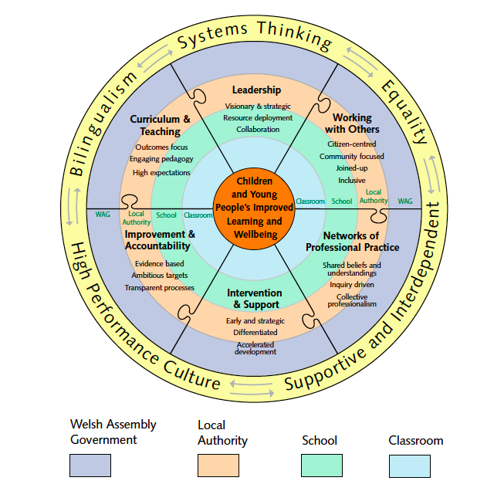

Slide 18
Generalisation
Many factors that make for good schools are conceptually quite similar in countries that have widely different cultural, social and economic contexts (Reynolds, (2011)

Slide 19
So what about less effective schools?

Slide 20
Ineffective Schools (Reynolds 1991)
Belief that change is for other people
Past methods are fine
Reluctance to try new things
Blaming of factors external to the school
Teachers believe there is little they can do
Personality clashes, dysfunctional relatiosnships
Unwillingness to face the ‘brutal facts’

Slide 21
Do we have the technology to turn around failing schools? (Harris, 2001)
Diagnosis
Development- focus on instructional practices
Drive
Data

Slide 22
Implications
All children can learn and come to school motivated to do so
Schools control enough of the variables to assure that virtually all students do learn
Schools should be held accountable for measured student achievement

Slide 23
Why Less Focus on Teaching – More Talk Than Research
Less research than the school level
American tradition stopped
UK research limited

Slide 24
Why No Science or Technology of Teaching?
The view that it is innate / artistry
School effectiveness research

Slide 25
Effective Teaching
Clarity
Maximising opportunity to learn
Variety
An academic orientation
Classroom management
Student time on task
High expectations
Student success rate
Questioning
Structure

Slide 26
Teacher Behaviours
Using and incorporating student ideas
Varied questioning from teacher and students
Frequent feedback-assessment for learning
Instructional variety
Time on task

Slide 27
www.education.auckland.ac.nz/staff/j.hattie/

Slide 28
Effect on Achievement over time?
Typical Effect Size
0
.20
.40
1.0
Decreased
Zero
Enhanced

Slide 29
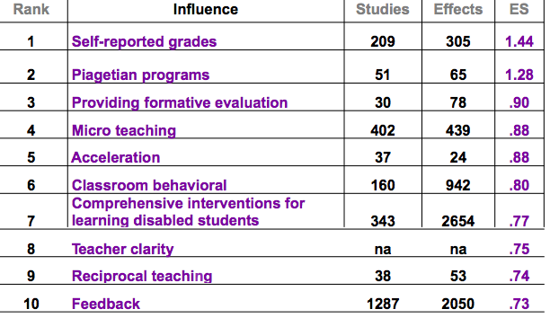
Hattie

Slide 30
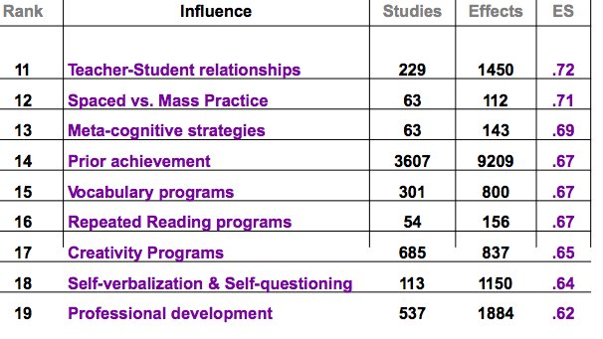
Hattie

Slide 31
Professional Development with Impact
Peer Tutoring
Professional Learning Communities
Learning Walks
Lesson Study
Mentoring/Coaching

Slide 32
Future Directions
Educational Policy Makers- PISA
Leaders and Teachers- What Works
Researchers-Studies in Other Countries

Slide 33
Further Reading
Reynolds,D. (2011) Failure Free Education: the Past, Present and Future of School Effectiveness and Improvement, London, Routledge.
Muijs, D. and Reynolds, D. (2011) Effective Teaching: Policy, Practice and Research, London, Sage.

Slide 34
Contact
almaharris@um.ed.my
#ah1
almaharris.co.uk

