Slide 1
iPIPS: An International Study of Children’s Development at the Start of School and Progress in their First Year
Peter Tymms & Christine Merrell

Slide 2
Overview
CEM
Challenges of assessing young children
The PIPS assessment
iPIPS
Data quality
  Reliability
  Predictive validity
  What children know and can do
  Progress across jurisdictions
  Changes over a decade
  Monitoring policy changes

Slide 3


Slide 4
Centre for Evaluation & Monitoring
Our Mission
… fundamental aim to improve teaching and learning for children and young people
… high quality research information through a scientific and evidence-based approach

Slide 5
30 years old
100 staff
Monitoring systems for children ages 3-18
Process data from 1 million students a year
1000s schools
Computer adaptive tests with 10,000 in a day
England, Scotland, Australia, New Zealand, the Netherlands, Abu Dhabi, USA, China, Germany, Russia, Chile & S. Africa

Slide 6
The Challenges of Assessing Young Children
Many can’t read
Communication issues
Limited time for assessment
Low STM
Content:
  The official content?
  What best predicts success/difficulty?
  What is malleable?
Mode
  Observation or direct questions?

Slide 7
The PIPS Baseline and Follow up
Translated/adapted into 9 languages
Assessed > 1 million children
Used initially for formative feedback

Slide 8
Content: PIPS Assessment
Early Reading
Early Maths
Vocabulary
Short term memory
Personal, Social and Emotional Development
Inattentiveness, hyperactivity & impulsivity
Contextual Data
Physical development

Slide 9
Distinctive Nature of PIPS
Very quick
Very reliable
Good prediction
Robust
Broadly based
Can be adapted
Long term follow up data
International
Liked by teachers
Enjoyed by children
Rapid feedback

Slide 10
Compared to Other Assessments
There are hundreds of baseline assessments
We have reviewed 25
PIPS wins

Slide 11
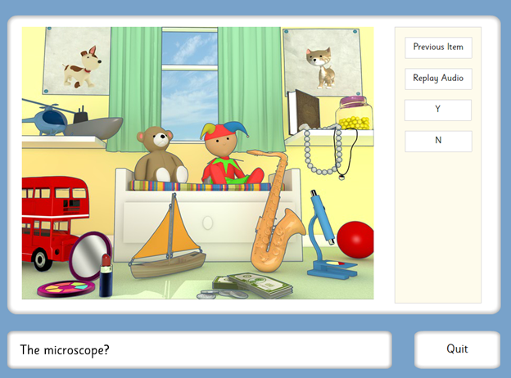
A Look at the Assessment

Slide 12
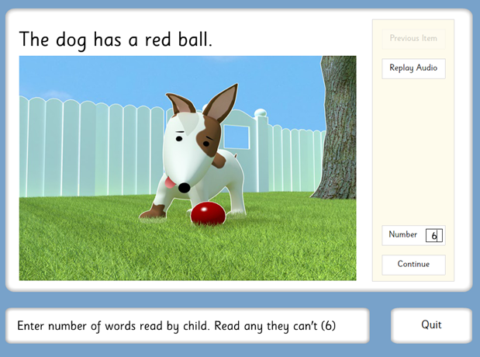

Slide 13
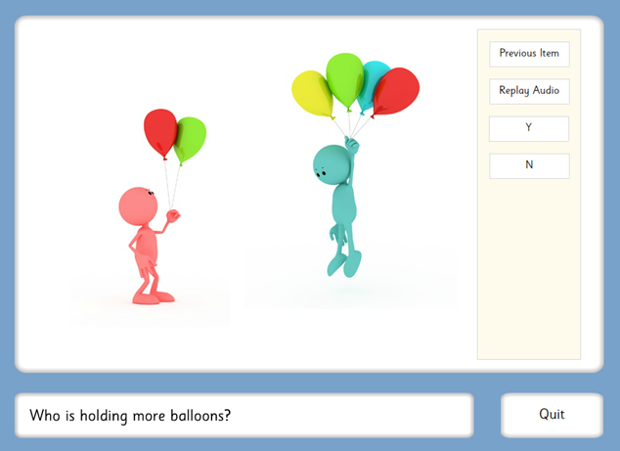

Slide 14
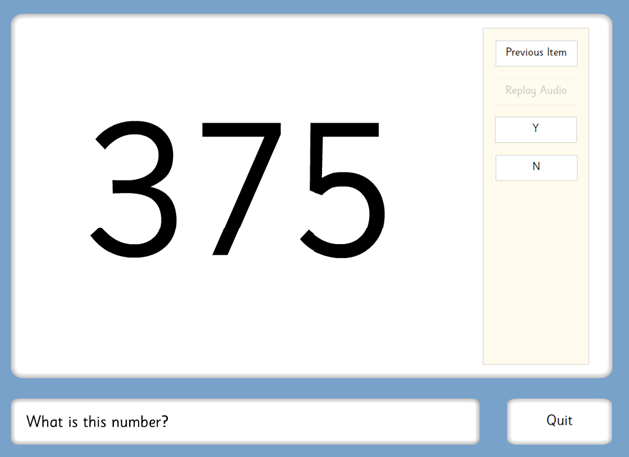
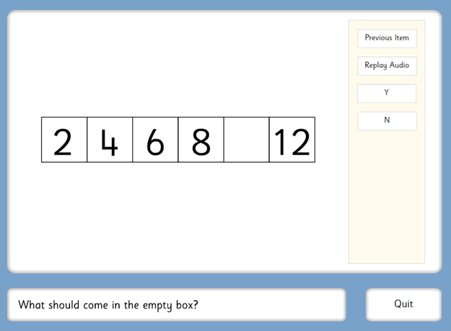

Slide 15
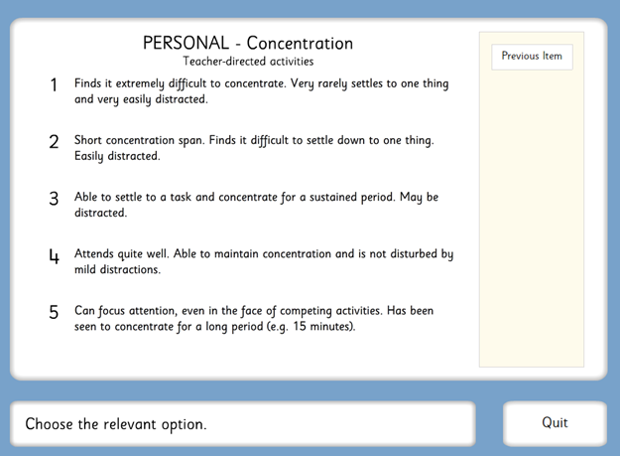

Slide 16
iPIPS
iPIPS is a international project looking at children starting school around the world and the progress they make in their first school year

Slide 17
iPIPS Vision
iPIPS in
6 countries
Bigger Comparative Study: Every 4 years
Scale up to include more countries
Developmental Projects
Through governments
On-going project
3 years:
2013/2014
2014/2015
2015/2016

Slide 18
Data Quality (Objective data from England)
Reliability
  Test/retest 0.98
Does it predict?

Slide 19
An Example of Prediction

Slide 20
What Children Know and Can Do

Slide 21
Reading across Jurisdictions

Slide 22
Changes Over a Decade
Example: Pre-school and mathematics at start of school ten years ago:

Slide 23
Monitoring the Impact of a New Policy
Northern Ireland, UK
New Enriched Curriculum
PIPS Baseline and later PIPS Assessments
Tracked reading and mathematics from start to end of primary school
No additional benefit for Enriched Curriculum

Slide 24
Thank You

