Slide 1
Rethinking Institutional Autonomy: University Governance, Provincial Government Policy, and Canada’s Flagship Research Universities
Glen A. Jones

Slide 2
Organization of Presentation
Provide a brief introduction to higher education in Canada
Describe our study of university governance in major research universities
Provide preliminary findings based on three case studies
Implications for university governance and university autonomy

Slide 3
Canada
Federation created in 1867
Division of responsibility between federal government and provinces – provinces assigned responsibility for education
No national higher education policy, no national ministry
Federal government plays a major role in research policy, student loans, culture and language

Slide 4
The Canadian Federation
10 provinces with tremendous differences in size, population
3 northern territories (extremely sparse populations)
2 official languages (English and French)
Highly diverse population with tremendous cultural and regional differences.

Slide 5
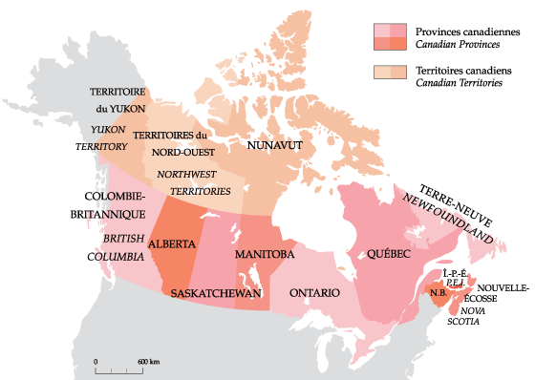
Canadian Provinces and Territories

Slide 6
Provincial Higher Education Systems
Each province created its own “system” in the process of post-WWII massification
Major differences in system structure, regulation, funding, tuition fees, etc.
Relatively homogenous university sector emerged across Canada – similar governance structures, undergraduate standards, comprehensive, public

Slide 7
University Governance
Almost all Canadian universities adopted a bicameral system of governance
Governing board (largely external members, often appointed by government)
Senate (largely internal members: faculty, students, academic administrators)

Slide 8
Governance and Institutional Autonomy
Institutional autonomy was largely associated with the governance of the Anglo-Saxon systems – separating universities from the state
In these systems it was regarded as an “innate good” – in contrast to continental European traditions of a strong state role.

Slide 9
Governance and Institutional Autonomy
There have been major reforms to governance in many systems
State stepping back to allow universities to govern themselves
State steering function
Greater university management capacity
Anglo-Saxon systems – greater government intervention

Slide 10
Governance and Autonomy
Bologna process and governance reform
European University Association Autonomy Scorecard
Organizational Autonomy
Financial Autonomy
Staffing Autonomy
Academic Autonomy

Slide 11
Governance and Autonomy
Now linked to “world-class universities” since the leading universities in the world have considerable autonomy
Importance of academic self-governance (academics making academic decisions)

Slide 12
Our project
To look at institutional governance and decision-making in Canada’s major research universities
Have there been changes in institutional autonomy?
Have there been changes to institutional governance and decision-making?
How do we understand the relationship between university governance and the provincial policy environment?

Slide 13
Institutional Autonomy
Informed by previous conceptions
Bordieu and the tension between elite (artisan) university processes and mass (responsive to external stakeholders) higher education

Slide 14
The study
Focused on 6 universities in 5 provinces
Detailed document analysis of institutional and provincial government materials
Interviews with key informants (government, board, senate, senior administration, students, faculty leaders)
Generally between 12 and 22 interviews per case study

Slide 15
This presentation will focus on 3 case studies:
University of Toronto (Ontario)
University of Alberta (Alberta)
University of British Columbia (British Columbia)
All are top 100 universities using most rankings

Slide 16
University of Toronto
Canada’s leading research university
67,000 undergraduates; 15,000 graduate students
Unicameral governance structure
Governing Council with 50 members representing all major constituencies
Most decisions make by 3 boards (Academic, Business, and University Affairs Boards)

Slide 17
Changes in Governance
Provincial government does not have a major impact – respects autonomy – increasing accountability but few changes
Transition to new university budget model in 2004 – responsibility centered management & budget – large decentralization of authority to the Faculties/Deans

Slide 18
Institutional Autonomy
Leaders believe that the university has a very high level of autonomy – tremendous respect for elite academic decision-making
Little government interference, board members chosen by university
Professional bodies have an impact on autonomy
Considerable autonomy for Deans – less capacity for university-wide strategic planning.

Slide 19
University of Alberta
Created as the “provincial university” in 1908
30,000 undergraduate, 7000 graduate students
Bicameral governance structure with Governing Board and General Faculties Council

Slide 20
Changes in Governance
Post-Secondary Learning Act (PLA) in 2007 established 6 sectors within Campus Alberta
University of Alberta is one of two major research universities
PLA is the “bible” for governance and policy discussions

Slide 21
Changes in Governance
Strong role for board and board chair (strategic direction)
Government officials sit on university audit committee
University prevented from borrowing money (BUT government provides good support)
Moving towards decentralized budget process

Slide 22
Institutional Autonomy
High levels of autonomy, but province has a legitimate role as major funder
Respect for academic self-governance
Province assigns major accountability role to the board (chooses board members and chair carefully)

Slide 23
University of British Columbia
A top 50 university in Shanghai, THE
27,000 undergraduate; 8000 graduate
Bicameral governance structure with Board of Governors and Senate

Slide 24
Changes in Governance
University Act governs all public universities in BC
University is a Government Reporting Entity (GRE) and so university budget is closely monitored
Okanogan College transferred to University
University now controls significant amount of land – President is unofficial Mayor
Moving towards decentralized budget control

Slide 25
Institutional Autonomy
High autonomy, but province is attempting to clarify expectations
Reduced autonomy as GRE, increased autonomy with increased authority over land/zoning
Respect for academic self-governance

Slide 26
Concluding Observations
Some common trends:
Movement towards decentralized decision-making within the university
Governments have respected institutional autonomy and academic self-governance

Slide 27
Concluding Obervations
The Provincial policy environment makes a difference:
Importance of PLA in Alberta
Differences in funding levels (and accountability)
Differences in board role and appointment processes (Alberta)

Slide 28
Concluding Observations
There have been no major reforms to university governance
High levels of autonomy – institutions are able to find a balance between elite and mass activities
Most government interventions had little impact on autonomy (university still decides what it will do)

Slide 29
Thank You!!
Glen Jones
www.glenjones.ca
gjones@oise.utoronto.ca

