Slide 1
Russian school principal: between "yesterday" and "tomorrow"
Anatoly Kasprzhak, Nadezhda Bysik, Natalia Isayeva, Katerina Kukso, Rustam Baiburin, Institute of Education, NRU HSE http: www.ioe.hse.ru
Институт образования, Высшая школа экономики, 2015
ioe.hse.ru

Slide 2
Basis for the research: the "mysteries"
Situation | Research questions
Russian principals have not been studied since the mid 90's (no data). | What has changed today? The extent to which school principals are result-oriented, are the best examples ready to rely on the team?
In recent years, reforms in education are going one after the other ("Our new school", NSOT, per capita funding, autonomous institutions, etc.) | Are Russian school principals able and ready to support reforms, to become agents of change?
In the 90-ies education reform were focused on the school economic independence. Principal was seen as an effective manager. Currently, the priority of educational policy is Federal state standard implementation, high student achievement. Principal is responsible for the student achievement (Federal state standard, an independent education quality assessment, certification, effective contract, school ratings). | How Russian principals manage the educational process? How Russian principals are prepared for educational process management in the current retraining system of retraining and professional development?
Высшая школа экономики, Москва, 2015

Slide 3
Main empirical research of principals within the project
Research of principals’ decision-making styles on A. Rowe methodology (Center for Leadership IE HSE), 2014
International comparative study "7 SYSTEM LEADERSHIP STUDY» TO 2015
Effective models of educational management relating to the personal and professional practices of school principals (IE Center for Leadership HSE), 2014
Leadership distribution pattern (publishing firm "September," Center for Leadership IE HSE), 2015
The Economics of Education Monitoring of Higher School of Economics, 2015
International comparative study of «SYSTEM APPROACH FOR BETTER EDUCATION RESULTS», 2014
A comparative study of the OECD «TEACHING AND LEARNING INTERNATIONAL SURVEY», 2014

Slide 4
A statistical portrait of the Russian school principal
Public school
Rural
Female
He/ she has full employment, sometimes combining with teaching
Qualifying Category - first
Education - higher pedagogical
Work experience is over 20 years
The age is between 35-55 years old (really – from 40, taking into account the experience of 20 years)

Slide 5
A statistical portrait of the Russian school principal
The vast majority of the principals of public schools (94.3%) is over the age of 35 years. In urban areas, the figure is even higher - 96.7%.
The proportion of principals with teaching load, declining rapidly in metropolitan areas

Slide 6
Research of principal management decision-making styles in 2014
The purpose of research - to determine whether the modern Russian principals tend to use leadership style and management model adequate to the goals and objectives of public policy changes in education.
The sample - 1299 respondents in 7 regions of the Russian Federation (Samara region, Novosibirsk region, Yaroslavl region, Stavropol Territory, the Khabarovsk Territory, Krasnodar Territory, Perm Territory and St. Petersburg).
Methodology - A. Rowe [Reardon, Reardon & Rowe, 1996].
Высшая школа экономики, Москва, 2015

Slide 7
The distribution of principals by management decision-making styles
There are NO significant differences in the distribution of principals surveyed on management decision-making styles!
This refutes the vision of many authors, especially foreign ones, that Russian principals use directive management style as dominant.
Высшая школа экономики, Москва, 2015

Slide 8
The proportion of school principals using conceptual and analytical decision-making styles
 | Conceptual | Analytical
Principals, total | 1299 | 1299
The style use | 155 | 139
Percentage | 12% | 11%
Conclusion #1
Only 12% of school principals can be referred to as transformational leaders and only 11% to as transactional leaders - leaders with a predisposition to the effective implementation of change and a shift towards transformational leadership style. This is the reform potential of the current body of principals.
Высшая школа экономики, Москва, 2015

Slide 9
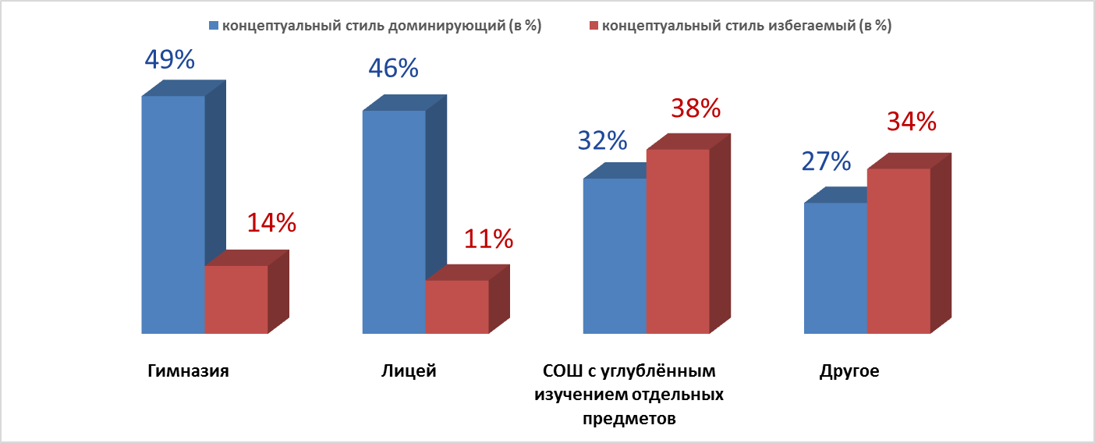
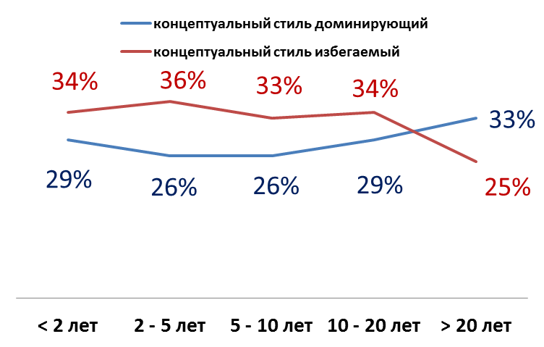
The most interesting finding or the advice to education authority chiefs
Давно здесь сидим...
If you want to implement innovations successfully you are to lean on principals at the age of 35 years with serious management experience heading large gymnasiums and lyceums.
It is the community where the largest number of reform agents would appear (principals using conceptual management decision-making style as the dominant) in comparison to any other group of school leaders.
Высшая школа экономики, Москва, 2015

Slide 10
School management models study
Name - management model of a comprehensive organization in the conditions of reforms
The goal - to identify models of school management, sustainable and reproducible patterns of relationship between the principal and the various agents of the internal and external school environment
Sample:
24 focus groups of 10-15 principals in 7 regions of Russia (Yaroslavl Oblast, Stavropol, Krasnodar, Ulyanovsk region, Novosibirsk region, Yamalo-Nenetsky, Khabarovsk region and St. Petersburg
4477 survey of principals in 65 regions of Russia
Survey of 1248 workers of educational departments of 65 regions of Russia

Slide 11
The principals’ survey results
The main task of the principal managing the school, N = 4477 | %
The creation of decent conditions for the educational process implementation | 59,1
Ensuring students to achieve specific learning outcomes | 18,8
Meeting the interests of students and their parents | 12,1
Creating a favorable psychological climate at school | 4,6
The upgrade school rating | 4,5
Meeting the interests of the teaching staff | 0,3
Difficult to answer | 0,7

Slide 12
The results of the principals’ focus groups
“My working time is distributed as follows: 1 hour of conversation with an accountant, 2-3 hours of discussion on building, 1 hour communication with the parents, because every day someone comes along, 40 minutes is for dining room, mail and document takes 3 hours, from 17:00 to 19:00 I look webinars on various topics. Also it regularly takes time to communicate with business leaders on attracting funds"
"We have a central accounting department, I lose half a day to go to the Department of Education, which is due to a seal I have to affix."
"School is judged by the state exam results, in this area I know everything, but I do not go into methodical work

Slide 13
The results of the survey of Education authority employees
An essential part of school administrators follow adaptive patterns of behavior: primarily because the principal does not see school as an educational organization, it is an economic complex for him, which must be maintained in a certain condition, in order to provide teaching process
Notes:
Реформы последних лет требуют от руководителей доминирование модели управления – «демократичный предводитель», однако социальный контекст, задачи и критерии оценки, которые формируют ОУО, предполагают следование другим моделям, деятельность директоров сводится к адаптации, а горизонт планирования не превышает 3-5 лет (61%). Это приводит к тому, что многие из нововведений оказываются фиктивными.
71% опрошенных сотрудников ОУО заявили, что основным показателем эффективности работы директора, который влияет на стимулирующие выплаты, является отсутствие предписаний надзорных органов и объективных жалоб.
Чаще всего (53%) директоров привлекают к ответственности за нарушение организации административно-хозяйственной и финансовой деятельности школы (по данным опроса ОУО)
68% директоров общаются с представителями ОУО несколько раз в день. По данным опроса сотрудников ОУО, в среднем в школу поступает 11 запросов (почта, звонки) в день от управления образованием. По данным ФГ от 10 до 80 в день.
Поводом для запроса в школу от ОУО чаще всего являются реакция на запрос от сторонних организаций, контролирующих органов (74%), внеплановая отчетность (72%), запрос количественных данных (52%).
По предварительным данным опроса работников УО (ответы требуют дополнительной перекодировки*) порядка 40-70% запросов от ОУО в школы об информации, которая существует в альтернативных источниках, например, на сайтах школ, в базах данных, в предыдущих отчетах, в других подразделениях органа управления образованием и т.д.**

Slide 14
7 SYSTEM LEADERSHIP STUDY
Research Questions
How Russian principals manage the educational process? In which way their working with teachers practices differ as compared to the practice of successful school leaders in foreign countries?
How principals are prepared for educational process management in the current system of retraining and professional development?
Sample
big federal city - St. Petersburg – 120 survey participants, 10 interviews
National Caucasian republic - North Ossetia-Alania - 78 survey participants, 6 interviews
a typical region of central Russia - Nizhny Novgorod region - 39 survey participants, 7 interviews
remote Far East region - Khabarovsk Krai - 63 survey participants, 3 interviews.

Slide 15
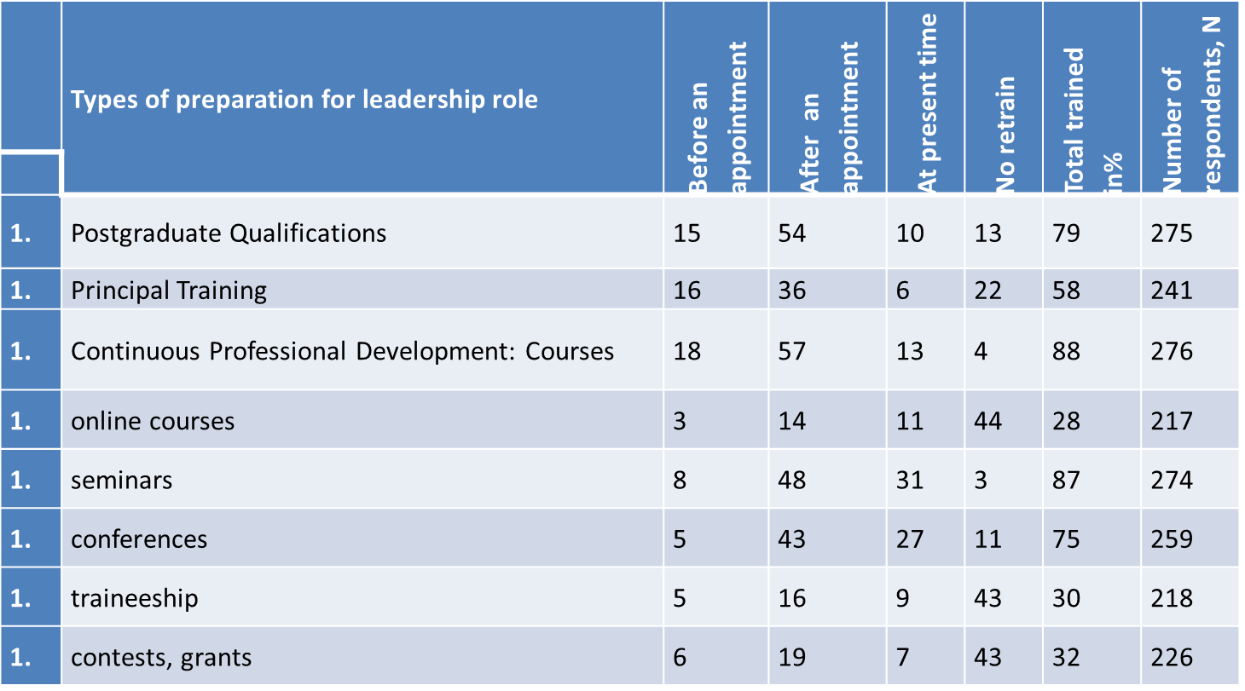
Training

Slide 16
The content of training, %

Slide 17
International trends
The link between the activities of a principal and students’ academic results is proven
Instructional leadership – an educational process leadership for improving the results of the students
Distributed leadership - creation and support of teacher professional communities

Slide 18
Block C: Leadership Practices

Slide 19
Quotes
Placement: "Well, probably I was not that interested, but engaged. School had to be lifted to a new level."
The training: "... The novice manager needs conversation with the chief of educational governing body. It should be possible to come and communicate a problem or a question. Some people prefer to hush up. Such negative experience the previous principal had. He said, do not ask and do not call, they will think that we do not know.«
Leadership Practice: "That is, the leader is the father of the family, he has to create conditions in which everyone feels comfortable. Then he is a leader, then he takes care of all."
"I work in a team, but still, I can not immerse in the teamwork, because I realize that I need to be always one step ahead."

Slide 20
Conclusion
There is no unified system of selection, training, appointment, support and continuing professional development for principals.
The content of training do not teach school leadership, educational program management and students’ educational outcomes.
Principals are not familiar with the concepts of instructional leadership and distributed leadership, their working with teachers practice is pedagogical leadership.
Leadership is the ability to lead, not professional skills and personality traits that are influenced by life experience.

Slide 21
EEM: management practices of different school principals (summary of the research)
The name of the study: Education Economics Monitoring http://memo.hse.ru/met
(questionnaire for secondary school principals)
Objective: To study the management practices of principals of various groups of schools (city, with high results, complexes, etc.)
Sample: 1,200 respondents from 64 regions. The sample is representative for the Russian Federation

Slide 22
EEM: management practices
The duties principal deems the most important in actual practice, %
Most principals are paying increased attention to the overall school quality assessment (81%), the budget management, teachers’ work quality assessment and solution of economic issues.
The functions related to the educational process management, pedagogical leadership and interaction with the public, are not a priority.
Высшая школа экономики, Москва, 2015

Slide 23
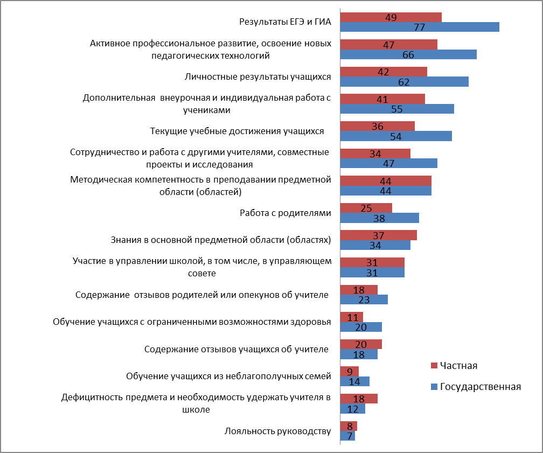
EEM: management practices of principals of different schools (results)
Factors taken into account when principals fix teacher incentive payments, %
In public schools, in general, teacher work is evaluated primarily by the results of the State exams and the current results of student educational achievements.
In private schools a priority in the evaluation of teachers is given the deficit of the subject, the need to retain a teacher, teacher's knowledge in the subject area and students recalls.

Slide 24
A comparative study of the OECD «TEACHING AND LEARNING INTERNATIONAL SURVEY», 2014
Name: Teaching and Learning International Survey http://www.oecd.org/edu/school/talis.htm
The OECD Teaching and Learning International Survey (TALIS) provides basic information about the teaching workforce and the school environment
Sample: 198 principals of schools in 14 Russian regions
Methodology: a questionnaire survey of teachers and principals

Slide 25
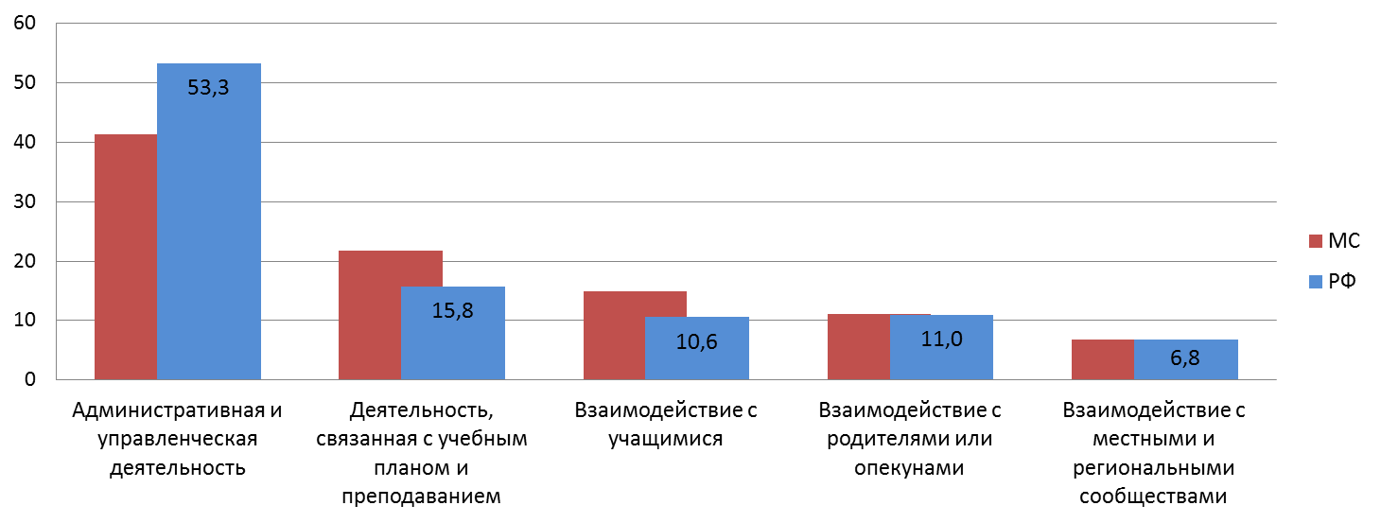
The distribution of school principal working time in different areas of management, %
Russian principal spends most of the working time on administrative work and school management.
* MС – The International average index of the countries participating in TALIS
Высшая школа экономики, Москва, 2015

Slide 26
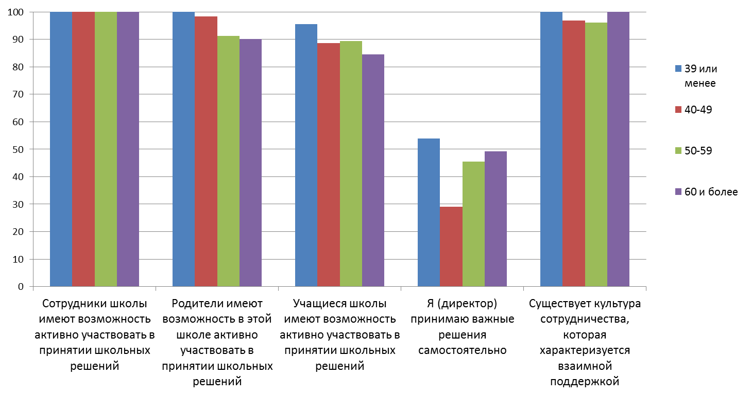
TALIS international study of teaching and learning (results)
Due to increasing experience principals delegate authority less. Almost half of principals make decisions on their own.

Slide 27
SABER Teachers Russia (description)
Name: SABER Teachers, http://saber.worldbank.org/index.cfm
Objectives: to collect data on ten core teacher policy areas to offer a comprehensive descriptive overview of teacher policies that are in place in each participating education system
Sample: 3 region of Russia - Tomsk Oblast, Ivanovo Oblast, St. Petersburg Methodology: Data collection focuses on the rules and regulations governing teacher management systems

Slide 28
Strategy profiles for working with teachers in the Russian regions

Slide 29
SABER Teachers Russia
In Russia, the national standards that define the duties of principals specify management abilities, but do not refer specifically to abilities related to pedagogical leadership (Ministry of Social Development and Health, 2011); their duties are determined by the local authorities that employ them, and not by standard expectations set by regional or national authorities.
While some principals may be expected to support teachers in some municipalities, national or subnational policies and support do not exist.

Slide 30
Social capital of school
Aims
social capital assessment (How are the interactions among teachers? Do we have group work in schools? Who are professional leaders?)
principals consulting (How to improve social capital?)
Sample
398 schools in 2 Russian regions. More than 7000 participants.
Methodology .
Questionnaire on interactions
Social network analysis
Interviews
Research partner:
Publishing house “September”
More at
http://socio.direktoria.org

Slide 31
Social capital of school
Social capital is declared to be high,
but is it the truth?
70% respondents say that they like when colleagues observe their lessons. But only 19% often give “open lessons”.
73% respondents consider themselves to be professional group members, but only 25% meet at least once a month.

Slide 32
Who are the power brokers of Russian schools?
 | In Degree Centrality
Principals | 9,3
Deputies (average) | 9,7
Most influential deputies | 12,9
Teachers (average) | 3,5
Most influential teachers | 9,7
Network average | 4,2

Slide 33
Thank you for attention

