Slide 1
7 System Leadership study
Professor Alma Harris
Dr Michelle Suzette Jones

Slide 2
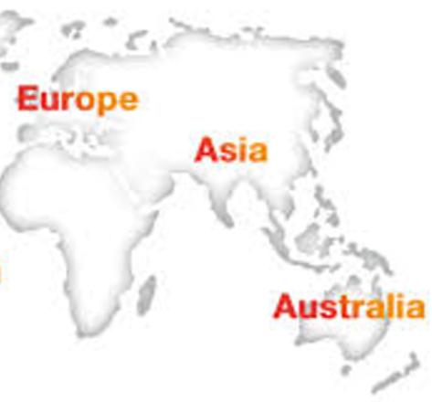
7 System Leadership Study
Australia
England
Hong Kong
Indonesia
Malaysia
Russia
Singapore

Slide 3
World Bank Rankings as at July 2015
ECONOMIES | REGION | INCOME GROUP | PER CAPITA INCOME
MALAYSIA | East Asia & Pacific | Upper Middle Income | $4126 - $12,735
INDONESIA | East Asia & Pacific | Lower Middle Income | $1045 or less
SINGAPORE | East Asia & Pacific | High Income Non- OECD | $12,736 or more
AUSTRALIA | East Asia & Pacific | High Income OECD | $12,736 or more
CHINA | East Asia & Pacific | Upper Middle Income | $4126 - $12,735
HONG KONG | East Asia & Pacific | High Income Non- OECD | $12,736 or more
RUSSIA | Europe & Central Asia | High Income Non- OECD | $12,736 or more
UNITED KINGDOM | Europe & Central Asia | High Income OECD | $12,736 or more
*

Slide 4
RATIONALE
This research study is a detailed and systematic comparative analysis of leadership development and leadership practice in seven different countries, Australia, England, Hong Kong, Indonesia, Malaysia, Russia and Singapore.
It examines how different programmes of leadership development are being designed and deployed as a deliberate strategy for system wide improvement and transformation.
The primary goal of this study is to contribute to the field of educational leadership and the knowledge base concerning educational improvement at the school and system level.

Slide 5
Data Collection Methods
Background & Contextual Data
Documentary Analysis
Performance Data
7SLS Survey
Semi-Structured Interviews
Focus Groups
Informal Observation

Slide 6
7SLS Survey
B1 = MODEL THE WAY
B2 = INSPIRE A SHARED VISION
B3 = CHALLENGE THE PROCESS
B4 = ENABLE OTHERS TO ACT
B5 = ENCOURAGE THE HEART
ALL 5 CONSTRUCTS
All B

Slide 7
Descriptive statistics of construct
Mean and standard deviations of the constructs
Constructs | Mean | SD
Model the way (B1) | 2.23 | 1.39
Inspire a shared vision (B2) | 4.95 | 2.01
Challenge the process (B3) | 3.90 | 1.95
Enable others to act (B4) | 5.65 | 2.12
Encourage the heart (B5) | 4.72 | 1.92
PLP (All B) | 3.10 | 1.58

Slide 8
Pearson correlation
Inter-item correlations of the study constructs
Constructs | 1 | 2 | 3 |  | 4 | 5
Model the way | -
Inspire a shared vision | .692** | -
Challenge the process | .671** | .721** |  | -
Enable others to act | .620** | .683** |  | .635** | -
Encourage the heart | .626** | .685** |  | .649** | .709** | -
PLP | .839** | .837** |  | .859** | .797** | .776**
**Correlation is significant at the .01 level (2-tailed).

Slide 9
One-way ANOVA results for principals’ leadership practices (All B)
on variables of qualification
Variables |  | df | Mean Square | F | Sig.
Qualification Between Groups Within Groups |  | 2 151 | 9.37 2.41 | 3.89 | .02*

Slide 10
Tukey Post Hoc Test results for Principals’ Qualifications
Qualification | N | Mean | I) Qualification | (J) Qualification | Mean Difference (I-J) | Sig.
Bachelor Master Doctorate | 83 65 6 | 2.93 3.17 4.73 | Bachelor | Doctorate | -1.80* | .02*

Slide 11
Emerging Findings : Leadership Preparation and Development (Harris et al, 2015)
No significant relationship between leadership training and leadership practices
A question mark over the return on investment i.e. impact
No relationship between qualifications and practice
Mismatch between what principals say they really want or need and what leadership training/development is provided.

Slide 12
Principals’ Experience Harris et al (forthcoming)
Greater ‘top down’ pressure upon principals to deliver school and system improvement;
Accountability and Austerity;
Fewer resources to educate those who need it most.
Increasing private sector involvement.
Recruitment and Retention Issues

Slide 13
7systemleadership@gmail.com
Thank you

