Slide 1
Assessment and teaching of 21 century skills
Patrick Griffin

Slide 2
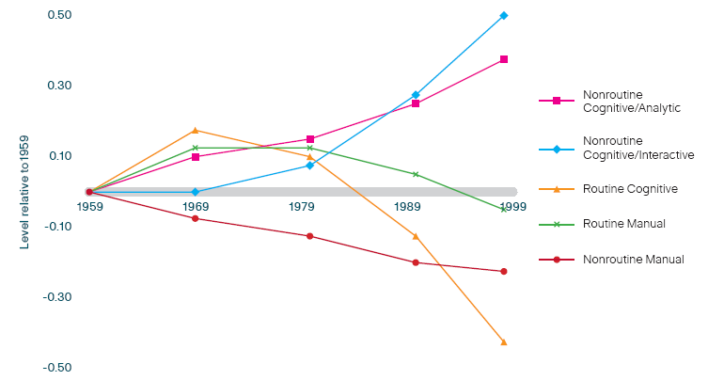
Changes in the labour force
U.S. measures of routine and non-routine task input
(Autor, Levy & Murnane, 2001)
Notes:
Autor 2001

Slide 3
Human capital
Human capital
formal education
literacy, numeracy, problem solving
Capital
Human capital
Information age: human assets
Industrial age: physical assets
Formal education
Literacy, numeracy, problem solving
21st century measure
Original measure

Slide 4
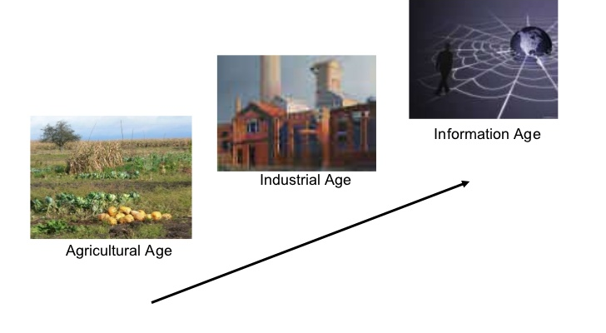
Change in assessment and teaching needed
Collaboration, creativity, communication, critical thinking,
Power and reward in sharing,
Accessing and evaluate information
Internet performance assessments
Information and literacy
Psychometric and standardised tests, MCQ summative assessments, sorting and selecting, rewarding knowledge
Read, write and arithmetic
Labour and capital;
?
Observation of performance
behaviours, skills, artisans
Land and religion
farm factory office internet

Slide 5
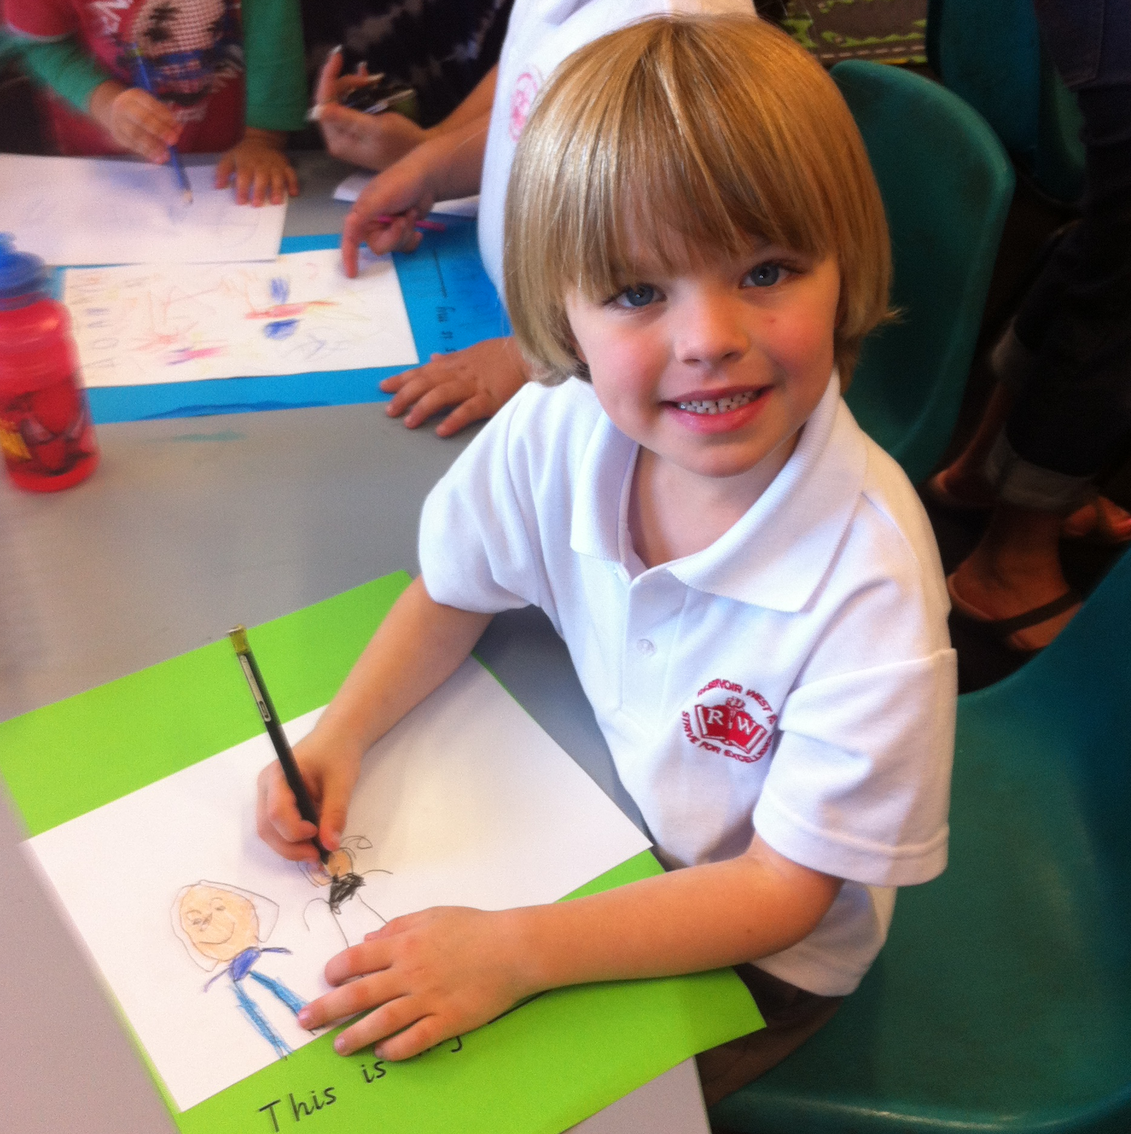
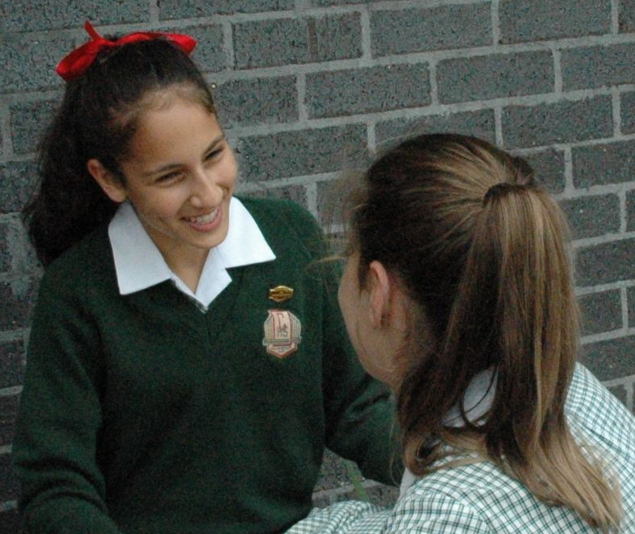
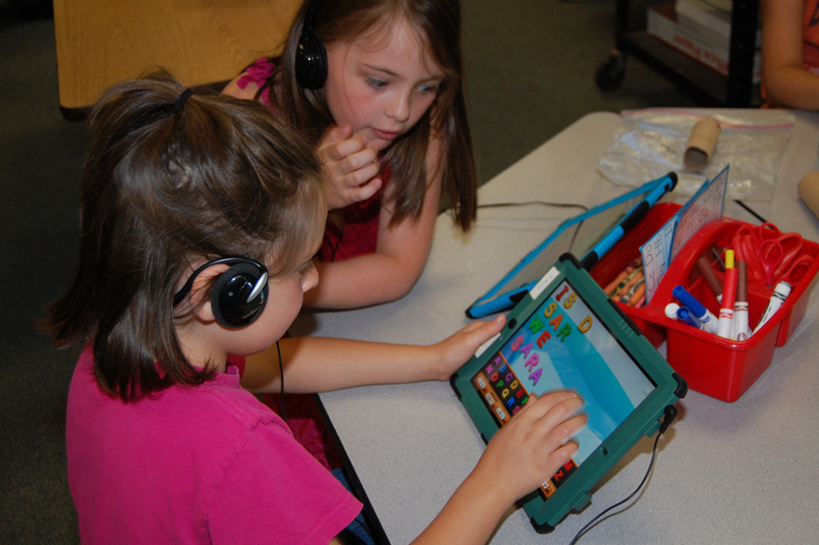
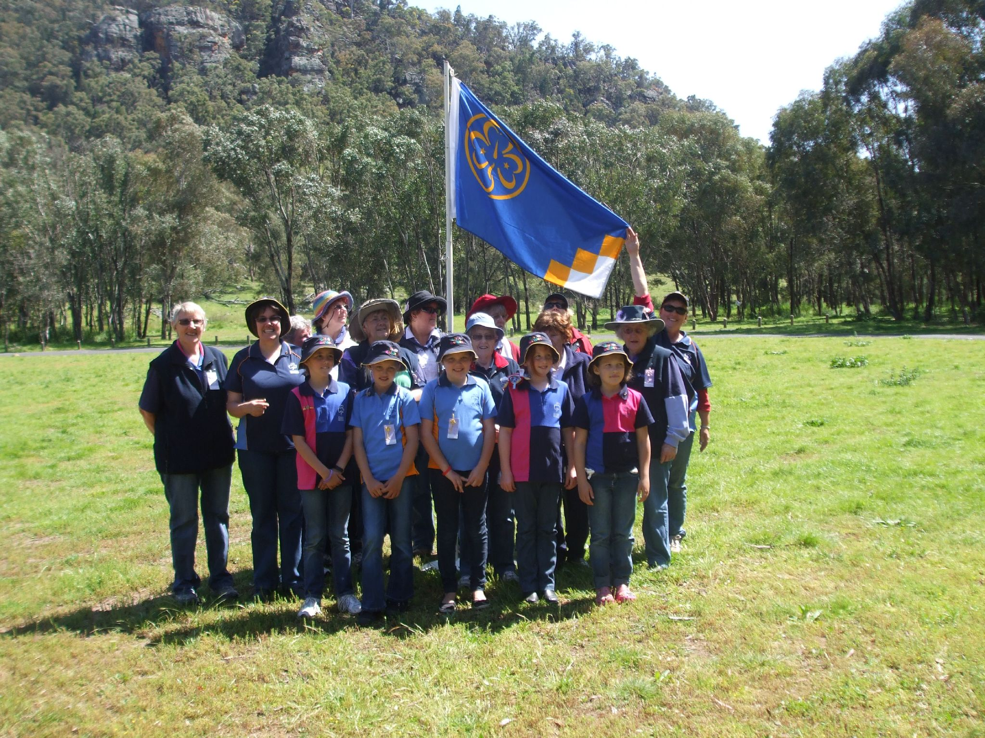
ATC21s - skills and technology influences
Ways of Thinking
  Creativity and innovation
  Critical thinking, problem solving, decision making
  Learning to learn and meta cognition
Ways of Working
  Communication
  Collaboration and teamwork
Tools for Working
  Information literacy
  ICT literacy
  Learning to learn and meta cognition
Living in the real world
  Citizenship, local and global
  Life and career
  Personal and social responsibility
Knowledge Skills Attitudes Values Ethics
Notes:
KSAVE represents the knowledge, skills, attitudes, values, and ethics of the 21st century. In sketching this out, the team of academics identified four broad areas of skills needed in the workplace. They wrote about new ways of thinking that included creativity and innovation, critical thinking, problem solving, decision making, learning to learn, and meta-cognition. They examined the skills needed for new ways of working through communication and collaboration. They discussed the tools for working in the 21st century, that required information literacy, ICT literacy. They raised our awareness, that living in the world in a 21st century requires local and global skills of citizenship, life and career skills and an acceptance of personal and social responsibilities.

Slide 6
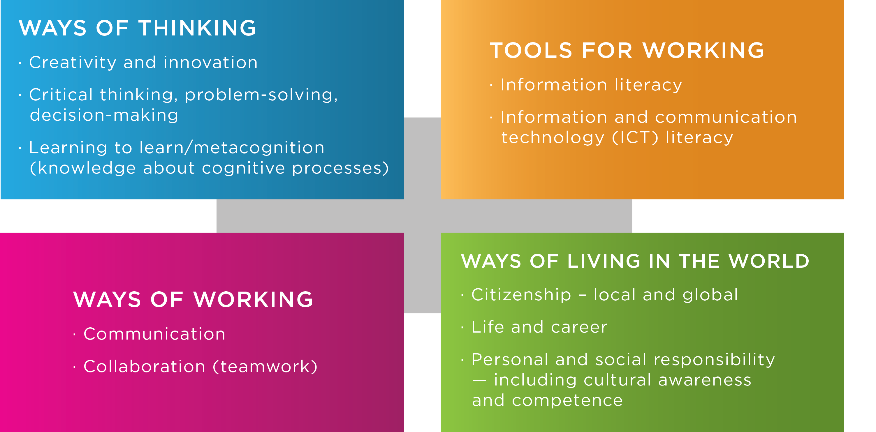
What is it about?

Slide 7

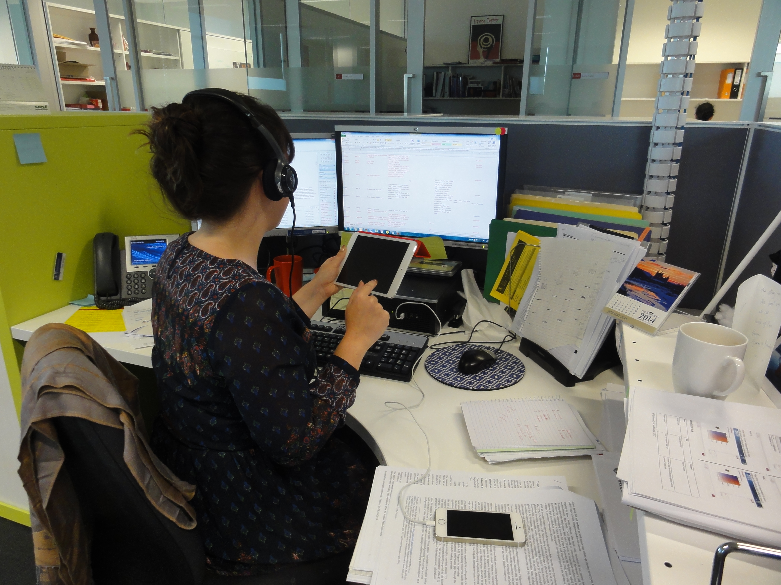
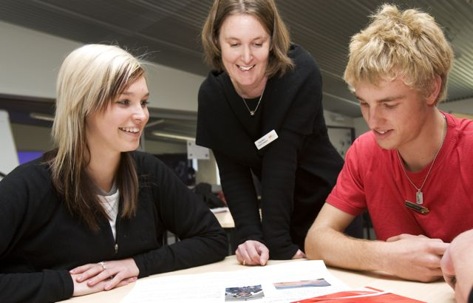
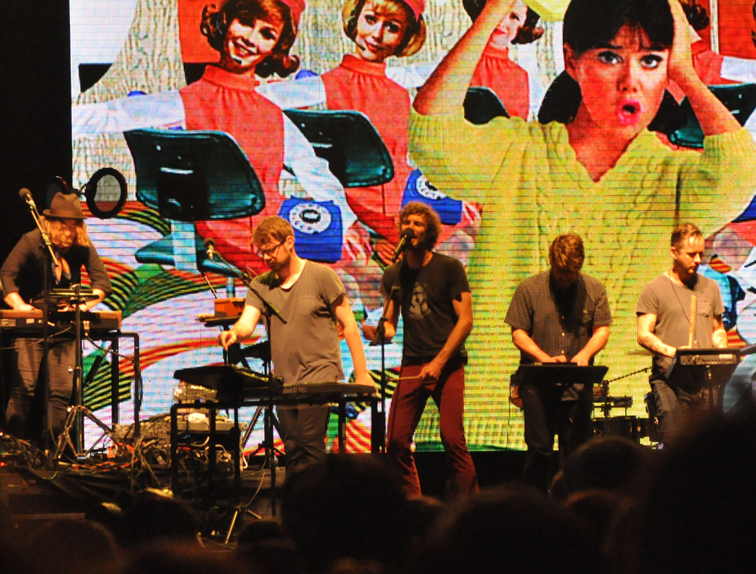
Collaborative Problem Solving
Learning
to
Learn
Critical Thinking
Problem Solving
Communication
Creativity and Innovation
Collaboration
COLLABORATIVE PROBLEM
SOLVING
Personal and Social Responsibility
Information Literacy
Life and Career
Citizenship
ICT Literacy

Slide 8
New skills for new workplace
The quality and excellence challenge
Education needs to prepare students…
  … to deal with more rapid change than ever before…
  … for jobs that have not yet been created…
  … using technologies that have not yet been invented…
  … to solve problems that we don’t yet know will arise
Notes:
But the challenge isn’t just to produce more of the same skills. Education is now so much more than accumulating and reproducing subject matter content. You can solve many conventional school tests today in seconds with the help of a smartphone. If you want your students to be smarter than a smartphone, you will have to enable them to create, mobilise, and share knowledge. In the fast-changing flat world in which we live, everything we call our proprietary knowledge today will be a commodity available to everyone else tomorrow. Value is less and less created vertically through command and control but increasingly so horizontally by whom you connect and work with.
Said differently, we are seeing a shift from a world of stocks – with knowledge that is stacked up somewhere depreciating rapidly in value – to a world in which the enriching power of communication and collaborative flows is increasing.
The challenge for education now is to foster
New ways of thinking,
New ways of working,
New tools for working,
And the capacity to live in a multi-faceted world as active and responsible citizens. Let me illustrate this with some data.

Slide 9
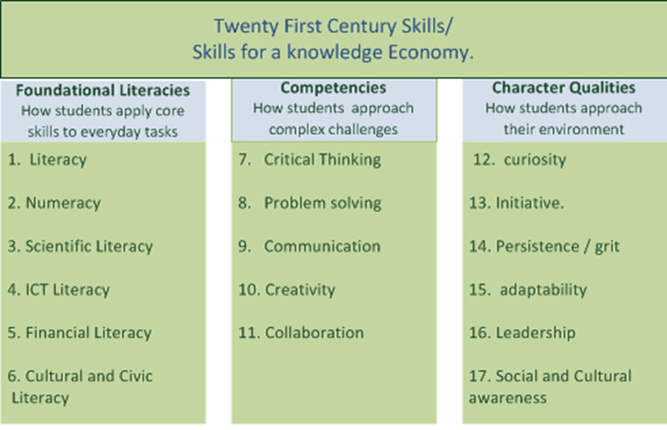
Boston Consulting -Global analysis

Slide 10
Economist research unit
Problem solving, team working and communication are the skills that are currently most in demand in the workplace.
Education systems are not providing enough of the skills that students and the workplace need.
Some students are taking it into their own hands to make up for deficiencies within the education system.
Technology is changing teaching practice and resource use, but education systems are keeping up with the transformation rather than leading it.
Study conducted in 26 countries and 19 business sectors

Slide 11
Individual vs collaborative problem-solving
Polya 1973 | PISA 2003/2012 | ATC21S
Understand the problem | Explore and understand | Collect and share information about the collaborator and the task
Devise a plan | Represent and formulate | Check links and relationships, organise and categorise information
Carry out the plan | Plan and execute | Rule use: set up procedures and strategies to solve the problem using an “If, then..” process
Look back and check | Monitor and reflect | Test hypotheses using a “what if” process and check process and solutions
Notes:
Assessment in 21st c

Slide 12
Collaborative Problem solving Assessment
Human to human
Students collaborate irrespective of location
Automated coding and interpretation of student performance
Instant feedback reports for students and teachers
Formative information on student ZPD for teachers

Slide 13


Online interactive assessment
Collaborative assessments

Slide 14
Social skills
Social skills
Participation
Perspective-taking
Social Regulation Skills

Slide 15
Participation skills
Action
Interaction
Task Completion
General level of participation
Difference in level of competence acting in a group
Responding or coordinating with others
Persistence
Motivational aspects

Slide 16
Perspective-taking skills
Responsiveness
Audience awareness
Ability to integrate contributions of collaborators
Tailor our contributions to the needs of others

Slide 17
Social regulation skills
Metamemory
Transactive memory
Negotiation
Ability to evaluate one’s own knowledge, strengths and weaknesses
Describe collaborative partners’ knowledge, strengths, weaknesses
Find ways to reconcile and accommodate differences
Responsibility initiative
Account for differences and then take initiative

Slide 18
Cognitive skills for CPS
Cognitive skills
Task regulation skills
Knowledge building and learning skills

Slide 19
Task Regulation Skills
Task regulation skills
Problem analysis
Goal-setting
Resource management
Flexibility and ambiguity management skills

Slide 20
Learning and Knowledge Building Skills
Learning and knowledge building skills
Information collection
Systematicity
Relationships
Contingencies
hypotheses

Slide 21
Contingencies and rules
Link information
Identify cause and effect
Communicate cause and effect
Establish and share simple rules
Solution

Slide 22
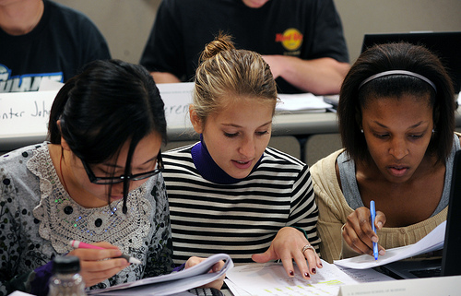
Hypothesis
What if we…?
Whether this happens seems to depend on that happening.
What about we try a different approach?

Slide 23
Skills and indicators
Element | Behavioural Indicator
Task regulation
Organises (problem analysis) | Analyses and describes a problem in familiar language
Sets goals | Sets a clear goal for the task
Resource management | Manages resources or people to complete a task
Flexibility and ambiguity | Accepts ambiguous situations
Learning and knowledge building
Collects information | Explores and understands elements of the task
Systematicity | Tries possible solutions to a problem and monitors progress
Relationships (represents and formulates) | Identifies connections and patterns between and among elements of knowledge
Contingencies – rules “if…then” | Uses understanding of cause and effect to develop a plan
Hypothesis “what if…” (reflects and monitors) | Adapts reasoning or course of action as information or circumstances change

Slide 24
Log stream files
Student | Online Conversation
B | how does this work...?
A | I’ve got to move the cameras
B | so YOU're moving the cameras?
A | I think we can both move the cameras; Can you?
B | i can't; i have to help ya out
A | Kay. just tell me your thoughts on where to put them then
B | just put the cameras and i'll comment
A | Im guessing there is a better way
B | i have to help you; you can't see the line-of-sight of the cameras, right?
A | hahah i dont know what Im doing. next time you should move first
B | lol
B | with the cameras that are supposed to cover the interior, dont position them in the exterior, cos they block the other cameras
A | better?
B | just move one to cover the left column
A | Wait that doesnt work
B | one more square; put another camera; to the LEFT of the top-left box

Slide 25
Dimensions
Collaborative Problem Solving
Social Skills
Participation
Perspective taking
Cognitive Skills
Task regulation
Social regulation
Knowledge building
1 | 2 | 5

Slide 26
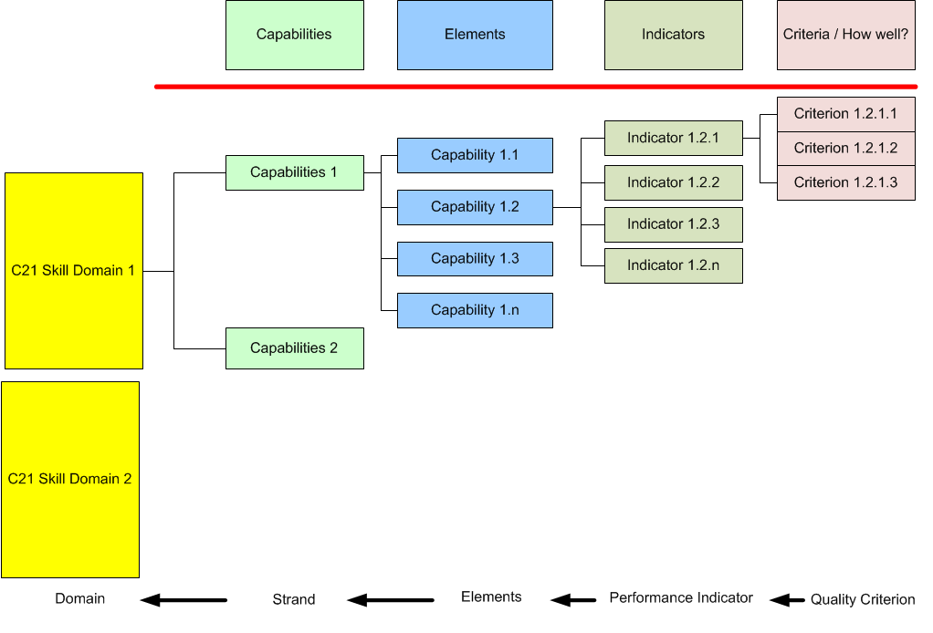
Interpretation Structure – rubrics

Slide 27
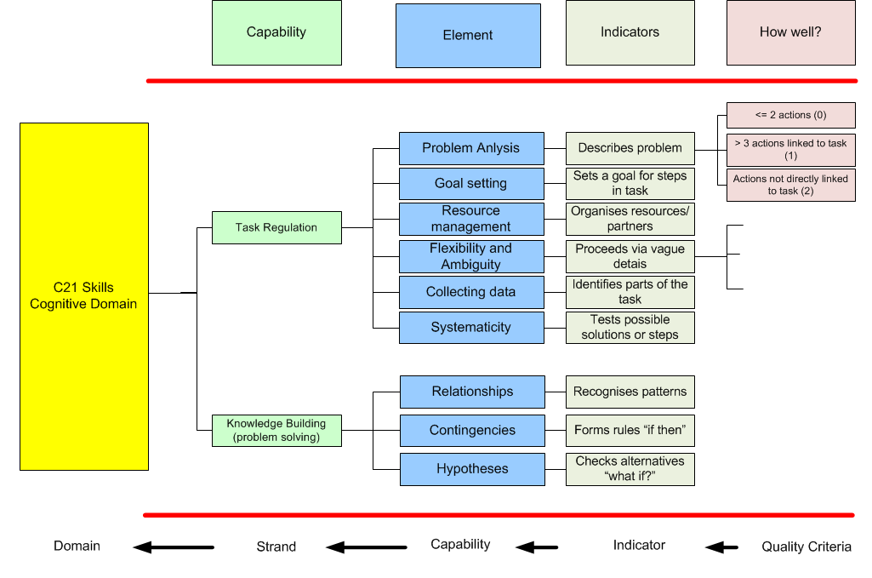
Interpretation Structure – rubrics

Slide 28
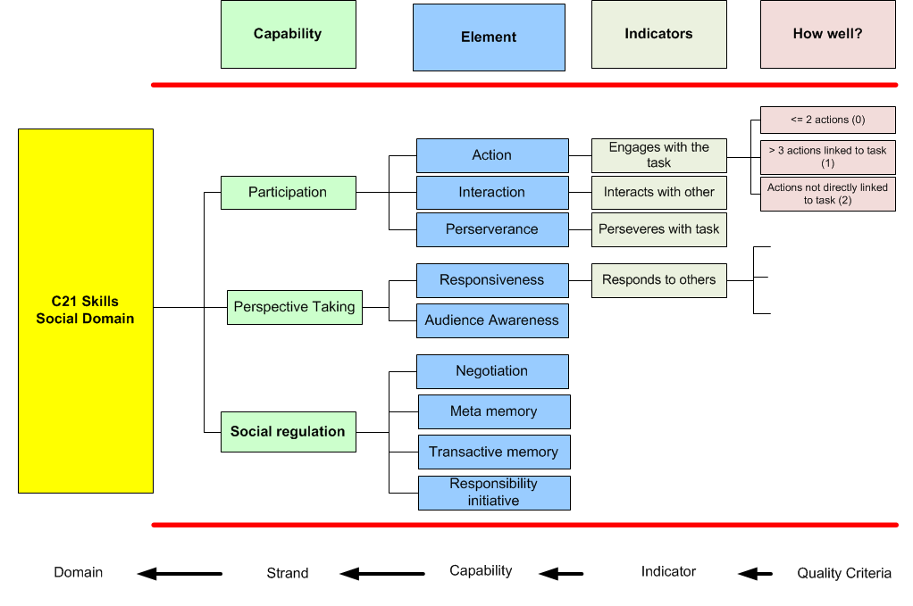
Interpretation Structure – rubrics

Slide 29
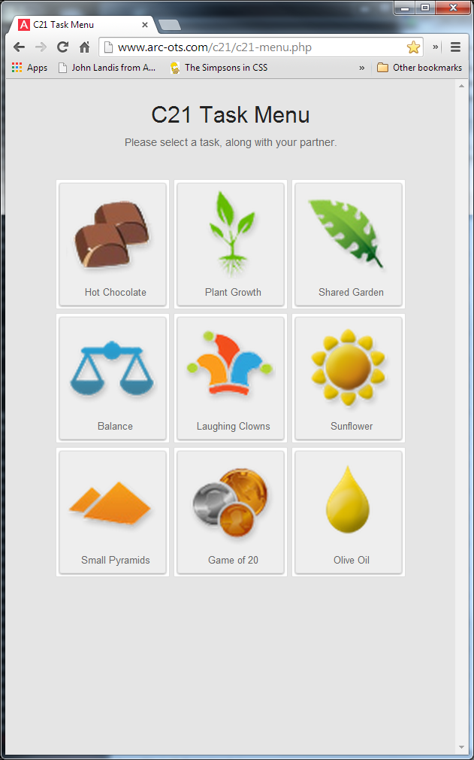
The dashboard – item bank (partial)

Slide 30
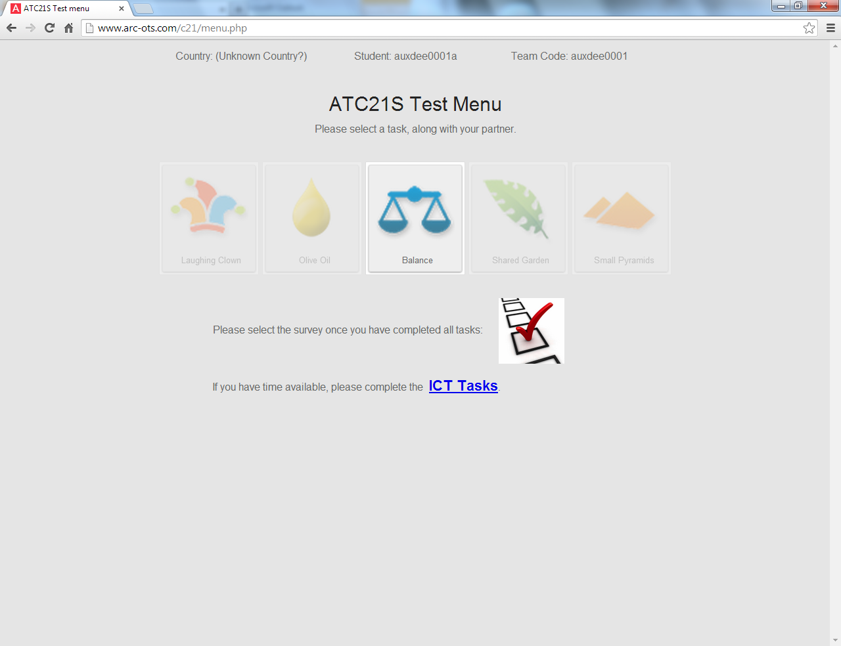
Sub tests

Slide 31
Defining a task – Clowns Example
Events & Processes established
Students are both presented with a clown machine, and 12 balls to be shared between them. The task is to work out whether their two clown machines work in the same way.
The students must place the balls into the clown’s mouth while it is moving in order to determine the rule governing the direction the balls will go (L,M,R/1,2,3).
Each student must then indicate whether they believe the two machines work in the same way or not.
Student A Student B

Slide 32
Defining a task – Clowns Example
Graphical components outlined
Find patterns, form rules and form conclusions.
Share information and discuss the rules, negotiate allocation of resources.
Symmetrical
Shared resources
Solution dependent on collaboration
Single page
Student A Student B
Student B

Slide 33
Defining a task – Clowns Example
Event | Data | Comments
Start | Task started is 103 | Indicates the start of task
Action | startDrag:ball12:535:85 | The ball was picked up
 | stopDrag:ball12:535:85 | The ball was dropped (reset back to intial position)
 | dropShuteM:ball11:824:136 | This shows that the ball was dropped, "Shute"__ where __ indicates position of clown's mouth. Ex., L=left, M=middle, R=right
 | radioSelection:1 | This shows A/B's answer. 0=machines are the same, 1=machines are different
Chat | im finished | When event column is "chat", data column shows the actual message written by the students
FInished | Student pressed the Finished button | indicates the end of the task

Slide 34
Element | Behaviour | An example of data captured for assessing
Interaction | Interacting with partner | Presence of chat before allowing partner to make a move
Audience Awareness | Adapts contributions to increase understanding for partner | Number of ball moves attempted before stopping and waiting for partner to move or respond
Responsibility initiative | Takes responsibility for progress for the group task | Number of times communicated with partner before the first half of the shared balls were used up
Resource Management | Manages resources | Realises that balls are meant to be shared and uses only allotted half
Systematicity | Implements possible solutions to a problem | Uses the allotted half of the balls to cover the positions in a sequential order
Relationships | Identifies connections and patterns between elements of knowledge | Both students coming to an agreement on how their machine works
Solution | Correct answer | Selection of the correct option by A and B on how their machine works

Slide 35
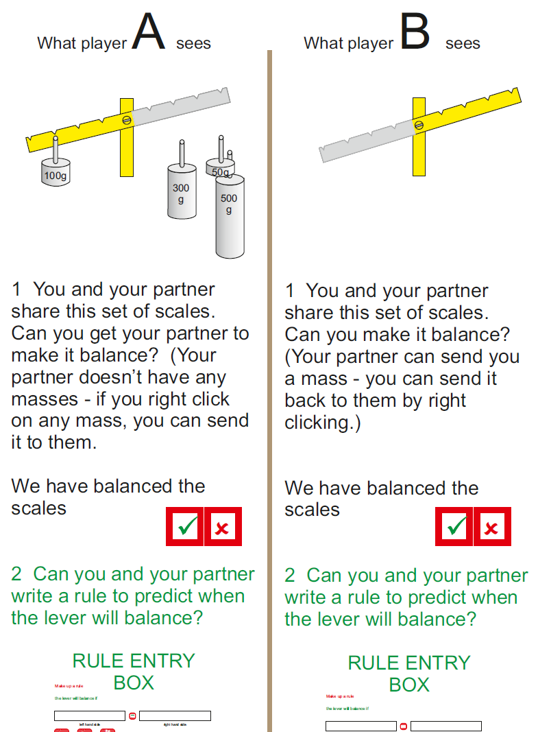


Collaborative problem solving
Notes:
Tasks relying on more and less school-based learning
Examples of two tasks in the maths/science area and then one content-free task

Slide 36
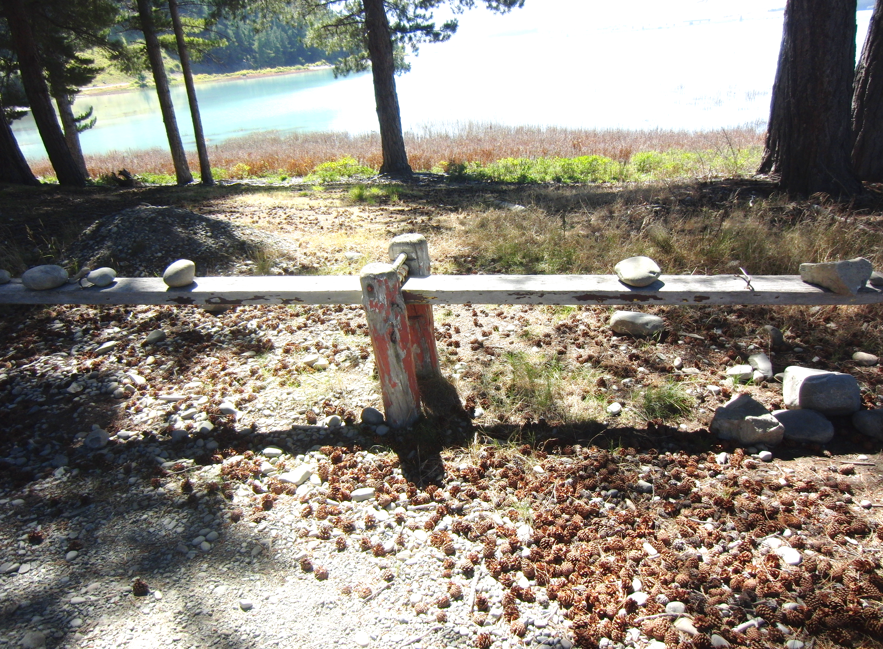
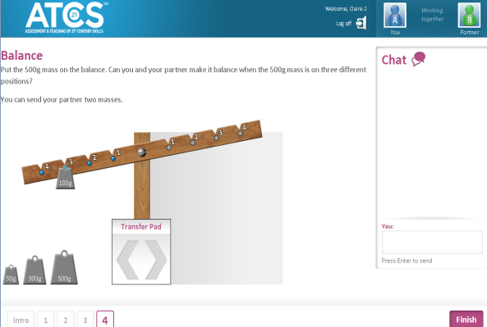
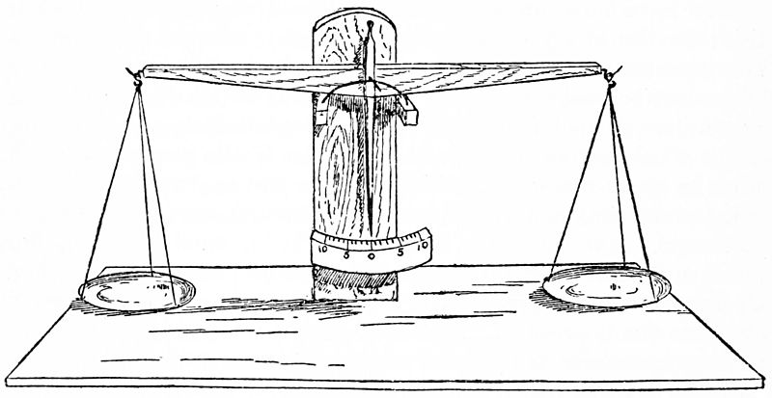
Curriculum based- Science

Slide 37
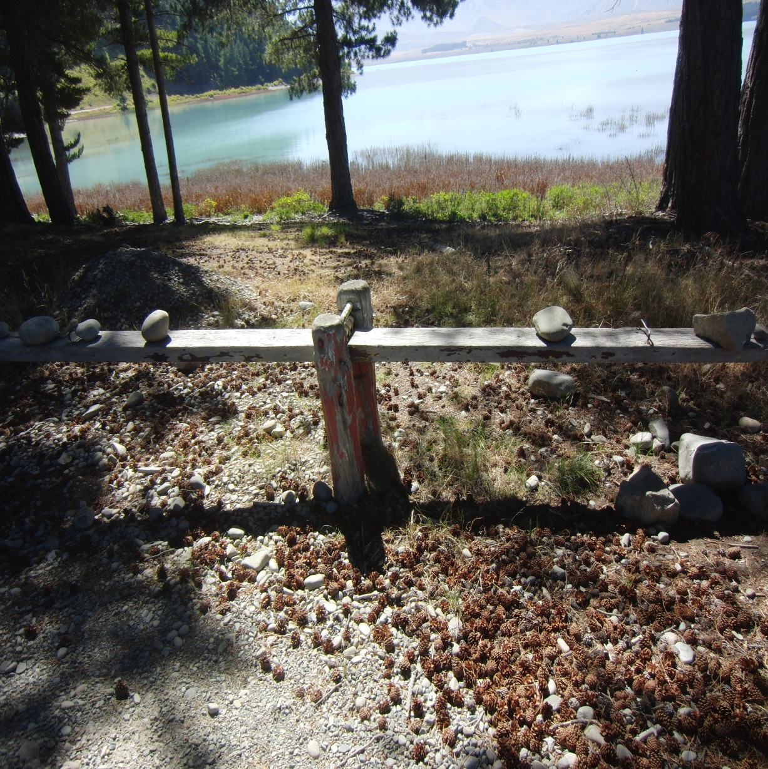
Non-technology example
Part
Content
In the playground…
What do the players have to do to solve this?
‘what are the steps?
How generalisable are these steps?
Part

Slide 38
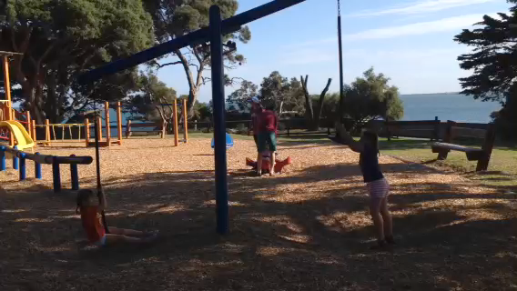
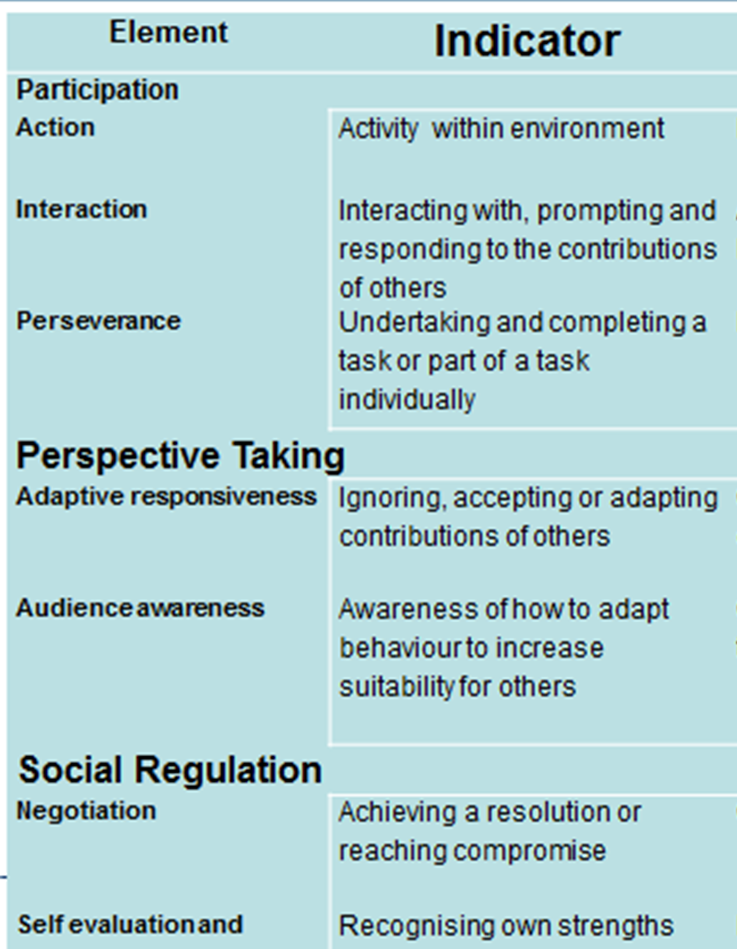
Collaborative problem solving in the Park
Notes:
These two good friends (X and Y) are playing in the playground. They have a problem. Can you see what it is? Can they see what it is?
07,
15,
17,
20 trying to jump for you)
33 have an idea jump together
38 close negotiation
44 plan into action
48 still some resolution
They do indeed understand that there is a problem. Moreover they are able to discuss the problem between themselves. They haven't invited anyone else to come and help with solving the problem at least not at this stage.
Clearly they are both very active in trying to find a way to resolve the situation. Each of them is active and they are responding to one another and interacting as well by exchanging ideas suggestions and talking about how things worked or did not work. We eventually find that they persisted until they were able to solve the problem.
One of the things about collaboration is that people have to be aware of the people are working with. We don't necessarily have to be in the same playground or in the same sandpit. But we do have to be aware of the other people and what those other people in this case the good friends are trying to do to contribute to solving the problem. This responsiveness means that each of us will adapt our behaviour to work towards a solution once we understand what we can contribute and what the friend is going to contribute.
It is also essential that each of these two good friends is aware of the kinds of things that the friend or partner is able to do to help solve the problem and therefore each of them adjust what they do to make sure that they're not in conflict.
This avoidance of conflict means that each one of them makes a suggestion on the other evaluates that in a kind of informal way before responding and making their own suggestion or adjusting what they would do themselves if if we jointly contribute ideas towards the solution we will have a win win situation. These two good friends clearly understand the idea of win-win without any formal translational use of that language.
It's also clear that they each recognise their own limitations in strength, jumping ability, ability to explain the situation to the other, but there is a determination to succeed. This awareness of themselves and their weaknesses and strengths becomes combined with their view of their friend each of the fence has strengths and weaknesses and some of the suggestions are making use of those observations.
After a while, one of them takes the lead and makes a suggestion I'll count to 3 and will jump together. The other one responds completely to this and agrees and even contributes to the count. This responsibility and showing initiative is part of the group work in solving a problem collaboratively.
So they have a look at what the situation is. They try to see how things relate when different actions are taken. That in a way to a very systematic analysis of the situation. They understand that if one side goes down due to the weight of someone sitting on the chair the other side goes up and out of reach. They understand that even if they pull it down they can't have enough strength to hold it down and sit on the seat. Clearly there has to be another way to do it. They understand that every time a pool one side down the other side goes out of reach. This is a very general rule or a generalisation that they clearly understand.
So they start by exploring possible solutions and setting goals. They do suggest you hold it down and I'll jump on but that doesn't work. They then come to the realisation that they need to have the seats at the same height and that they need to get into the seat simultaneously. So once this moment to Kirsten aha is what we call these moments, they start to devise a systematic plan and set goals that will enable them to resolve this situation.
So now once they go have this goal in mind, each of them can manage the resource that they have (i.e. the rubber seat) and they need to bring the two seats to be level the same distance from the ground. This becomes a way that they manage and take control of the resources that they have one of which is the seat the other is their self belief and their belief that their partner and jump in time and high enough to get onto the seat. So they're both evaluating their own strengths and weaknesses and those of their friend in solving this problem.
They need to believe that their partner can do what is needed. And they need to believe that they can do it. Moreover they need to be flexible because if this doesn't work they have to find another solution. Can you see the possible solution resources in the background?
So in a way they begin to systematically collect information that will enable them to solve the problem. The need to know how high they themselves can jump and how high their friend can jump. They need to know how to arrange the seats to be at the same height. These are fairly obvious and it stretching the point a little but it does show that people do need to understand the task understand the elements and the information that they need to collect; and be able to organise the data in order to make decisions these two good friends have done this very well indeed.
They then discuss and develop a plan of action that would lead very systematically to the resolution of the problem. They have ceased to be trialling and error. They now want to set about very strategic plan that will lead to the solution of them both on the swings at the same time. This is being systematic.
While event testing ideas they've learned quite a bit. They know for sure that if one of them pulls down on the seat the other one goes up and out of reach. This is a regular pattern that occurs each time. It could almost be called a rule that they need to take into account when trying to solve the problem. They don't have too right down the rule because they can see it intuitively. They've also begun to understand that if they can get the two seats at the same level they have a really good chance of being able to jump together according to their plan on the count of 3 to be able to balance and sit on the swing together. What else could they have done? Other other ways that they could have solved it? Do they even look for other ways to solve the problem?
Finally one, two, three – jump! Each on a seat! The problem is solved using a very simple process. Squeals of delight illustrate that it was a problem that they needed to resolve it that they had to do lots of very systematic learning and that they were able to collect, interpret and use information about themselves, about their friend, about the swing, and in a lovely way about the physics of the situation. But the nice thing is they didn't need to be a physicist, or any kind of scientist they simply had to reason their way around the problem find a solution.
So they recognised the problem was bringing something to a balanced set of circumstances or equilibrium. They were active, interactive and persistent. They were both aware of what their friend wanted to do and how well their friend understood the situation as well is being able to respond to suggestions and activities that their friend was showing.
Once they had an idea of how to proceed each of them was able to negotiate with the other one. They were able to make suggestions for progress in solving the problem by understanding their own limitations and strengths as well as the limitations and strengths of their friend. Each of them then was a capable and willing to take responsibility and even take the lead show initiative.
So these were the kind of social skills that they were exhibiting in addressing the problem of the swing in the playground.
There were several problem-solving skills and abilities on display as well! They were making a mental note of what happened when they lifted or lowered their seat. They were watching how sometimes their partner could not act because they had taken action that would prevent their partner being successful. All of this meant that they were intuitively and quietly collecting information that help them understand the situation and to be able to formulate a plan to solve the problem. In order to do this they are needed to understand how one action led to another and how the rules of behaviour and rules of action and reaction or cause and effect implied that certain actions should be taken and others should not be taken. Clearly they would not be required or probably would never write all this down but if we're teaching in this area that's the sort of thing would that we would take to help this children understand another problem or another one later on. They had to be flexible and make adjustments to what they wanted to do according to how they saw their friend being able to solve the problem. They need to be sure that they could control the height of their seat if we are ever going to solve the problem. They couldn't just randomly run around trying to solve the problem they needed a systematic plan or a strategic plan to resolve the great swing in the playground problem. All of this systematic behaviour and learning that was occurring helped everybody come to a solution.
They had to understand the cause and effect, they needed to put their own plans into action is because of this understanding of cause and effect and when this realisation occurred they could formulate a plan to solve the problem. Maybe we can see if they could solve it in a number of different ways.
They recognise they have a problem that impeded progress of the group
A problem – a state of disequilibrium that has to be resolved before the group an progress
Recognition of the problem
Agreement on the nature of the problem
Exploration and goal setting
Agreement on the nature of a solution
Look for the elements
Social (collaboration)
Participation
Activity levels - both very active and participating
Interaction – lots of discussions and exchange of views
Persistence and task completion have to wait to the end to see this but then only one solution tried. Can you see others
Perspective taking
d. Adaptive responsiveness (changing own behaviour in response to others)
e. Audience awareness (understands what the friend is trying to do but at times fails to connect pieces of information
Social regulation
f. Negotiation (17) lets try and see if it works.
g. Meta memory ( own weakneeses changing efforts
h. Transactive memory frields weaknesses and sterngths m\leadsa to suggestions and change
i. Responsibility initiative taking the lead or respondint to the lead suggestions
Cognitive (Problem solving)
Task regulation
j. Problem analysis – organisation nature of the problem clear
k. Set goals discusses possible solutions and sets simele goal – jumop toigether)
l. Resource management each trying to coontrol the swinig to help th firend
m. Flexibility and ambiguity able to chnge when tngs go awry
Collect information what is poiissbile- das\d in backgroiund; possible ways to solve
n. Systematicity lets to it together getting a little cross nbbiut focused on solution
Knowledge building and problem solving
o. Relationships –represents and formulates – organises data if we ….then…
p. Rules and contingencies lets see if the jump together will work
q. Generalisations and hypotheses what is we try jumpinig together 1m2 3 jump squuel in dleight- if ny all our probles could be sdolved like that@

Slide 39
Skill examples
video
Strand | Element | Description | Students Behaviour
Participation | Action | Activity within environment | Student A passes student B a mass
Participation | Task completion/ perseverance | Understands task | Student follows the instructions of the task, student understands scales must balance
Perspective Taking | Responsiveness | Responds to contributions of partner/s | Student B responds to incorrect masses sent by partner, by sending back 50g when it doesn’t balance
Task Regulation | Sets Goals | Set goals for task | Student asks where partner puts mass in anticipation of needing that information later
Task Regulation | Collects information | Collects information | Student asks partner when unsure or needs more information

Slide 40
Skill | Behaviour | An example of data captured
Action | Active in scaffolded environments | Student A passes B a mass
Task Completion | Undertaking part of a task individually | Follows instructions, moves 100g to position 4
Responsiveness | Responding to contributions of others | Realising that some masses cannot balance. If Student A resends 50 or 500, B returns it immediately
Sets Goals | Sets goals for a task | Requesting mass amounts
Systematicity | Implements possible solutions to a problem | Trying out of different combinations of masses on different beam positions
Solution | Correct answer | Number of successful balances achieved (3 optimum)
Balance Beam
Insert screen recorded video
Part

Slide 41
Olive oil
video

Slide 42
Game of 20
video

Slide 43
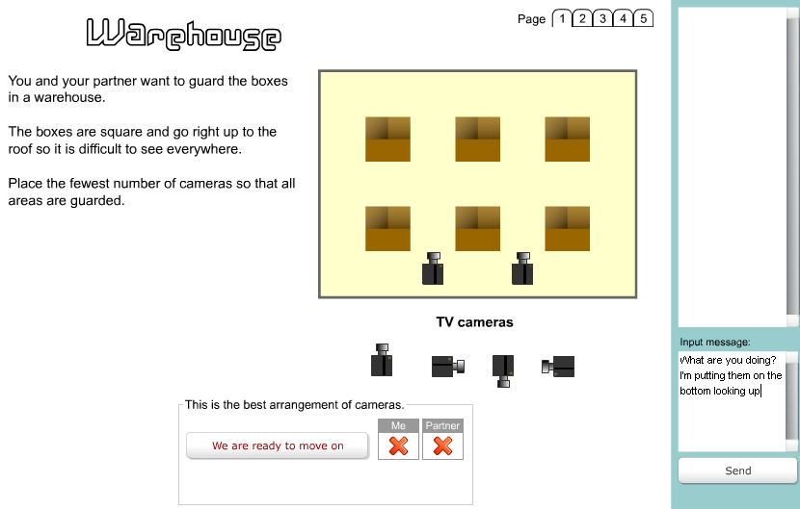
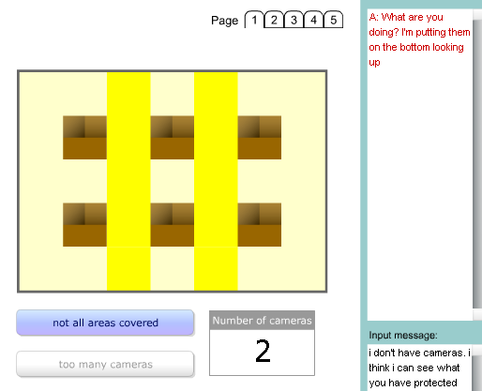
Collaborative problem solving

Slide 44
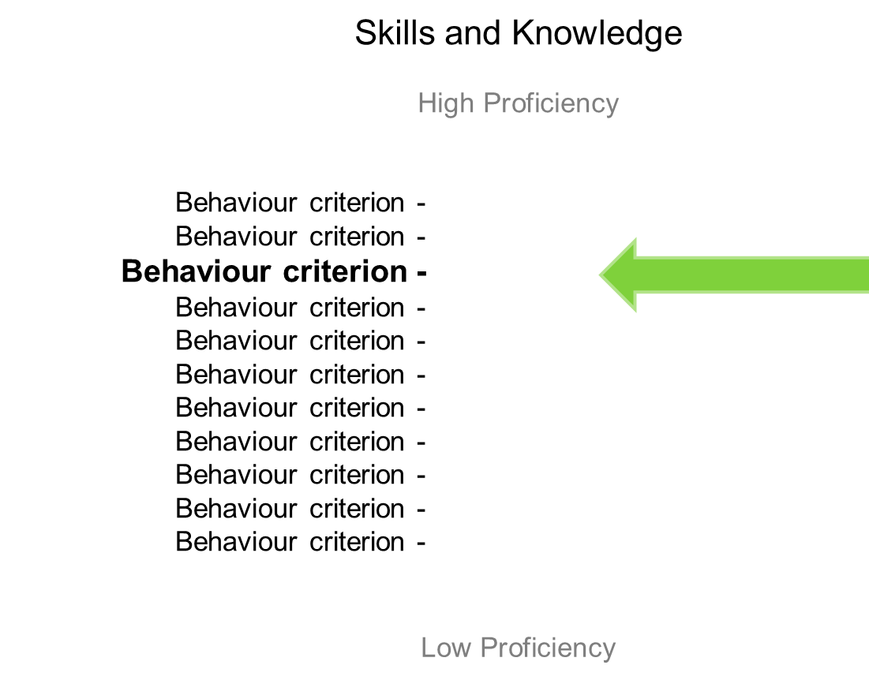
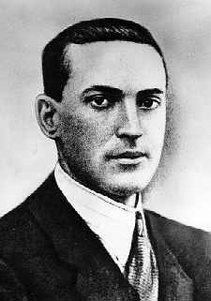
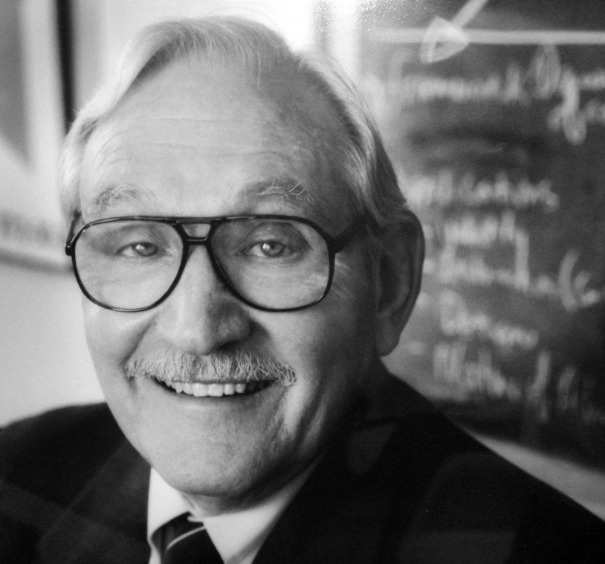
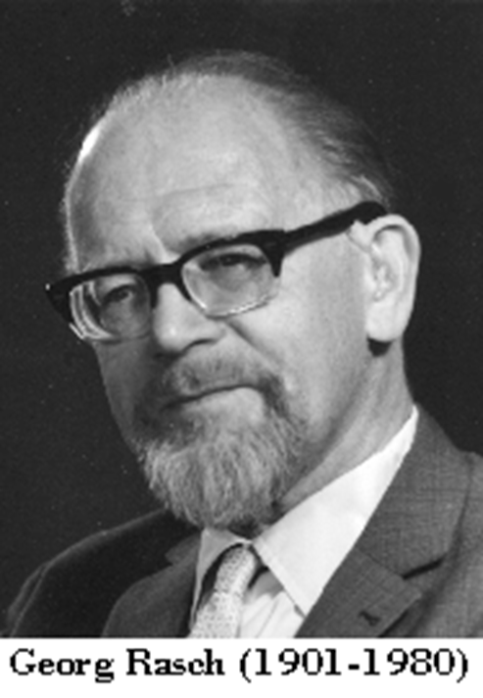
Three Theorists combined
Glaser
Criterion-referenced interpretation
Rasch
Linking task difficulty and person ability
Vygotsky
Zone of Proximal Development

Slide 45
Cognitive Behaviour
Social Behaviour
U2L001A = presence of chat before any action
U2L00 4A = All positions have been covered (providing player had access to 3 balls)
U2L006A = sequential placement of balls -6 combinations
LMRLMR
RMPRML
RMLLMR
LMRRML
LLMMRR
RRMMLL
ATC21S Assessment and Teaching of 21st Century Skills
The University of Melbourne • Cisco • Intel • Microsoft • www.atc21s.org

Slide 46
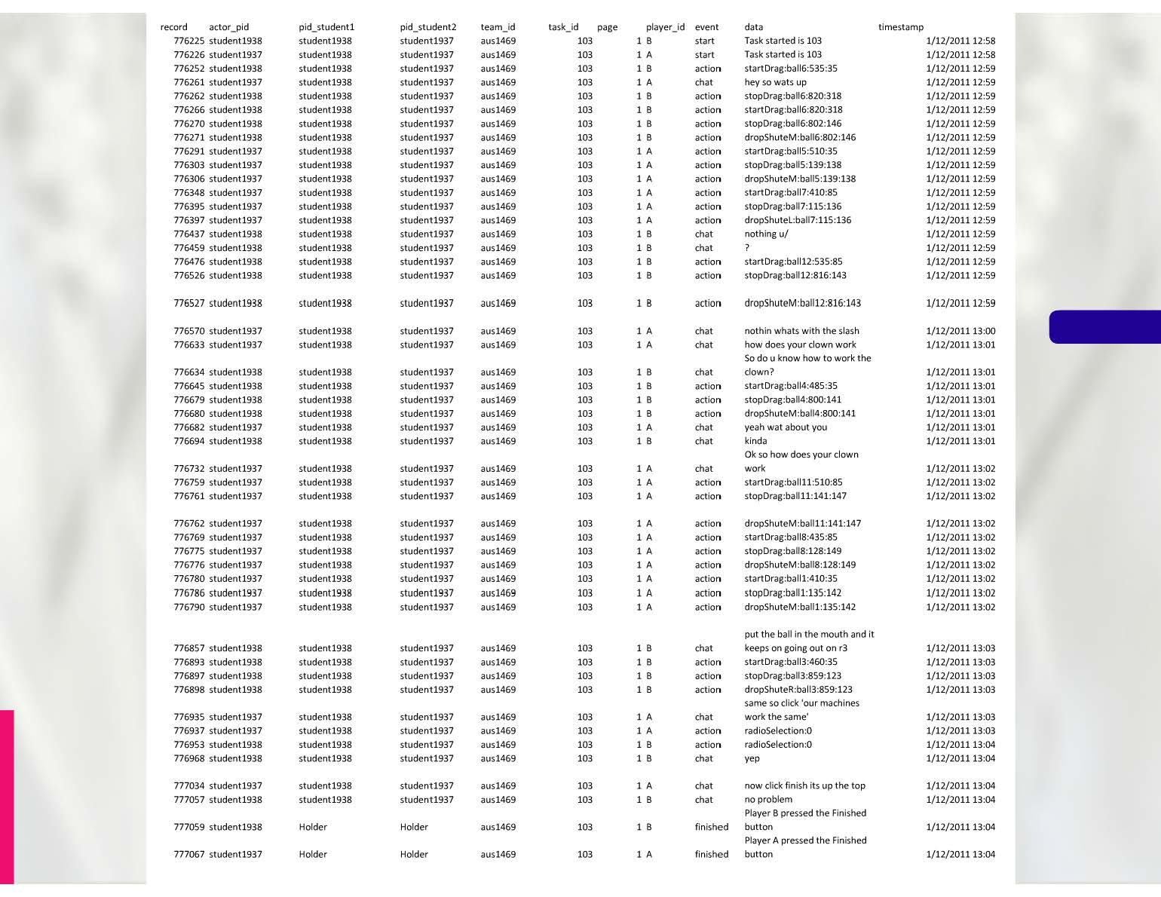

Slide 47


Slide 48
Example variables- Clowns Task
Examples of indicators (all applicable to students A & B in this task)
U2L001 | Awareness of partner’s presence | Presence of chat before any moves/actions
U2L003 | Realises that balls are meant to be shared | Using only allotted half of the balls. Actual number of balls used. Threshold number = 6 or less.
U2L004 | Systematic approach | All positions have been covered (provided player has at least 3 balls)
U2L005 | Systematic approach | Using 6 balls or less + all positions have been covered
U2L007 | Interaction [specific location, early in task] | Number of chat before all balls have been put in (1st half window, between 1st ball and 6th ball have been put in)
U2L008 | Interaction [specific location, late in task] | Presence of chat after last ball has been put in and before answering
U2L009 | Consensus | Same answer for both players

Slide 49
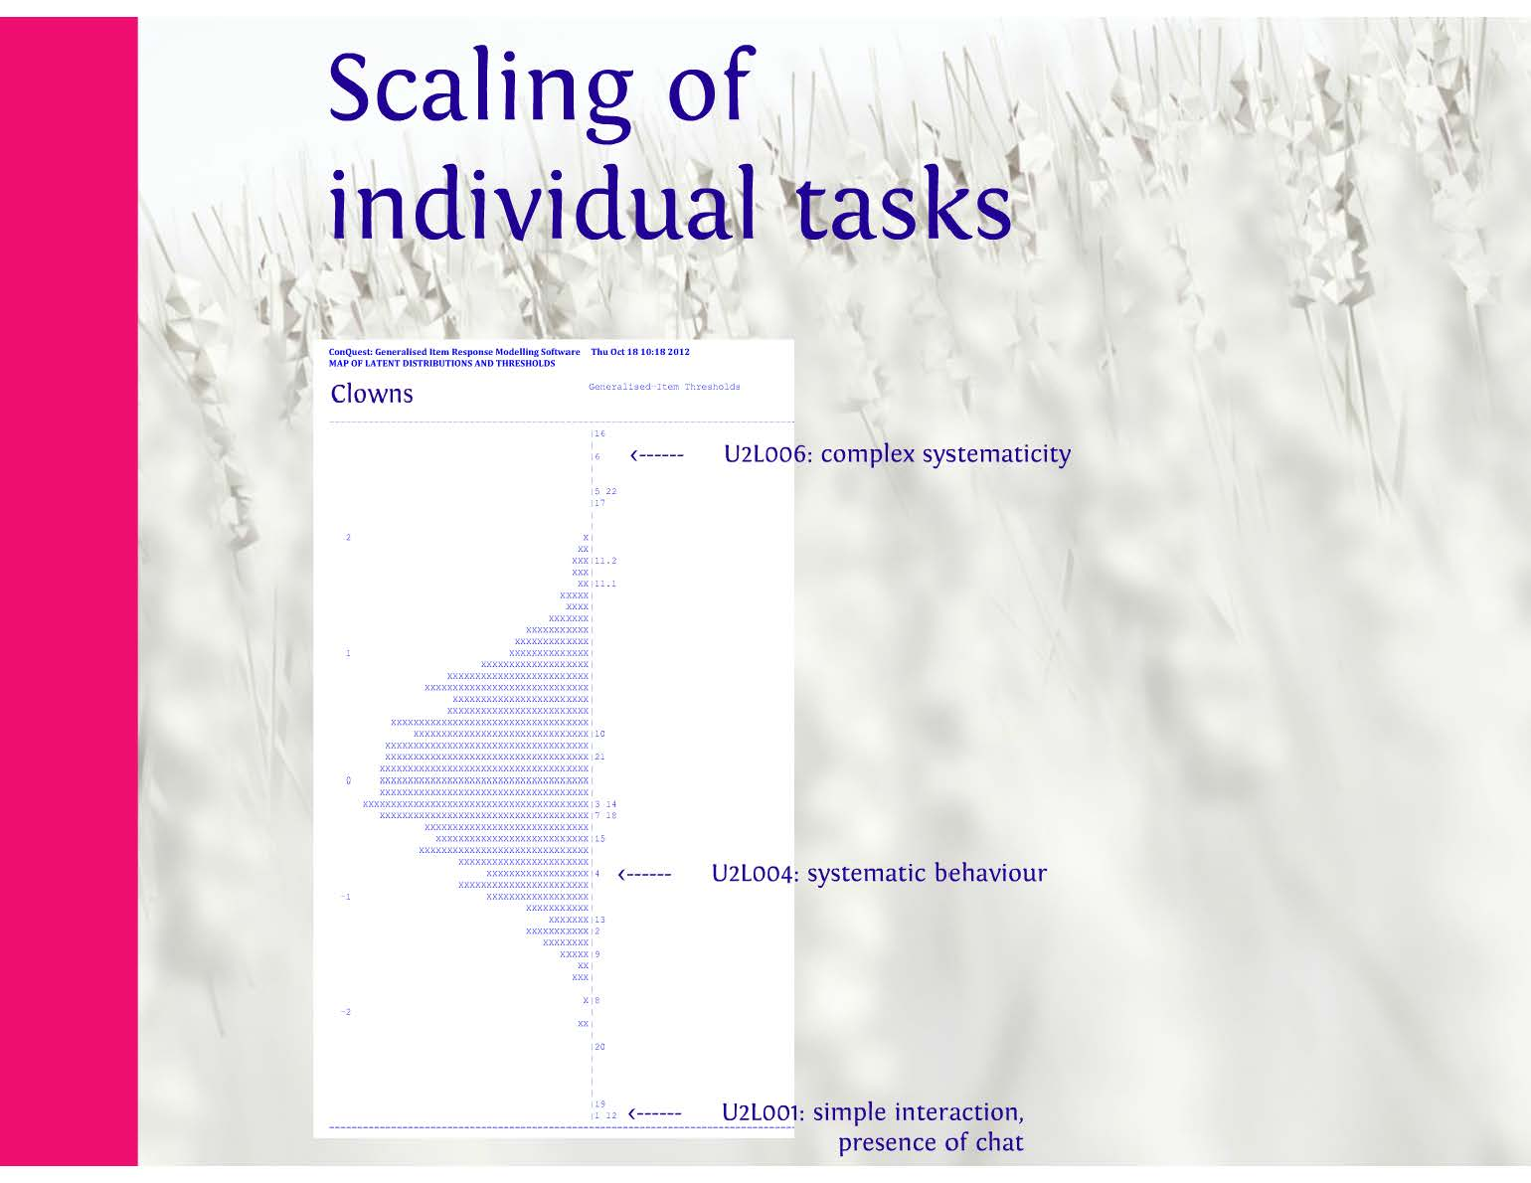
Single task calibration
Complex systematicity
Systematic behaviour
Simple interaction – presence of chat

Slide 50
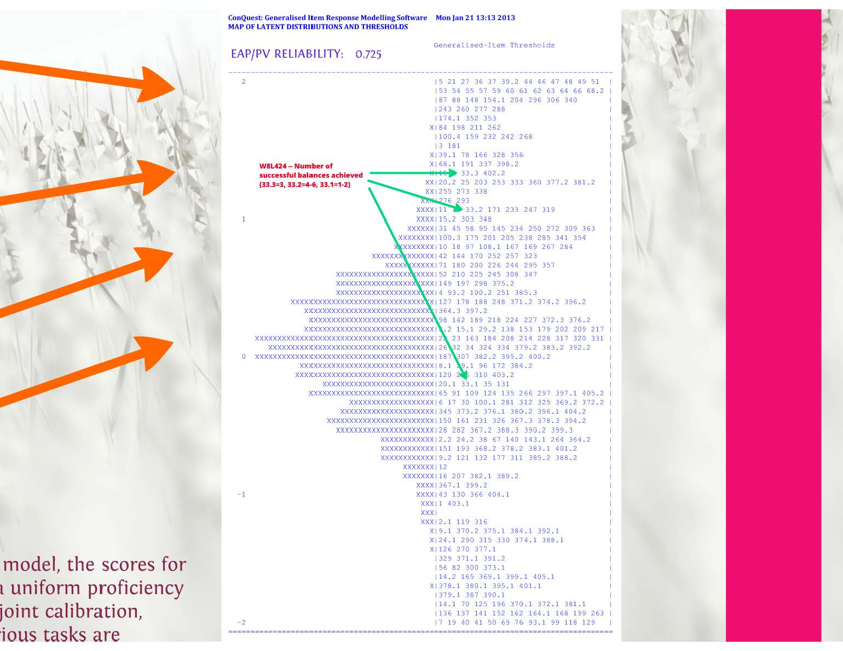
Balance
Clowns
pyramids
g20
Using partial credit Rasch model indicator scores for all students snd vindicators were concurrently calibrated

Slide 51
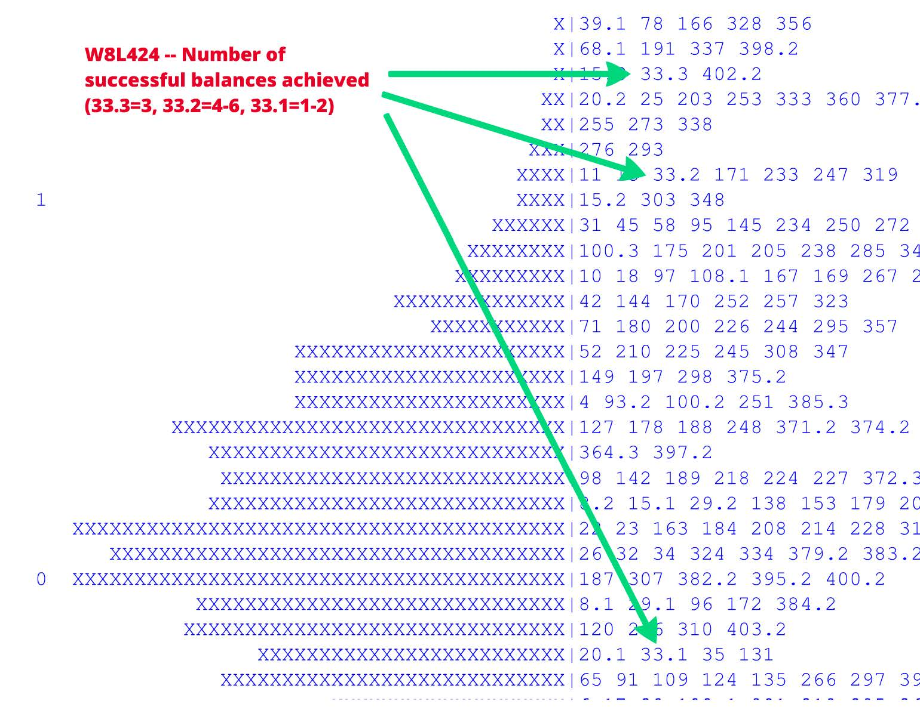

Slide 53
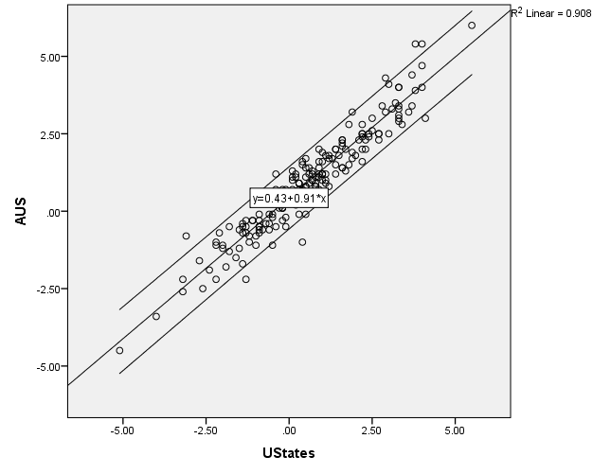
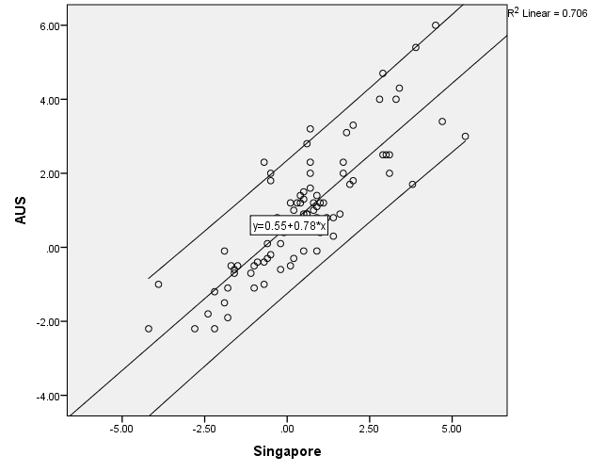
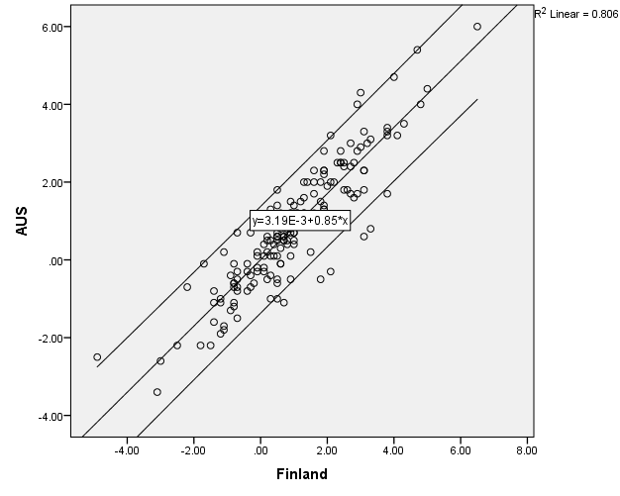
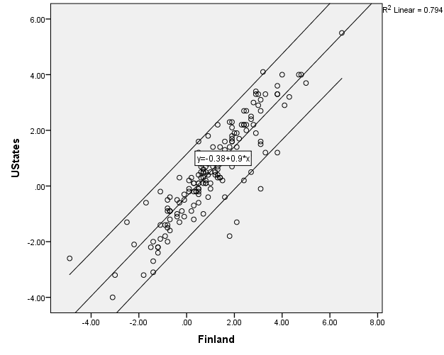
Parameter stability

Slide 54
- cognitive

Slide 55
Using a developmental progression
Student name:
Collaborative Problem Solving – One Dimension
Level | Level Title | Level Description
6 | Strategic approach to problem via a collaborative process | The student works collaboratively through the problem solving process and assumes group responsibility for the success of complex tasks. The student works through the problem efficiently and systematically using only relevant resources. They tailor communication, incorporate feedback from their partner and resolve conflicts.
5 | Efficient working partnership | The student’s actions appear planned and purposeful, identifying cause and effect and basing their goals on prior knowledge. The student promotes interactions and responds to their partner’s contributions but may not resolve differences. They adapt original hypotheses and uses suitable strategies to gain a correct path solution for more complex tasks.
4 | Cooperative planning | The student perseveres, through multiple strategies, to successfully complete subtasks and simpler tasks. They have developed awareness of their own and their partner’s performance abilities. They strive to achieve common understanding and increase co-working by planning strategies and refining goals with their partner. The student adopts a sequential approach and can identify connections and patterns between multiple pieces of information.
3 | Awareness of partner & directed effort | The student recognises their partner’s significant role in solving the problem and demonstrates effort towards solving the problem. They realise they do not have all the required information and begin to share resources and information with their partner, but with no regard for relevance. They report their own activities and make contributions for their partner’s understanding.
2 | Investigating the problem | The student attempts to better understand the problem through limited analysis. They assess and utilise their own resources, begins testing hypotheses, and generating broad goals. Interaction with their partner is limited to significant events.
1 | Independent inefficient exploration | The student explores the problem space independently with no evidence of collaboration. Their approach is unsystematic and focusing on isolated pieces of information. Interaction with their partner is limited to brief acknowledgements.

Slide 56
CPS developmental progression – 2 dimensions
Level | Level Title | Social | Level Title | Cognitive
6 | Cooperation & Shared Goals | At this level, the student works collaboratively through the problem solving process and assumes group responsibility for the success of the task. Feedback from their partner is incorporated and used to identify solution paths or modify incorrect ones. The student can evaluate their own and their partners performance and understanding of the task. The student may tailor their communication and manage conflicts with partner successfully, resolving differences before proceeding on a possible solution path. | Refined Strategic Application & Problem Solving | The student’s sequential investigations and systematic behaviour require fewer attempts for success and are completed in an optimal amount of time. The student works with their partner to identify and use only relevant and useful resources. The student has a good understanding of the problem and can reconstruct and/or reorganise the problem in an attempt to find alternative solution paths.
5 | Appreciated & Valued Partnership | At this level, the student is able to actively participate in scaffolded and unscaffolded environments. The student initiates and promotes interaction with their partner and acknowledges and responds to contributions from their partner. Despite efforts, differences in understanding may not be fully resolved. The student is able to comment on their partner’s performance during the task. | Efficient Working | At this level the student’s actions appear to be well thought out, planned and purposeful, identifying the necessary sequence of subtasks. The student identifies cause and effect, basing their goals on prior knowledge and uses suitable strategies to gain a correct path solution for both simple and complex tasks. The student can modify and adapt their original hypotheses, in light of new information, testing alternatives hypotheses and adapt additional or alternative of thinking.
4 | Mutual Commitment | At this level, the student perseveres to solve the task as shown by repeated attempts and/or multiple strategies. They share resources and information with their partner and modify communication where necessary to improve mutual and common understanding. Students have an awareness of their partner’s performance on the task and can comment on their own performance. | Strategic Planning & Executing | At this level the student can identify connections and patterns between multiple pieces of information. The student is able to simplify the problem, narrow their goal focus and increase co-working by planning strategies with their partner. The student adopts strategic sequential trials and increasing systematic exploration. The student can successfully complete subtasks and simpler tasks.
3 | Awareness of Partnership | At this level, the student demonstrates effort towards solving the problem. They become aware of their partner’s role in the collaborative problem solving process and recognise the need to engage with their partner. They discuss the task with their partner and make contributions to their partners understanding. The student reports to their partner regarding their own activities on the task. | Sharing & Connecting Information | At this level the student recognises the need for more information, realising that they may not have all the required resources and allocates their own resources to their partner. They attempt to gather as much as possible and begins connecting pieces of information together.
2 | Supported Working | The student actively participates in the task when it is scaffolded but works largely independently. Communication between partners occurs more frequently but is limited to significant events and information necessary to commence the task. | Establishing Information | At this level, the student identifies possible cause and effect of actions, demonstrates an initial understanding of the task concept and begins testing hypotheses and rules. The student limits their analysis of the problem, using only resources and information they have. The student also remains limited in their goal setting generating broad goals.
1 | Independent Working | At this level, the student commences the task independently with limited interaction from partner, mainly prompted by instructions. They may acknowledge communication cues by their partner but have not started to work collaboratively. Most communication occurs at the beginning of tasks and only in those tasks where the instructions are clear. | Exploration | At this level, the student explores the problem space but this is limited to following instructions, adopting a singular approach, and focusing on isolated pieces of information. Trial and error appears random and there is little evidence of understanding the consequences of actions resulting in a lack of progress through the task.

Slide 57
CPS developmental progression – 5 dimensions
Level | Social |  |  | Cognitive
 | Participation | Perspective Taking | Social Regulation | Task Regulation | Knowledge Building
6 |  | The student can tailor communication with their partner based on their awareness of their partner’s understanding, and are easily understood from the start of the task. The student incorporates the contributions from their partner to suggest new solution paths or modify incorrect ones. They use solutions provided by their partner and work more collaboratively through the problem solving process. | The student assumes group responsibility for the success of the task. They can manage conflicts with partner successfully, resolving differences before proceeding on a possible solution path. The student is able to evaluate their overall performance in the task. They are also able to evaluate the strengths and/or weaknesses of their partner based on their performance during task. | The student’s approach to the task is systematic. They continue to engage in sequential investigations and systematic behaviour in subsequent task pages that have increased in difficulty. Their actions require few attempts and are hence completed in an optimal amount of time. They have developed an awareness of which resources are most useful and works with their partner to identify the relevant resources and disregard those that posed no benefit in previous trials. | The student has a good understanding of the problem and can reconstruct and/or reorganise the problem in an attempt to find a new solution path.
5 | The student is able to actively participate in scaffolded and unscaffolded environments. The student initiates and promotes interaction with their partner often before entering their own answer. | The student acknowledges and responds to contributions from their partner but does not make changes to their original course of action. | The student attempts to resolve differences in understanding with their partner but resolution of differences are not reached. The student is able to comment on their partner’s performance during the task. | The student can identify the necessary sequence of subtasks in order to achieve task completion. Actions appear to be well thought out and planned and each action appears purposeful. The student plans goals based on knowledge and experience from previous goal outcomes and subtask completion. They note information which may be useful in future tasks /subtasks or for an alternative solution path. | The student can identify cause and effect and use suitable strategies to gain a correct path solution for both simple and complex tasks. The student can modify and adapt their original hypotheses, in light of new information, testing alternatives hypotheses and altering their course of thinking.
4 | The student perseveres to solve the task as shown by repeated attempts and/or multiple strategies. | The student modifies communication with their partner to improve mutual understanding and share resources and information. | The student reports to their partner regarding their own activities on the task. | The student adopts strategic sequential trials and increasing systematic exploration. They narrow their goal setting and focus on successfully complete a subtask before moving on. The student simplifies the problem, analysing it in stages and plans strategies with their partner. | The student can identify connections and patterns between multiple pieces of information. The student can successfully complete subtasks and simpler tasks.
3 | The student demonstrates effort towards work towards solving the problem. The student discusses the task with their partner by responding to communication cues and requests. | The student makes contributions to their partners understanding. | The student comments on or share information to their partner regarding their own performance while attempting the task. The student is aware of their partner’s performance on the task. They can reach a common understanding with their partner in regards to the task. | The student becomes aware of the need for more information pertaining to the task and begins to gather as much information as possible. The student realises that they may not have all the required resources and allocate their own resources to their partner. | The student begins to connect pieces of information together.
2 | The student is aware of their partner’s role. and actively participates in the task when it is scaffolded. Communication between partners occurs more frequently but is limited to significant events and information necessary to commence the task. | The student is not overtly responsive to their partner, often taking a long time to respond or not at all and tends to ignore their partners contributions. | The student still works largely independently taking responsibility for their own actions during the task. The student is aware of their own level of performance during the task. | The student limits their analysis of the problem by only using the resources and information they have and, following system instructions. They make good use of their own resources. The student will remain limited in their goal setting with broad goals such as completing the task. | The student tests their hypotheses based on the information they have. They identify possible cause and effect of actions and repeats attempts in order to gain more information about an actions outcome.
1 | The student commences the task independently and task exploration is mainly directed by system instructions. The student shows limited interaction with partner. They may acknowledge communication cues by their partner but have not started to work collaboratively (i.e. sharing information or resources). Most communication occurs at the beginning of tasks and only in those tasks where the instructions are clear. |  |  | The student explores the problem space by clicking on various resources often in a random fashion. However, if the student has difficulty understanding the task they make very little attempt to explore the problem space. They engage in singular approaches to trial and error in an attempt to build knowledge of the problem space. They attempt to solve the problem through an apparent unsystematic guessing approach and tend to repeat errors or reproduce unproductive actions with no clear indication of advancing through the task within several attempts. | The student continually attempts the task with the same approach with little evidence of understanding the consequences of actions taken. The student focuses on each piece of information individually; only following the specific instructions provided.

Slide 58
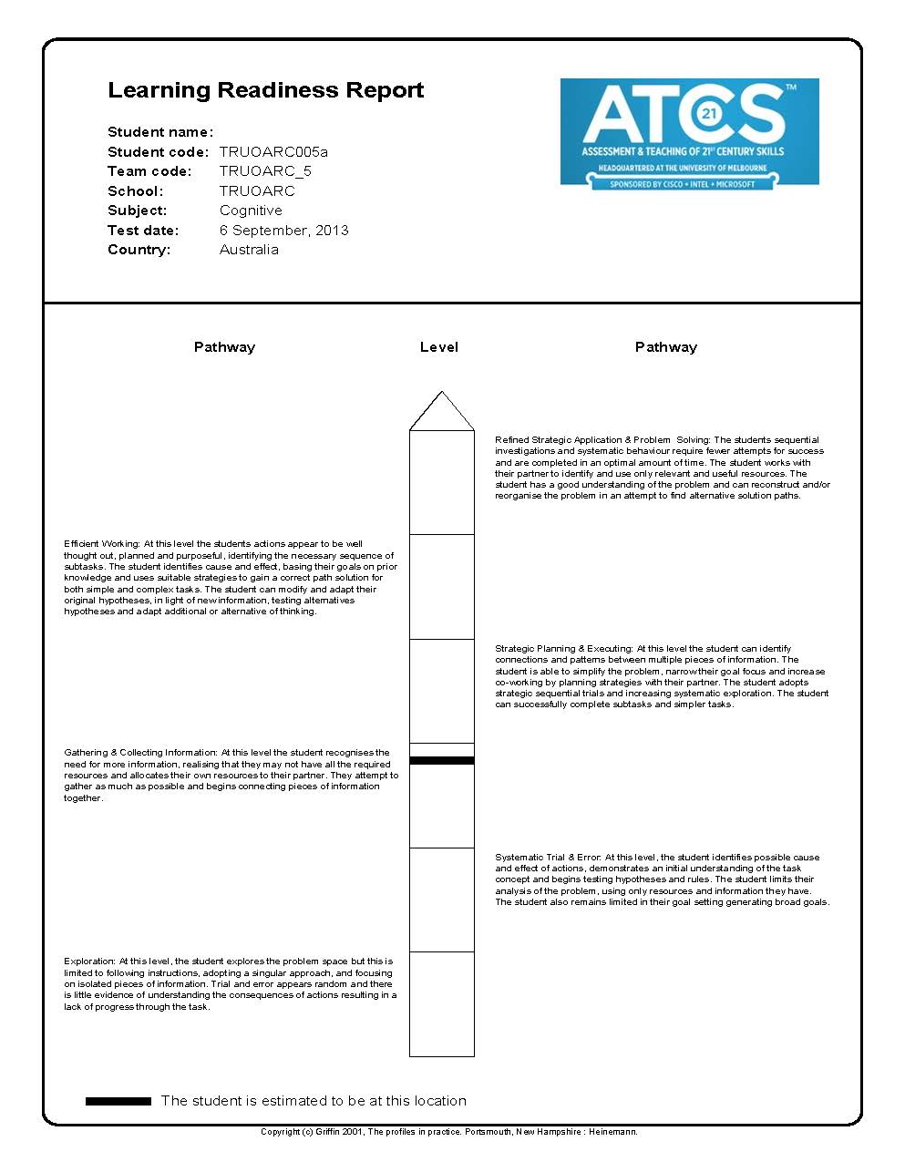
Description
of skills and
abilities
for each level
Student
Information
Students
Level (ZPD)
FORMATIVE ASSESSMENT REPORT

Slide 59
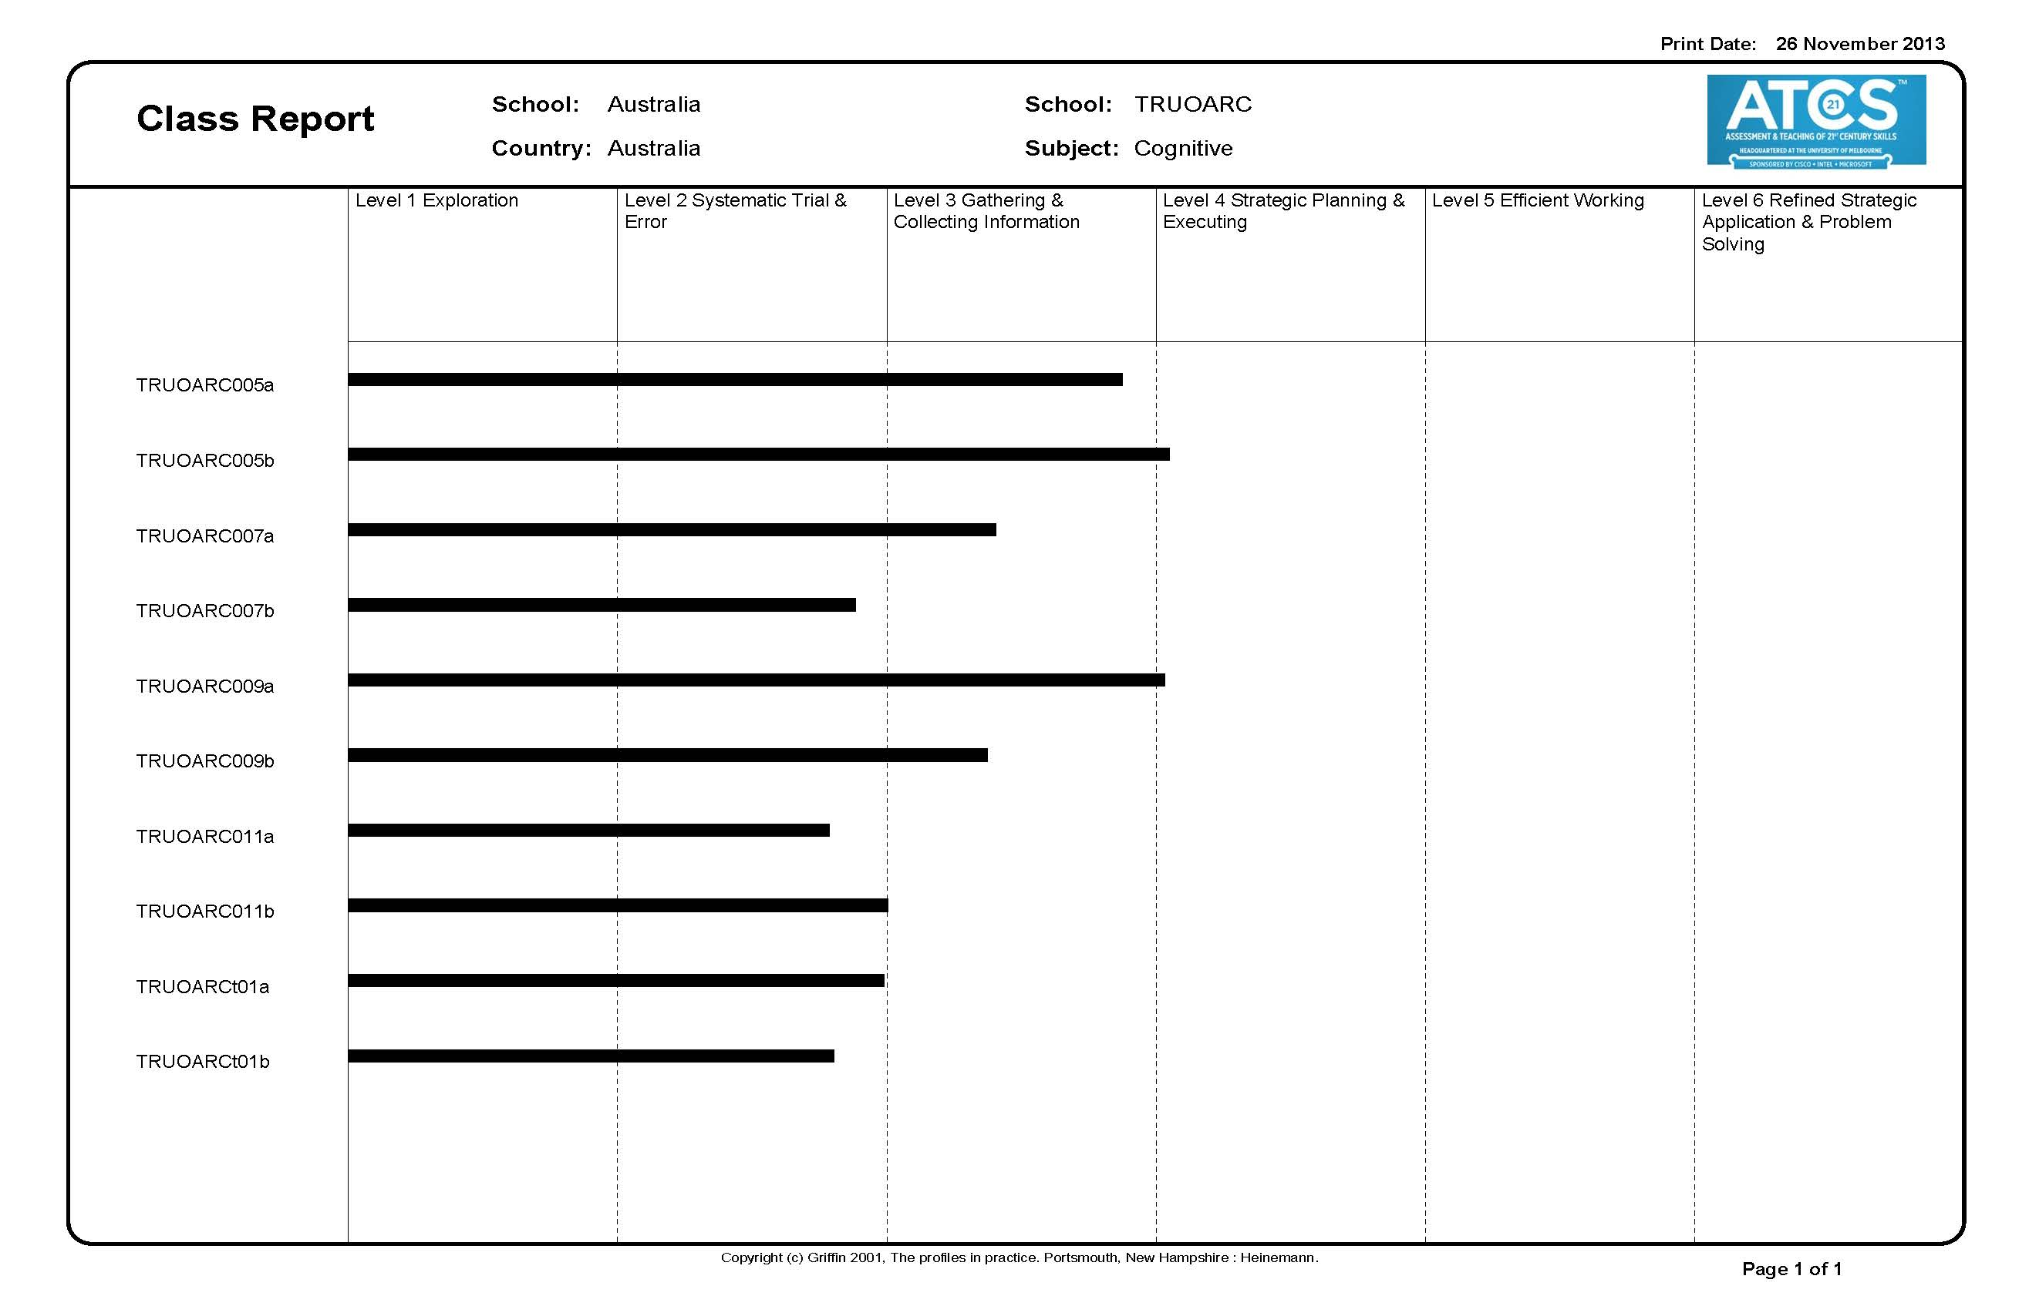
Class report
Organise
classroom
to support
small group
instruction

Slide 60
Professional development modules
Defining and Assessing 21st Century Skills
Using a Developmental Model
ATC21S Assessments: Getting Started
Interpreting Reports
Teaching and Learning 21st Century Skills
Notes:
Defining and Assessing 21st Century Skills
Using a Developmental Model
ATC21S Assessments: Getting Started
Interpreting Reports
Teaching and Learning 21st Century Skills
We hope that the teachers will work through these modules and videos as first step.

Slide 61
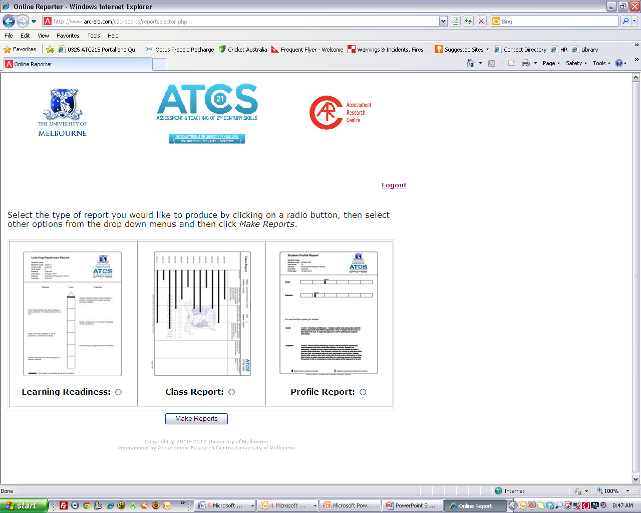
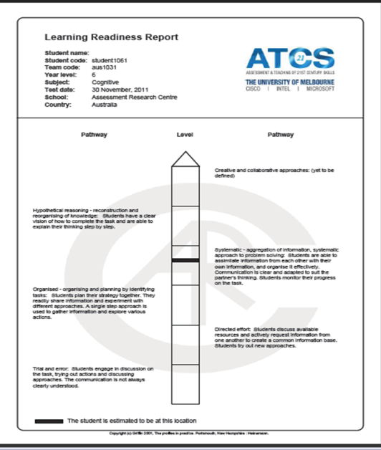
Reports

Slide 62
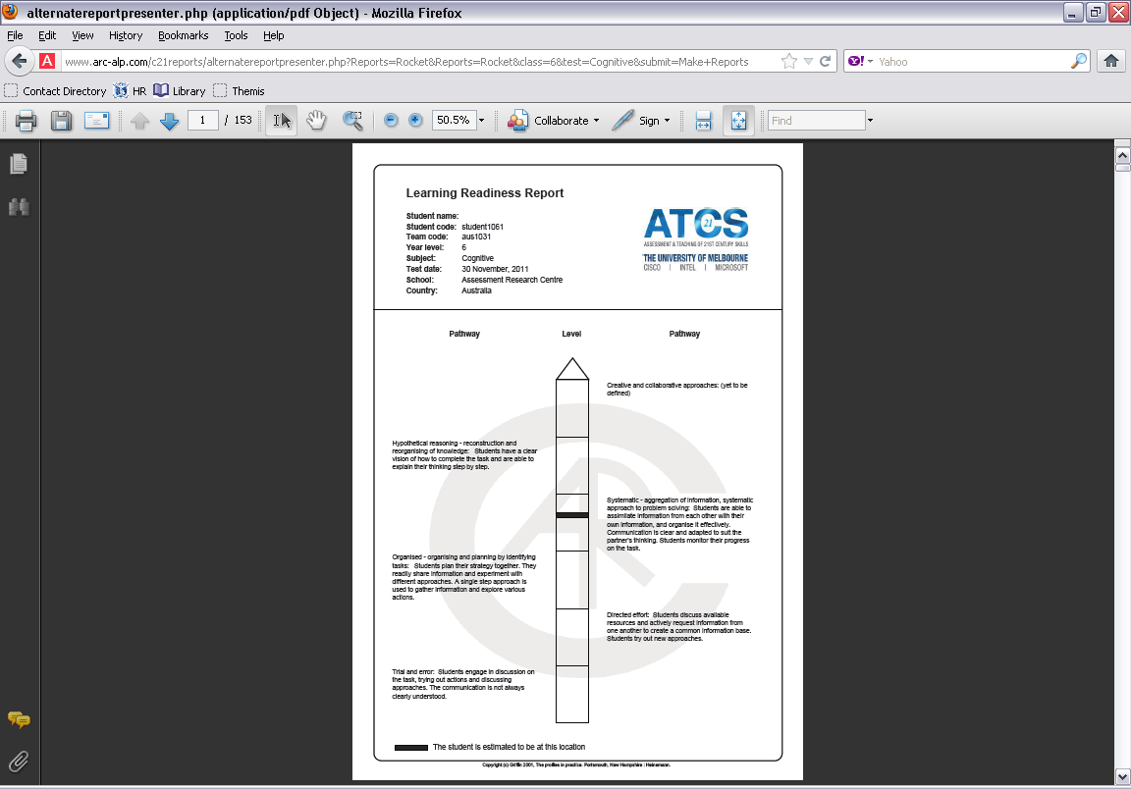
Reporting to Students
Learning Readiness
Real time reports will be available, based on empirically developed learning progressions. They will identify a point of readiness to learn for each student.
This type of report will be linked to teaching interventions associated with readiness to learn as indicated by the black bar in the spine of the chart.

Slide 63
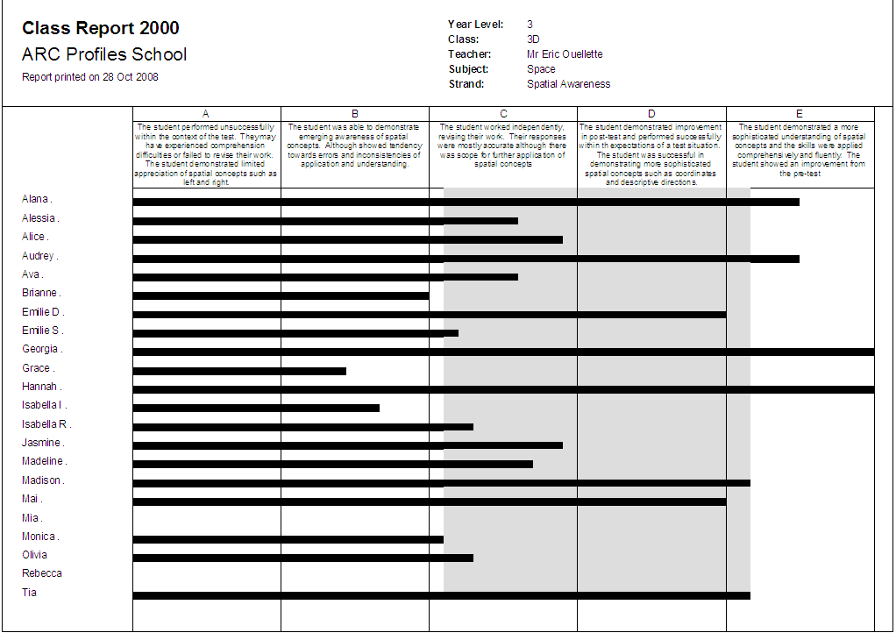
Instructional groups

Slide 64
The System
An integrated system
  Developmental progressions – standards referenced
  Assessment tasks with automatic scoring
  Teaching intervention and professional development
  Reports for students, teachers and systems
Next steps
Access and Use
  Validation studies
  Expanded resources – mainstream curriculum
  Other 21st century skills

Slide 65
Transfer and Utility
To what degree will 21st century skills such as collaborative problem solving or ICT Literacy in Learning Networks facilitate student learning?
  Are these skills teachable and learnable?
  Will the skills enhance learning in the classroom?
To what degree might enhanced 21st century skills contribute to adaptiveness of graduate students to the workforce?

Slide 66
Next steps - research agenda
  Translations
      English
      Dutch
      Chinese
      Finnish
      Spanish
      Korean?
  Validation studies
  Expanded resources
  Links to mainstream curricula
  Other skills
  Other formats

Slide 67


Publications
Vol 1: P. Griffin, B. McGaw & E. Care (Eds). Assessment and Teaching of 21st Century Skills. Springer,.
Volume 2: P. Griffin, & E. Care (Eds) (2015) Assessment and Teaching of 21st Century Skills: Methods and Approach. Springer, Dordrecht. (release date - October, 2014)
Volume 3 – Research (2015)
Volume 4 -- C21 skills (2016)
Volume 5 – Workplace entry skills(2016)

Slide 68
Thank you

