Slide 1
Working group on Foundational Literacies 6th E2030 IWG meeting
By Maria Dobryakova, Gemma Moss, Norbert Seel
October 23-25, 2017
Paris, France

Slide 2
Foundational literacies: key findings
Literacy is not a purely technical skill. It is embedded in its social context.
Literacy is about communication and inclusion.
in various spheres, domains
You are literate if
You are able to understand what someone (a person, an agency) tries to communicate to you
You are able communicate something that others understand.
in various spheres, domains
As these spheres change their language and tools you need to continue to develop your capacity to communicate in them.

Slide 3
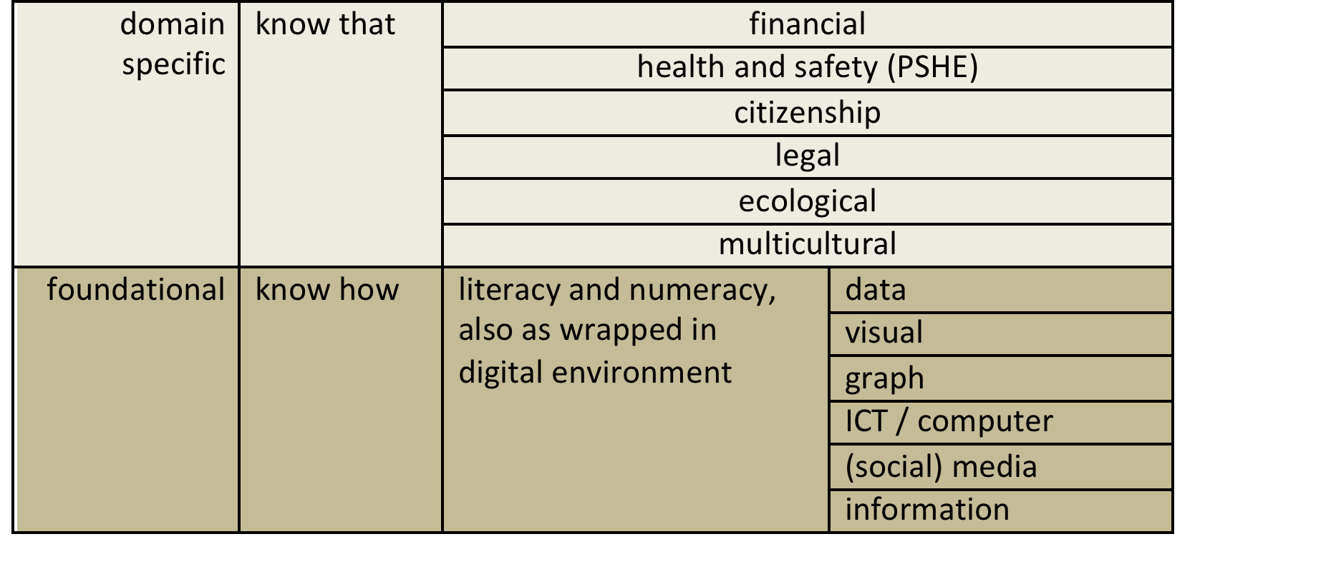
Finding a way through the maze: A taxonomy of literacies
Foundational literacies (= the know-how type / tools) make a foundation for disciplinary knowledge (= know-that type).
Literacy is a tool-based foundation for transversal competences.
A foundational literacy equips students with the capacity to develop and diversify the skills they have acquired through formal teaching, giving them many opportunities to use those skills for many diverse purposes.
Notes:
I think this is very strong – and guess what! You’ve got capacity to develop!

Slide 4
Questions
Variety of literacies: The NeverEnding Story?
What does digital revolution actually revolutionise for literacy?
The new dimensions that foundational literacies are acquiring today have to do with a greater emphasis on agency and inclusion, with communication as a proxy.
Transition from illiteracy to literacy: stages or a continuum?
Conceptual knowledge
Declarative knowledge
‘Know that’ literacy domains
Contextual knowledge
Procedural knowledge
‘Know how’ literacy
tools
versus

