Slide 1
Evaluation of Universities in Western Europe: From Quality Assessment to Accreditation Erik DE CORTE Center for Instructional Psychology and Technology (CIP&T) University of Leuven, Belgium

Slide 2
Introduction
At the start of my career in the early 1970s as associate professor in the Faculty of Psychology and Educational Sciences of the University of Leuven assessment of teaching was more or less unexistent
In those days assessment and evaluation was a well-established practice with respect to students:
their achievement was and still is regularly evaluated as a basis for taking decisions about the transition in their school career and the awarding of a degree at the end of their study
Assessment of academics was focused on decisions about appointment and promotion and about the allocation of grants; such assessment addressed mainly the research activities of individual scholars

Slide 3
In my university our Department of Education took a first initiative toward the evaluation of teaching behavior by the development in the late 1970s of the EVADOC Questionnaire: * a tool for assessing the quality of lecturing behavior of individual professors by means of student evaluation * administration of the questionnaire was on a voluntary basis * EVADOC enabled professors to get insight in strengths and weaknesses relating to seven observable aspects to their teaching behavior (De Neve & Janssen, 1984)

Slide 4
The emergence of national evaluation schemes in higher education (HE) occurred in the mid-1980s, and originated in The Netherlands, France and the United Kingdom In the years thereafter many other Western European countries established similar evaluation systems In Central and Eastern Europe such schemes were introduced from the 1990 onwards Over the past thirty years these systems have undergone important changes

Slide 5
I will present and discuss the following topics relating to evaluation in HE : * Causes for the establishment of evaluation schemes in Europe * Concepts and definitions relating to evaluation in HE * Quality assessment focused on improvement of HE * Accreditation focused on accountability of HE * Revising the accreditation approach to meet criticisms * Final comments and a future perspective For an extensive overview of how quality assessment schemes and accreditation have spread across Europe during the past decades, I refer to the comparative study of 20 countries published in the volume Accreditation and evaluation in the European higher education area (Schwarz & Westerheijden, 2004a).

Slide 6
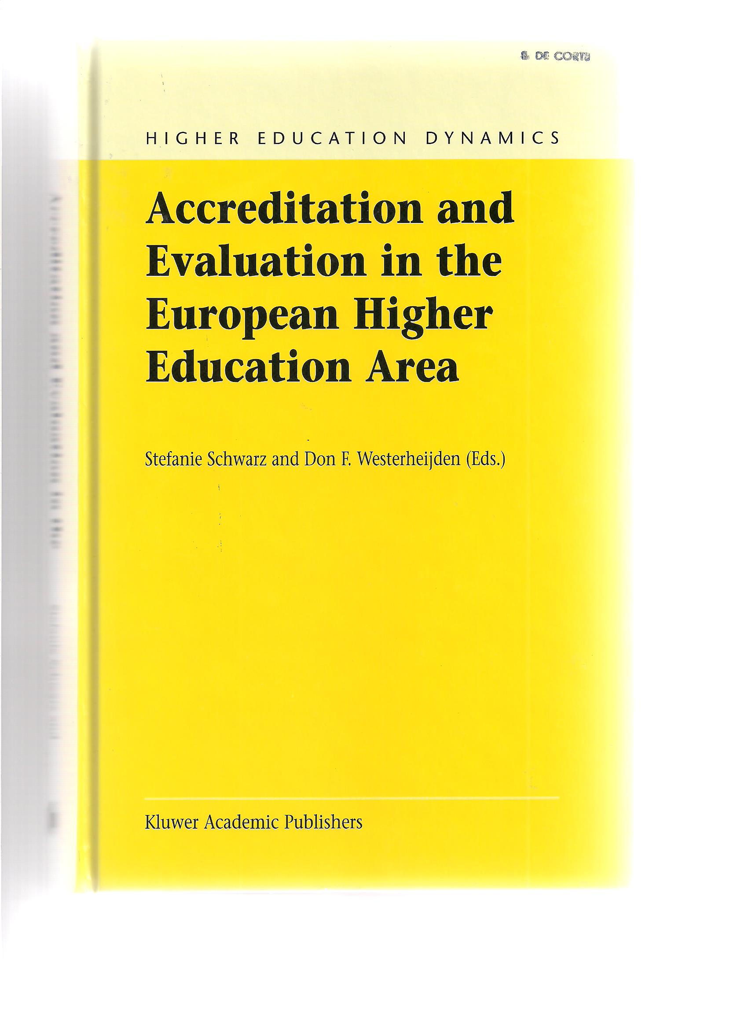

Slide 8
Causes of the emergence of evaluation schemes in the 1980s and initial developments
Pursuing quality in view of achieving excellence has always been a major goal in HE
Until the 1970s this quality was controlled by bureaucratic measures such as legal conditions for starting institutions, faculties and study programs, formal rules for the appointment of academic personnel, etc.
In addition there was in the society a good degree of trust that universities themselves could guarantee quality
However, in the late 1970s there was a loss of confidence in the role of academics as guardians of quality and efficiency
Moreover, quality assurance used as a management tool in the industrial sector was seen more and more as an instrument that could also be appropriately applied in the management of HE

Slide 9
Application of this tool was strongly stimulated through several other developments: * First of all, the enormous expansion and “massification” of HE in the 1970s called for new forms of management And this was strengthened by the growing concern that this “massification” could slacken the quality and performance of higher education institutions (HEIs) * Second, also due to the expansion of HE and its increasing complexity and differentiation central control reached its limits. Whereas in the previous era governments were heavily involved in the planning and organization of higher education, there occurred in the 1980s a loss of trust in the capacity of governments to guarantee and enhance its quality, relevance and efficiency. Nevertheless governments, being the major financial source of universities, were eager to maintain and even to improve the level of quality and performance of higher education through the application of external tools of control

Slide 10
* Third, in the 1980s and 1990s hopes raised that the use of quality assurance as a management tool would stimulate institutionalized reflection on the activities and outcomes of universities, and that growing managerial capacity in HEIs would foster improved levels of quality and performance It must be added that all these reasons did not play an equally important role in different countries. For instance, as argued by Schwarz and Westerheiden (2004b), in countries that were slow at establishing an evaluation system the public confidence in the self-regulation of quality by academics was mostly not higher than in countries that were pioneers in the introduction of evaluation systems

Slide 11
The described causes have certainly had impact on the establishment of an evaluation scheme in the pioneer countries, The Netherlands, France and the UK Inspired by the new management tools and approaches mentioned above, governments aimed at making universities more accountable for the funding they received, but also at restraining detailed regulation in favor of market-like mechanisms As argued by Westerheijden (2007): “Quality assurance can be seen, on the one hand, as a policy instrument supporting transparent markets for students and graduates by making information about quality differences public, and, on the other hand, as a safeguard against too blunt minimizing of quality levels in the free supply behavior of higher education providers on (quasi-) markets.” (p. 12)

Slide 12
However, it is important to add here explicitly that quality assurance systems intended also to stimulate and foster quality improvement, taking into account the changing demands on higher education graduates resulting from the development from industry-based to service-based economies and toward a knowledge society From 1990 on the quality assurance movement disseminated quickly throughout Western Europe This dissemination was stimulated by the European Union’s Pilot Project of 1994 on external evaluation methodology (Management Group, European Committee Meeting, 1995)

Slide 13
The project was based on the observation that in most quality assurance systems a four-phase approach was used: a national co-ordinating office, a self-evaluation report, a peer review phase and a public report about the outcomes of the evaluation In the project one or two teaching programs in different knowledge domains were evaluated in all (then) EU countries and some other Western Europe countries As a major consequence of the project the EU decided years later in 1998 to launch the European Network for Quality Assurance in Higher Education (ENQA). Soon thereafter this network played an important role in the well-known Bologna Process initiated by the Bologna Declaration of June 1999, and aimed at harmonizing higher education in Europe By the end of the 20th century almost all Western European countries had installed a policy and system of quality assessment in higher education, Germany being a remarkable exception till 2003

Slide 14
Some concepts and definitions
As argued by Teichler (2007), quality assurance has become the most popular umbrella term in Europe referring to all kinds of assessment in HE relating to activities aimed at developing and improving the quality of HE
A key question is then what is meant by “quality” in HE ?
Looking at the literature it becomes quickly obvious that there is no simple answer to the question. According to Westerheijden (2007), all definitions of quality in the literature refer
“to the link between the good or service under consideration and desires of customers as the essence of quality”. (p. 9)
But with respect to HE there are different categories of customers representing distinct stakeholders
For instance, considered from the standpoint of students quality of higher education refers to what happens in the classroom. The same holds true for the authorities of institutions, although they may focus as well on other aspects than the students

Slide 15
But quality has a different meaning from the perspective of employers who look for graduates as manpower, but also for governments that are the main funders of HE In addition quality may have a different meaning at different moments in time, or in distinct geographical regions Taking all this into account Harvey and Green (1993) have grouped the widely differing conceptualization of quality into five discrete but interrelated categories. Quality can be viewed * as exception * as perfection * as fitness for purpose * as value for money * as transformative

Slide 16
Other terms that are commonly used in relation to quality assurance are quality control, quality management, quality audit, quality assessment, evaluation, and accreditation Quality control and quality management refer to systems used internally in HEIs. In quality control the focus is on measurement and maintenance of educational standard, whereas quality management aims at linking quality control to planning and control cycles in view of possible changes and improvements Quality assessment and evaluation refer to external quality assurance systems oriented toward the measurement of quality, quantitatively as well as qualitatively. Quality audit is used to indicate an evaluation procedure that focuses on quality management arrangements within HEIs. This latter system is so far less common, but as an example I refer to the evaluation of leadership and management of education the University of Helsinki in 2008 (Saari & Frimodig, 2009)

Slide 17
Accreditation differs from quality assessment in function as well as in the kind of judgment. Schwarz and Westerheijden (2004b, p. 2) define accreditation as follows: “Institutionalised and systematically implemented evaluation schemes of HEIs, degree types and programmes that end in a formal summary judgment that leads to formal approval processes regarding the respective institution, degree type or programme.” Accreditation involves thus two phases: an evaluation phase provides the data and information as a basis and starting point for the approval that grants the “right to exist” (or, alternatively, rejects the “right to exist”) of a HEI, a degree type or a programme The approval is granted by a legitimate, supra-institutional organization or power An obvious implication is that the focus of accreditation is on accountability

Slide 18
Quality assessment focused on improvement of higher education
HE evaluation originated in the USA in the 1970s, and took from the beginning the format of accreditation
In Western Europe the emergence of national evaluation schemes started in the second part of the 1980s
Whereas the introduction of such schemes was inspired by practices in the USA, it did in those days not take the format of accreditation
According to Teichler (2007) at the time no need was experienced to install an accreditation system for several reasons
A major reason was that the focus in Europe was more on quality improvement, and assessment was seen as a tool to initiate reflection on the quality and performance of HEIs as a lever for improvement

Slide 19
In addition no need was felt to link quality assessment to an approval of the “right to exist”, nor to install a system intended at identifying the “black sheep” that should not have the right to exist Consequently quality assessment and not accreditation was the focus of evaluation schemes in Western Europe, and this lasted till the late 1990s A representative example of this kind of HE evaluation is the system developed in The Netherlands and Flanders (the Flemish part of Belgium) that were among the pioneer countries in implementing a quality assessment system The Dutch system was operational in 1988, and served as model for the Flemish scheme that was implemented in 1992. In that year an agreement between the two countries led to the organization of joint evaluation activities I will briefly review here the Dutch system

Slide 20
The assessment system can be described in terms of the following steps: * internal quality assurance as the starting point * writing a self-evaluation report by the institution * visitation by an external review committee; * writing of a report by the external review committee * meta-evaluation by the inspectorate An important point is that the quality assessment procedure built on the internal quality assurance arrangements of the institutions stressing the greater autonomy that was granted to them In the same line, the basis of the evaluation was a self-evaluation report compiled by the institution and describing the individual programs to be evaluated

Slide 21
This report had to follow a pre-determined format covering the following topics: * objectives of the program * structure and content of the program * input-throughput-output of students * description of the learning environment * feasibility * quality of the graduates * effectiveness of the organization * quality of the personnel * facilities * internationalization * internal quality care

Slide 22
Next, an external review committee visited the institution during several days This committee was always composed in consultation with the institution showing again that the procedure was not at all a purely externally designed activity The committee involved peers (= scholars from the same discipline), an educational professional and often a student Based on the self-evaluation report the committee critically reviewed the programs by * analyzing documents (e.g., exams, report of internships, theses. etc.) * interviewing all relevant actors and stakeholders (authority members, teaching staff, students , graduates, and members of the administrative staff) These interviews aimed at clarifications, verification, and gathering additional information The same committee visited similar programs in different universities (e.g., the programs in educational sciences)

Slide 23
Based on the interviews and their observations, the external committee compiled a report focusing on the strengths and points of attention taking thereby as a guideline the topics addressed in the self-evaluation report As the committee visited similar programs in different universities, it was possible to derive some general comments and conclusions about the programs of the evaluated discipline It is important here to stress that in the report of the committee a strong focus was on suggestions and advices for improvement The final step, namely a meta-evaluation by the inspectorate took place regularly but not always. The inspectorate could make additional comments and suggestions complementing those of the external committee. For instance, the inspectorate can stress certain remarks of the committee that need special attention during the next visitation

Slide 24
As stated by Wijnen (2007) important characteristics of this quality assessment scheme were: * final responsibility by the institution * important role of peer assessment * formal sanctions as an exception * improvement as a major goal * trust as a leading principle This quality assurance system, that was repeated every six years, was mainly based on internal quality assessment HEIs themselves were granted the main responsibility for the quality care The autonomy of the institutions was highly valued, and no decisions were taken by external agencies such as the external committee or the inspectorate Consequently, the external quality assessment was not threatening for the institutions as there were no formal sanctions

Slide 25
As argued by Wijnen (2007) this evaluation system had a positive impact: “The self-study reports were public, there was a growing openness about educational programmes, external review committees brought ideas from elsewhere and there was a positive drive for improvement at the HEI’s”. (p. 128) Based on my own involvement in different evaluation committees, I can confirm that the role of improvement was very important in this quality assessment system Writing the self-evaluation report was a very instructive experience for the institutions and stimulated reflection on their teaching programs and practices I have several times observed that as a result the institutions became themselves well aware of their own strengths and weaknesses The reports of the external committee often involved useful suggestions for improvement, and induced exchange of ideas and cooperation in joint projects and action programs. An important side effect was the increased interest in and attention for education, besides research, in HEIs

Slide 26
Accreditation focused on accountability of higher education
Notwithstanding the largely positive influence of the quality assessment system, in the early years of the 21st century The Netherlands and Flanders switched over to an accreditation approach
An accreditation system was installed in The Netherlands in 2003, and in 2005 the Dutch-Flemish Accreditation Organization (NVAO) was founded. So the co-operation of the previous era between the two countries was continued, and an important argument for it was that jointly they could play a more important role at the international level
In line with the definition given above accreditation was described as a formal judgment that the quality of a degree course or an institution meets certain standards. This judgment is based on quality assessment. This shows that accreditation and quality assurance are connected (Dittrich, 2004)
In other words, accreditation was placed on top of quality assessment leading to an independent decision whether the quality of a program is satisfactory or not, i.e. whether it achieves a basic level of quality

Slide 27
Taking into account the positive influence of the quality assessment procedure, a relevant question is: Why moved The Netherlands and Flanders to accreditation? A major reason for the change was the impact of the Bologna Process that stimulated international benchmarking to enable comparison between programs within Europe. Accreditation makes such comparison possible, which is important in view of facilitating student mobility in Europe, a major objective of the Bologna Process But an additional reason was also that the quality assessment system slackened: over the years it lost some of its effectiveness due to the development of routines and the fact that the expected improvements did not materialize. Therefore, the need was more and more felt to establish a new, more strict and more effective approach to evaluation of HE Accreditation was considered as the appropriate answer also because it facilitates governmental decisions. Indeed, a positive outcome of an accreditation has clear consequences for an institution or a program: it qualifies for government funding, students can get bursaries, and an institution can issue degree certificates recognized by the government

Slide 28
Since 2003 all teaching programs of HEIs in The Netherlands were subjected to an accreditation every six years. The accreditation involved four steps: * writing a self-evaluation report by the institution * visitation by an external review committee * writing of a report by the external review committee * decision by the Dutch-Flemish Accreditation Organ. This makes clear that accreditation was built upon the previous quality assessment procedure. Indeed, the first three steps are the same, although there are differences in the specification of these steps For instance, the format of the self-evaluation report introduced more specific requirements. The report needed to address six subjects involving altogether 21 facets that were related to explicitly stated criteria

Slide 29
Objectives of the program
- domain-specific requirements
- level of the program
- orientation of the program (professional or academic)
Quality of the program
- relationship between objectives and content of the program
- requirements of professional and academic orientation of the program
- coherence of the program
- study load
- linking-up to the entrance level of students
- size of the program
- alignment of design and content of the program
- assessment and testing
Quality and quantity of the personnel
- professional or academic orientation
- quality of personnel
- quantity of personnel
Available facilities
- material facilities
- guidance of students
Internal quality assurance
- evaluation of the results
- measures for improvement
- involvement of co-workers, students , alumni and professionals
Academic outcomes
- realized level of education
- output of the program

Slide 30
The visitation of the external evaluation panel is organized by an intermediate agency which is in charge of and responsible for the report of the committee A major change is that the committee has to assess the facets on a four-point scale: unsatisfactory, satisfactory, good or excellent Based on these judgment the six subjects are evaluated dichotomously: satisfactory or unsatisfactory * Unsatisfactory judgments have to be justified * A single unsatisfactory judgment for one of the six subjects is sufficient to refuse accreditation The report of the committee is made available to the institution that has the opportunity to check it only for possible inaccuracies, but not to comment on or to criticize the assessment of the committee The final version of the report is delivered to the Dutch-Flemish Accreditation Organization which takes the decision about accreditation

Slide 31
This Dutch accreditation system was more or less copied in Flanders, and is again fairly representative for Western Europe For instance, in all countries - study programs are the unit of analysis - all degree programs are addressed (except for doct. programs) - the modes of inquiry and assessment are similar for core element - a national accreditation agency was established with a close link to the government Of course, there are also differences between the countries with regard to the specific elaboration and implementation of the accreditation schemes (Witte, 2009). It is obvious that this accreditation scheme differs substantially from the previous quality assessment system. Wijnen (2007) describes the major changes as follows: * From improvement to accountability * From trust to distrust * From peers to bureaucrats * From institutions to governments * From decentralization to centralization

Slide 32
The shift from a focus on improvement to accountability, and the fact that the responsibility for quality assurance is removed from the HEIs, were certainly two very important changes As argued by Westerheijden (2007), * the ownership of quality assurance shifted from the institutions to the State * the improvement dimension almost vanished Because of these fundamental changes, but also because of the bureaucratic burden and the fact that the system became very expensive, the accreditation scheme became heavily criticized, especially by the HEIs This led to very intensive discussions and consultations that resulted in a revised accreditation system that is operational in The Netherlands since 2012 A similar revised system was introduced in Flanders in the current academic year 2013-2014

Slide 33
Revising the accreditation approach to meet criticisms
A major step in the Bologna Process was the adoption at a ministerial meeting in Bergen in 2005 of the Standards and Guidelines for Quality Assurance in the European Higher Education Area (ESG) of the European Network for Quality Assurance in Higher Education (ENQA)
The ESG were developed to meet the need for a common understanding of quality assurance in European HE
The new Dutch accreditation framework was developed on the basis of these standards and guidelines for quality assurance of HEIs
The new scheme of the NVAO has attempted to translate and rearrange the ESG in order to shift the focus from quality assurance to quality enhancement (see: www.nvao.net: click on “beoordelingskaders”).
In the new system of accreditation the focus is still on the quality of individual programs

Slide 34
However, a major innovation is that in addition HEIs can ask the NVAO to conduct an institutional quality assurance assessment Such an institutional assessment aims at determining whether an institution as a whole has implemented an effective quality assurance system that enables it to guarantee the quality of its individual programs Institutions that have received a positive evaluation as result of an institutional assessment can benefit from a so-called limited program assessment scheme: an assessment panel of independent experts evaluates an individual program on a limited number of standards that relate to the educational quality and the content of the program It is assumed that this can reduce the accreditation burden by 25 percent In that perspective limitations are imposed with regard to the number and size of the annexes Important to mention is that for institutions that are not asking for an institutional assessment, or got a negative judgment on such an assessment, the individual programs are subjected to an extensive program assessment that is more or less similar as before

Slide 35
Institutional quality assurance assessment: addresses five interrelated issues that are translated in five standards:
The institution has a broadly supported vision of the quality of its education and the development of a quality culture
The institution pursues an adequate policy in order to realize its vision of the quality of its education. This comprises such aspects as policies in the field of education, staff, facilities, accessibility for students with disabilities, embedding of research in the education provided
The institution has insight into the extent to which its vision on the quality of its education is realized. It gauges and evaluates the quality of its programs regularly
The institution can demonstrate that it systematically improves the quality of its programs whenever required
The institution has an effective organization and decision-making structure with regard to the quality of its programs which clearly defines the tasks and responsibilities

Slide 36
The NVAO appoints an audit panel of at least four members that conducts the assessment. The panel * involves administrative, educational and audit expertise * is counseled by a process-coordinator * is supported by a secretary Based on the information provided by the institution and two visits to the institution, the panel evaluates each of the five standards in terms of meets, does not meet or partially meets the standard Subsequently the panel formulates a substantiated general judgment about the overall question whether the institution has implemented an effective quality assurance system that enables it to guarantee the quality of its educational programs The judgment can be positive, negative , or conditionally positive In case of a negative or conditionally positive evaluation the institution can under certain circumstances be given a chance for remediation within a period of, for instance, one year

Slide 37
Limited program assessment
The limited program evaluation is applied to programs of institutions that have obtained a positive result following an institutional assessment
The assessment is based on a discussion with peers focused on the quality and the content of the program. Thereby three main issues are addressed that are again translated into three standards:
Intended learning outcomes: The intended learning outcomes of the program have been concretized with regard to content, level and orientation (bachelor or master; academic or professional); they meet international requirements
Teaching-learning environment: The curriculum, staff and program-specific services and facilities enable the incoming students to achieve the intended learning outcomes. The curriculum, staff, services and facilities constitute a coherent teaching-learning environment for students
Assessment and achieved learning outcomes: The program has an adequate assessment system in place and demonstrates that the intended learning outcomes are achieved

Slide 38
The review committee for a limited program assessment is convened by the institution or by an external quality assessment agency in consultation with the institution. The panel has to be independent of the institution, and needs to be approved by the NVAO The panel consists of minimum four members among whom at least two domain experts and a student Besides domain expertise the committee commands international expertise, educational expertise, assessment and audit expertise, and, if relevant, professional expertise relevant to the program. The members of the panel receive a limited number of specified documents to read before the visit to the institution Based on the information in the documents and the discussions during the visit the committee formulates a substantiated judgment regarding each of the three standards on a four-point scale: unsatisfactory, satisfactory, good, or excellent Subsequently the committee formulates on the same four-point scale a substantiated overall judgment about the quality of the program

Slide 39
* Unsatisfactory: the program does not meet the current generic quality standards and shows serious shortcomings in several areas * Satisfactory: the program meets the current generic quality standards and shows an acceptable level across its entire spectrum * Good: the program systematically surpasses the current generic quality standards across its entire spectrum * Excellent: the program systematically well surpasses the generic quality standards across its entire spectrum and is regarded as an (inter)national example The secretary prepares an assessment report of about 20 pages that is finalized after it has been checked by the members of the panel The main part of the report consists of the panel’s judgments about the three standards and the underpinnings of these evaluations Suggested measures for improvement are presented in a separate section Based on the assessment report the institution applies to the NVAO for accreditation The NVAO can take one of three possible decisions: to accredit the program, not to accredit it, or to grant – under certain stipulated circumstances – an improvement period

Slide 40
Final comments and future perspective
Besides the fact that as a result of the introduction of accreditation the focus of the evaluation of HE has shifted from improvement to accountability, Wijnen (2007) lists five additional unwarranted effects of the accreditation system:
* it is expense
* stimulates bureaucracy
* leads to uniformity
* stimulates window dressing
* hinders real innovation
It is now certainly too early to fully judge the extent to which the revised accreditation system can remove or at least reduce these negative effects
It cannot be denied that an effort has been made to focus more on the content and the quality of the programs

Slide 41
I nevertheless tend to agree with the viewpoint of van Schijndel & van Kemenade (2011) that the criticisms on the previous system are only partially removed For instance, it must be admitted that a certain simplification has been carried through by eliminating the nightmare of evaluating 21 facets in the previous scheme But on the other hand, an institutional assessment has been introduced and is complemented with a limited program assessment The danger is still there that this leads to duplication To what degree the bureaucratic burden will decrease remains thus to be seen, and the same holds true for the reduction of the costs

Slide 42
Notwithstanding the effort to focus more on quality, * the system remains in the first place an output measure aiming at assuring a basic level of quality * accountability still tends to dominate the improvement function Moreover, the scheme also still involves the risk of a negative accreditation, and, together with the focus on basic quality, this can indeed lead to uniformity and window dressing It easily induces a tendency to conform to traditional, accepted ideas and patterns, and to over-accentuating in the self-evaluation report positive aspects of a program, and hiding weaknesses Consequently, accreditation is also an obstacle for innovation, because institutions do not want to take any risk: new approaches and innovative ideas could be rejected by the accreditation organization

Slide 43
According to Brennan (2007) the two factors that are most important for quality improvement are self-assessment and peer review: * self-assessment provides the academic community an internal opportunity for discussion, dialogue and interaction * peer review induces the exchange of good practices and innovative ideas with external evaluators However, these two factors do not at all prevail in the accreditation philosophy and approach, and are rather at odds with the dominant accountability function Wijnen (2007) has also pointed to a move from trust to distrust as a major difference between the original quality assessment and the accreditation approach In this respect Westerheijden (2007) has characterized external quality assurance as policy instruments of ‘organized distrust’ Policy makers and HE managers deplore this situation, and would like to return back to a high-trust situation, but they want at the same time keep in place a form of quality assurance that has proven to be a useful instrument for them

Slide 44
Westerheijden (2007) comments on this: “The fundamental question here is whether it is possible at all to shift back to a high-trust situation. Who coined the one-liner: Innocence once lost cannot be regained?” (p. 15) It seems to me that the question is still relevant with respect to the revised accreditation system Taking especially into account that accreditation seems to be a serious hindrance for the improvement function, the important issue is whether it is possible to combine the accountability and improvement functions in one quality assurance scheme I tend to join the viewpoint of several authors that both functions are relevant and needed, but that they require a different approach In this respect, taking into account the results of an empirical study with a large group of university lecturers, van Kemenade and Hardjono (2010) have proposed what they call a two-way system of intelligent accountability, wherein accountability and improvement are separated as shown in the following Table (van Kemenade & Hardjono, p. 266)

Slide 45
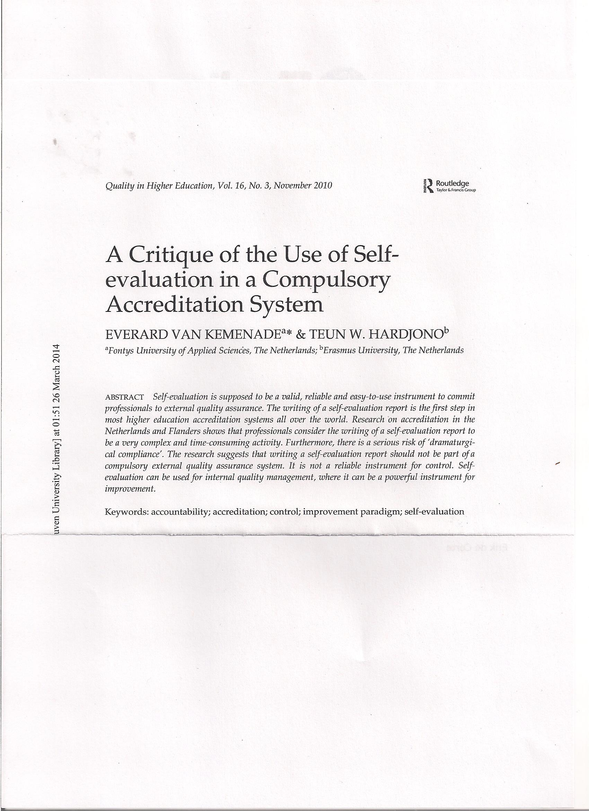

Slide 46
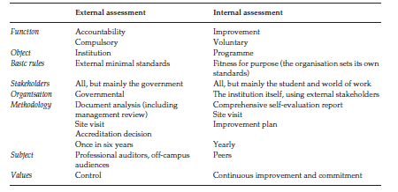

Slide 47
In this system accountability is realized through an external audit based on an analysis of documents and a site visit by external professional auditors to objectify the performance outcomes of an institution or a program Improvement is pursued and achieved through internal audits organized by the HEIs themselves based on self-evaluation and site visits by peers

Slide 48
Thank you for your attention ! E-mail: erik.decorte@ppw.kuleuven.be URL: http://perswww.kuleuven.be/~u0004455

