Slide 1
Videre majus quiddam:
the diversification in higher education institutions
Dmitry Semyonov
Director,
Universities Development Laboratory,
Higher School of Economics
Daria Platonova
Analyst,
Universities Development Laboratory,
Higher School of Economics

Slide 2
Diversification. Key issues
How institutions change?
What determines HEIs’ changes?
What kind of universities appear as a result of such changes?

Slide 3
Russian context
USSR
Extreme example of state control (Clark, 1983)
“Quasi-corporate” system (Froumin et al, 2014)
Post-Soviet transformation
Breaking links between authorities, industry, HEIs
90s: State funding decrease
Fee-paying students & private HEIs
System segmentation
Student population in Russia

Slide 4
Russian context: system segmentation
Institutional mechanisms
2001-2009: Unified state examination
2003-2010: introduction of Bologna (bachelor+master) education model
System segmentation
2006-2011: Nine federal universities – building strong regional universities 2008-2012:
29 national research universities
2013 – 2020: 15 global research universities
2012: HEIs effectiveness monitoring
aimed to eliminate “low-quality” sector

Slide 5
Background
Diversity of HEIs
Internal
diversity within the HEI
External
diversity of HEIs within the higher education system
Program diversity of HEIs
variety of programs, their number, specialization etc.
Program drift
Institutional environment
Enrollment economy
Clark, 1956
State regulation
Technical environment
Market
Scott, 1980
Dill, Teixeira

Slide 6
Data & method
Index of diversification
Index of specialization
216 specialized HEIs
numbers of students in each university within 8 fields (1998, 2014):
Humanities, Health and welfare, Engineering, Manufacturing and construction, Arts, Mathematics and natural science, Social science, Education, Agriculture

Slide 7
Diversification index
Medical – the lowest level of diversification
Agricultural – the most diversified
Industrial – the rise of diversification index

Slide 8
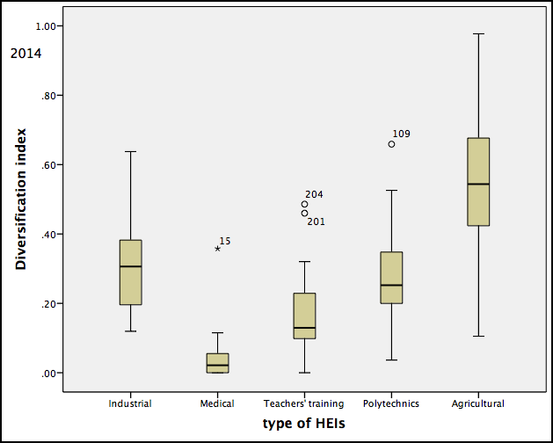
Diversification index
The results are quite different even within the same historical group
External forces influenced differently

Slide 9
Specialization index
 | Industrial |  | Medical |  | Teachers’ training |  | Polytechnic |  | Agricultural
 | 1998 | 2014 | 1998 | 2014 | 1998 | 2014 | 1998 | 2014 | 1998 | 2014
Humanities | -1 | -0,69 | -1 | -0,79 | 0,45 | -0,45 | -0,94 | -0,58 | -0,98 | -0,82
Health and welfare | -1 | -1 | 0,86 | 0,84 | -0,98 | -1 | -1 | -0,97 | -1 | -1
Engineering | 0,42 | 0,4 | -0,99 | -0,99 | -1 | -0,86 | 0,34 | 0,36 | -0,6 | -0,38
Arts | -0,91 | -0,82 | -1 | -1 | -0,09 | -0,26 | -0,92 | -0,77 | -1 | -1
Natural science | -0,76 | -0,3 | -0,94 | -0,98 | 0,33 | -0,55 | -0,77 | -0,21 | -0,89 | -0,37
Social science | -0,39 | -0,12 | -0,94 | -0,94 | -0,44 | -0,56 | -0,22 | -0,13 | -0,1 | 0,04
Education | -1 | -0,96 | -0,93 | -0,99 | 0,56 | 0,74 | -0,99 | -0,93 | -1 | -0,86
Agriculture | -0,79 | -0,95 | -1 | -1 | -1 | -0,95 | -0,53 | -0,76 | 0,82 | 0,83
Notes:
the positive values indicates that institutions are over-specialized in the educational area and negative – under-specialized.

Slide 10
Specialization index
Medical HEIs – transformed from “institutions” to “universities” nominally – the specialization is the same
Polytechnics, industrial, agricultural HEIs are actively boosting enrollments by introducing more popular programs
Case of teachers’ training HEIs:
What did we observe? - the rise of specialization in the educational disciplines
However – lots of mergers and renamings
Easy to deny their identity
Notes:
The difference between agricultural or transportation HEIs that are also held by the branch ministries and medical universities show us either ambiguousness of public demand or distinction between authorities’ management approaches.
In 15 years it has achieved positive values that seems to indicate weaker ability to resist external forces. If institutions are grouped according their nominal belonging to the professional area that was formed in Soviet times, we can assume that this kind of grouping reflex their path dependence.

Slide 11
Conclusion
Market force doesn’t influence equally: different results
State-market dichotomy?
OR
State regulation – market force – institutional intention
Russian case: institutional intention = path dependence
Notes:
The difference between agricultural or transportation HEIs that are also held by the branch ministries and medical universities show us either ambiguousness of public demand or distinction between authorities’ management approaches.
In 15 years it has achieved positive values that seems to indicate weaker ability to resist external forces. If institutions are grouped according their nominal belonging to the professional area that was formed in Soviet times, we can assume that this kind of grouping reflex their path dependence.

Slide 12
Thank you!

