Slide 1
The challenges of equating tests between Russia and Scotland
Alina Ivanova, Elena Kardanova, Irina Brun (HSE, Moscow, Russia)
Peter Tymss, Christine Merrell (Durham University, Durham, UK)
Higher School of Economics , Moscow, 2015
www.hse.ru

Slide 2
Assessments in Russia
International comparative studies
Since the middle of 1990s
PIRLS, TIMSS, PISA
National large scale assessment
Unified State Examination (EGE)
No standardized tests at the primary school level
Primary school monitoring
Author tests and diagnostics
Russia, TIMSS-2011 = 539
6-th in the list
Russia, PISA-2012 = 482
34-th in the list
photo
photo
photo
Higher School of Economics , Moscow, 2015

Slide 3
Purposes of the report
To describe the adaptation process for creating a Russian language version
To show the potential of iPIPS to compare children from Russia and Scotland at the start and at the end of their first school year
To illustrate that this is valid comparison, despite a big difference in the age of children
photo
photo
photo
Higher School of Economics , Moscow, 2015

Slide 4
Adaptation process
Test adaptation includes many activities from deciding whether or not a test could measure the same construct in a different language and culture, to checking equivalence of the initial and adapted test versions (Hambleton, 2005).
photo
Successive test adaptation process
The equivalence of different language versions of tests (backward translation)
The equivalence of test conditions (similar procedure of testing as in UK)
Equivalence of measurement (psychometric analysis)
IRT analysis of test items and tests
identification of DIF
photo
photo
Higher School of Economics , Moscow, 2015

Slide 5
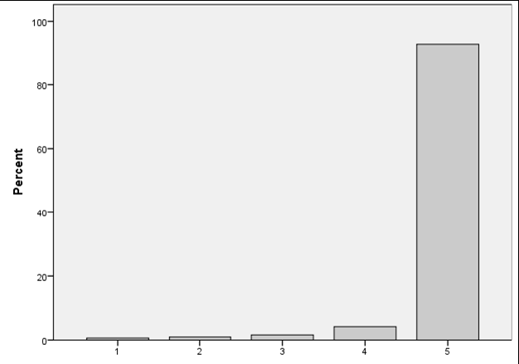
iPIPS adaptation in Russia
Baseline and follow-up booklets of English version were translated into Russian by two independent translators
Edition and discussion
Expertise (experts in literacy and numeracy)
Back-translation of the Russian booklet
photo
5. Piloting
Ceiling effect
6. Significant revision of Russian booklet
93% of Russian sample’s kids knew digits 2, 6, 7, 5, 9.
photo
The both versions of the booklet have enough common items for equating and establishing the common scale.
photo
Higher School of Economics , Moscow, 2015

Slide 6
The final version of Russian iPIPS
Writing
Vocabulary
Repeating words
Rhyming words
Ideas about Reading
Letters
Words
Reading short story
Reading passages
Counting
Simple sums
Numbers
Math problems
Attitudes
photo
photo
photo
Higher School of Economics , Moscow, 2015

Slide 7
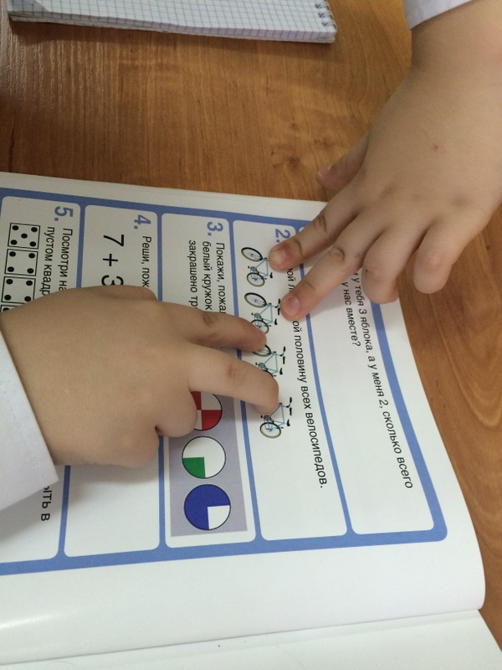
Assessment procedure
✓Assessing kids
Interviewers:
• Individual work with each child, 20-30 min
Teachers:
• Personal social and emotional development of a child
• Behavioral survey
photo
photo
✓Surveying teachers
• Teacher’s questionnaire
✓Surveying parents
• Parents questionnaire
Higher School of Economics , Moscow, 2015

Slide 8
The Russian Sample
photo
The Russian sample (Krasnoyarsk), October 2014
photo
The Russian sample (Krasnoyarsk), April 2015
photo
Higher School of Economics , Moscow, 2015

Slide 9
Samples in Russia and Scotland
Country | Number of participants in the baseline assessment | Number of participants in the follow up assessment
Scotland | 6627 | 6627
Russia | 1438 | 1393
photo
Country | 5% Trimmed Mean, age in years
Scotland | 5.09
Russia | 7.31
photo
photo
Higher School of Economics , Moscow, 2015

Slide 10
Analysis
Two Russian data sets from baseline and follow-up assessments separate analysis
Use of the one-parameter dichotomous Rasch model
Russian math scale’s construction
photo
The next task - to compare the results of 2 countries
photo
Higher School of Economics , Moscow, 2015

Slide 11
Steps of equating process
Random subsamples of Russian and Scottish samples
The simultaneous Rasch calibration
Analysis of fit the model
DIF analysis relating country
11 items with DIF
photo
Higher School of Economics , Moscow, 2015

Slide 12
DIF items
# | List of items | Direction of DIF
1 | Number teen (10) | Ru>En,SC
2 | Number 2dig (25) | Ru>En,SC
3 | Number 3dig (100) | Ru>En,SC
4 | What is 1 more than 5? | En,Sc>Ru
5 | What is 3 less than 7? | En,Sc>Ru
6 | What is 2 more than 6? | En,Sc>Ru
7 | What is 3 more than 8? | En,Sc>Ru
8 | Can you do this sum? 7+3= | Ru>En,SC
9 | Sasha would like to buy an orange, which costs 12 rubles. Which coin should he use? | Ru>En,SC
10 | Can you do this sum? 15-4= | Ru>En,SC
11 | Look at this set of numbers. What should be there instead of the asterisk? 10 20 30 40 * | En,Sc>Ru
12 | Look at this set of numbers. 2 4 6 8 * 12 | En,Sc>Ru
photo
photo
Higher School of Economics , Moscow, 2015

Slide 13
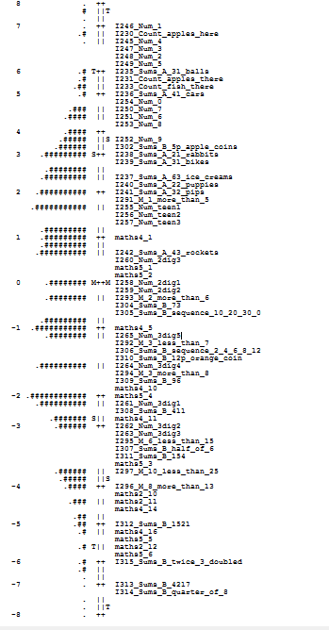
Steps of equating process (continued)
photo
3. Dimensionality study
4. Analysis of the whole scale
5. Analysis of stability of item
6. Children estimation
photo
Higher School of Economics , Moscow, 2015

Slide 14
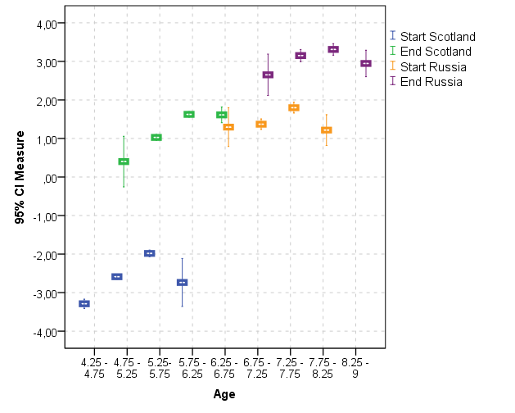
Results
photo
phot
photo
Higher School of Economics , Moscow, 2015

Slide 15
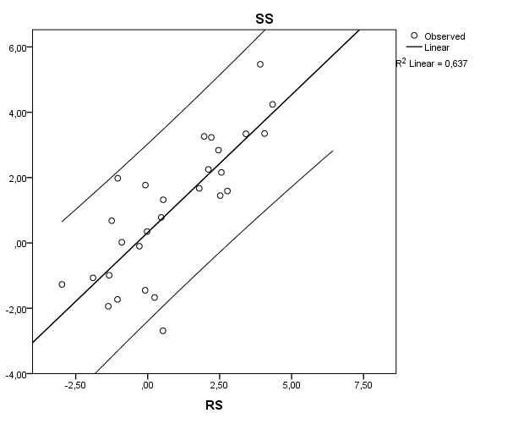
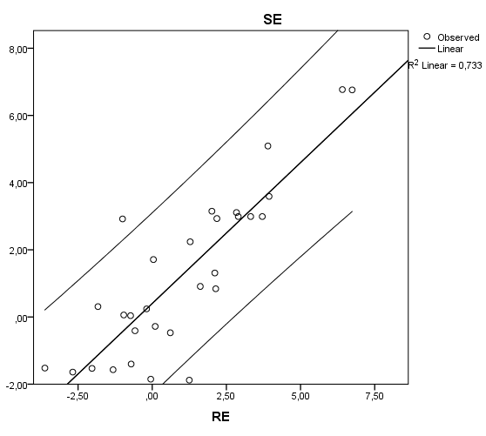
Results
photo
phot
photo
Higher School of Economics , Moscow, 2015

Slide 16
Results
Scotland, baseline
 | 4.25 - 4.75 |  | 4.75 - 5.25 |  | 5.25- 5.75
4.75 - 5.25 | -,70*
5.25- 5.75 | -1,31* |  | -,61*
5.75 - 6.25 | -,55 |  | ,15 |  | ,75
photo
*p<0.05
Scotland, follow up
 | 4.75 - 5.25 | 5.25- 5.75 | 5.75 - 6.25
5.25- 5.75 | -,63
5.75 - 6.25 | -1,23* | -,60*
6.25 - 6.75 | -1,21* | -,58* | ,01
photo
Higher School of Economics , Moscow, 2015

Slide 17
Results
Russia, baseline
 | 6.25 - 6.75 | 6.75 - 7.25 | 7.25 - 7.75
6.75 - 7.25 | -,08
7.25 - 7.75 | -,50* | -,43*
7.75 - 8.25 | ,08 | ,15 | ,58*
photo
*p<0.05
Russia, follow up
 | 6.75 - 7.25 | 7.25 - 7.75 | 7.75 - 8.25
7.25 - 7.75 | -,50
7.75 - 8.25 | -,66* | -,16
8.25 - 9 | -,29 | ,21 | ,37*
photo
Higher School of Economics , Moscow, 2015

Slide 18
Conclusions
It is possible to equate iPIPS scores in mathematics from the start and the end of the first year at school across Scotland and Russia
despite the age differences
The findings are limited
by the smaller Russian sample
by different time between the two assessments in Russia and the other countries
photo
photo
Higher School of Economics , Moscow, 2015

Slide 19
Future research
It would be interesting to compare the relative progress of year 2 Scottish pupils and Russian first graders
how changes the dynamics of the progress with age?
could it be that younger children demonstrate bigger relative progress during a year of schooling
photo
photo
Higher School of Economics , Moscow, 2015

Slide 20
20, Myasnitskaya str., Moscow, Russia, 101000
Tel.: +7 (495) 628-8829, Fax: +7 (495) 628-7931
www.hse.ru

