Slide 1
PISA results and policy in Poland
Maciej Jakubowski
April 2017

Slide 2
Poland in international assessments
before 1990:
FIMS 1964
FISS 1970
SIMS 1980
SISS 1983
2000s:
PIRLS 2001 PIRLS 2006
TIMSS 2003 TIMSS 2007
TALIS 2008
TED S-M
ICCS 2009
PISA 2000 PISA 2003
PISA 2006 PISA 2009
2010+
TALIS 2013 TALIS 2018
ESLC 2012
ICILS 2013 ICILS 2018
TIMSS 2011 TIMSS 2015
PIRLS 2011 PIRLS 2016
PISA 2012 PISA 2015 PISA 2018
1990s:
Reading L
TIMSS 1995
IALS
CIVIC

Slide 3
PISA cycles and the Polish reforms
1999
REFORM
2008
REFORM
PISA2000
PISA2003
PISA2006
PISA2012
PISA2009

Slide 4
The 1999 reform major components
Change of the school structure
Further decentralization
New financing scheme
School and teacher autonomy
National exams
New professional scheme for teachers

Slide 5
PISA 2000: country average and between school differences
High scores
Low Differences
High scores
Large differences
Low scores
Low differences

Slide 6
Poland in PISA 2000

Slide 7
Poland in PISA 2009
Low scores
Large differences

Slide 8
2007/2008 Curriculum Reform
The new curriculum was developed under these principles:
Describe the expected learning outcomes for each stage of education
Indicate the main objectives of teaching each school subject
Increase teacher autonomy
Define the requirements of central assessments
Constitute a coherent part of the Polish Qualifications Framework

Slide 9
School evaluation system in Poland
External evaluation
Internal evaluation
Requirements
Reports

Slide 10
Poland in PISA 2000-2015

Slide 12
Evidence from matched samples (Jakubowski, Patrinos, Porta, Wisniewski, 2016)

Slide 13
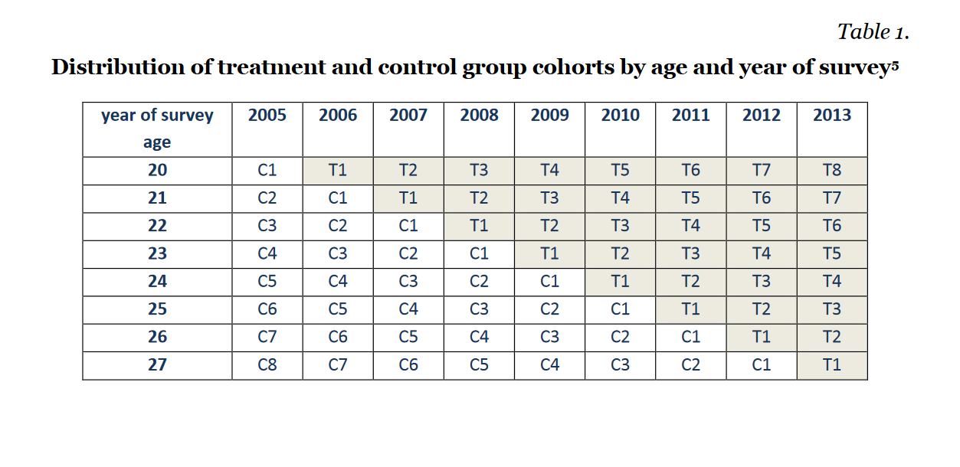
Horn, Drucker, 2016

Slide 14
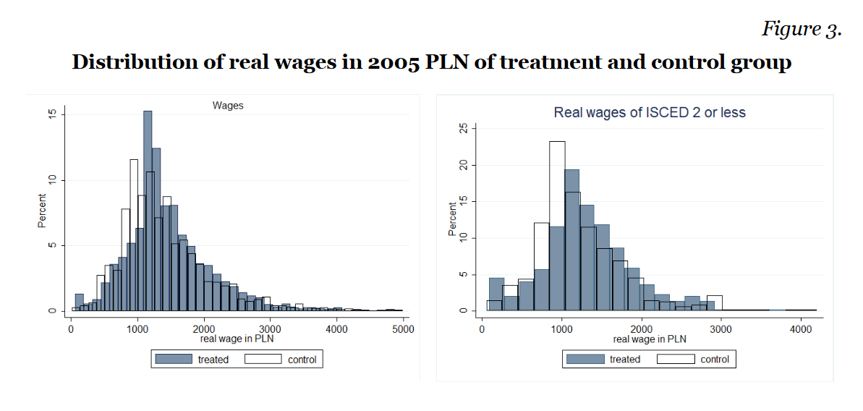
The reform of 1999 has long-term positive effects on labour market outcomes

Slide 15
Paper-based vs. computer-based assessments in Poland

Slide 16
What kind of job do you expect to have when you are about 30 years old?

Slide 17
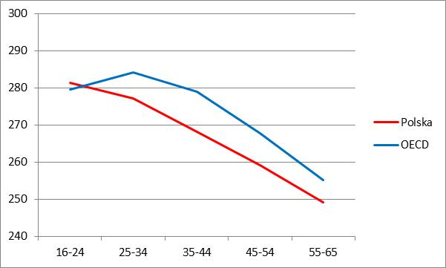
Adult reading skills
PIAAC 2012

Slide 18
Summary
Poland was extending its comprehensive education over last 16 years with positive effects for low-achievers in school and on labour market
Teacher autonomy and decentralization + National examinations
Highly efficient system
Core curriculum + external evaluation instead of inspections

Slide 19
References
Jakubowski Maciej, Patrinos Harry, Porta Emilio, Wisniewski Jerzy, 2016. "The effects of delaying tracking in secondary school: evidence from the 1999 education reform in Poland," Education Economics
Jakubowski Maciej, Patrinos Harry, Porta Emilio, Wisniewski Jerzy, 2010. "The impact of the 1999 education reform in Poland," Policy Research Working Paper Series 5263, The World Bank.
Dolata Roman, Jakubowski Maciej, Pokropek Artur, 2013. „Polska oświata w międzynarodowych badaniach umiejętności uczniów PISA OECD. Wyniki, trendy, kontekst i porównywalność”, Wydawnictwo Uniwersytetu Warszawskiego.
M. Jakubowski, 2015. „Opening up opportunities: education reforms in Poland”, policy paper, Instytut Badań Strukturalnych
M. Jakubowski, A. Pokropek, 2015, „Reading achievement progress across countries” International Journal of Educational Development, Volume 45
D. Horn, L. Drucker, 2016. „Decreased tracking, increased earning: Evidence from the comprehensive Polish educational reform of 1999”, BWP 2016

Slide 20
www.evidenceinstitute.eu
mj@evidenceinstitute.eu
@MaciejEvidence

