Slide 1
Socioeconomic Differences in Secondary and Postsecondary Access and Completion
Susan A. Dumais, Susan.Dumais@lehman.cuny.edu
Lehman College and The Graduate Center, City University of New York, USA
2 July 2018

Slide 2
Lecture Overview
Defining “socioeconomic status”
Socioeconomic inequality in the United States and worldwide
Secondary education completion around the world: socioeconomic differences
Postsecondary (tertiary) education completion around the world: socioeconomic differences
A focus on patterns in the United States
  Costs and financial aid
  First-generation college students (assigned reading)
Cross-national differences in selective college attendance (assigned reading)
Discussion and questions

Slide 3
“Socioeconomic” – what do we mean?
Socioeconomic status (SES) is a composite measure of an individual’s educational attainment, occupational prestige, and income
The term is sometimes used interchangeably with “class,” though not all researchers agree with this
We’ll be looking at inequality based on SES as well as some of its individual components (income, education) and some other factors, like wealth
The next two slides focus on the United States, followed by a slide with a global perspective

Slide 4
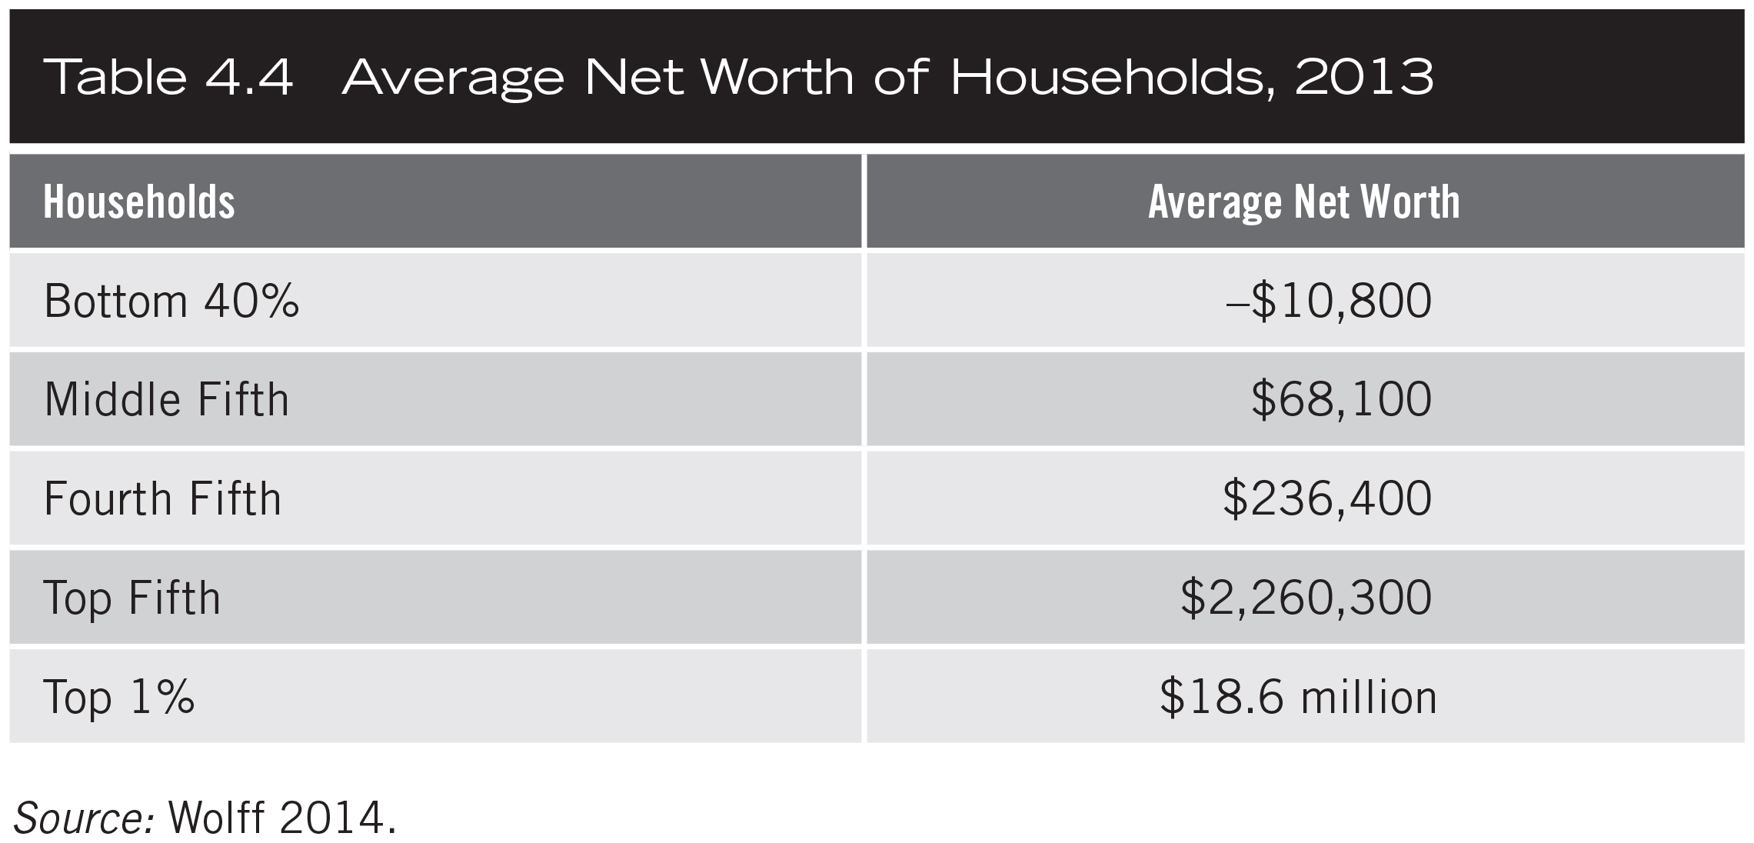
Table 4.4

Slide 5
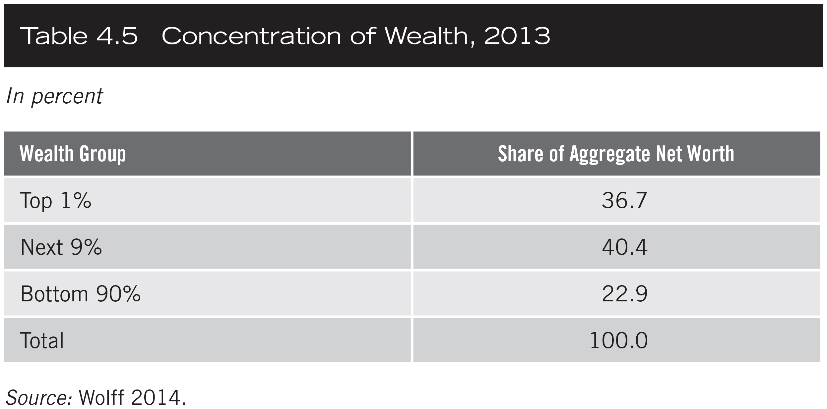
Table 4.5

Slide 6
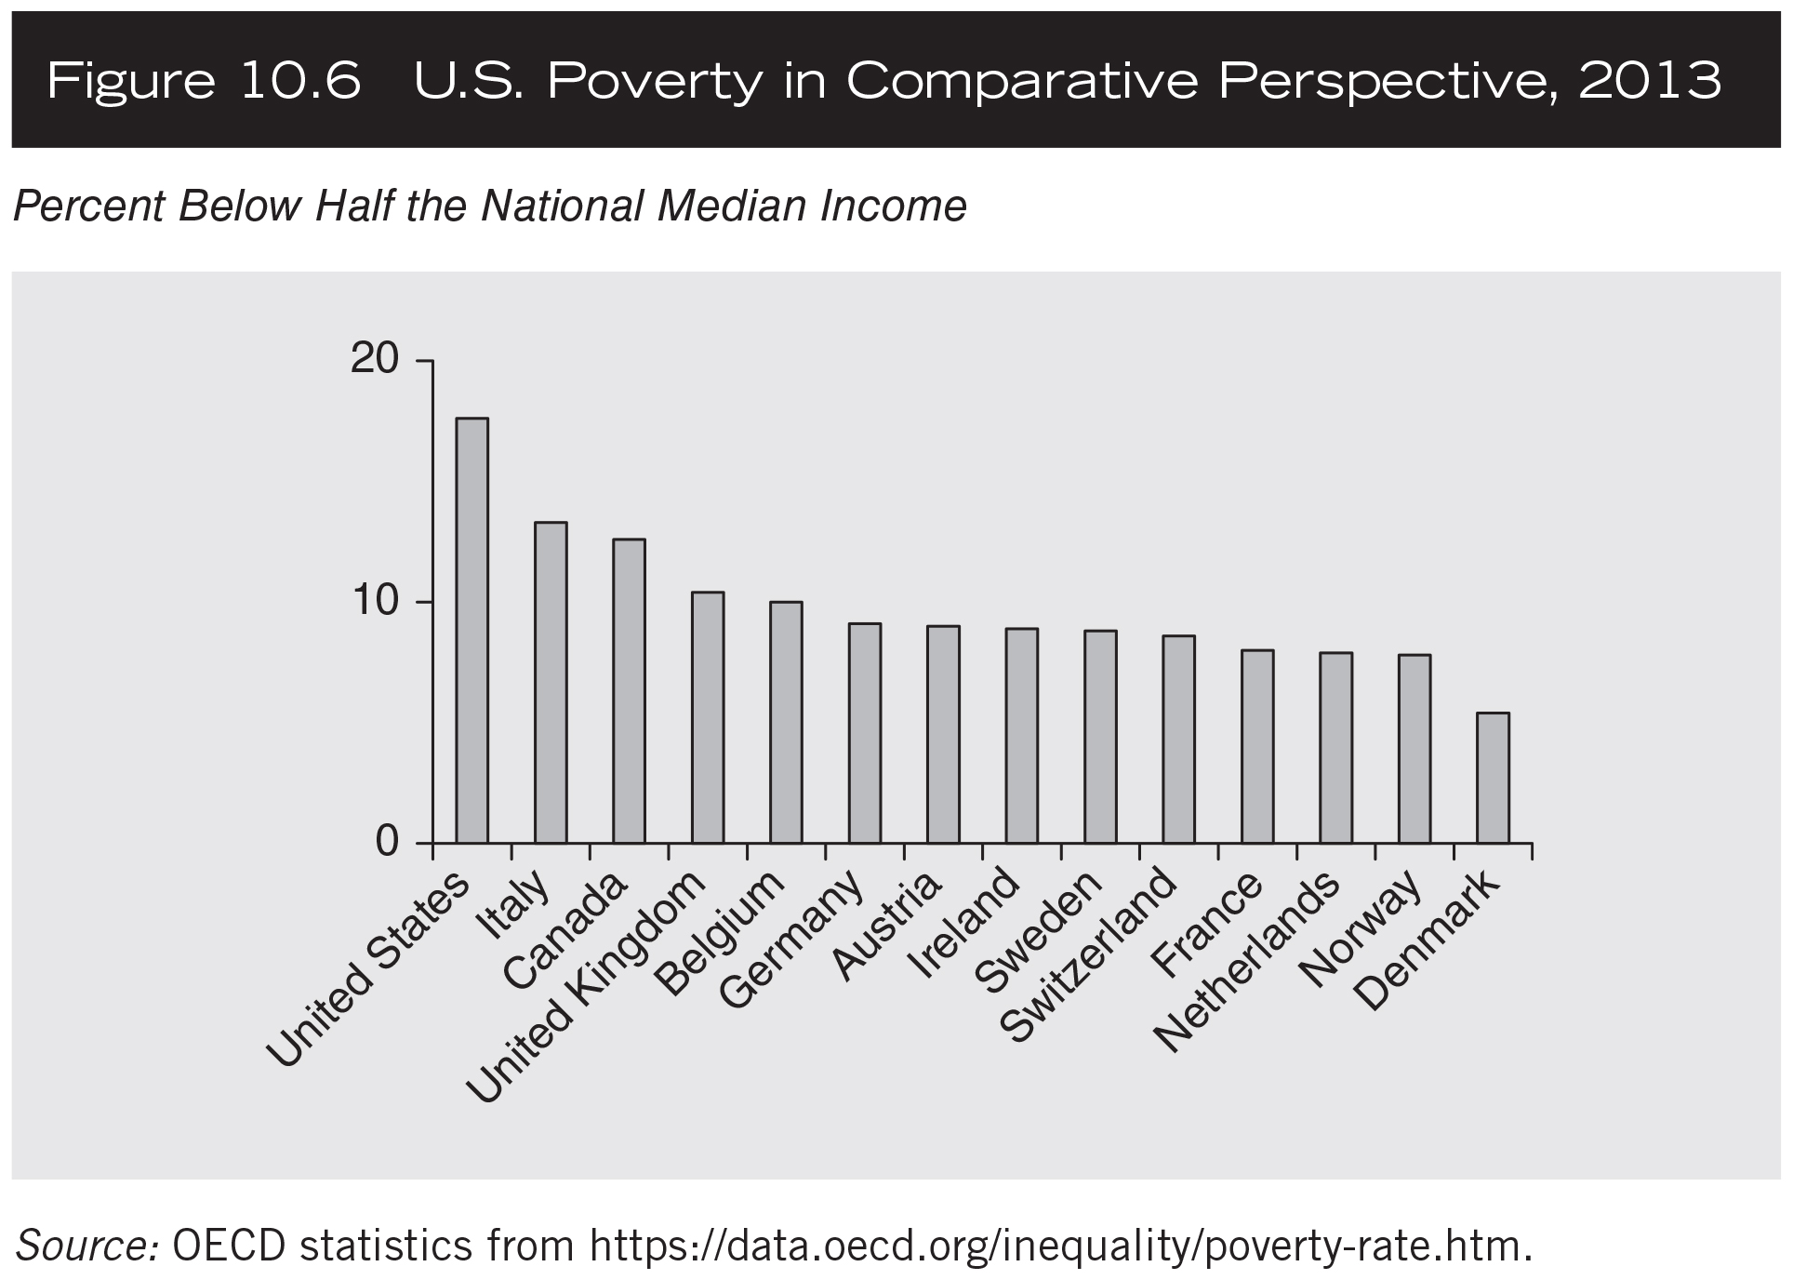
Figure 10.6

Slide 7
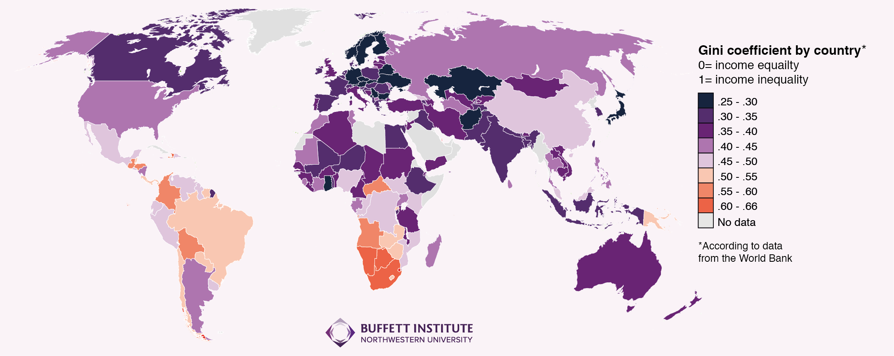
Inequality around the World

Slide 9
World Inequality Database on Education (WIDE)
The next three slides are from the World Inequality Database on Education, https://www.education-inequalities.org/
This is a very useful website where you can compare countries, or look at one country over time, for different educational outcomes (enrollment rates, test scores, graduation rates, etc.) and different types of inequalities, like gender, wealth, and region.
We will be looking at wealth. From the website: “Broadly speaking, this is either an index based on housing characteristics and other household assets or a measure of household per capita income/consumption. Households are classified into five groups from the lowest to the highest value of the index or per capita income/consumption.”

Slide 10
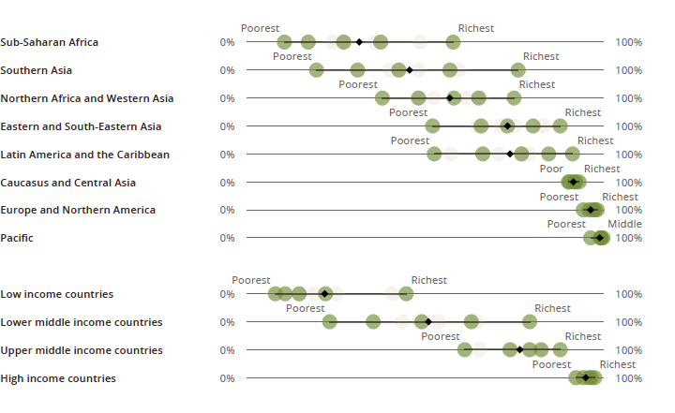
Lower secondary completion rate
Percentage of young people aged 3-5 years above lower secondary school graduation age, who have completed lower secondary school

Slide 11
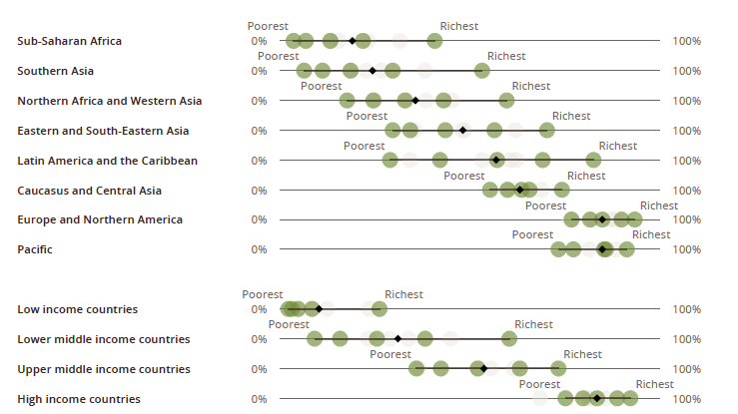
Upper secondary completion rate
Percentage of young people aged 3-5 years above upper secondary school graduation age, who have completed upper secondary school.

Slide 12
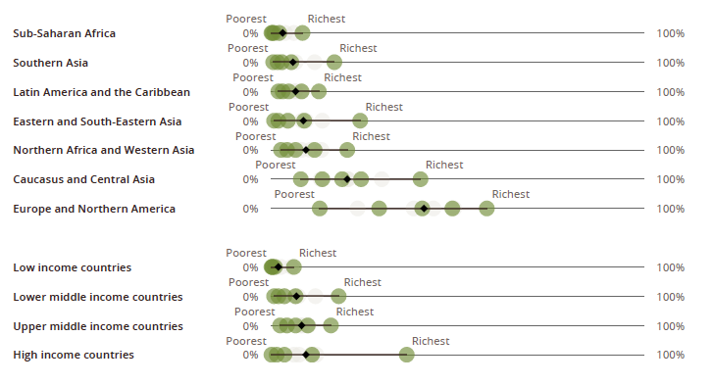
Tertiary completion rate
Percentage of people aged 25–29, who have completed at least four years of higher education. (Note: no data for several countries, including US and Russian Federation)

Slide 14
Higher Education in the US
In 2011-2012, there were 4,706 higher education institutions in the United States
  1,738 two-year colleges
  2,968 four-year colleges

Slide 15
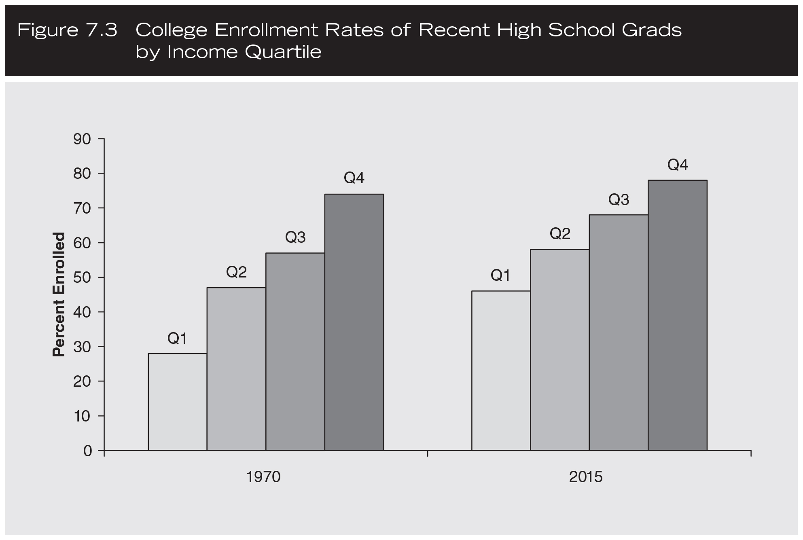
From Gilbert, The American Class Structure

Slide 16
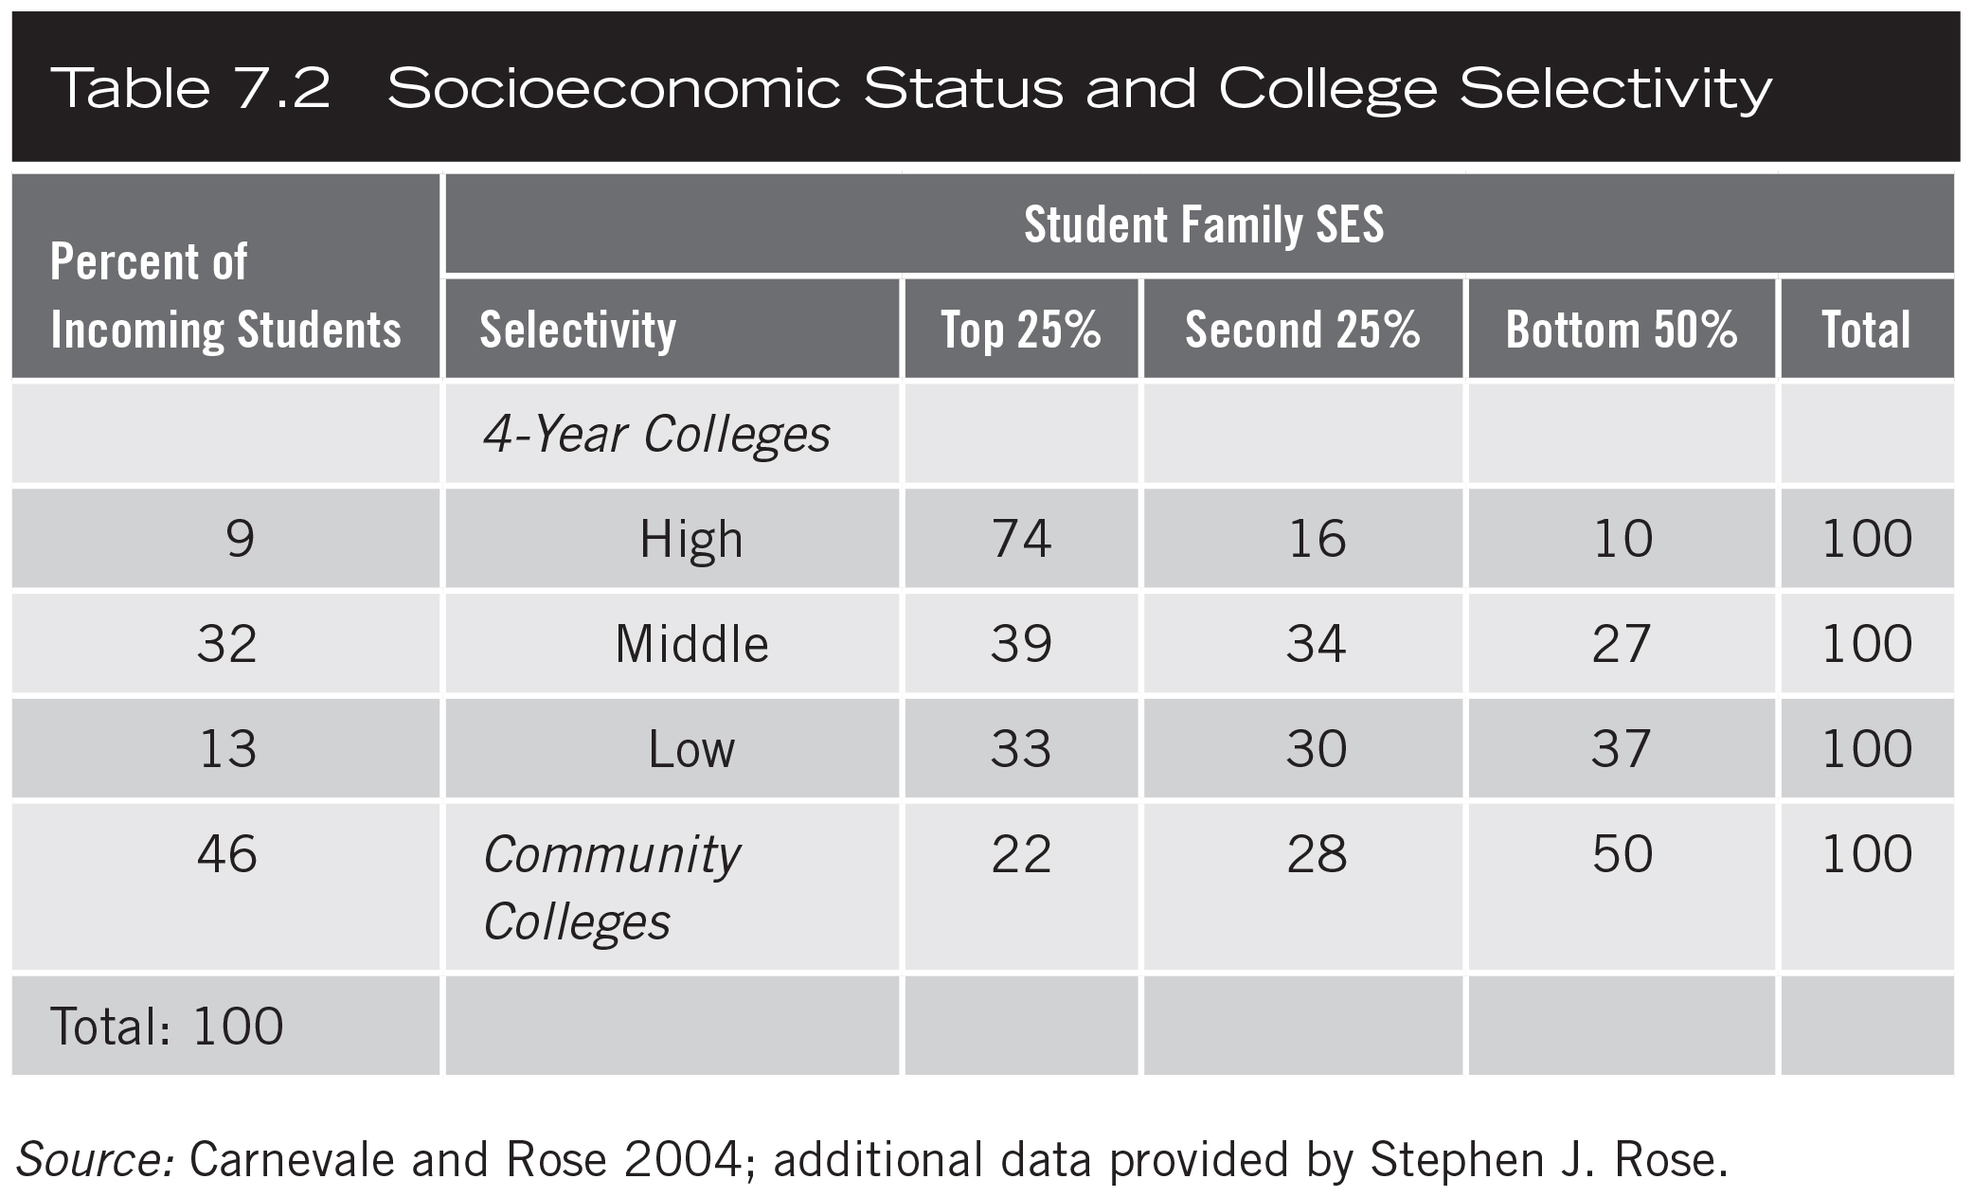

Slide 17
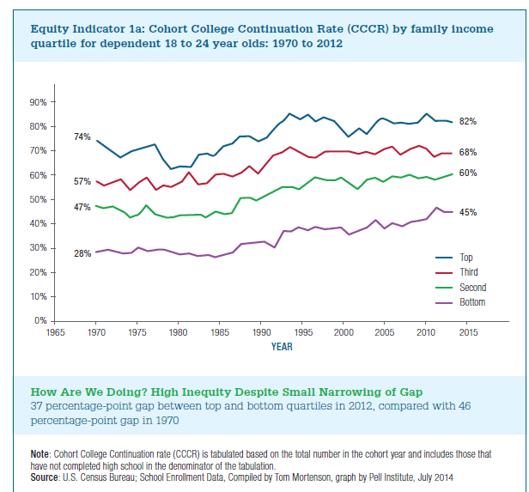
Income and Higher Education in the US

Slide 18
College Costs in the US
Annual tuition, fees, room and board in 2015-2016 (from nces.ed.gov):
Public four-year institutions: $19,189
Private four-year institutions: $39,529
Financial aid: there are many sources, including
  Pell grants (do not need to be repaid; based on financial need)
  Federal student loan program
  Work-study program
  State-level grants
  Institution-level grants

Slide 19
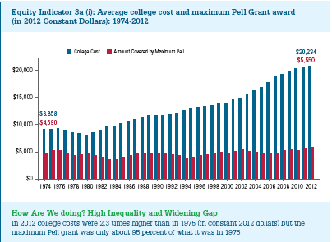
Financial Aid in the US: Pell Grants (from the Pell Institute, 2015)

Slide 20
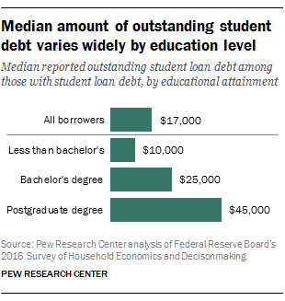
Student Debt in the United States

Slide 21
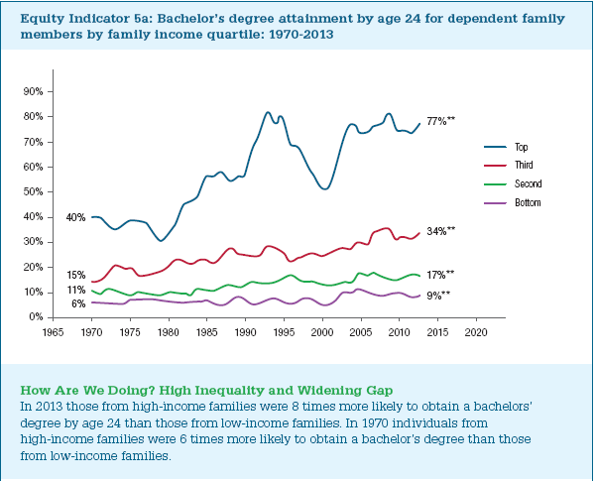
Family Income and Graduating from College in the US (from the Pell Institute, 2015)

Slide 22
Why Do Completion Rates Vary by Income, SES, or other factors? (from Alanna Bjorklund-Young, Johns Hopkins University)
“(S)tudents from low-income backgrounds are less likely to be academically prepared than students from high-income backgrounds. However, as highlighted above, lack of academic preparation alone does not explain why student from low-income backgrounds are so much less likely to graduate with a college degree. Other causes include financial constraints, the types of colleges that students from low-SES backgrounds attend, and lack of necessary support or information along the way.”
Academically strong students, defined as those who scored in the top quartile in math, from low-SES backgrounds were still much less likely to graduate from college than students of similar or even lower academic ability from high-SES backgrounds. In fact, only 41% of academically strong students from low-SES backgrounds graduated from college, in comparison to 74% of similarly scoring students from high-SES backgrounds.

Slide 23
Beyond Income: First-Generation College Students
Article by Wilbur and Roscigno (2016): “First-generation Disadvantage and College Enrollment/Completion”
First-generation students do not have a parent who has attained a bachelor’s degree
Prior to entering college, first-generation students differ from non-first-generation students in:
  Cultural capital (knowledge of and participation in “legitimate” culture)
  Parents’ discussions with the child about high school
  Parents’ interactions with the child’s high school
  Parents’ discussions with child about college
  Money saved for college
  Grade point average and standardized test scores

Slide 24
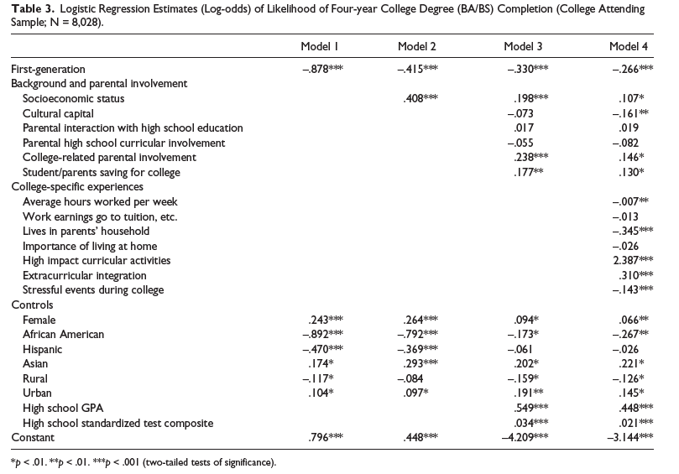
“First-generation Disadvantage and College Enrollment/Completion” – page 8

Slide 25
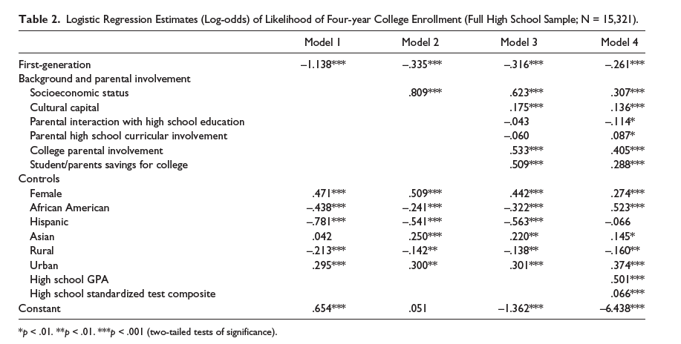
“First-generation Disadvantage and College Enrollment/Completion” – page 7

Slide 26
Cross-National Comparisons in Higher Education Inequality
Article by Jerrim, Chmielewski, and Parker (2015): “Socioeconomic Inequality in Access to High-Status Colleges: A Cross-Country Comparison”
Comparing the United States, England, and Australia: Do high achieving students from low-SES backgrounds have similar chances of attending high-status colleges as high-achieving students from high-SES backgrounds?
The high-status colleges in England and Australia are public sector; in the United States, there are both private and public sector high-status colleges
Page 30: “although academic achievement in high school is an important reason why high SES groups dominate enrollment at elite colleges, substantial direct effects of family background nevertheless remain. This holds true across Australia, England and the United States, with very similar magnitudes of socioeconomic inequality observed in each.”
  Big exception: Private high status colleges in the US

Slide 27
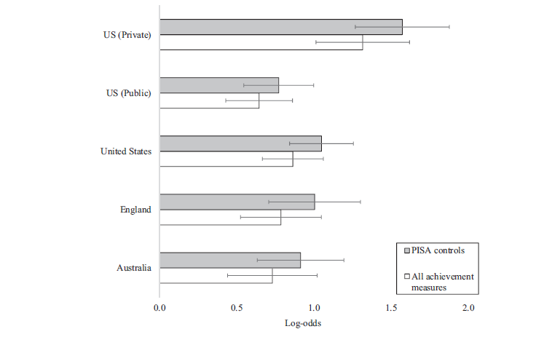
“Socioeconomic Inequality in Access to High-Status Colleges: A Cross-Country Comparison” Figure 1, page 28

Slide 28
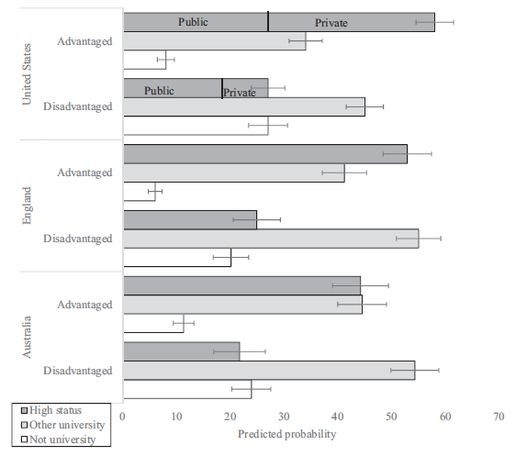
“Socioeconomic Inequality in Access to High-Status Colleges: A Cross-Country Comparison” Figure 2, page 29

Slide 29
Questions and Discussion
Questions?
Discussion 1: What can be done to increase the rates at which high-achieving low-SES students attend and graduate from high-status colleges?
Discussion 2: Many Western nations have achieved universal primary education and even secondary education. Should universal tertiary education (“college for all”) be the next goal for these nations? Why or why not?

