Slide 1


Inequality of Educational Opportunities
Second International Summer School
Ricardo A. Madeira
Department of Economics – University of São Paulo (USP)
Lecture 2:
Education choice and academic mobility: Evidence and Policy Interventions

Slide 2
Outline
Determinants of education choice and educational trajectory
Costs and benefits (perception) of investing in education might vary across social/racial groups
Using a experimental design in Brazil we tackle two relevant issues to explain differences in HK investment across social groups:
  The role of information about academic activities
  The effects of Psychology of Poverty on educational choices

Slide 3
Determinants of educational trajectory
Different social/racial groups present very different educational trajectories
  There are several potential explanations for that
    Benefit vs Costs of acquiring education
Returns to education (or perception) might be different across social groups
    Discrimination in the labor market
    Family inputs (human capital and wealth)
    Information on the return of academic activities
    Aspirations might not the same across social/racial groups
    Psychological tax associate with poverty/life hardships

Slide 4
Determinants of educational trajectory
Costs/effort to acquire education might also be different
    Access to credit markets (enable long run investments)
    Discrimination within school
      Last lecture we present evidence of racial stigma among K-12 teachers
    Social norms/identity among groups might impose psychological costs
      e.g the acting-white story (Austen-Smith and Fryer, 2005)
Investments in children’s HK have very high returns (Jensen, 2010). However, such investments are puzzling low (Glennerster and Kremer, 2011).

Slide 5
School Production Function
School fixed factors
Family fixed factors
Student Learning
School variable factors
Family variable factors
Student Characteristics

Slide 6
School Production Function
School fixed factors
Family fixed factors
Student Learning
School variable factors
Family variable factors
Student Characteristics

Slide 7
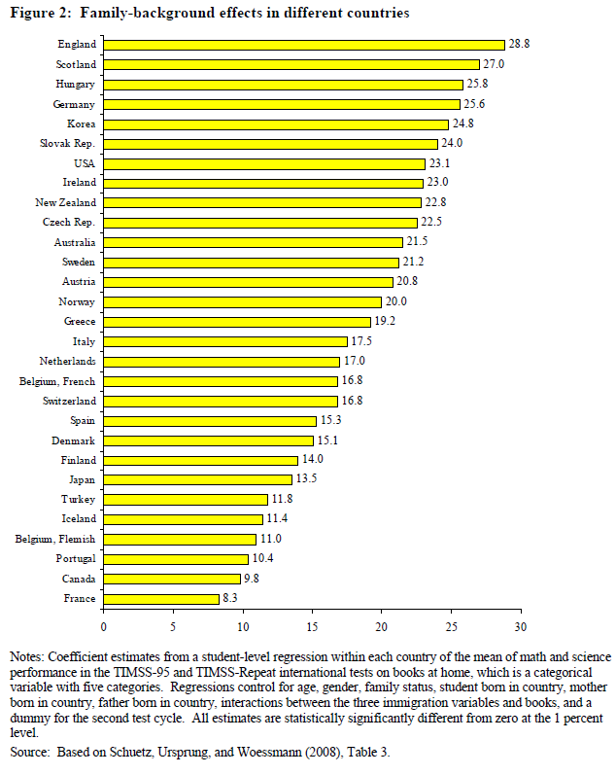
“(…) in England the difference in educational achievement between children of families with more than two bookcases of books and children of families with only very few books at home (the two extremes of the five available categories) is 1.15 standard deviations, or more than three times what students on average learn during a whole school year.”
- Hanushek and Woessmann (2011), p. 15.

Slide 8
Family Matters
Family SES is a key factor behind variation in educational achievement (Hanushek and Woessmann, 2011).
However, affecting family dynamics is daunting:
    Black-box of intra-household education production function
    Many children’s educational attainment is equal to or higher than that of their parents (62% in our sample of 9th graders)
Face-to-face interventions to support families are challenging:
    School activities for parents: low attendance
    Home visits: expensive
Remote interventions to support families: communication.

Slide 9
Communicating with parents works
  There is increasing evidence that communicating with parents can improve students’ outcomes:
    Attendance information sent by mail reduces absences by 5.3% (Rogers and Feller, 2016)
    Phone calls, text and written messages increase homework completion by 42% (Kraft and Dougherty, 2013).
    Emails, text messages and phone calls increase GPA by 0.08-0.19 standard deviations (Berlinski et al., 2017; Bergman, 2017)

Slide 10
Parent-child moral hazard
Informational interventions are based on the hypothesis that there is a moral hazard problem between parents and children, with high monitoring costs (Cunha and Heckman, 2007; Heckman and Mosso, 2014; Burztyn & Coffman, 2012)

Slide 11

The role of information
Nina
missed
Math class
yesterday!

Slide 12
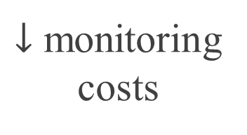
The role of information
$↓$ monitoring
costs
Nina
missed
Math class
yesterday!

Slide 13
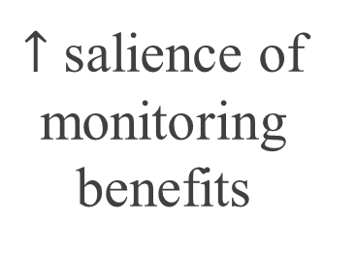
The (double) role of information
$↓$ monitoring
costs
Nina
missed
Math class
yesterday!
$↑$ salience of monitoring
benefits

Slide 14
Is it really about information?
Informing parents about their child’s attendance also draws their attention to the importance of attending class
    Hence, communication involves not only information, but also increasing awareness about monitoring benefits
Effects of communication interventions could be primarily driven by behavioral mechanisms, such as “learning through noticing” (Hanna, Mullainathan and Schwartzstein, 2014):
    Inattention, inaccuracy, and low willingness to acquire information
    Failures of learning even under Bayesian updating

Slide 15
Why does it matter?
The distinction between monitoring costs and salience of monitoring benefits matters for two reasons:
    Providing timely and accurate information is much more costly than nudging parents to pay attention
    Nudging may induce higher effects:
Certain pieces of information may not be as effective in raising perceived returns to monitoring
      Nudging allows for higher frequency and interactivity
      Nudging might be understood as a more “relevant type of information”.

Slide 16
Research Questions
  Does increasing the salience of the importance of monitoring children’s school behavior improve educational outcomes?
  How effective are nudges relative to information?
  What are the mechanisms behind the effects of nudges?

Slide 17
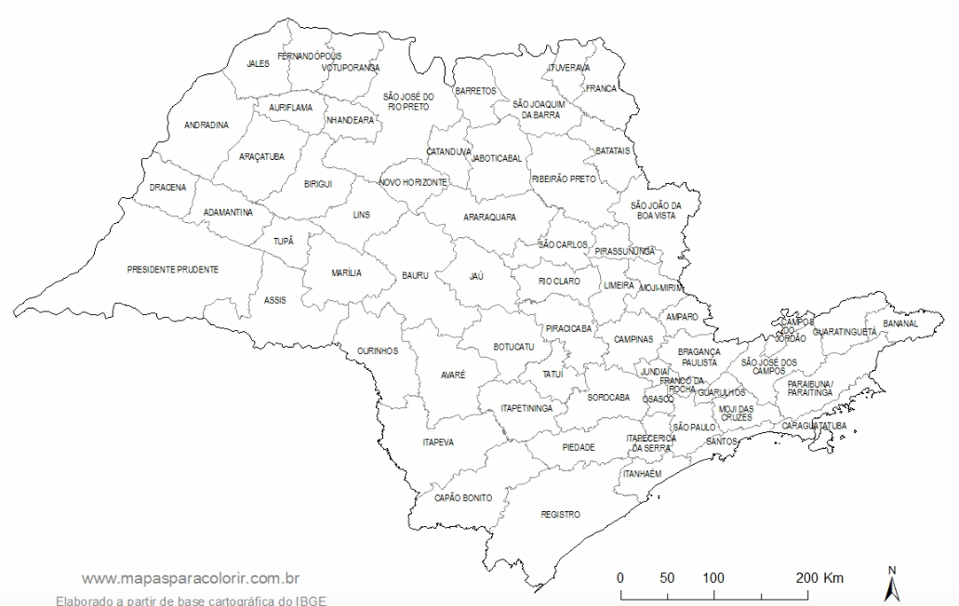
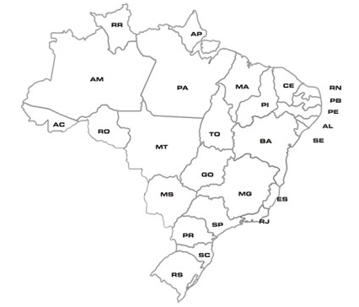
Sample
  São Paulo is the richest and most populous state in Brazil (43 million)
  It is the most extensive educational system of the country (9 million students)
  It is divided in 91 Regional Boards of Education
  The study: 5 Regional Boards of Education
    23,700 parents of 9th graders invited to participate
    15,600 parents enrolled (66%) – 226 schools

Slide 18
Timeline
Notes:
Tirar AAP

Slide 20
The intervention
Math teachers from treatment schools had to log into a platform each week to fill in with that week’s featured dimension of students’ behavior (attendance, tardiness or assignment completion), over the course of 18 weeks
Teachers from pure control schools do not log into the platform
Teachers are required to fill in information for all students, and are oriented to evaluate their behavior on each dimension considering the past three weeks.

Slide 21
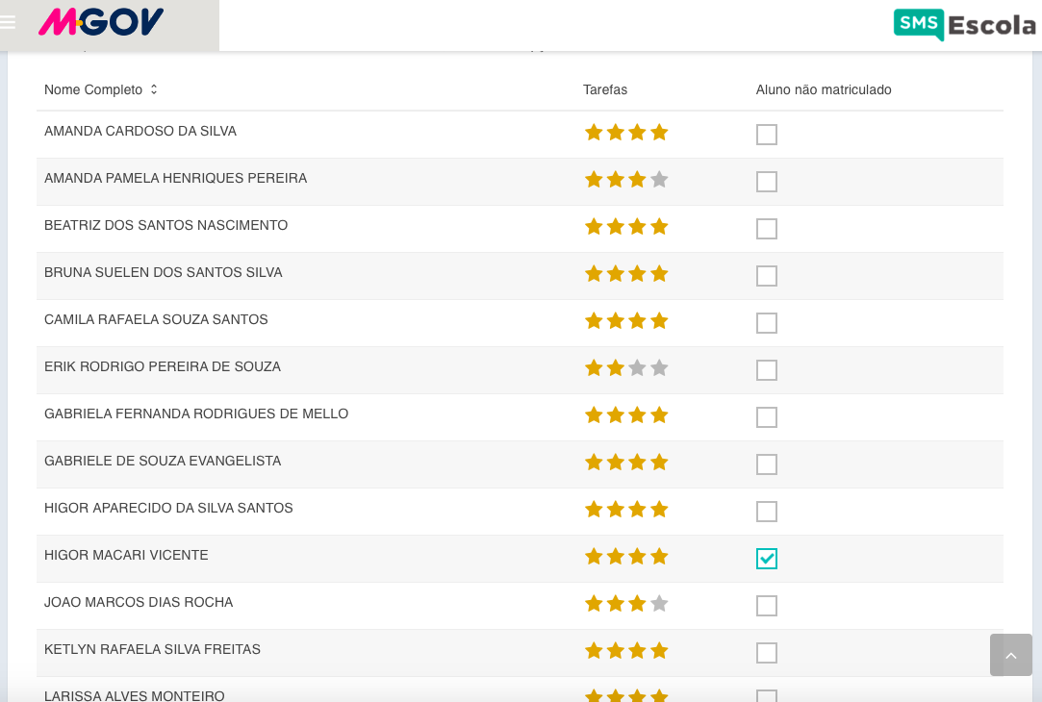
The intervention

Slide 22
The intervention
NINA CUNHA
GUILHERME LICHAND
RICARDO MADEIRA

Slide 23
The research design
  Concerns:
    Spillovers
    Teacher effects
    Type of information (nudge / absolute / relative)
  Randomization in two steps:
  Schools were randomly assigned to 4 different subsamples (A-D), varying saturation
    Stratifying assignment by the % of parents enrolled in the program, school math score and school absenteeism
  Students were randomized within class to each treatment arm (stratified by math score)

Slide 24
The research design
    Subsample A allows separating the effects of information and salience
    Subsample B provides a counterfactual for estimating spillovers
    Subsample C provides a more demanding counterfactual for salience: relative information
    Subsample D allows estimating the effect of salience without interactions with information
    Subsample E is a parallel intervention to test the optimal design of a SMS campaign and also allows isolating the effect of SMS from teacher behavior (not balanced with pure control)

Slide 25
The research design
  All schools can use the platform to inform parents about school events
    Allows surveying parents in the control group
    Controls for selection at enrollment in the program

Slide 26
Assignment
  Parents in treatment schools were randomly assigned to either the Control group (no message), to the Salience group, or to the Information group.
  Although teachers fill in child-level information every week, parents in the Salience group only receive general information aimed at raising awareness about that dimension of children’s effort.

Slide 27
Assignment and SMS content
  Teachers and schools were not aware of their assignment, nor of parents’ assignment.
  Text messages are designed such that they have approximately the same number of characters across groups.
  Parents in any treatment group only received text messages if the teacher filled in the platform that week. This is true even for Salience, in order to avoid confounding treatment effects with teachers’ non-compliance.

Slide 28
Outcomes
  Platform data:
    Attendance, lateness and assignment completion
  Administrative data:
    Attendance, GPA and promotion rates
    Standardized test (System of School Performance Evaluation of the State of São Paulo, SARESP), taken at the end of the school year
  Parents’ surveys:
    Phone surveys about beliefs and parental engagement (baseline & endline)
  Students’ survey:
    Endline survey about parental engagement and student’s habits, values, aspirations and socio-emotional skills
Notes:
Tirar AAP

Slide 29
Manipulation Tests: Platform

Slide 30
Manipulation Tests: Endline Survey

Slide 31
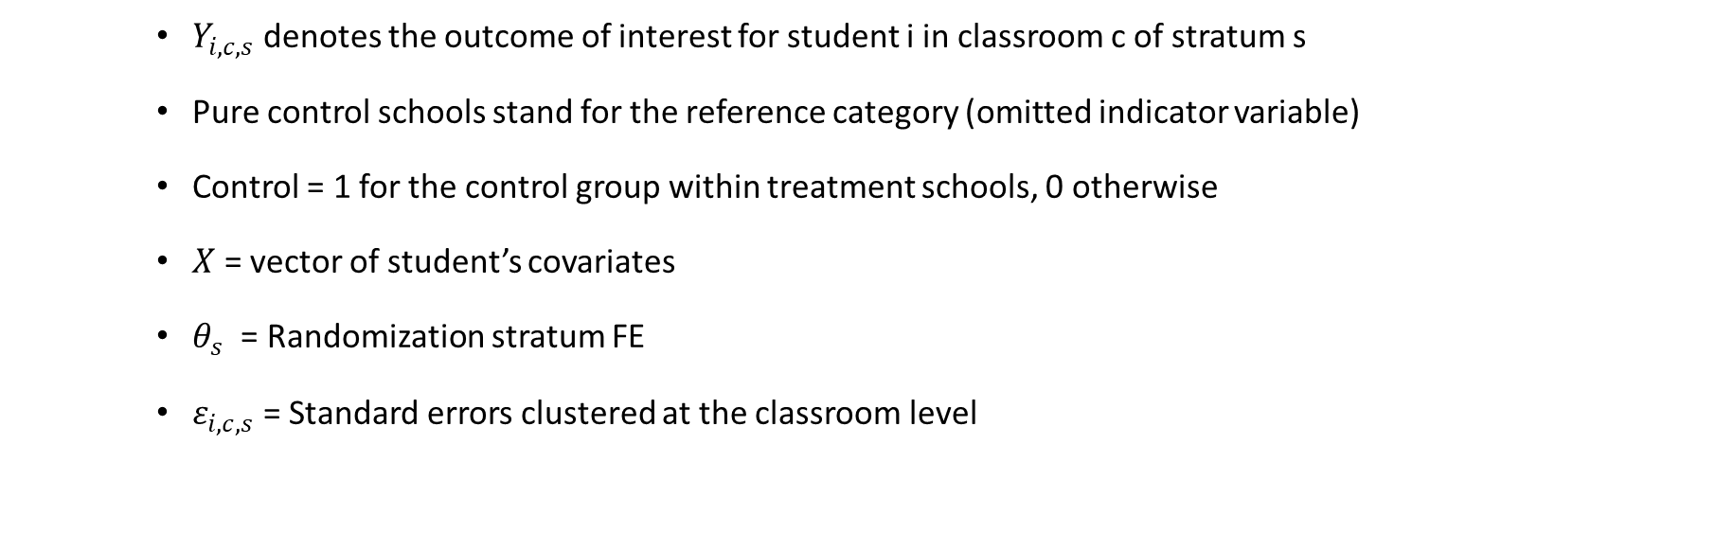
Empirical Strategy
    $Y_{i,c,s}$ denotes the outcome of interest for student i in classroom c of stratum s
    Pure control schools stand for the reference category (omitted indicator variable)
    Control = 1 for the control group within treatment schools, 0 otherwise
    $X$ = vector of student’s covariates
    $θ_{s}$ = Randomization stratum FE
    $ε_{i,c,s}$ = Standard errors clustered at the classroom level

Slide 32
Results:

Slide 33
Results:

Slide 34
Relative Information:
    Parents may already have information about their child; the relevant missing piece may be how to place student behavior within the classroom
    If that is the case, relative information is that right benchmark to which awareness should be compared
    Platform computes the classroom median behavior once the teacher submits all students’ weekly information.

Slide 35
Results:

Slide 36
Theory of Change
  Parent’s behavior, beliefs and aspirations
  Children’s behavior and socio-emotional skills
  Attendance, grades and promotion rate

Slide 37
Theory of Change
PARENTS
BEHAVIOR
    Talking more with their kids: 0.096** s.d.
    Incentivize good academic behavior: 0.068* s.d.
BELIEFS
    More accurate about GPA: 0.071** p.p.
ASPIRATIONS
    Updated aspirations about children going to college (student’s survey): 0.074**s.d.
STUDENTS
OUTPUTS
BEHAVIOR
    Academic activities: 0.17***s.d.
    Reading activities: 0.12**s.d
    Other activities: -0.07
SOCIO-EMOTIONAL
    Increase in growth mindset (only for the Information treatment): 0.077*s.d
OUTCOMES
ATTENDANCE
0.021***p.p.
GPA
0.09***s.d.
STANDARDIZED TEST
0.095**s.d.
PROMOTION RATE
0.032***p.p.

Slide 38
Boys vs Girls:
PARENTS
BEHAVIOR
    Academic Activities
Boys Girls Diff.
0.12** -0.03 -0.15**
    Talking more with their kids
Boys Girls Diff.
0.13*** 0.07 -0.06
    Incentivizing them to a good academic behavior
Boys Girls Diff.
0.06 0.07 0.02
BELIEFS
    More accurate about GPA (p.p)
Boys Girls Diff.
0.12*** 0.03 -0.09*
ASPIRATIONS
    Updated aspirations about children going to college (student’s survey):
    Boys Girls Diff.
0.10* 0.05 -0.06
STUDENTS
OUTPUTS
BEHAVIOR
    Academic activities
Boys Girls Diff.
0.24*** 0.11* -0.13**
    Reading activities
Boys Girls Diff.
0.16** 0.08 -0.07
    Other activities
Boys Girls Diff.
-0.08 -0.07 0.01
SOCIO-EMOTIONAL
    Grit
Boys Girls Diff.
0.08 - 0.08 -0.16**
    Self-Esteem
Boys Girls Diff.
0.07 -0.05 -0.13*
    Impulsivity
Boys Girls Diff.
0.07 -0.03 -0.10
OUTCOMES
ATTENDANCE
Boys Girls Diff.
0.03*** 0.02** -0.01
GPA
Boys Girls Diff.
0.12*** 0.06* -0.05
STANDARDIZED TEST
Boys Girls Diff.
0.11** 0.08 -0.02
PROMOTION RATE
Boys Girls Diff.
0.04** 0.02** -0.02

Slide 39
The nudge program
Week 1
Week 1
Week 2
Week 2
Motivating fact
Suggested activity
Interactivity
Growth
Reading
develops skills!
Read to
your child!
Did you
do it?
Do it
every week!

Slide 40
Summing up
Weekly communication has large impacts:
  2.1 p.p in attendance
  0.9 + SD in test scores
  3.2 p.p in promotion rates
Salience and information have similar effects
Consistent with the mechanism, effects of communication are larger for higher frequency and alternating delivery times.
The optimal nudge program increased test scores by 0.33 standard deviations, almost 4-fold the effect of information alone.

Slide 41
Psychology of Poverty
Lab evidence that poverty imposes a psychological tax on the foundations of decision-making:
  Mental bandwidth focuses on scarcity at hand at the expense of “allocating” attention, memory and impulse control to all other dimensions (Mullainathan and Shafir, 2013)
Field evidence still scarce.
In particular, no causal evidence on:
  Psychological effects of poverty on education decisions
  Psychological effects of poverty on decisions that could generate poverty traps (through educational choices)
We take advantage of the SMS intervention to run a companion experiment (in the following year) to tackle these issues

Slide 42
Our research
Studies the causal effects of the psychology of poverty on parents’ decision to invest in an educational program with large (but heterogeneous) impacts on their children’s learning outcomes:
  First to document effects on real economic decision, with real consequences for their children’s HK formation and future earnings – potential for inter-generational persistence
  Focus on how willingness to invest varies with returns on investment:
    Do the poor respond to ROI the same way as the rich do?
Isolates psychological mechanism by means of:
    Removing liquidity constraints
    Undertaking a survey experiment that specifically manipulates worries about $
    Documenting focus on short-term outcomes
    Documenting how decisions change when long-term returns are top-of-mind

Slide 43
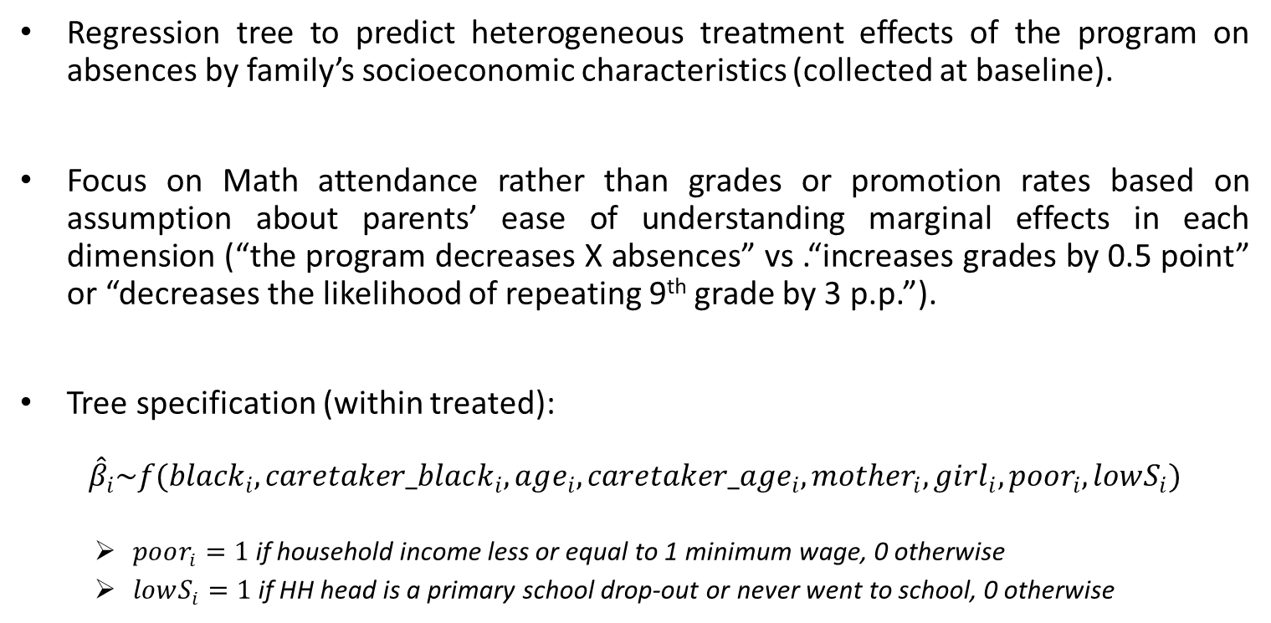
Predicting heterogeneous returns
Regression tree to predict heterogeneous treatment effects of the program on absences by family’s socioeconomic characteristics (collected at baseline).
Focus on Math attendance rather than grades or promotion rates based on assumption about parents’ ease of understanding marginal effects in each dimension (“the program decreases X absences” vs .“increases grades by 0.5 point” or “decreases the likelihood of repeating 9th grade by 3 p.p.”).
Tree specification (within treated):
$${\hat{β}}_{i}\sim f({black}_{i},caretaker_black_{i},age_{i},caretaker_age_{i},mother_{i},girl_{i}, poor_{i}, lowS_{i})$$
  $poor_{i}=1$ if household income less or equal to 1 minimum wage, 0 otherwise
  $lowS_{i}=1$ if HH head is a primary school drop-out or never went to school, 0 otherwise

Slide 44
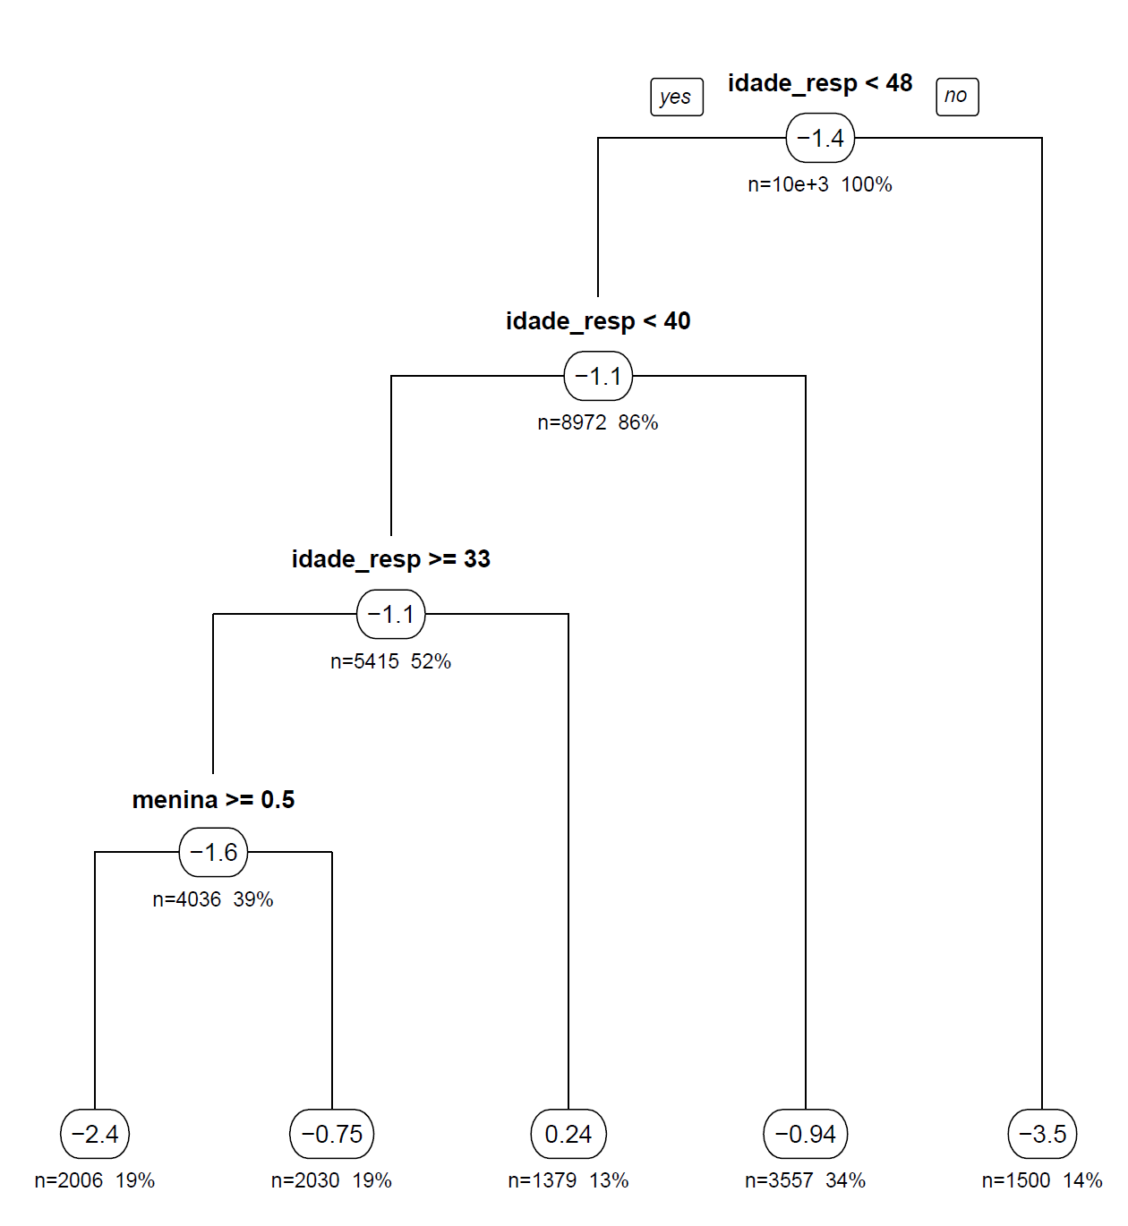
Predicted returns
Caretaker younger than 48
split.Rule = "TOT"
cv.option = "fit"
minsize =250
cv.Honest = F
split.Bucket = T
xval = 10
propensity = 0.8
Caretaker younger than 40
Caretaker older than 33
girl
Predicted ROI:
1
0
1
3
2

Slide 45
Predicted returns

Slide 46
Experimental design
3 experiments:
  Prior SMS experiment
  Survey experiment
  Salience experiment
Survey experiment stratified by assignment to other experiments, and by predicted returns.

Slide 47
Experimental design
Survey experiment:
  Control: “What would you do if your child’s school started charging R$20 for school uniforms and you had to pay by the end of this month?”
  Treatment: “What would you do if your child’s school started charging R$400 for school uniforms and you had to pay by the end of this month?”

Slide 48
Experimental design
Prior SMS experiment:
  Control: Up to 1 school-wide SMS every other week with communication about school activities
  Treatment: 1 SMS per week from school with child-specific message

Slide 49
Experimental design
Salience experiment:
  Control: “Last year, 19,000 families in the State of São Paulo participated in the project, receiving weekly text messages about their children’s school life.”
  Treatment: “Last year, we found out that sending messages about your child’s school life has the potential to decrease his/her absences by 0/1/2/3 over the course of 6 months.”

Slide 50
Timeline
2016 assignment:
  Prior exposure experiment
SMS:
  Salience experiment
Call (~6 minutes):
  Survey experiment
  Investment decision
  Worries about $
  Cognitive tests
Aug-Dec/
2016
Jun/2017
(d-2)
Jun/2017
(d)

Slide 51
Design Summary: sampling frame
Stratified by predicted returns and by prior exposure to the program:
 |  | Survey experiment
 |  | Not Primed | Primed
Salience | No | Rich (3,873) | Poor (3,904)
 | Yes | Rich ROI top-of-mind (3,944) | Poor ROI top-of-mind (3,853)

Slide 52
Design Summary: sample
Stratified by predicted returns and by prior exposure to the program:
 |  | Survey experiment
 |  | Not Primed | Primed
Salience | No | Rich (663) | Poor (638)
 | Yes | Rich ROI top-of-mind (634) | Poor ROI top-of-mind (623)

Slide 53
Worries about $
Manipulation check: “How worried are you about not having money to pay all household bills at the end of this month? If you are not worried at all, press 0; if you are somewhat worried, press 1; if you are very worried, press 2; or if you are desperate, press 3.”

Slide 54
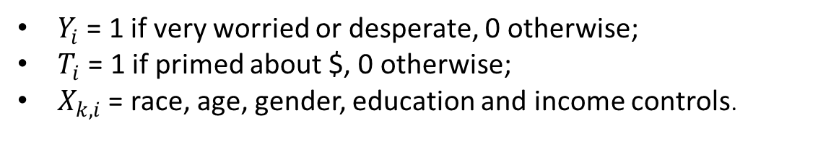
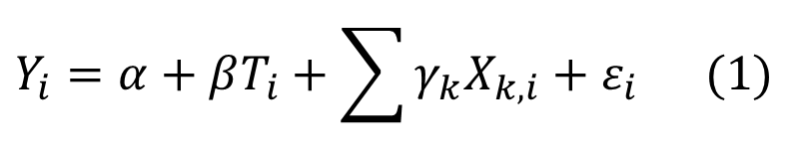
Empirical strategy
$$Y_{i}=α+βT_{i}+\sum{γ_{k}X_{k,i}}+ε_{i} (1)$$
$Y_{i}$ = 1 if very worried or desperate, 0 otherwise;
$T_{i}$ = 1 if primed about $, 0 otherwise;
$X_{k,i}$ = race, age, gender, education and income controls.

Slide 55
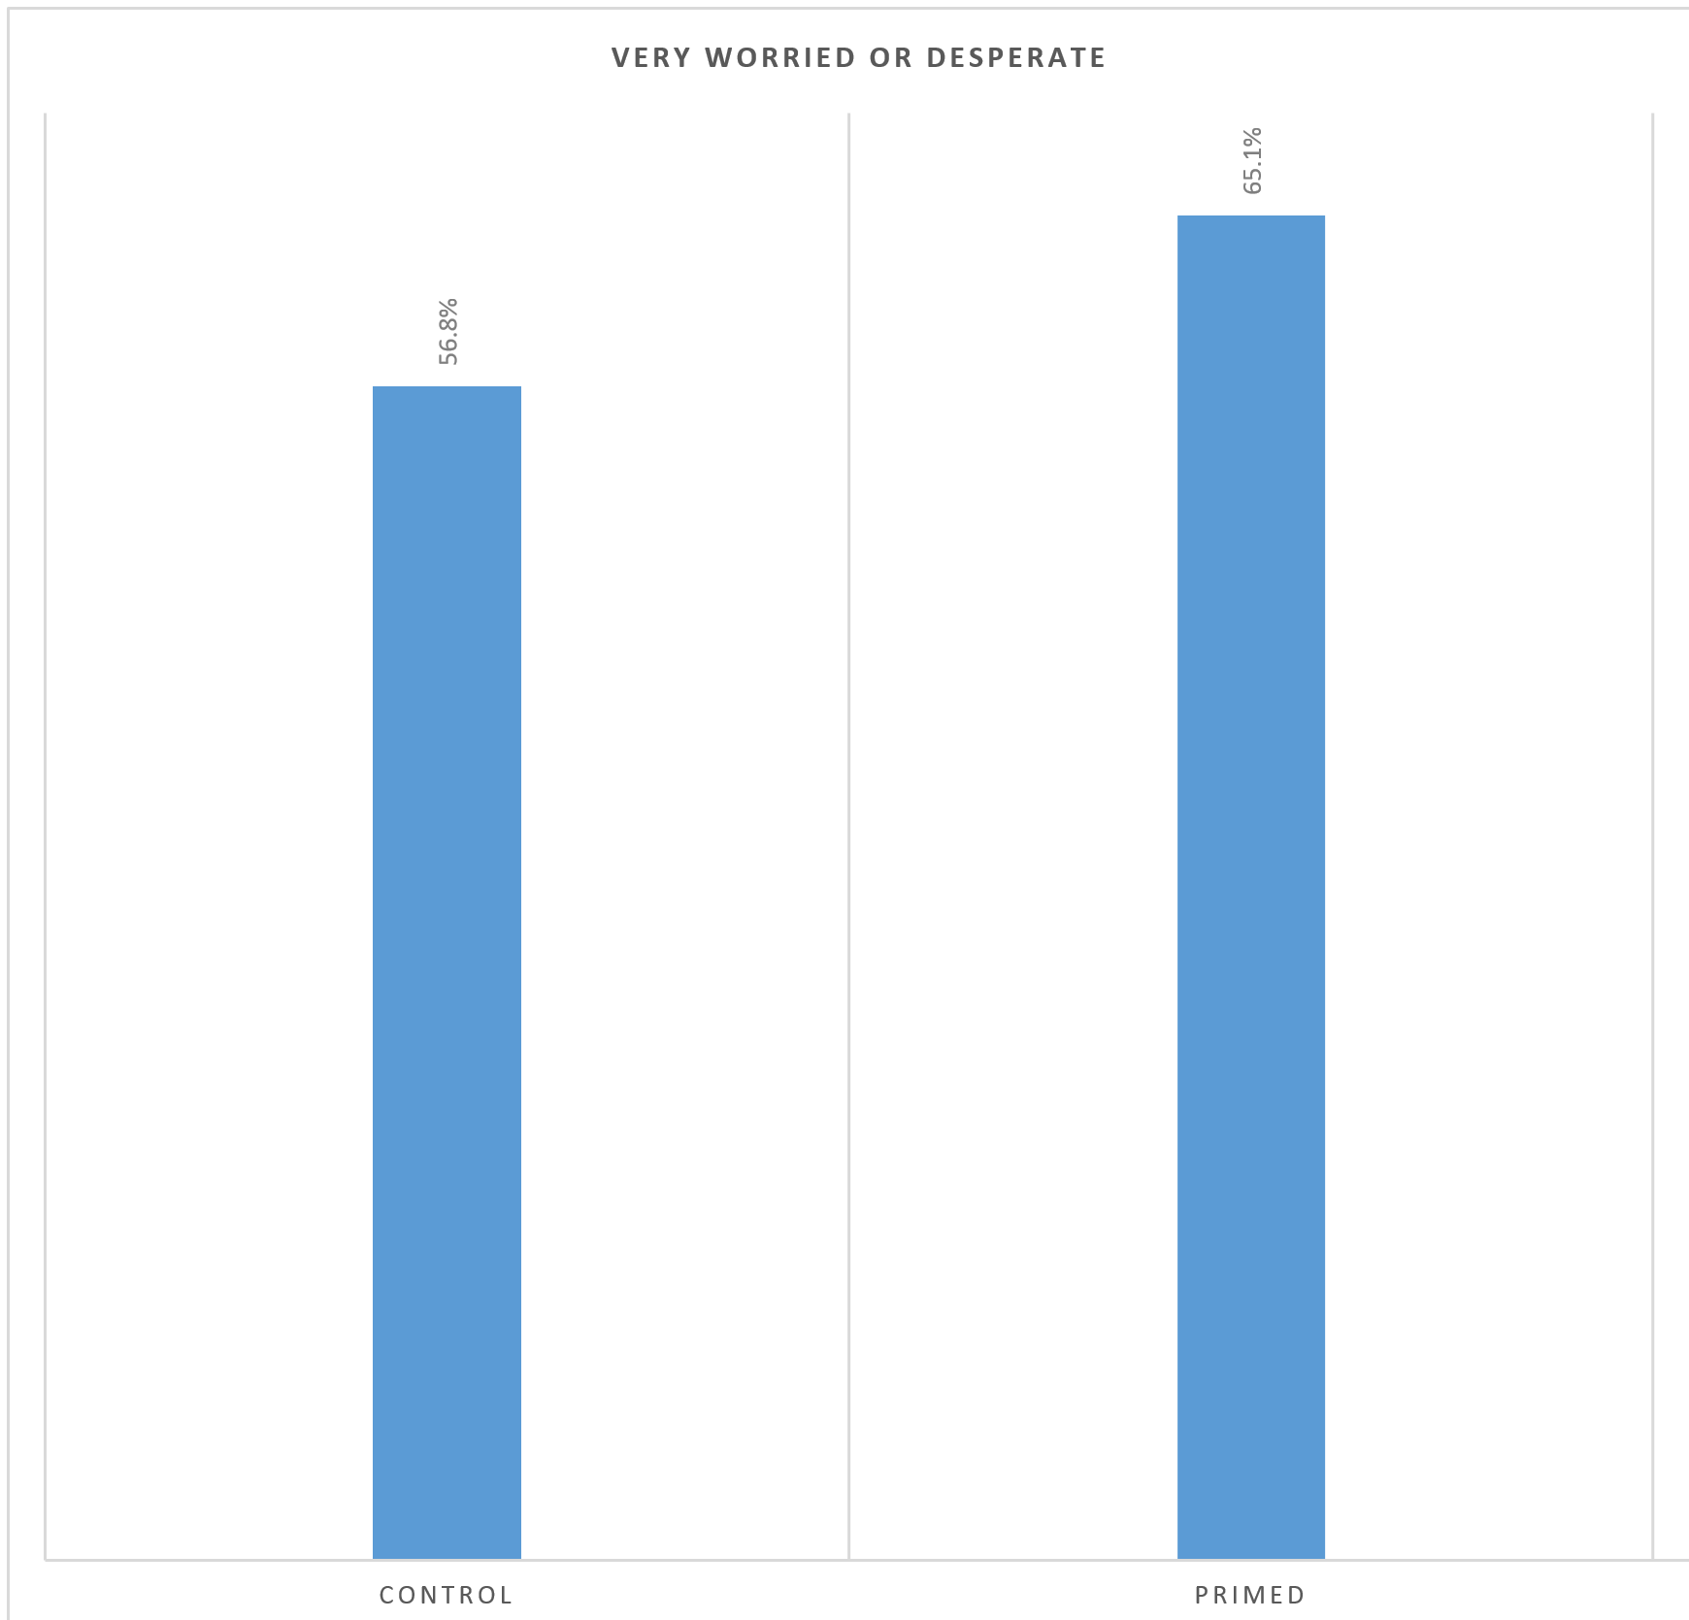
Worries about $
Manipulation check: “How worried are you about not having money to pay all household bills at the end of this month?”
8.3% ***

Slide 56
Worries about $

Slide 57
Investment in children’s hk
  Investment decision: “You already earned R$10 in airtime credit by answering this call until the end. Would you rather exchange those R$10 for 6 months of weekly text messages about your child’s school life? If you would like to exchange airtime by the text messages, press 1; if you would like to keep the airtime, press 2; or to listen again, press 9.”

Slide 58
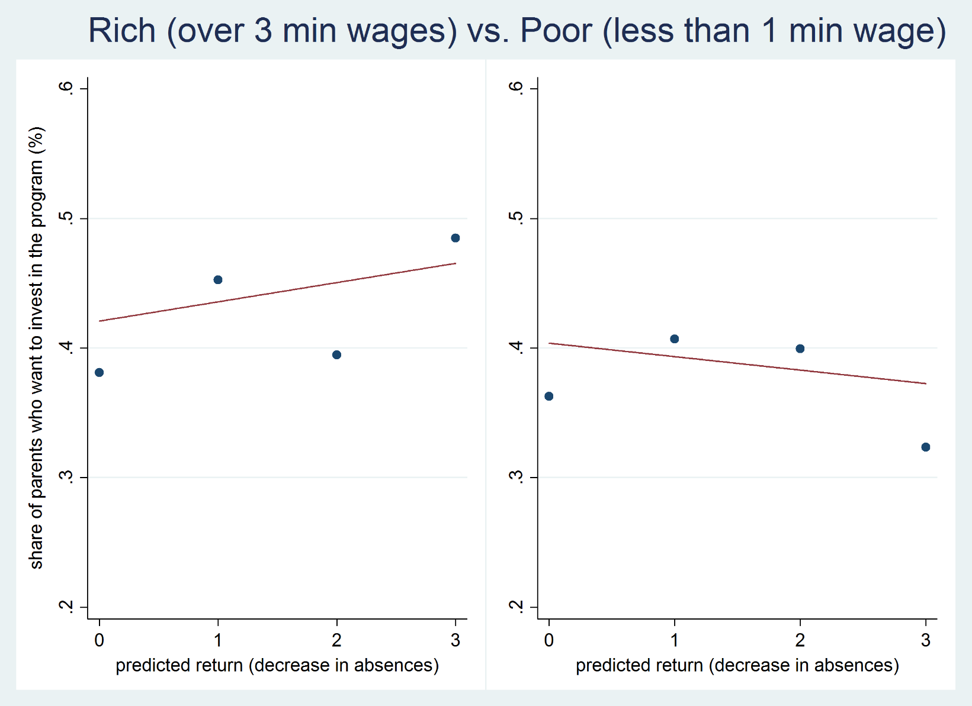
Sample correlation

Slide 59
Sample correlation

Slide 60
Sample correlation

Slide 61
Experimental variation
Survey experiment:
  Control: “What would you do if your child’s school started charging R$20 for school uniforms and you had to pay by the end of this month?”
  Treatment: “What would you do if your child’s school started charging R$400 for school uniforms and you had to pay by the end of this month?”

Slide 62
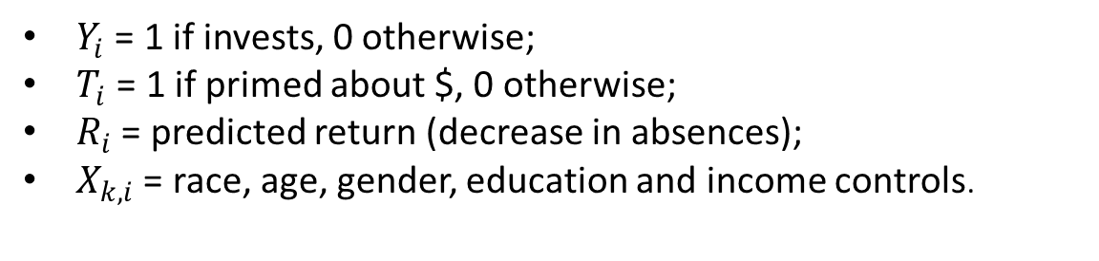
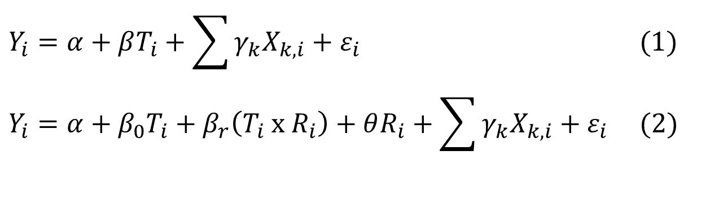
Empirical strategy
$$Y_{i}=α+βT_{i}+\sum{γ_{k}X_{k,i}}+ε_{i} (1)$$
$$Y_{i}=α+β_{0}T_{i}+β_{r}\left(T_{i} x R_{i}\right)+θR_{i}+\sum{γ_{k}X_{k,i}}+ε_{i} (2)$$
$Y_{i}$ = 1 if invests, 0 otherwise;
$T_{i}$ = 1 if primed about $, 0 otherwise;
$R_{i}$ = predicted return (decrease in absences);
$X_{k,i}$ = race, age, gender, education and income controls.

Slide 63
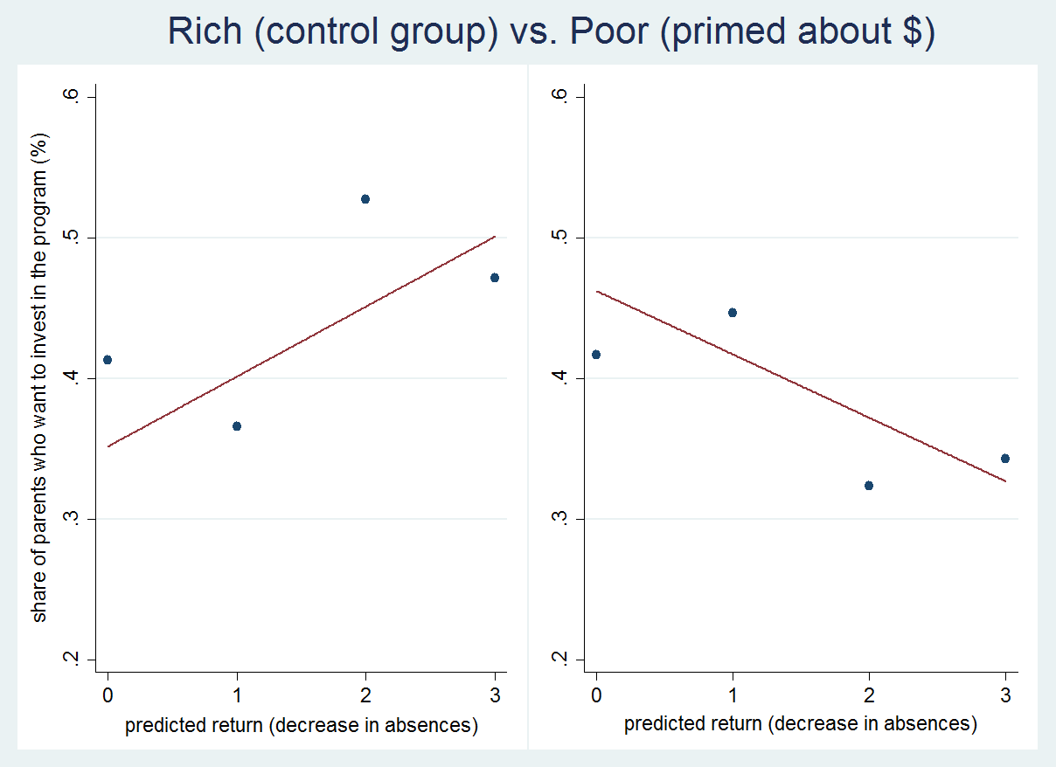
EXPERIMENTAL RESULTS

Slide 64
EXPERIMENTAL RESULTS

Slide 65
EXPERIMENTAL RESULTS

Slide 66
EXPERIMENTAL RESULTS

Slide 67
EXPERIENCE vs. investment
  Investment decision: “You already earned R$10 in airtime credit by answering this call until the end. Would you rather exchange those R$10 for 6 months of weekly text messages about your child’s school life?”

Slide 68
Effects of EXPERIENCE

Slide 69
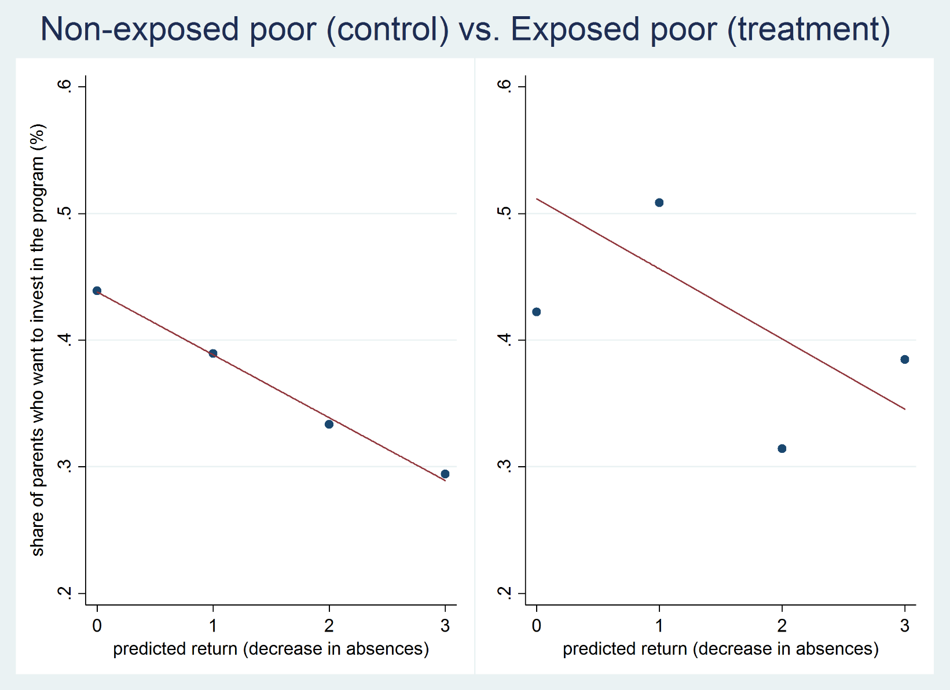
Effects of EXPERIENCE

Slide 70
Making returns top-of-mind
Salience experiment:
  Control: “Last year, 19,000 families in the State of São Paulo participated in the project, receiving weekly text messages about their children’s school life.”
  Treatment: “Last year, we found out that sending messages about your child’s school life has the potential to decrease his/her absences by 0/1/2/3 over the course of 6 months.”

Slide 71
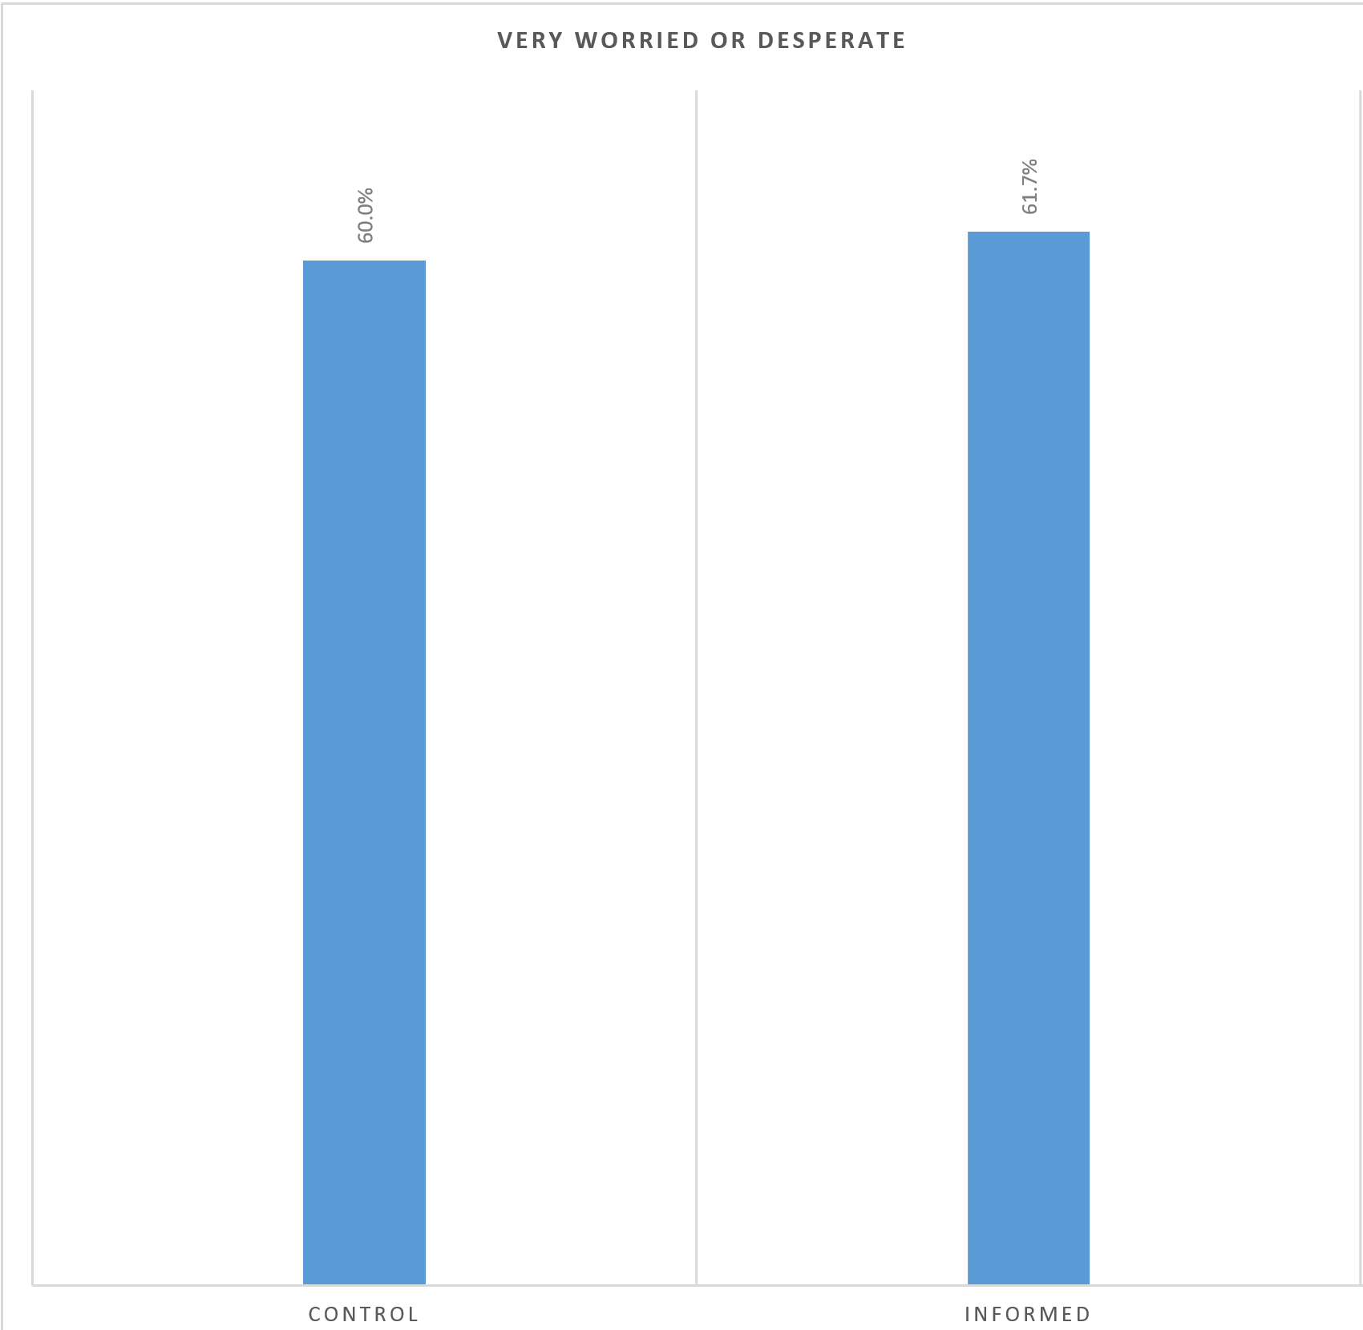
SALIENCE DOESN’T AFFECT WORRIES
Manipulation check: “How worried are you about not having money to pay all household bills at the end of this month?”

Slide 72
SALIENCE DOESN’T AFFECT WORRIES

Slide 73
SALIENCE vs. investment
  Investment decision: “You already earned R$10 in airtime credit by answering this call until the end. Would you rather exchange those R$10 for 6 months of weekly text messages about your child’s school life?”

Slide 74
Effects of SALIENCE

Slide 75
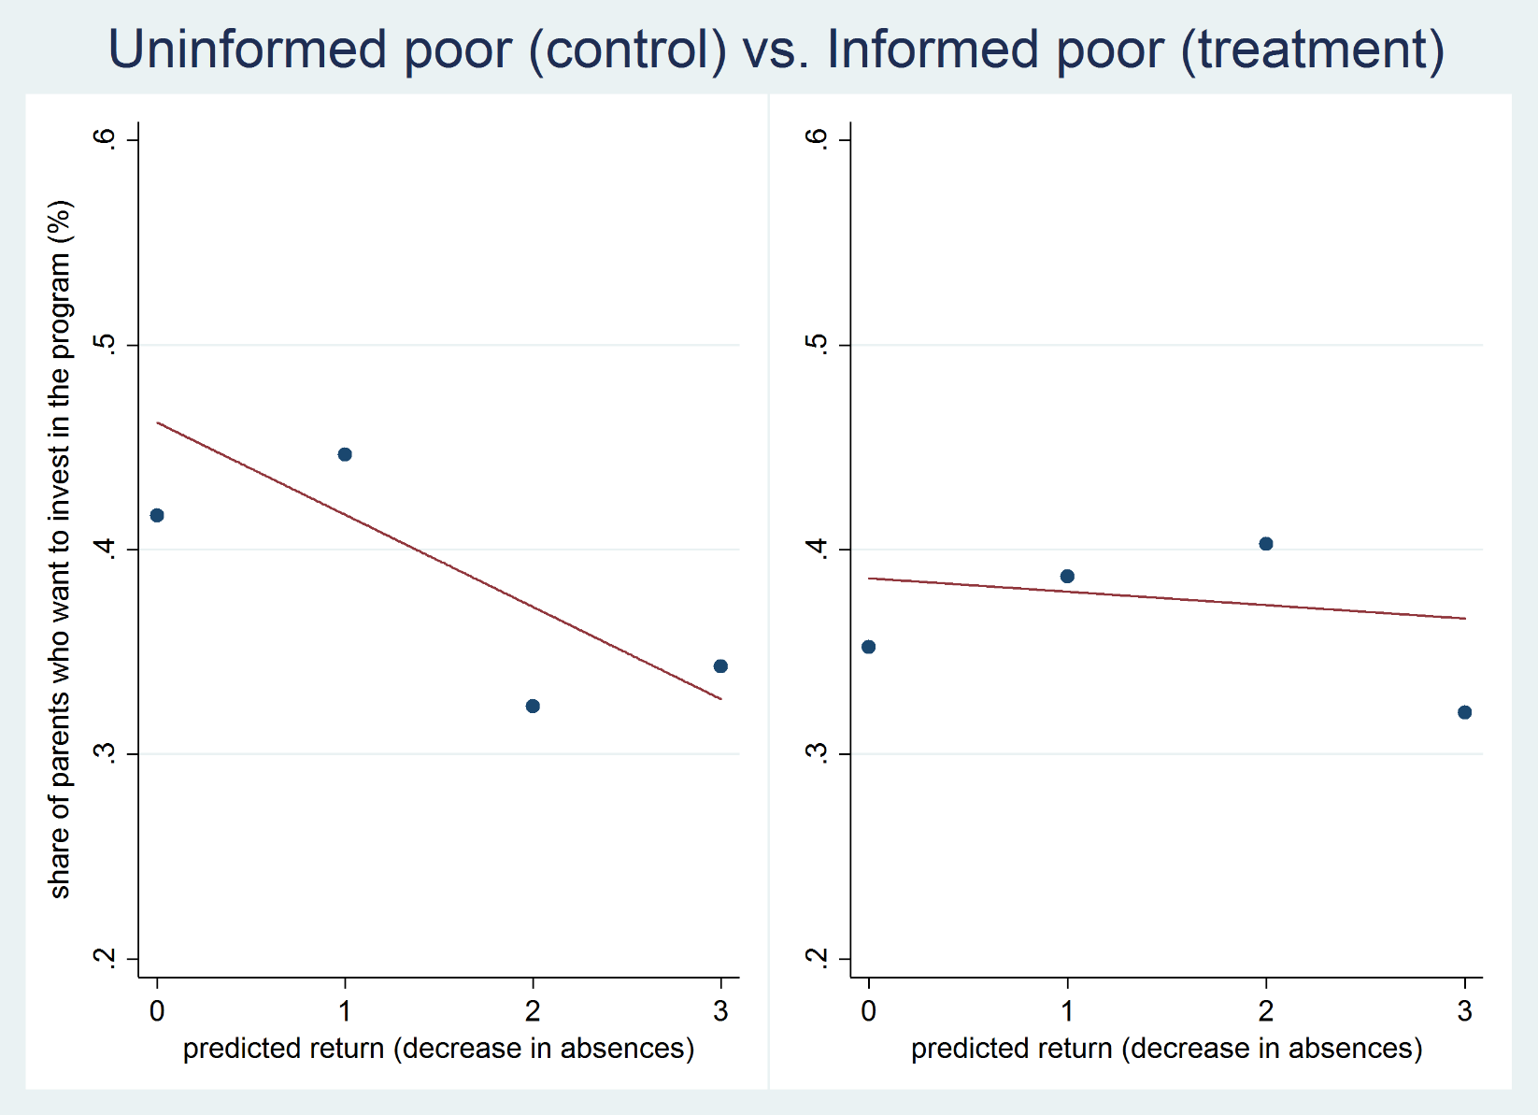
Effects of SALIENCE

Slide 76
Concluding remarks
Psychological consequences of poverty affect real economic decisions, with potential consequences for inter-generational transmission and poverty traps through educational choice.
Poverty shifts focus away from long-term returns, inducing the poor to invest less when it yields high returns – and more when it yields low returns, amongst inexperienced subjects.
May help explain puzzles of low-take and demand-driven misallocation of investments in Health and Education.
Policy implications:
  Alleviating liquidity constraints is not enough
  Prior exposure to build up experience may help with levels, but not with response to ROI
  Need to modify the environment: make decisions automatic, make returns top-of-mind

Slide 77
Thank You
Ricardo A. Madeira
rmadeira@usp.br

