Slide 1
Educational Opportunity during and after the COVID-19 Pandemic
Fernando M. Reimers
Professor of International Education
Harvard University
@FernandoReimers

Slide 2
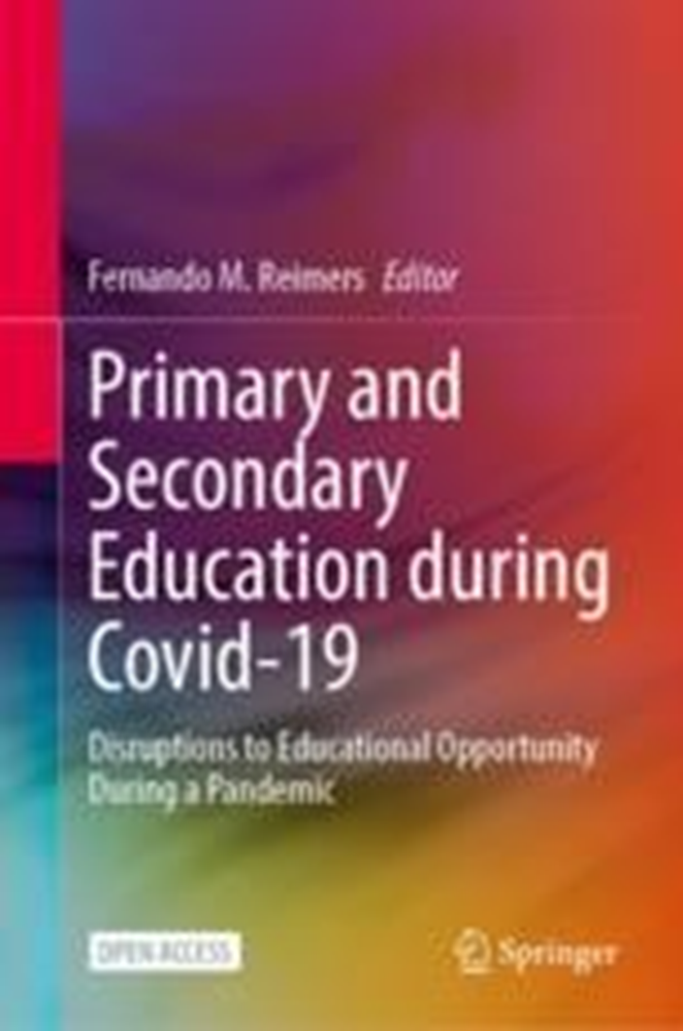
https://link.springer.com/book/10.1007/978-3-030-81500-4

Slide 3
Countries Covered
Brazil
Chile
Finland
Japan
Mexico
Norway
Portugal
Russia
Singapore
Spain
South Africa
United States

Slide 4
Influence of COVD-19 on Education Austerity (Governments) Austerity (Individuals) Health Impact of Life Loss Interruption of Schools (Learning Loss) Multiplier effects of Pandemic on other challenges

Slide 5
Lessons learned – Not a single story
Importance of policy (duration of closures, focus on disadvantaged students)
Role of pre-existing conditions
Inter-sectoral coordination
Coordination across levels of government
Leadership
Partnership with civil society
Cross-national cooperation

Slide 6
http://www.ibe.unesco.org/en/news/education-and-covid-19-recovering-shock-created-pandemic-and-building-back-better-educational

Slide 7
Reteach competencies
not learned
Teach with more effectiveness
Build back better

Slide 8
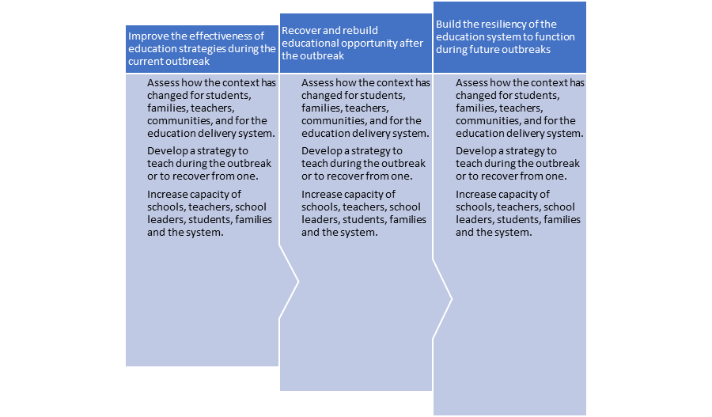

Slide 9
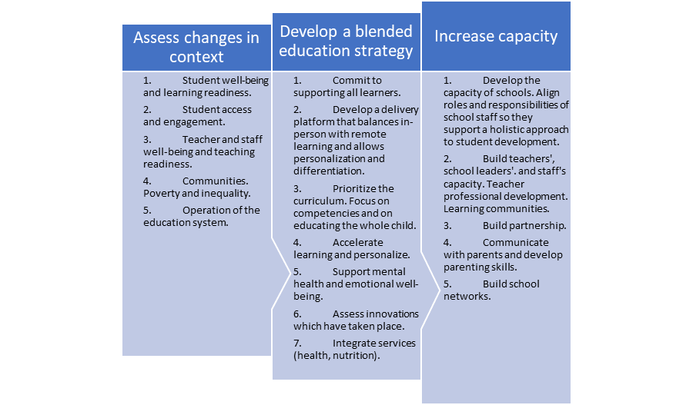

Slide 10
https://link.springer.com/book/10.1007/978-3-030-82159-3

Slide 11
Four Theses
Technology allows the development of educational networks and the pandemic created an opportunity to increase the capacity of those networks. The crisis generated by covid-19 promoted the link between universities and schools The creation of networks between universities and schools and educational systems, provides a unique opportunity to integrate the missions of advancing knowledge, educating and extension of the University. Networking with universities provides schools and education systems with the opportunity to increase their capacity to innovate in curriculum development, pedagogy and school management.

Slide 12
Four Theses
Technology allows the development of educational networks and the pandemic created an opportunity to increase the capacity of those networks. The crisis generated by covid-19 promoted the link between universities and schools The creation of networks between universities and schools and educational systems, provides a unique opportunity to integrate the missions of advancing knowledge, educating and extension of the University. Networking with universities provides schools and education systems with the opportunity to increase their capacity to innovate in curriculum development, pedagogy and school management.

Slide 13
Four Theses
Technology allows the development of educational networks and the pandemic created an opportunity to increase the capacity of those networks. The crisis generated by covid-19 promoted the link between universities and schools The creation of networks between universities and schools and educational systems, provides a unique opportunity to integrate the missions of advancing knowledge, educating and extension of the University. Networking with universities provides schools and education systems with the opportunity to increase their capacity to innovate in curriculum development, pedagogy and school management.

Slide 14
Studying the University's responses during the pandemic provides insight into its responsiveness to complex social challenges, and its ability to operate as learning organizations, open to their outside environment.

Slide 15
The COVID-19 Pandemic: An Adaptive Challenge
The most recent forecast of global trends from the U.S. National Intelligence Council describes the impact of Covid-19 as disrupting economies and political dynamics within and between nations, creating new uncertainties about the global economy, governance, geopolitics and technology. The report concludes that the pandemic accelerated and accentuated pre-existing trends, highlighting global health and health care, revealing and widening social fissures, and highlighting gaps in international coordination. The effects of the pandemic spread to other areas, such as the disruption of global supply chains, the increase in national debt, government intervention in economies, the accentuation of exclusionary nationalism and polarization, deepening inequality, exposure to the digital divide, governance tension , the exacerbation of polarized information that undermines public trust in government, among other challenges. (National Intelligence Council 2021, 11-13).

Slide 16
http://tinyurl.com/UnivSocial

Slide 17
Did the high-impact disruptions to the external environment caused by the pandemic show that the university is a learning organization? Did universities' response to the pandemic actually support the idea that they are institutions open to their external environment, able to learn from and with their environment?

Slide 18
Develop and share a vision focused on learning for all students; Create and support continuous learning opportunities for all staff; Promote team learning and collaboration among staff; Establish a culture of research, innovation and exploration; The establishment of integrated systems for the collection and sharing of knowledge and learning; Learning with and from the external environment and a broader Learning system; and modeling and increasing learning leadership (Kools and Stoll 2016, 3).
Learning educational organizations

Slide 19
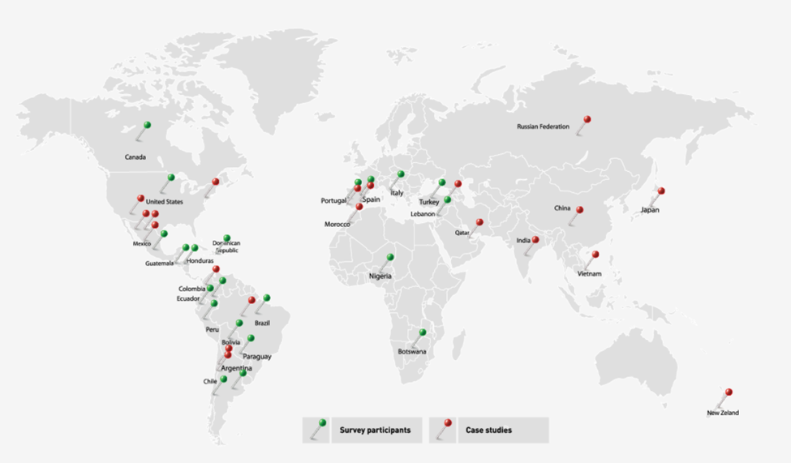

Slide 20
Brazil: Fundação Getulio Vargas
provide policymakers with access to reliable information to navigate the crisis, and make high-quality online educational resources available to high-school students and education professionals. In particular, FVG created a website that allows students to practice for the National High School Examination (ENEM), which is used by prestigious institutions of higher education as an admission test for enrollment. Other initiatives carried out by FGV in support of school education include the provision of free online courses and a significant effort to disseminate best practices and establish a policy dialogue with local governments. The pandemic has allowed to increase the level of collaboration between the different areas of FGV that focus on primary and secondary education.

Slide 21
Chile – Pontificia Universidad Catolica de Chile (PUC)
In response to a request from the Chilean government to support efforts to address the pandemic, an advisory committee was established under the leadership of the Presidents of the Catholic University of Chile (PUC) and the University of Chile (UCh). One of the tasks of this ad hoc committee has been to work on specific proposals and guidelines to assist the school system with the necessary measures to provide social and academic support to primary and secondary school students and their parents. One of the results of the partnership is the development of specific and adaptive guidelines to implement a prioritized curriculum in schools that will be implemented for the 2020 and 2021 academic years. In addition, in conjunction with other universities, two documents were drafted and disseminated with guidelines for the proper management of schools during the pandemic and curriculum adjustment policies. Finally, at PUC, the practical training system for students of the Faculty of Education was quickly adapted to a virtual educational environment that allows the design of new materials, the training of students in schools, etc.

Slide 22
Chile – Universidad de Chile (UC)
During the pandemic, the University of Chile (UC) redesigned and maintained a public-private partnership between the Arauco Educational Foundation, the Center for Advanced Research in Education (CIAE-Universidad de Chile) and the Andalien Sur Local Public Education Service (SLEP) with the aim of preventing school exclusion (repetition and dropout) in public schools. The program has been supporting education in a group of 12 schools through pilots, with the ultimate goal of continuing to implement successful practices in a greater number of public schools in the country.

Slide 23
China – Tsinghua University (TU)
Tsinghua University, a public university in Beijing, China, with more than 50,000 students, a number of hosts within its main campus, and a network of schools, including Tsinghua University High School (TUHS), International School, Elementary School and Kindergarten, covering all pre-K through Grade 12 for the national curriculum and AP courses. The fact that TUHS implemented a blended learning approach in 2016 supported the transition to online learning due to the pandemic and helped accelerate curriculum restructuring. Another initiative, the Open Forum on The Cultivation of Innovative Talent (ITCOF) organized by the K-16 Technology and Engineering Education Alliance (K-16 Alliance) — a collaborative partnership of TU and the Ministry of Education with the aim of building a stronger link between K-12 and higher education — involved the participation of educators, researchers and university professionals , schools and governments to share ideas on education for innovative talents. ITCOF hosted 18 public online talks in six weeks, with speakers from TU, Beijing Normal University, high schools and education technology companies. The talks covered a variety of topics, including educational research, policy review, educational perspectives, learning and teaching strategies, and best practice review. In addition, the TUHS Student Development Center hosted the Minds of Youth (MoY), a learning camp designed during the pandemic with the goal of creating collaborative online learning communities for students from different parts of China, from 6th graders to undergraduate students. MoY is a 5-day online learning camp aimed at providing opportunities for participating students to learn how to stay positive while learning at home, away from friends and teachers.

Slide 24
Colombia: Universidad EAFIT
EAFIT, a private university based in Medellin, Colombia, illustrates how the institution's long-standing capacity building support, provided by the institution to local governments and schools as part of an ongoing collaboration with the Ministry of National Education (MoE), and with the national capital city government, was rapidly expanded and adapted in the Covid-19 pandemic. This collaborative work between a university and a government stems from EAFIT's development of the UbiTAG model in 2012, a holistic approach to digital maturity and change management in schools that has been implemented through ongoing long-term projects in more than 400 schools. From this experience, just before the pandemic, EAFIT supported the Ministry of Economy in the development of Digital Learning, a strategy that became very useful in response to the COVID-19 emergency. EAFIT's role has been to provide guidance in the creative adaptation of traditional learning methodologies, and to transfer the lessons and strategies provided by the UbiTAG model, in order to improve the continuity of students' educational processes from their homes. Eafit's involvement in government support has fostered greater communication and collaboration between the different units and schools in EAFIT, although the project's connection to the teaching-learning side of the university has not yet been improved.

Slide 25
India – Symbiosis International University
In the case of India, Symbiosis International University (SIU) illustrates the involvement of an institution of higher education with primary and secondary schools to ensure continuity of teaching and learning during the pandemic, for which the experience of using remote means to interact with teachers and parents became very useful. Symbiosis Society is a trust encompassing Symbiosis Schools and Symbiosis International (Deemed University). Symbiosis Schools include elementary and secondary schools that SIU has worked with during the pandemic. In addition, 23 rural public schools established in the village of Lavale, the neighbourhood surrounding siu's main campus, have been "adopted" by SIU even before the pandemic. This occurred through the provision of training programmes for schoolteachers, the creation of technology platforms for the remote delivery of teaching available to schools and the installation of solar panels to enable the use of electronic equipment in cases where regular electricity is not available. During the pandemic, most efforts were devoted to training teachers on how to integrate the Collaborative International Online Learning (COIL) approach into their curriculum. Efforts have been easier to implement in urban schools, and continue to face serious difficulties in rural schools. A key element of SIU's related work is to systematically monitor these efforts through holding regular meetings with school principals, attending online sessions to review the quality of implementation, receiving feedback from students and sharing them with teachers, and processing feedback from parents.

Slide 26
Japan – Keio University
Based on research and practice, Keio University developed expertise in implementing distance education. This know-how was mobilized to support the efforts of Japanese K-12 education with distance learning for the continuity of education. In addition, a pre-existing partnership between the Ministry of Education and the university had the power to change the old regulations and define the technical specifications to carry out a new ICT system to support distance education. Building on a pre-existing partnership with the Ministry of Education, Keio University developed a model that allows K-12 schools to implement distance education in ways that are socially acceptable and economically viable.

Slide 27
Mexico – Benemerica Universidad Autónoma de Puebla (BUAP)
The Autonomous University of Puebla (BUAPoffering of "EmprendeBUAP", a six-semester face-to-face program that, since its inception, has benefited 16,400 students. As the pandemic forced the closure of the facility, the BUAP team quickly transitioned the training program to an online format to ensure educational continuity. In its new format, "EmprendeBUAP" has reached 18,000 beneficiaries, including not only students but also teachers and parents, and is expected to reach another 10,000 students by the end of the year. The redesigned online program was developed after extensive consultation with faculty members and school principals, and with the participation of instructional design specialists and business consultants. In addition, by looking at the challenges faced by students, parents, and faculty members, the team decided to develop another initiative called "Get Out of the Curve." This initiative consists of a series of mentoring sessions with the aim of supporting students in the development of self-knowledge, resilience and family well-being. To increase its impact, a partnership was established with universities in Central and South America, which is offered to buap students, as well as to a group of 120 elementary and middle schools in the state of Puebla.

Slide 28
Mexico: Tecnológico de Monterrey
The case of the Universidad Tecnológico de Monterrey in Mexico illustrates the advantages of having an academic model based on the concepts of flexibility and digital pedagogies, which allowed the multi-campus institution to quickly support academic continuity during the pandemic. Specifically, the case describes the experience of two intermediate schools of the Tecnológico de Monterrey in the implementation of the Flexible-Digital Model (FDM). Since FDM was originally designed to support teaching-learning during the pandemic at the higher education level, some concerns about its applicability in lower secondary education were present among teachers and institutional administrators. Assessments conducted during the implementation processes helped identify challenges for teachers (need for training, access to platforms, security, modified assessment, etc.), students (internet access failures, emotional attention, distraction at home, etc.) and parents (lack of experience and training on using the platforms, frustration and anxiety , flexibility, etc.) Preliminary assessments indicate that most students have been satisfied or very satisfied with the modified learning experience.

Slide 29
Mexico – Universidad de Guadalajara (UdeG)
The University of Guadalajara (UdeG) is the second largest public university in Mexico, including 71 upper secondary schools, representing 50% of the total enrollment at this level in the state of Jalisco. Before the pandemic, academic collaboration between upper secondary and higher education institutions within the UdeG was not systematically monitored and supported, mainly due to the internal governance of the university. However, the pandemic opened up opportunities to address the problem and led to a number of actions, including massive training of around 6,000 full-time teachers, 1400 of whom are upper secondary teachers, on the use of technology and active learning approaches by teachers on the higher education side of the university (professors). In addition, related teacher training programs were designed for the first time, aimed at discussing and rethinking the academic model of the university, without separating the levels of higher-secondary and higher education, involving everyone in joint discussions and solutions by teachers of both levels to face the challenges of the pandemic. This collaborative approach resulted in a number of recommendations for university leadership, including the need to build common teaching capacities for the entire academic community (an approach advocated primarily by upper secondary school teachers, but supported by members of the higher education faculty) and the need to make the transition between the higher and upper secondary levels more effective and easier for students.

Slide 30
Morocco -- Al Akhawayn University
Morocco's Al Akhawayn University of Ifrane (AUI), located in a rural, mountainous and low-income area, implemented a number of student- and teacher-led projects aimed at alleviating poverty and exclusion, especially in K-12 education. Many of these projects have benefited primary schools in the area and some have even had a national impact, some of which occurred in the context of the Covid-19 pandemic. For example, the CITI (Center for Information Technology Innovation) project developed a platform that houses middle school science teaching materials, which is available across the country to students and teachers and continues to update materials with mediated contributions from teachers. This platform with digital materials proved to be a strong resource for online education during the pandemic.

Slide 31
New Zealand – Massey University
At Massey University in New Zealand, as part of a pre-existing research programme on mathematics education, faculty members have been providing support during the pandemic to school leaders and teachers to engage them in a variety of new and different ways of teaching mathematics to traditionally neglected Māori and Pāsifika students in Aotearoa. The pandemic provided a unique opportunity to mitigate traditional inequality in the education of Indigenous and Pacific Islanders by involving not only students but also their family members. While supporting teaching, researchers at Massey University examined and explored opportunities to develop a richer understanding of students' knowledge backgrounds. While recognizing the clear digital divide in access to devices and connectivity, educators who participated in the project ensured that families had culturally sustainable math activities at home. Teaching mathematics using online modalities allowed researchers to observe how engaged family members were in student learning, and how beneficial this participation was to improving the students' educational experience. The whole process allowed teachers to gain a better appreciation of family members' involvement in student learning. As confinement has ended, and schools are in the process of reopening, educators are trying to find ways to continue the positive relationships they had in their students' communities, which will ultimately result in more equitable math education for underserved populations.

Slide 32
Portugal – Universidad de Lisboa
The Institute of Education of the University of Lisbon (IE-ULisbon) adapted its research and outreach efforts with schools during the pandemic. With a long history of engaging in partnerships with elementary and secondary schools, IE-ULisbon continued to work with schools during the pandemic with positive results, as indicated in interviews with school principals, teachers and partnership coordinators. IE-ULisbon implemented a pre-pandemic training on digital skills provided to teachers in a school cluster in the Lisbon district, which resulted in a Digital Action Plan that was recently developed with teachers. Due to the blockage, work on this issue went from face to face to remote. Thanks to the continuous guidance and involvement of IE-ULisbon, the process was successfully concluded, which translates into an easy adaptation of the use of digital technologies by teachers, students and parents. Another related experience at IE-ULisbon was the "Let's GoSTEM" project involving 60 teachers and 800 primary and secondary school students with the aim of assessing the impact of a STEM approach on learning, motivation and interest in future STEM careers. The training phase of the project was scheduled to take place in a face-to-face format, as well as interaction related to students. Both activities were quickly adapted to a remote format. Preliminary results indicate a successful transition and implementation.

Slide 33
Qatar – Qatar Foundation (QF)
Due to its unique role as the main driver of innovation and educational development at the national level, the Qatar Foundation (QF) was involved in supporting the continuity of education at all levels of the education system. Established universities in QF's City of Education quickly established activities aimed at transitioning their existing outreach programs to a virtual delivery mode. At the same time, QF entities that support the government in the professional development of schoolteachers, developed and conducted massive training programs on the use of technology platforms. QF's main support efforts consisted of online delivery of teaching, development of online resources, professional development of teachers and principals, research efforts in relation to the continuation of education, and support for policy at the national level. In addition, a considerable number of activities aimed at supporting the delivery of education among the K-12 schools established at the Qatar Foundation were made available to external schools and the public. All of the experience led QF to develop a framework for action analysis, which is being used to assess the effectiveness of interventions, lessons learned, and ways to maintain efforts in the new post-pandemic "normal."

Slide 34
Russia: HSE-National Research University Higher School of Economics
The case of the National Research University (HSE) Secondary School of Economics in Russia underscores the importance that previously established relationships with secondary schools played in supporting the continuation of activities during the pandemic. The different HSE units have worked in the past in promoting the development of the Russian education system, providing methodological support for education and working with high school students and schools across the country on the use of digital technologies, among other activities. The most recent work consisted of conducting research and analysis and disseminating knowledge, promoting best practices, enabling discussions on experiences and training practices in the pandemic, training teachers and school principals, providing online instruction and assistance to students, and helping parents support homeschooling. This work was made possible by HSE's ongoing cooperation with schools in Moscow and other Russian regions through initiatives such as the "HSE School District" project, the HSE Distributed Lyceum School, a distance learning website created ex-professo during the pandemic, YouTube and other social media-based educational resources. In addition, HSE conducted a variety of monitoring and research activities aimed at learning from teachers, students, and policymakers about their perspectives on the transition to remote education. The leading role of the HSE in supporting pre-university education during the pandemic led the Russian Ministry of Education to request the HSE to prepare a report on the state and context of the education system during the pandemic. In addition, an interesting development described in the case is the involvement of HSE students who were recruited to support teaching and provide tutoring to high school students.

Slide 35
Espana: Universidad José Camilo Cela
Universidad Camilo José Cela (UCJC), a private university located in Madrid, is part of the largest organization, SEK Education Group, which administers primary and secondary schools in several countries. While UCJC's collaboration with these schools has been around for a while, due to the pandemic, several related activities were adapted or developed to ensure the continuity of education. One of these activities was the participation of a group of ucjc university education students as teaching assistants supporting the online teaching of primary and secondary teachers. This effort directly helped high school students, but also served as an opportunity for the training and knowledge of participating college students. A related activity was the offering of personalized online teacher training programs for schoolteachers, with the active participation of teacher assistants. In addition, UCJC has been able to continue supporting vulnerable refugees residing in Spain during the pandemic through a network of volunteers, providing advice, online tutoring and online social-emotional or mental health support to students and teachers. Ucjc has also partnered with local NGOs to support parents and students from vulnerable sectors, and is remotely supporting the provision of education to refugees in Kenya, especially through female teachers. The entire experience of UCJC's involvement during the pandemic has helped foster innovation and entrepreneurship among students and faculty, and has also strengthened the social engagement of the academic community.

Slide 36
Turkey - Bahçeşehir University (BAU)
Bahçeşehir University (BAU), a private institution of higher education with six campuses in Istanbul, is part of the bau Global Education Network, which includes two chains of K-12 schools with 180,000 students and 21,000 teachers on some 280 campuses across Turkey. Bau's Faculty of Education has worked with these schools prior to the pandemic, through the "University within the School" program. This previous commitment facilitated collaboration with schools during confinement by providing training to mitigate the anxiety of parents, students and teachers. Due to the magnitude of the task, instructors partnered with master's and doctoral students and oversaw the advice the students volunteered in individual and group sessions. In addition, a massive dissemination effort was carried out through social networks to share good practices and recommendations. In addition, as a result of a survey conducted in schools, bau's Faculty of Education established a wide range of virtual outreach sessions for parents, teachers and students that focus on psychological resilience and coping with anxiety. Other activities included leadership skills training for school principals, the display of technological applications and methodologies to enrich online learning, and online training on computer technologies for teaching, offered to teachers working in state schools with the collaboration of the Ministry of Education. The overall volunteer work of BAU faculty members who support elementary and secondary schools has helped strengthen collaboration between the university and schools, and has also helped refine collaboration between different university departments.

Slide 37
Estados Unidos: Arizona State University
At Arizona State University (ASU, for its, for its, for its, different units organized rapid responses to the pandemic that provided elementary and high school students with resources and learning opportunities that they would not otherwise have had access to. Those units include ASU Preparatory Academy (a free school serving students in ASU-chartered K-12 grades), ASU Prep Digital (a flexible online school that offers a path to college admission), the Gary K. Herberger Young Scholars Academy (a learning environment for intellectually gifted students) and ASU's Mary Lou Fulton Teachers College. Actions focused on ensuring a direct provision of education to K-12 learners; supporting schools with human and intellectual capital resources; and the curating and availability of free educational resources for learners, families and schools. As ASU has long experience of partnerships with elementary and high schools, many of the existing long-term commitments helped the university develop capabilities that could be quickly applied to help elementary and high school students during the pandemic. A key facilitator of collaboration with K-12 schools is that ASU has in place a formal institutional vision for universal learning that requires a university to be ready and able to deliver instruction in many modalities to all students.

Slide 38
Estados Unidos – Massachusetts Institute of Technology
The Massachusetts Institute of Technology (MIT) case study describes the efforts and impact of an initiative aimed at supporting remote collaborative learning for K-12 students, parents, and educators. Known as Full STEAM Ahead (FSA), the program was implemented in response to the pandemic, and included offering weekly packages with activities appropriate for student development, and developing a summer program for high school students. Both initiatives were established targeting at-risk students on the assumption that MIT can contribute to improving K-12 remote collaborative learning experiences through the development and sharing of a meaningful curriculum, and by leveraging existing structures and projects within MIT in support of community partnerships. FSA activities have shown that such a collaborative approach has helped meet existing goals, and that interaction and community building are critical. It is hoped that the resources already developed and the experience gained in the implementation of the project will support mit's more effective future outreach efforts.

Slide 39
Vietnam – University of Education (UEd)
The Department of Education Sciences of the University of Education (UEd) in Vietnam, has a history of continuous support to K-12 education with a variety of collaborative teaching and research activities, also has the role of training teachers, education specialists and managers of educational institutions. During the pandemic, due to this involvement with the sector, the UEd immediately began collaborating with the Ministry of Education and Training (MOET) and UNICEF to provide digitally based mental and social-emotional support to K-12 teachers and students, through webinars, social media channels and television programmes, and through the dissemination of printed materials. UEd faculty members participated in this effort on a voluntary basis. The whole set of initiatives has been welcomed by the beneficiaries, which has led to further development of other training and counselling materials aimed at supporting students through Covid-19. Further monitoring of the different interventions shows that the demand for counselling among students in times of crisis is significant, that parents must be involved and that the demand for psychological and mental health support from teachers is as high as the support requested from students. The success of support in response to the emergency has reinforced the need to develop plans, drawn on the basis of experiences and lessons learned, for a sustained effort beyond the pandemic.

Slide 40
Four Theses
Technology allows the development of educational networks and the pandemic created an opportunity to increase the capacity of those networks. The crisis generated by covid-19 promoted the link between universities and schools The creation of networks between universities and schools and educational systems, provides a unique opportunity to integrate the missions of advancing knowledge, educating and extension of the University. Networking with universities provides schools and education systems with the opportunity to increase their capacity to innovate in curriculum development, pedagogy and school management.

Slide 41
Seven Innovations
Research and analysis to support decision makers in the formulation of strategies for educational continuity (dissemination and research). Advance research-based knowledge in schools in the context of the pandemic (research). Educational and technology resources and online platforms for students and teachers, including efforts to support connectivity (outreach and teaching). Professional development for teachers, education administrators, and parents (outreach). Highlighting the importance of attention to social-emotional support for students (outreach). Learning and organizational innovation (synergies between research, teaching and dissemination). Innovations in teaching: Involve university students in these collaborations with schools (teaching).

Slide 42
These seven innovations include products, solutions, processes, and management improvements, and for the most part are evolutionary and, in some cases, revolutionary innovations.
Products Research and analysis to support decision makers in the formulation of educational continuity strategies. Advance research-based knowledge in schools in the context of the pandemic. Highlighting the importance of attention to social-emotional support for students. Solutions Educational and technology resources and online platforms for students and teachers, including efforts to support connectivity. Processes Professional development for teachers, education administrators and parents. Innovations in teaching: Involve college students in these collaborations with schools. Improved management Organizational learning and innovation.

Slide 43
These collaborations were facilitated by and, in turn, strengthened three institutional processes to support outreach:
University mission and strategy Collaboration and institutional integration Pre-existing structures and collaborations with schools

Slide 44
Four Theses
Technology allows the development of educational networks and the pandemic created an opportunity to increase the capacity of those networks. The crisis generated by covid-19 promoted the link between universities and schools The creation of networks between universities and schools and educational systems, provides a unique opportunity to integrate the missions of advancing knowledge, educating and extension of the University. Networking with universities provides schools and education systems with the opportunity to increase their capacity to innovate in curriculum development, pedagogy and school management.

