Slide 1
Rasch models with time-parameters within B-GLIRT
Denis Federiakin
Center for Psychometrics and Measurement in Education,
Institute of Education, NRU HSE
Moscow, 2020

Slide 2
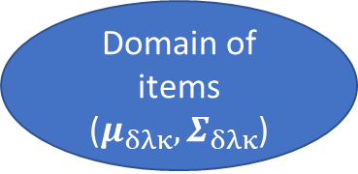
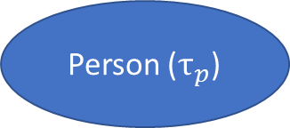
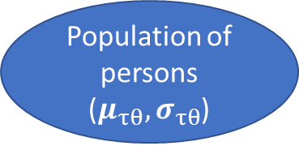
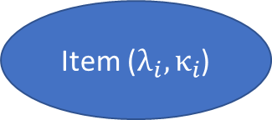
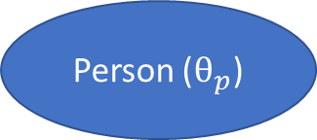
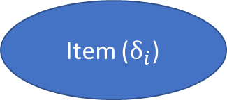
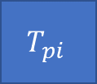
Conceptual framework for item response time and item response accuracy (van der Linden, 2007)
Population of persons ($μ_{τθ},σ_{τθ}$)
Domain of items ($μ_{δλκ},Σ_{δλκ}$)
Level 2:
Item ($δ_{i}$)
Person ($θ_{p}$)
Item ($λ_{i},κ_{i}$)
Person ($τ_{p}$)
Level 1:
Data:
$$U_{pi}$$
$$T_{pi}$$

Slide 3
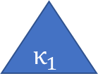

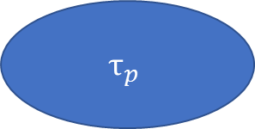

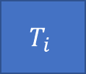
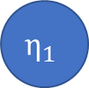
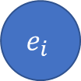
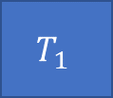
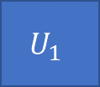

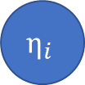
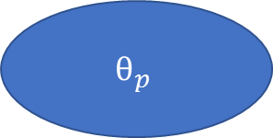
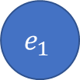
Bivariate generalized linear IRT framework (B-GLIRT) (Molenaar, Tuerlinckx, van der Maas, 2015a)
$$\left\{\begin{aligned}g\left[E\left(U_{pi}\right)\right]=α_{i}θ_{p}+β_{i} \\ E\left(\ln{T_{pi}}\right)=κ_{i}+λ_{i}τ_{p}+f\left(θ_{p};ρ\right)\end{aligned}\right.$$
$$τ_{p}$$
$$θ_{p}$$
$$f\left(θ_{p};ρ\right)$$
$$λ_{1}$$
$$λ_{i}$$
$$α_{i}$$
$$α_{1}$$
$$T_{1}$$
…
$$T_{i}$$
$$η_{1}$$
…
$$η_{i}$$
$$κ_{1}$$
$$e_{1}$$
$$κ_{i}$$
$$e_{i}$$
$$β_{1}$$
$$U_{1}$$
$$β_{i}$$
$$U_{i}$$

Slide 4
Cross-relation function $f\left(θ;ρ\right)$
Cross-relation function can have many forms (including non-linear) and describes the exact form of relations between seediness and ability
Manipulating cross-relation function, it is possible to show that many IRT-models for response time and response accuracy can be described as special cases of the framework (e.g., van der Linden (2007), Fox, et al. (2007), Partchev & De Boeck (2012), De Boeck & Partchev (2012), Roskam (1987), Wang and Hanson (2005))
Nonetheless, $ρ$ is one of the key parameters according to the framework of van der Linden (2007) – it describes correlation between speediness and ability: $f\left(θ;ρ\right)=ρλ_{i}θ$

Slide 5
Speediness- and ability-tests
Between-person speed-accuracy trade off suggests that the more time is spent on decision-making, the more accurate the decision is (traditional ability-tests) (Goldhammer, 2015)
Nonetheless, some tests contain many simple items, and a respondent should solve them as quickly as possible (speediness-tests) (e.g., Cheung, & Yang, 2020)
Since $f\left(θ;ρ\right)$ is the same for all items, it reflects an assumption that all items are either speediness-kind or ability-kind
Moreover, it provides rather limited information on item-level time-parameters
Unconstrained simplistic factor analytical model has not been studied yet under B-GLIRT formulation (Molenaar, Tuerlinckx, van der Maas, 2015b)

Slide 6
Current study
This study aims to (i) investigate Rasch-models possible within B-GLIRT framework, and (ii) investigate a subset of simplistic Rasch-models which provide extended information on item-level parameters
The outline:
Discussion of the Rasch models within B-GLIRT framework
Simulation study of the parameter recovery
An example of EE test for higher education students

Slide 7
Rasch models within B-GLIRT framework
$$\left\{\begin{aligned}g\left[E\left(U_{pi}\right)\right]=αθ_{p}+δ_{i} \\ E\left(\ln{T_{pi}}\right)=κ_{i}+λ_{i}τ_{p}+f\left(θ_{p};ξ_{i}\right)\end{aligned}\right.$$
Key point: $ξ_{i}$ provides more information on item-level (Fox, et all., 2007) by sacrificing information on test-level (no $ρ$)
Originally proposed forms of $f\left(θ_{p};ρ\right)$:
Linear and polynomial function of ability ($θ_{p}^{k}$)
Linear and polynomial function of interaction between ability and speediness ($θ_{p}^{k}τ_{p}^{k}$) (see Bolsinova, Molenaar, 2018)
Polynomial function of difference between person ability and item intercept (${\left(α_{i}θ_{p}+β_{i}\right)}^{k}$)
Their combinations, other functions (e.g., Ranger and Kuhn, 2012) and their fixed counterparts (Roskam, 1987)
In Rasch-modelling the third form of $f\left(θ_{p};ρ_{i}\right)$ is not a simple option
Therefore, further we discuss only the first two forms of $f\left(θ_{p};ξ_{i}\right)$

Slide 8

Design of the simulation study 1
Constants:
$I=20$, all dichotomous
$P=2000$
$f\left(θ_{p};ρ_{i}\right)=ξ_{i}θ_{p}$
$κ=δ=$ equally spaced vector of length $I$ from -2 to 2
Conditions
$ρ=\left(0, 0.25, 0.5\right)$
100 replications for each condition:
$ξ^{2}\sim Uniform(min=0.16, max=0.49)$
$λ^{2}\sim Uniform(min=0.16, max=0.49)$
$\left(τ,θ\right)\sim MVN(μ,Σ)$, where $μ=\left(0,0\right),Σ=\left[\begin{matrix}1 & ρ \\ ρ & 1\end{matrix}\right]$
Statistics used for the analysis of simulations:
$Bias= \frac{\sum_{r=1}^{R}{\hat{ζ_{r}}}}{R}−ζ$
$RMSE= \sqrt{\frac{\sum_{r=1}^{R}{{\left(\hat{ζ_{r}}−ζ\right)}^{2}}}{R}}$
$MAD=\frac{\sum_{r=1}^{R}{\left|\hat{ζ_{r}}−ζ\right|}}{R}$
Linear Pearson correlation
The proposed model:
$$\left\{\begin{aligned}g\left[E\left(U_{pi}\right)\right]=αθ_{p}+δ_{i} \\ E\left(\ln{T_{pi}}\right)=κ_{i}+λ_{i}τ_{p}+ξ_{i}θ_{p}\end{aligned}\right.$$

Slide 9
Results of the simulation study 1
Statistics | $$ρ=0$$ | $$ρ=0.25$$ | $$ρ=0.5$$
Item difficulty vs. true values ($δ_{i}$) | Bias = 0.003 RMSE = 0.067 MAD = 0.053 | Bias < 0.001 RMSE = 0.065 MAD = 0.051 | Bias = 0.002 RMSE = 0.063 MAD = 0.050
Loading of ability on response times vs. true values ($ξ_{i}$) | RMSE = 0.023 MAD = 0.017 | RMSE = 0.163 MAD = 0.158 | RMSE = 0.324 MAD = 0.317
Loading of speediness on response times vs. true values ($λ_{i}$) | RMSE = 0.018 MAD = 0.014 | RMSE = 0.028 MAD = 0.023 | RMSE = 0.087 MAD = 0.082
Ability estimates vs. true values ($θ_{p}$) | Cor = 0.940 (SD = 0.012) | Cor = 0.940 (SD = 0.011) | Cor = 0.947 (SD = 0.009)
Speediness estimates vs. true values ($τ_{p}$) | Cor = 0.960 (SD = 0.015) | Cor = 0.930 (SD = 0.012) | Cor = 0.847 (SD = 0.015)
RMSEA | 0.003 (SD = 0.003) | 0.003 (SD = 0.003) | 0.004 (SD = 0.003)

Slide 10
Reliability
Omega coefficient for correlated measurement errors (Bentler, 1972, 2009) is calculated on linear CFA model. Expected a Posteriori (EAP; Bock, Mislevy, 1982) and Warm’s Weighted Maximum Likelihood (WLE; Warm, 1989) estimates were calculated on IRT model.
Conditions | Reliability | $$ρ=0$$ | $$ρ=0.25$$ | $$ρ=0.5$$
Without time | EAP | 0.769 (0.007) | 0.769 (0.007) | 0.771 (0.007)
 | WLE | 0.753 (0.006) | 0.753 (0.007) | 0.755 (0.007)
 | Omega for Ability | 0.754 (0.007) | 0.754 (0.008) | 0.756 (0.008)
With time | Omega for Ability | 0.961 (0.005) | 0.974 (0.003) | 0.981 (0.002)
 | Omega for Speediness | 0.969 (0.006) | 0.967 (0.007) | 0.957 (0.009)

Slide 11
Design of the simulation study 2
Constants:
$I=20$, all dichotomous
$P=2000$
$f\left(θ_{p};ρ_{i}\right)=ξ_{i}θ_{p}$
$κ=δ=$ equally spaced vector of length $I$ from -2 to 2
$ρ=0.25$
Conditions:
$N(ξ_{i}<0)=(5, 10)$
100 replications for each condition:
$λ^{2}\sim Uniform(min=0.16, max=0.49)$
$\left(τ,θ\right)\sim MVN(μ,Σ)$, where $μ=\left(0,0\right),Σ=\left[\begin{matrix}1 & ρ \\ ρ & 1\end{matrix}\right]$
Statistics used for the analysis of simulations:
$Bias= \frac{\sum_{r=1}^{R}{\hat{ζ_{r}}}}{R}−ζ$
$RMSE= \sqrt{\frac{\sum_{r=1}^{R}{{\left(\hat{ζ_{r}}−ζ\right)}^{2}}}{R}}$
$MAD=\frac{\sum_{r=1}^{R}{\left|\hat{ζ_{r}}−ζ\right|}}{R}$
Linear Pearson correlation
The studied model (see Fox, et al., 2007):
$$\left\{\begin{aligned}g\left[E\left(U_{pi}\right)\right]=αθ_{p}+δ_{i} \\ E\left(\ln{T_{pi}}\right)=κ_{i}+λ_{i}τ_{p}+ξ_{i}θ_{p}\end{aligned}\right.$$
Constrained models (e.g., van der Linden, 2007):
$$\left\{\begin{aligned}g\left[E\left(U_{pi}\right)\right]=α_{i}θ_{p}+β_{i} \\ E\left(\ln{T_{pi}}\right)=κ_{i}+λ_{i}τ_{p}−ρλ_{i}θ_{p}\end{aligned}\right.$$

Slide 12
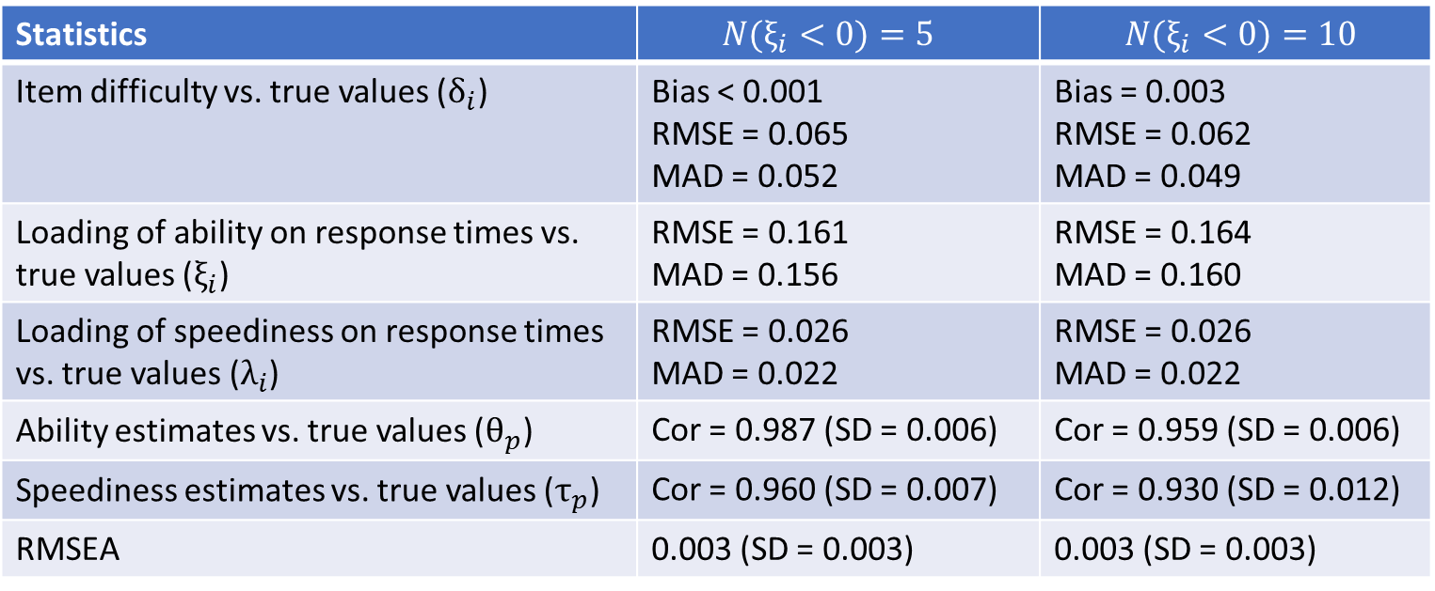
Results of the simulation study 2
Statistics | $$N(ξ_{i}<0)=5$$ | $$N(ξ_{i}<0)=10$$
Item difficulty vs. true values ($δ_{i}$) | Bias < 0.001 RMSE = 0.065 MAD = 0.052 | Bias = 0.003 RMSE = 0.062 MAD = 0.049
Loading of ability on response times vs. true values ($ξ_{i}$) | RMSE = 0.161 MAD = 0.156 | RMSE = 0.164 MAD = 0.160
Loading of speediness on response times vs. true values ($λ_{i}$) | RMSE = 0.026 MAD = 0.022 | RMSE = 0.026 MAD = 0.022
Ability estimates vs. true values ($θ_{p}$) | Cor = 0.987 (SD = 0.006) | Cor = 0.959 (SD = 0.006)
Speediness estimates vs. true values ($τ_{p}$) | Cor = 0.960 (SD = 0.007) | Cor = 0.930 (SD = 0.012)
RMSEA | 0.003 (SD = 0.003) | 0.003 (SD = 0.003)

Slide 13
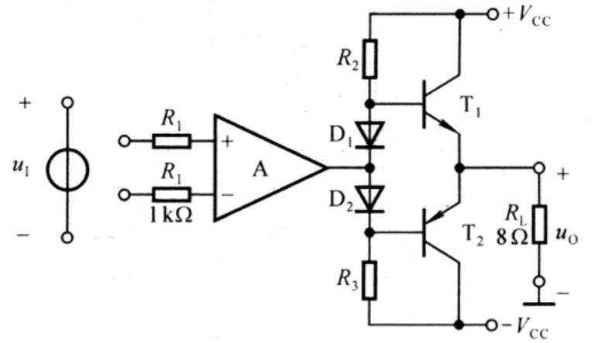
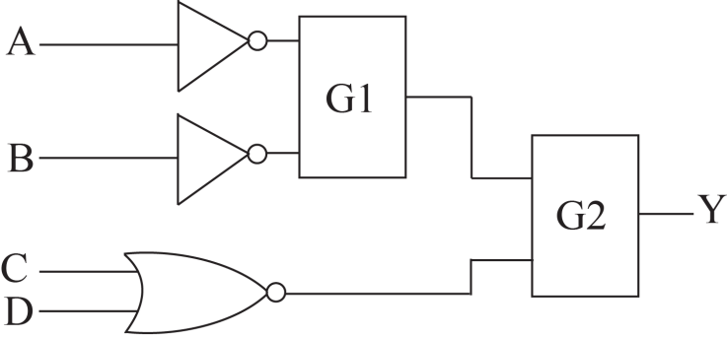
Electrical Engineering test for higher education students
25 dichotomous items, 853 Russian and 1662 Chinese EE students
For the following circuit: VCC =15V, the saturation voltage of both T1 and T2 is |UCES|=1V, the maximal output voltage amplitude of integrated operational amplifier is ±13V, the threshold voltage of the diode is 0.7V.
In the figure, the output Y is supposed to be Y = AB+ $\overline{C}\overline{D}$. The gates G1 and G2 must be, respectively
Please determine the maximal output power of the circuit assuming that the amplitude of the input voltage is great enough.
A. 15.6w
B. 18.5w
C. 10.6w
D. 8.1w
A. NOR, OR
B. OR, NAND
C. NAND, OR
D. AND, NAND

Slide 14
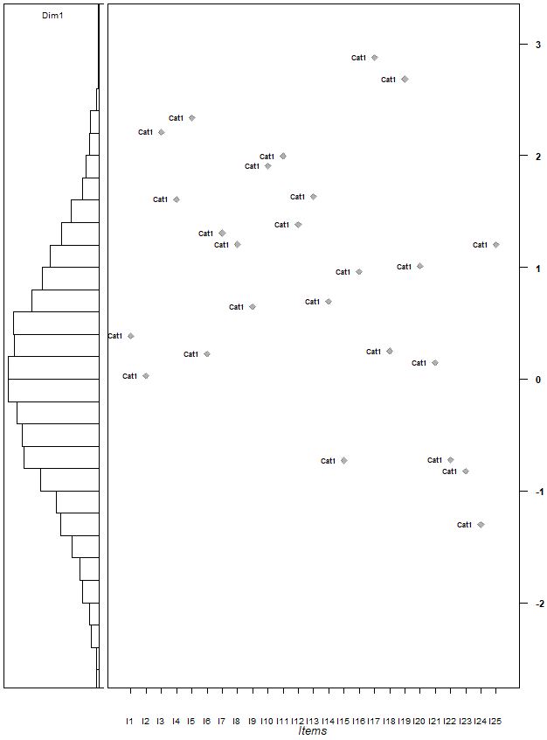
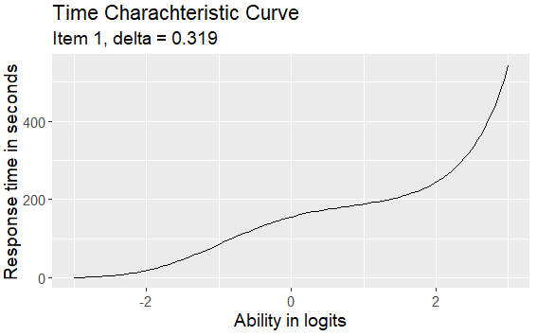
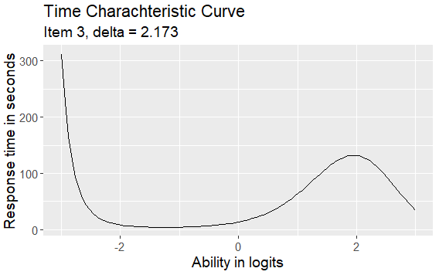
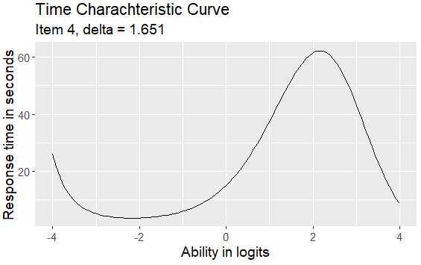
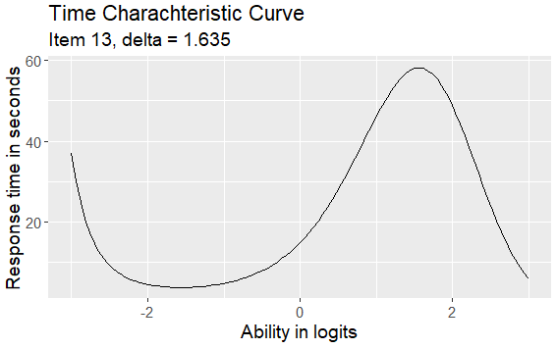
EE Results 1
$$\left\{\begin{aligned}g\left[E\left(U_{pi}\right)\right]=αθ_{p}+δ_{i} \\ E\left(\ln{T_{pi}}\right)=κ_{i}+λ_{i}τ_{p}+ξ_{1i}θ_{p}+ξ_{2i}θ_{p}^{2}+ξ_{3i}θ_{p}^{3}\end{aligned}\right.$$

Slide 15
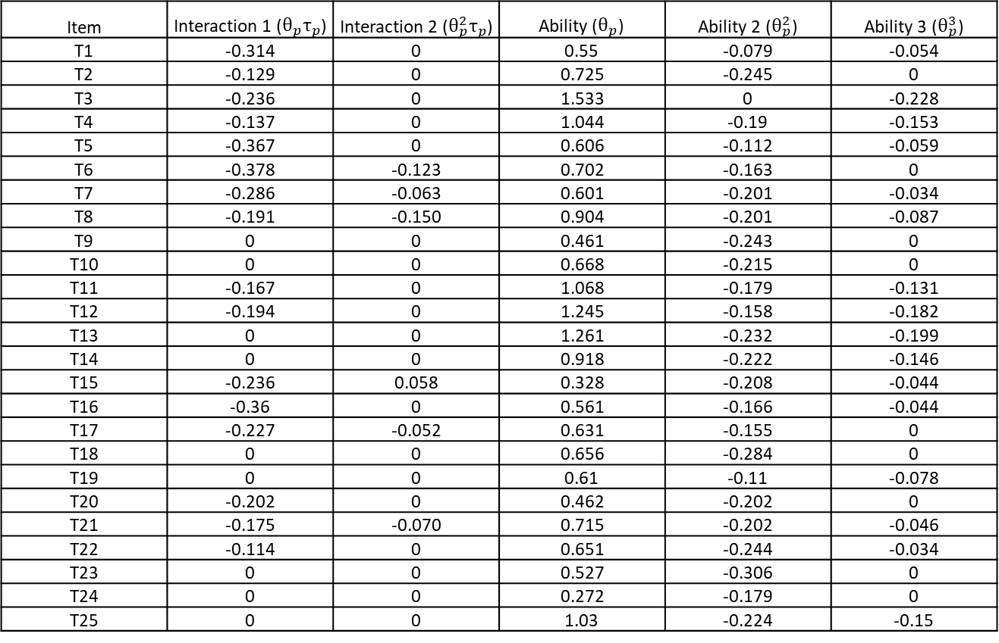
EE Results 2
$$\left\{\begin{aligned}g\left[E\left(U_{pi}\right)\right]=αθ_{p}+δ_{i} \\ E\left(\ln{T_{pi}}\right)=κ_{i}+λ_{i}τ_{p}+ξ_{1i}θ_{p}+ξ_{2i}θ_{p}^{2}+ξ_{3i}θ_{p}^{3}+ξ_{4i}θ_{p}τ_{p}+ξ_{5i}θ_{p}^{2}τ_{p}\end{aligned}\right.$$
Item | Interaction 1 ($θ_{p}τ_{p}$) | Interaction 2 ($θ_{p}^{2}τ_{p}$) | Ability ($θ_{p}$) | Ability 2 ($θ_{p}^{2}$) | Ability 3 ($θ_{p}^{3}$)
T1 | -0.314 | 0 | 0.55 | -0.079 | -0.054
T2 | -0.129 | 0 | 0.725 | -0.245 | 0
T3 | -0.236 | 0 | 1.533 | 0 | -0.228
T4 | -0.137 | 0 | 1.044 | -0.19 | -0.153
T5 | -0.367 | 0 | 0.606 | -0.112 | -0.059
T6 | -0.378 | -0.123 | 0.702 | -0.163 | 0
T7 | -0.286 | -0.063 | 0.601 | -0.201 | -0.034
T8 | -0.191 | -0.150 | 0.904 | -0.201 | -0.087
T9 | 0 | 0 | 0.461 | -0.243 | 0
T10 | 0 | 0 | 0.668 | -0.215 | 0
T11 | -0.167 | 0 | 1.068 | -0.179 | -0.131
T12 | -0.194 | 0 | 1.245 | -0.158 | -0.182
T13 | 0 | 0 | 1.261 | -0.232 | -0.199
T14 | 0 | 0 | 0.918 | -0.222 | -0.146
T15 | -0.236 | 0.058 | 0.328 | -0.208 | -0.044
T16 | -0.36 | 0 | 0.561 | -0.166 | -0.044
T17 | -0.227 | -0.052 | 0.631 | -0.155 | 0
T18 | 0 | 0 | 0.656 | -0.284 | 0
T19 | 0 | 0 | 0.61 | -0.11 | -0.078
T20 | -0.202 | 0 | 0.462 | -0.202 | 0
T21 | -0.175 | -0.070 | 0.715 | -0.202 | -0.046
T22 | -0.114 | 0 | 0.651 | -0.244 | -0.034
T23 | 0 | 0 | 0.527 | -0.306 | 0
T24 | 0 | 0 | 0.272 | -0.179 | 0
T25 | 0 | 0 | 1.03 | -0.224 | -0.15
Index | The model without interactions | The model with interactions
AIC | 169360.578 | 168662.308
BIC | 170386.663 | 169979.894

Slide 16
Conclusion
A set of simplistic Rasch models for item response accuracy and item response time can be proposed within B-GLIRT framework, but it limits possible cross-relation functions
Distribution of single cross-relation function over the set of item-specific functions results in sufficient model fit and provides more insight on response process on item-level
However, such models can be inefficient for measuring speediness parameter
Increasing correlation of ability and speediness results in increased loading of item response time on ability, but barely affects other estimates

