Slide 1
Laboratory for Modelling and Evaluating of Competencies in Higher Education, Centre for Psychometrics and Educational Measurement,
Institute of Education, HSE University
How Students Behave while Solving Critical Thinking Tasks in an Unconstrained Online Environment: Insights from Process Mining
Anastasiia Beliaeva, Ksenia Tarasova, Ekaterina Orel, Denis Federiakin

Slide 2
Research Design
Centre for Psychometrics and Educational Measurement, HSE
The testing was a part of a course “Economical thinking”. The data was collected in December 2021. The sample consisted of 330 students, who generated more than 11.000 events in total while solving the unconstrained task.
All students who underwent the test were split into 3 clusters based on their test results (from 0 to 8 points).
An open source software for process discovery ProM¹ was used for data analysis with the help of Inductive Miner.
¹ van der Aalst, W. M. P. (2016). Process Mining: Data Science in Action. Heidelberg: Springer. ISBN: 978-3-662-49850-7

Slide 3
COR Definition
Centre for Psychometrics and Educational Measurement, HSE
Critical online reasoning (COR) – is the ability of university students to analyze statements, assumptions and arguments, build causal relationships, select logically correct and convincing arguments, find explanations, draw conclusions and form their own position in solving problems in an online environment. ¹²
COR
Controlled environment
Unconstrained environment
¹ Тарасова К., & Орел Е. (2022). Измерение критического мышления студентов в открытой онлайн-среде: методология, концептуальная рамка и типология заданий. Вопросы образования / Educational Studies Moscow, (3). https://doi.org/10.17323/1814-9545-2022-3-187-212
²Zlatkin-Troitschanskaia, O., Beck, K., Fischer, J., Braunheim, D., Schmidt, S., & Shavelson, R.J. (2020). The Role of Students’ Beliefs When Critically Reasoning From Multiple Contradictory Sources of Information in Performance Assessments. Frontiers in Psychology, 11:2192. doi:10.3389/fpsyg.2020.02192

Slide 4
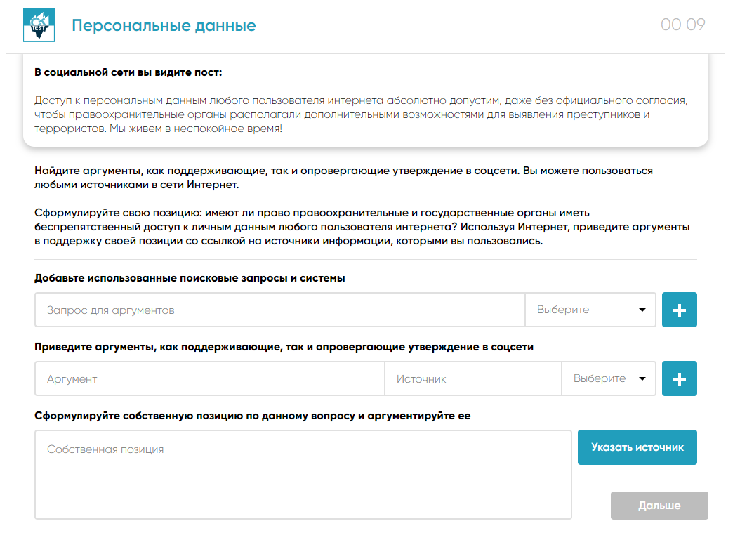
COR Indicators
Centre for Psychometrics and Educational Measurement, HSE
Analysis
Evaluate the actuality of the information
Evaluate the competence of the source of information
Evaluate the trustworthiness of the source of information
Evaluate the relevance of the source of information
Synthesis
Based on the information provided for argumentation, make a clear judgment (for, against)
Develop valid conclusions
Develop true conclusions
перевести задание, описать лучше

Slide 5
Agreement & COR Criteria
Centre for Psychometrics and Educational Measurement, HSE
Experts are offered criteria developed in accordance with the indicators included in the framework. The chosen method assumed dynamic refinement of the criteria, if there is a need to clarify or supplement them.¹
80 essays
kappa: 0.87%²
11 Criteria
23 criteria
Search query quality; Source quality; Information analysis; Conclusion
¹Downe‐Wamboldt, B. (1992). Content analysis: method, applications, and issues. Health care for women international, 13(3), 313-321.
²O’Connor, C., & Joffe, H. (2020). Intercoder Reliability in Qualitative Research: Debates and Practical Guidelines. International Journal of Qualitative Methods, 19. https://doi.org/10.1177/1609406919899220

Slide 6
Inductive Visual Miner
Centre for Psychometrics and Educational Measurement, HSE
Let L be an event log over A and a, b ∈ A.
|a >L b| is the number of times when a directly follows b in L, i.e.,
|>L|
|>L|
The IM algorithm iteratively splits the initial event log into smaller sublogs. For any sublog L there can be created a directly-follows graph G(L).
In order to cut off noise from the main behavior, threshold values can be set to |>L| and |⇒L|. Replay is used to understand how accurate a given model is to all the patterns¹.
¹ van der Aalst, W. M. P. (2016). Process Mining: Data Science in Action. Heidelberg: Springer. ISBN: 978-3-662-49850-7

Slide 7
Results
Centre for Psychometrics and Educational Measurement, HSE
 | 1 cluster | 2 cluster | 3 cluster
Number of cases | 51 | 137 | 54
Events in cluster | 4782 | 10232 | 2818
Events in case | 47 | 37 | 26
Total time (min) | 18 | xs | rf
Time in application | 30,90% | 29,10% | 25, 26%
Time out of application | 29,65% | 27,85% | 24,55%
Time spent for essay | 8,78% | 10,80% | 13,34%
Time spent for argument | 5,85% | 7,97% | 10, 71%

Slide 8
Results
Centre for Psychometrics and Educational Measurement, HSE
 | 1 cluster | 2 cluster | 3 cluster
Number of cases | 51 | 137 | 54
Events in cluster | 4782 | 10232 | 2818
Events in case | 47 | 37 | 26
Total time (min) | 18 | xs | rf
Time in application | 30,90% | 29,10% | 25, 26%
Time out of application | 29,65% | 27,85% | 24,55%
Time spent for essay | 8,78% | 10,80% | 13,34%
Time spent for argument | 5,85% | 7,97% | 10, 71%

Slide 9
Results
Centre for Psychometrics and Educational Measurement, HSE
 | 1 cluster | 2 cluster | 3 cluster
Number of cases | 51 | 137 | 54
Events in cluster | 4782 | 10232 | 2818
Events in case | 47 | 37 | 26
Total time (min) | 18 | xs | rf
Time in application | 30,90% | 29,10% | 25, 26%
Time out of application | 29,65% | 27,85% | 24,55%
Time spent for essay | 8,78% | 10,80% | 13,34%
Time spent for argument | 5,85% | 7,97% | 10, 71%

Slide 10
Results
Centre for Psychometrics and Educational Measurement, HSE
 | 1 cluster | 2 cluster | 3 cluster
Number of cases | 51 | 137 | 54
Events in cluster | 4782 | 10232 | 2818
Events in case | 47 | 37 | 26
Total time (min) | 18 | 16 | 13
Time in application | 30,90% | 29,10% | 25, 26%
Time out of application | 29,65% | 27,85% | 24,55%
Time spent for essay | 8,78% | 10,80% | 13,34%
Time spent for argument | 5,85% | 7,97% | 10, 71%

Slide 11
Results
Centre for Psychometrics and Educational Measurement, HSE
 | 1 cluster | 2 cluster | 3 cluster
Number of cases | 51 | 137 | 54
Events in cluster | 4782 | 10232 | 2818
Events in case | 47 | 37 | 26
Total time (min) | 18 | 16 | 13
Time in application | 30,90% | 29,10% | 25, 26%
Time out of application | 29,65% | 27,85% | 24,55%
Time spent for essay | 8,78% | 10,80% | 13,34%
Time spent for argument | 5,85% | 7,97% | 10, 71%

Slide 12
Results
Centre for Psychometrics and Educational Measurement, HSE
 | 1 cluster | 2 cluster | 3 cluster
Number of cases | 51 | 137 | 54
Events in cluster | 4782 | 10232 | 2818
Events in case | 47 | 37 | 26
Total time (min) | 18 | 16 | 13
Time in application | 30,90% | 29,10% | 25, 26%
Time out of application | 29,65% | 27,85% | 24,55%
Time spent for essay | 8,78% | 10,80% | 13,34%
Time spent for argument | 5,85% | 7,97% | 10, 71%

Slide 13
Results
Centre for Psychometrics and Educational Measurement, HSE
 | 1 cluster | 2 cluster | 3 cluster
Number of cases | 51 | 137 | 54
Events in cluster | 4782 | 10232 | 2818
Events in case | 47 | 37 | 26
Total time (min) | 18 | 16 | 13
Time in application | 30,90% | 29,10% | 25, 26%
Time out of application | 29,65% | 27,85% | 24,55%
Time spent for essay | 8,78% | 10,80% | 13,34%
Time spent for argument | 5,85% | 7,97% | 10, 71%

Slide 14
Results
Centre for Psychometrics and Educational Measurement, HSE
 | 1 cluster | 2 cluster | 3 cluster
Number of cases | 51 | 137 | 54
Events in cluster | 4782 | 10232 | 2818
Events in case | 47 | 37 | 26
Total time (min) | 18 | 16 | 13
Time in application | 30,90% | 29,10% | 25, 26%
Time out of application | 29,65% | 27,85% | 24,55%
Time spent for essay | 8,78% | 10,80% | 13,34%
Time spent for argument | 5,85% | 7,97% | 10, 71%

Slide 15
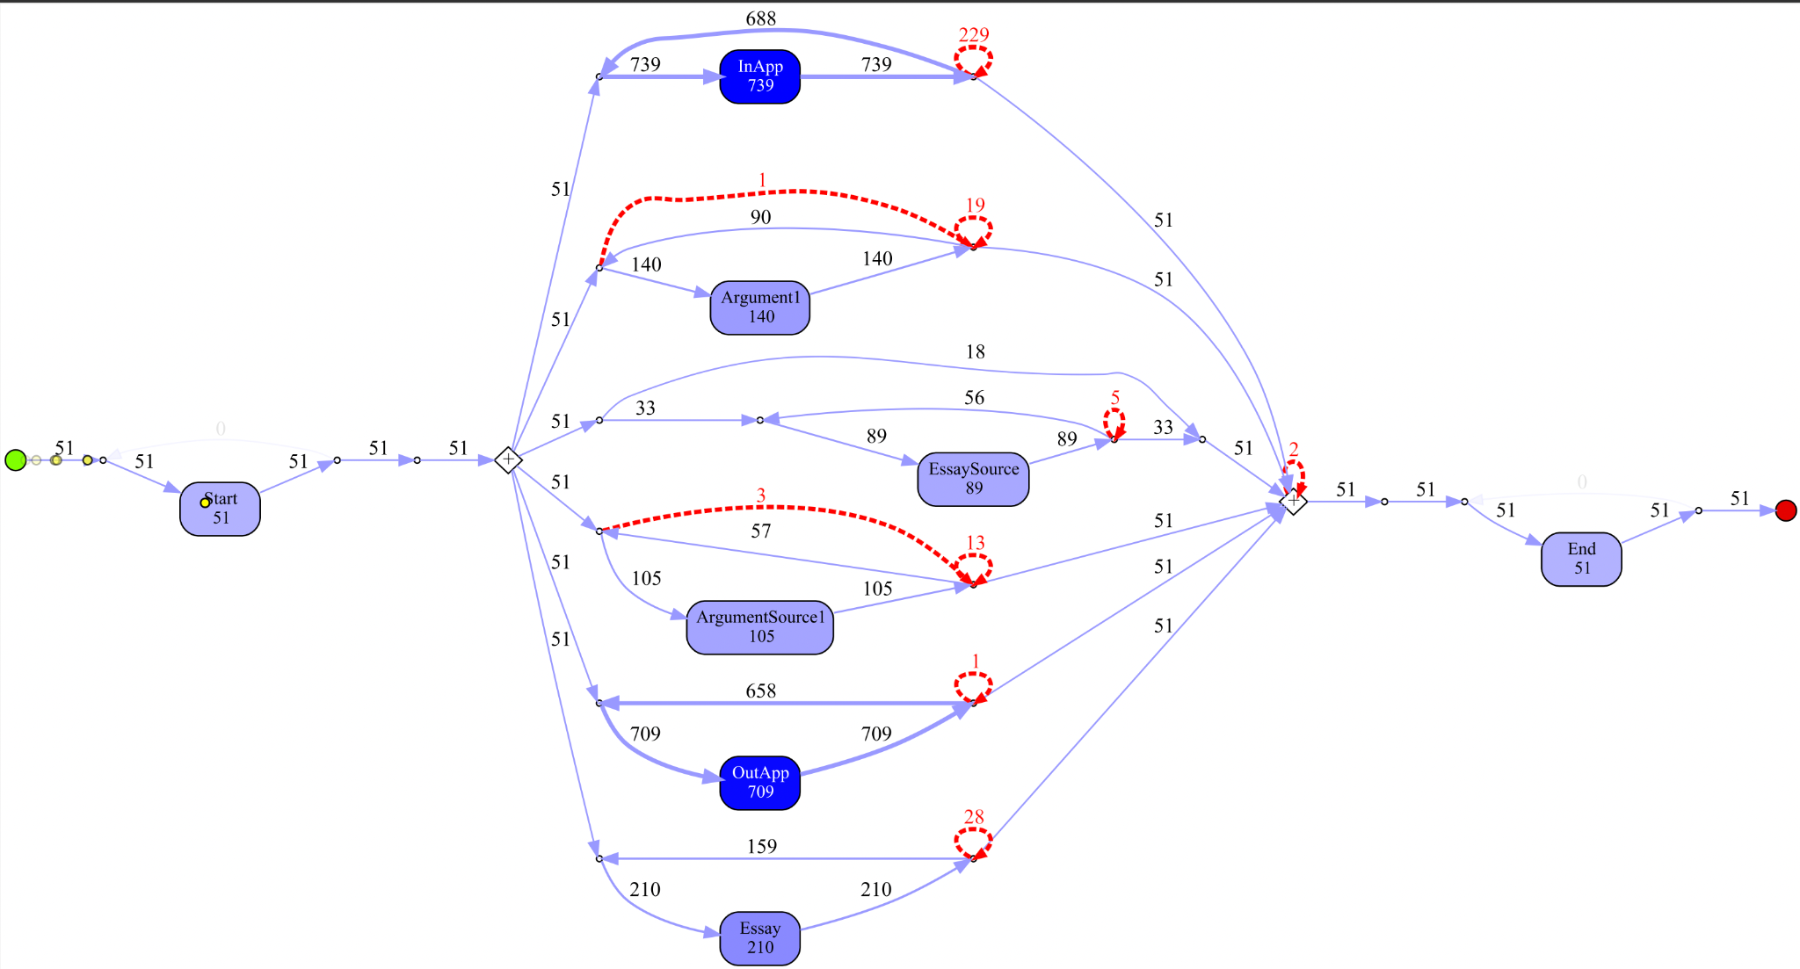
Results I
Centre for Psychometrics and Educational Measurement, HSE
Fitness 0,934

Slide 16
Results II
Centre for Psychometrics and Educational Measurement, HSE
Fitness 0,707

Slide 17
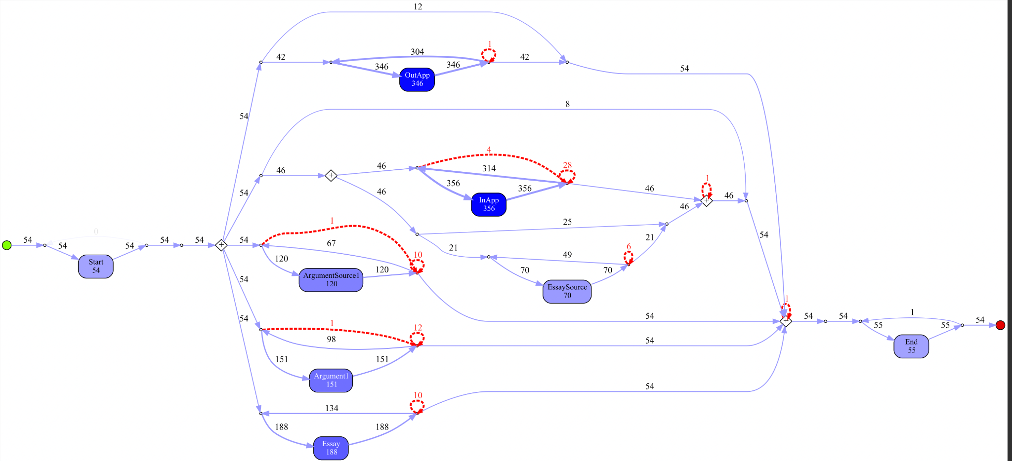
Results III
Centre for Psychometrics and Educational Measurement, HSE
Fitness 0,75

Slide 18
Дискуссия
Centre for Psychometrics and Educational Measurement, HSE
We cannot say which strategy of working in the application leads to higher COR scores and means a higher level of critical thinking. - ссылки
There is a relationship between the amount of time spent on the task and the score.
It can be seen that students with a higher level of COR spent more time searching for an answer to the task than on the essay writing.

Slide 19
Conclusions
Centre for Psychometrics and Educational Measurement, HSE
We cannot say which strategy of working in the application leads to higher COR scores and means a higher level of critical thinking. - ссылки
There is a relationship between the amount of time spent on the task and the score.
It can be seen that students with a higher level of COR spent more time searching for an answer to the task than on the essay writing.

Slide 20
Limitations
Centre for Psychometrics and Educational Measurement, HSE
The amount of data¹ (on average , it is necessary to have more than 1000 cases)
The amount of encoded information in the logs (noise)¹ (to filter out at least 20% of the unpopular behaviour)
The limitations of the application events only² (patterns outside the application may differ significantly between clusters)
The form of the task (it is clear from the case-study that not all students could understand how to fill in the form)
¹ van der Aalst, W. M. P. (2016). Process Mining: Data Science in Action. Heidelberg: Springer. ISBN: 978-3-662-49850-7
²McGrew, S., Smith, M., Breakstone, J., Ortega, T. & Wineburg, S. (2019). Improving university students’ web savvy: An intervention study. British Journal of Educational Psychology, 89(3), 485-500. https://doi.org/10.1111/bjep.12279

Slide 21
References
Centre for Psychometrics and Educational Measurement, HSE
Тарасова К., & ОрелЕ. (2022). Измерение критического мышления студентов в открытой онлайн-среде: методология, концептуальная рамка и типология заданий. Вопросы образования / Educational Studies Moscow, (3). https://doi.org/10.17323/1814-9545-2022-3-187-212
Cairns, A.H., Gueni, B., Fhima, M., Cairns, A., David, S., Khelifa, N., 2015. Process mining in the education domain. International Journal on Advances in Intelligent Systems 8, 219–232. (PDF) Learning behaviours data in programming education: Community analysis and outcome prediction with cleaned data.
Downe‐Wamboldt, B. (1992). Content analysis: method, applications, and issues. Health care for women international, 13(3), 313-321.
O’Connor, C., & Joffe, H. (2020). Intercoder Reliability in Qualitative Research: Debates and Practical Guidelines. International Journal of Qualitative Methods, 19. https://doi.org/10.1177/1609406919899220
McGrew, S., Smith, M., Breakstone, J., Ortega, T. & Wineburg, S. (2019). Improving university students’ web savvy: An intervention study. British Journal of Educational Psychology, 89(3), 485-500. https://doi.org/10.1111/bjep.12279
van der Aalst, W. M. P. (2016). Process Mining: Data Science in Action. Heidelberg: Springer. ISBN: 978-3-662-49850-7
Zlatkin-Troitschanskaia, O., Beck, K., Fischer, J., Braunheim, D., Schmidt, S., & Shavelson, R.J. (2020). The Role of Students’ Beliefs When Critically Reasoning From Multiple Contradictory Sources of Information in Performance Assessments. Frontiers in Psychology, 11:2192. doi:10.3389/fpsyg.2020.02192

Slide 22
Anastasiia Beliaeva aybelyaeva@hse.ru
Ksenia Tarasova ktarasova@hse.ru
Ekaterina Orel eorel@hse.ru
Denis Federiakin dafederiakin@hse.ru
Centre for Psychometrics and Educational Measurement, HSE

